Slide 1

Resugaring: Lifting Languages through Syntactic Sugar
Thesis Proposal
Justin Pombrio
Brown University
Committee
Mitchell Wand
Eelco Visser
Shriram Krishnamurthi
Notes:
Attribution Note: Many of these slides were storyboarded by me, and then constructed by Shriram.

Slide 2
Notes:
I’m going to be talking a lot about syntactic sugar.
The term was coined in 1964 by Peter Landin.
There are a couple different kinds of syntactic sugar.

Slide 3
Desugaring in Languages
Most famously in Lisp family:
(define-syntax let
(syntax-rules ()
[(let ((v e) …) b …)
((lambda (v …) b …) e …)]))
Notes:
Some languages, most famously lisps, allow users of the language to define their own syntactic sugar, in the form of macros.

Slide 4



Surface Language
desugar
Core Language
x + 2
desugar
x.__add__(2)
[x*x | x <- l]
desugar
map (\x -> x*x) l
desugar
x or y
let t = x in if t then t else y
Notes:
Other languages have syntactic sugar built in.
For example, in Python, addition desugars to a call to __add.
Likewise for Haskell list comprehensions.
And so on.
If syntatic sugar is so widespread...

Slide 5
What’s Not to Like?
Notes:
...what’s not to like?

Slide 6
typedef map<int, double> valmap;
valmap m;
for (int i = 0; i < NVALS; i++)
m.insert(make_pair(values[i], pow(values[i], .5)));
valmap::iterator it = 100;
valmap::iterator it2(100);
m.insert(1,2);
rtmap.cpp: In function `int main()':
rtmap.cpp:19: invalid conversion from `int' to `
std::_Rb_tree_node<std::pair<const int, double> >*'
rtmap.cpp:19: initializing argument 1 of `std::_Rb_tree_iterator<_Val, _Ref,
_Ptr>::_Rb_tree_iterator(std::_Rb_tree_node<_Val>*) [with _Val =
std::pair<const int, double>, _Ref = std::pair<const int, double>&, _Ptr =
std::pair<const int, double>*]'
rtmap.cpp:20: invalid conversion from `int' to `
std::_Rb_tree_node<std::pair<const int, double> >*'
rtmap.cpp:20: initializing argument 1 of `std::_Rb_tree_iterator<_Val, _Ref,
_Ptr>::_Rb_tree_iterator(std::_Rb_tree_node<_Val>*) [with _Val =
std::pair<const int, double>, _Ref = std::pair<const int, double>&, _Ptr =
std::pair<const int, double>*]'
E:/GCC3/include/c++/3.2/bits/stl_tree.h: In member function `void
std::_Rb_tree<_Key, _Val, _KeyOfValue, _Compare, _Alloc>::insert_unique(_II,
_II) [with _InputIterator = int, _Key = int, _Val = std::pair<const int,
double>, _KeyOfValue = std::_Select1st<std::pair<const int, double> >,
_Compare = std::less<int>, _Alloc = std::allocator<std::pair<const int,
double> >]':
E:/GCC3/include/c++/3.2/bits/stl_map.h:272: instantiated from `void std::map<_
Key, _Tp, _Compare, _Alloc>::insert(_InputIterator, _InputIterator) [with _Input
Iterator = int, _Key = int, _Tp = double, _Compare = std::less<int>, _Alloc = st
d::allocator<std::pair<const int, double> >]'
rtmap.cpp:21: instantiated from here
E:/GCC3/include/c++/3.2/bits/stl_tree.h:1161: invalid type argument of `unary * ‘
Notes:
Well, here’s some simple C++ code.
The author made the mistake of using iterators, which are template-based, and got * this error message.
[https://www.bdsoft.com/dist/gcc-demo.txt]

Slide 7
(;module: {#;doc "This will be our program's main module."}
lux
(lux (codata io)
(control monad)
[cli #+ program:]))
(program: args
(do Monad<IO>
[(io (log! "Hello, "))
(io (log! "world"))]
(wrap (log! "?"))))
Compilation failed:
@ main,8,10
Wrong syntax for io
[Analyser Error] Functions require function types: (-> ⌈v:191⌋ ⌈v:192⌋)
[Analyser Error] Argument expected: (-> ⌈v:191⌋ ⌈v:192⌋)
[Analyser Error] Can't apply function (-> (-> ⌈v:191⌋ ⌈v:192⌋) (lux/codata/io;IO ⌈v:191⌋) (lux/codata/io;IO ⌈v:192⌋)) to args:
(lux;lambda [(io (log! "Hello, "))]
(wrap (log! "?"))) (io (log! "world"))
[Analyser Error] Can't apply function (All {(All {(All {} (All {} (All {} (-> (-> 3 1) (5 3) (5 1))))) lux/codata/io;IO} (All {} (-> (-> 3 1)
(5 3) (5 1)))) ⌈v:191⌋ (All {} (All {} (All {} (-> (-> 3 1) (5 3) (5 1))))) lux/codata/io;IO} (->
(-> 3 1) (5 3) (5 1))) to args: (lux;lambda [(io (log! "Hello, "))] (wrap (log! "?"))) (io (log! "world"))
[Analyser Error] Can't apply function (lux/control/functor;Functor lux/codata/io;IO) to args: (lux;lambda [(io (log! "Hello, "))]
(wrap (log! "?"))) (io (log! "world"))
[Analyser Error] Argument expected: (lux/codata/io;IO (lux/codata/io;IO ⌈v:189⌋))
[Analyser Error] Can't apply function (-> (lux/codata/io;IO (lux/codata/io;IO ⌈v:189⌋)) (lux/codata/io;IO ⌈v:189⌋)) to args:
( map (lux;lambda [(io (log! "Hello, "))]
(wrap (log! "?"))) (io (log! "world")))
[Analyser Error] Can't apply function (All {} (-> (lux/codata/io;IO (lux/codata/io;IO 1)) (lux/codata/io;IO 1))) to args:
( map (lux;lambda [(io (log! "Hello, "))] (wrap (log! "?")))
(io (log! "world")))
Notes:
Another time, I was trying out a language called Lux, that was very proud of its syntactic sugar. I was literally trying to write hello-world, and got * this error message, which exposed all of the desugaring in the program.
I’m sure you’ve all seen some variation on this kind of issue. What can we do about it?

Slide 8
Solutions
Force implementer to re-build language at the surface level — undesirable
Use source location tracking — useful but not always sufficient
Automatically infer surface behavior (from description of sugars): Resugaring
Notes:
SAY: more on source tracking
There are a couple approaches we could take.
First, all of a language’s tooling be built around the surface language.
But that’s not great.
And it defeats the point of having sugar in the first place. If you’re going to have everything work with the surface langauge directly, why bother having sugar at all?
Second, you can use source location tracking.
This does help, but it doesn’t fully solve the problem.
What I’m going to present instead is a category of techniques called Resugaring.
The idea is to automatically infer the correct surface behavior from the sugar definitions.

Slide 9
Surface Language
Core
Language
desugar
Evaluator
Evaluator
Formal semantics
Formal semantics
Type system
resugar
Type system
Stepper
Stepper
Scope rules
Scope rules
Control flow
Control flow
Notes:
At a high level, here’s the picture.
There’s a large surface language that desugars down to a smaller core language.
And it’s easy to _run_ a program after desugaring it.
But a language is more than just the ability to run programs:
It may have a type system, a formal semantics, scope rules, control flow, etc.
The idea of Resugaring is to automatically lift these things up to the surface langauge.
/ And what I’ve done for my thesis is show how to automatically lift, or Resugar, some of these things to the surface language.

Slide 10
Thesis Statement
Many aspects of programming languages—in particular evaluation steps, type rules, and scope rules—can be non-trivially resugared from core to surface language, restoring the abstraction provided by syntactic sugar.
Notes:
That brings us to my thesis statement.
Many apsects of programming languages
-- in particular eval steps, type rules, and scope rules –
can be non-trivially Resugared from core to surface langauge,
thus restoring the abstraction provided by syntactic sugar.
The rest of the talk is going to be split up to talk about these three things in turn.

Slide 11
Resugaring Evaluation Steps
Resugaring Type Rules
Resugaring Scope Rules

Slide 12
Resugaring Evaluation Steps
Resugaring Type Rules
Resugaring Scope Rules

Slide 13
Thesis Statement
Many aspects of programming languages—in particular evaluation steps, type rules, and scope rules—can be non-trivially resugared from core to surface language, restoring the abstraction provided by syntactic sugar.
Notes:
First – resugaring evaluation sequences.
An evaluation sequence is the sequence of steps your program takes as your program runs. The idea here is to _resugar_ this sequence,

Slide 14
Surface T
desugar
Core T₁
How to present as a surface evaluation sequence?
Core T₂
resugar
Core T₃
Core T₄
Notes:
Let me say what evaluation resugaring is, more precisely.

Slide 15
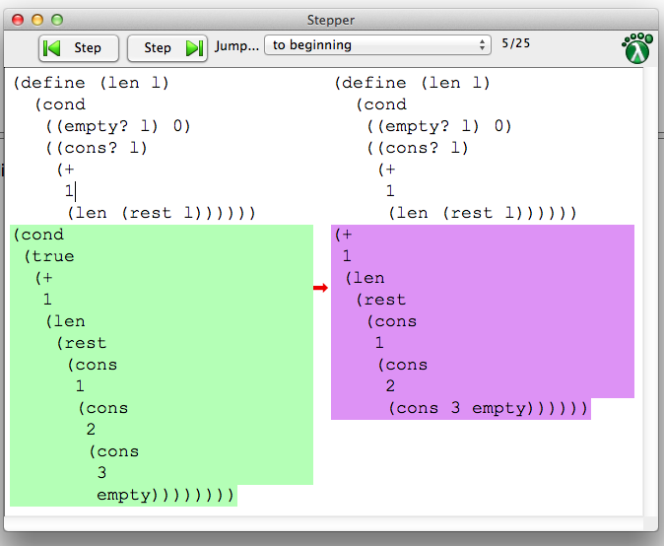
Why We Care
Algebraic stepper (education)
Theorem prover
Template expander
Debugger
Type elaborator
Notes:
This is useful for educational purposes – to show students how their program runs.
It’s also useful for other tools:

Slide 16
not(true) or true
desugar
let t = not(true) in
if t then t else true
eval not(true)
let t = false in
if t then t else true
substitute t
if false
then false else true
evaluate if
true

Slide 17
not(true) or true
desugar
let t = not(true) in
if t then t else true
Abstraction
Show a sugar precisely when the programmer actually used it
let t = false in
if t then t else true
let t = false in
if t then t else true
if false
then false else true
true

Slide 18
not(true) or true
desugar
let t = not(true) in
if t then t else true
Coverage
Show as many steps as possible
let t = false in
if t then t else true
if false
then false else true
true
true

Slide 19
not(true) or true
desugar
let t = not(true) in
if t then t else true
Emulation
Each surface term must desugar to the core term it purports to represent
false or true or true
let t = false in
if t then t else true
if false
then false else true
true
true

Slide 20
How It Works
Run desugaring “in reverse”: Match RHS of pattern against term, rewrite to LHS of term
Avoid terms like using tags
CPS/ANF track state of execution
let t = false in
if t then t else true

Slide 21
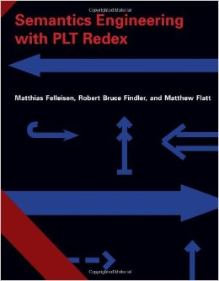
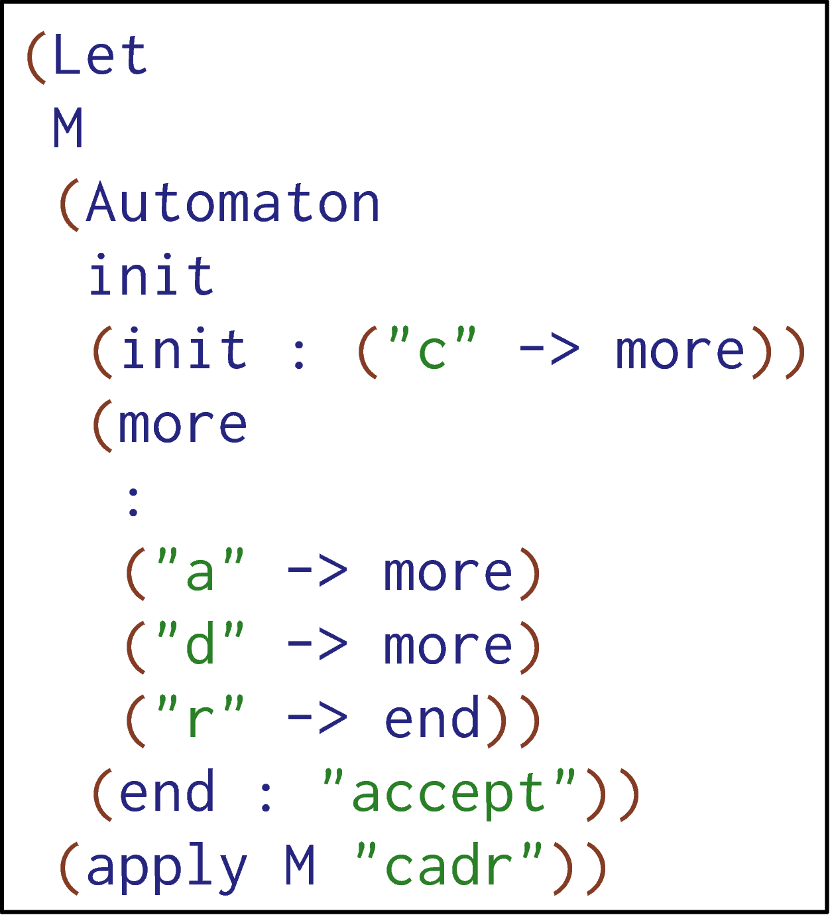
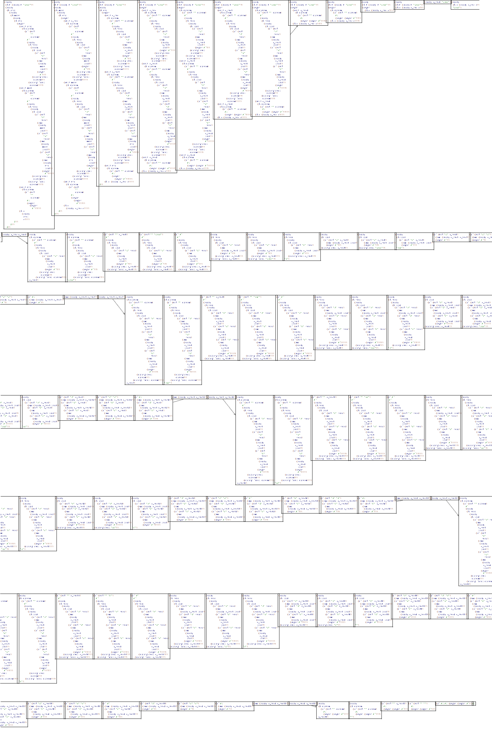
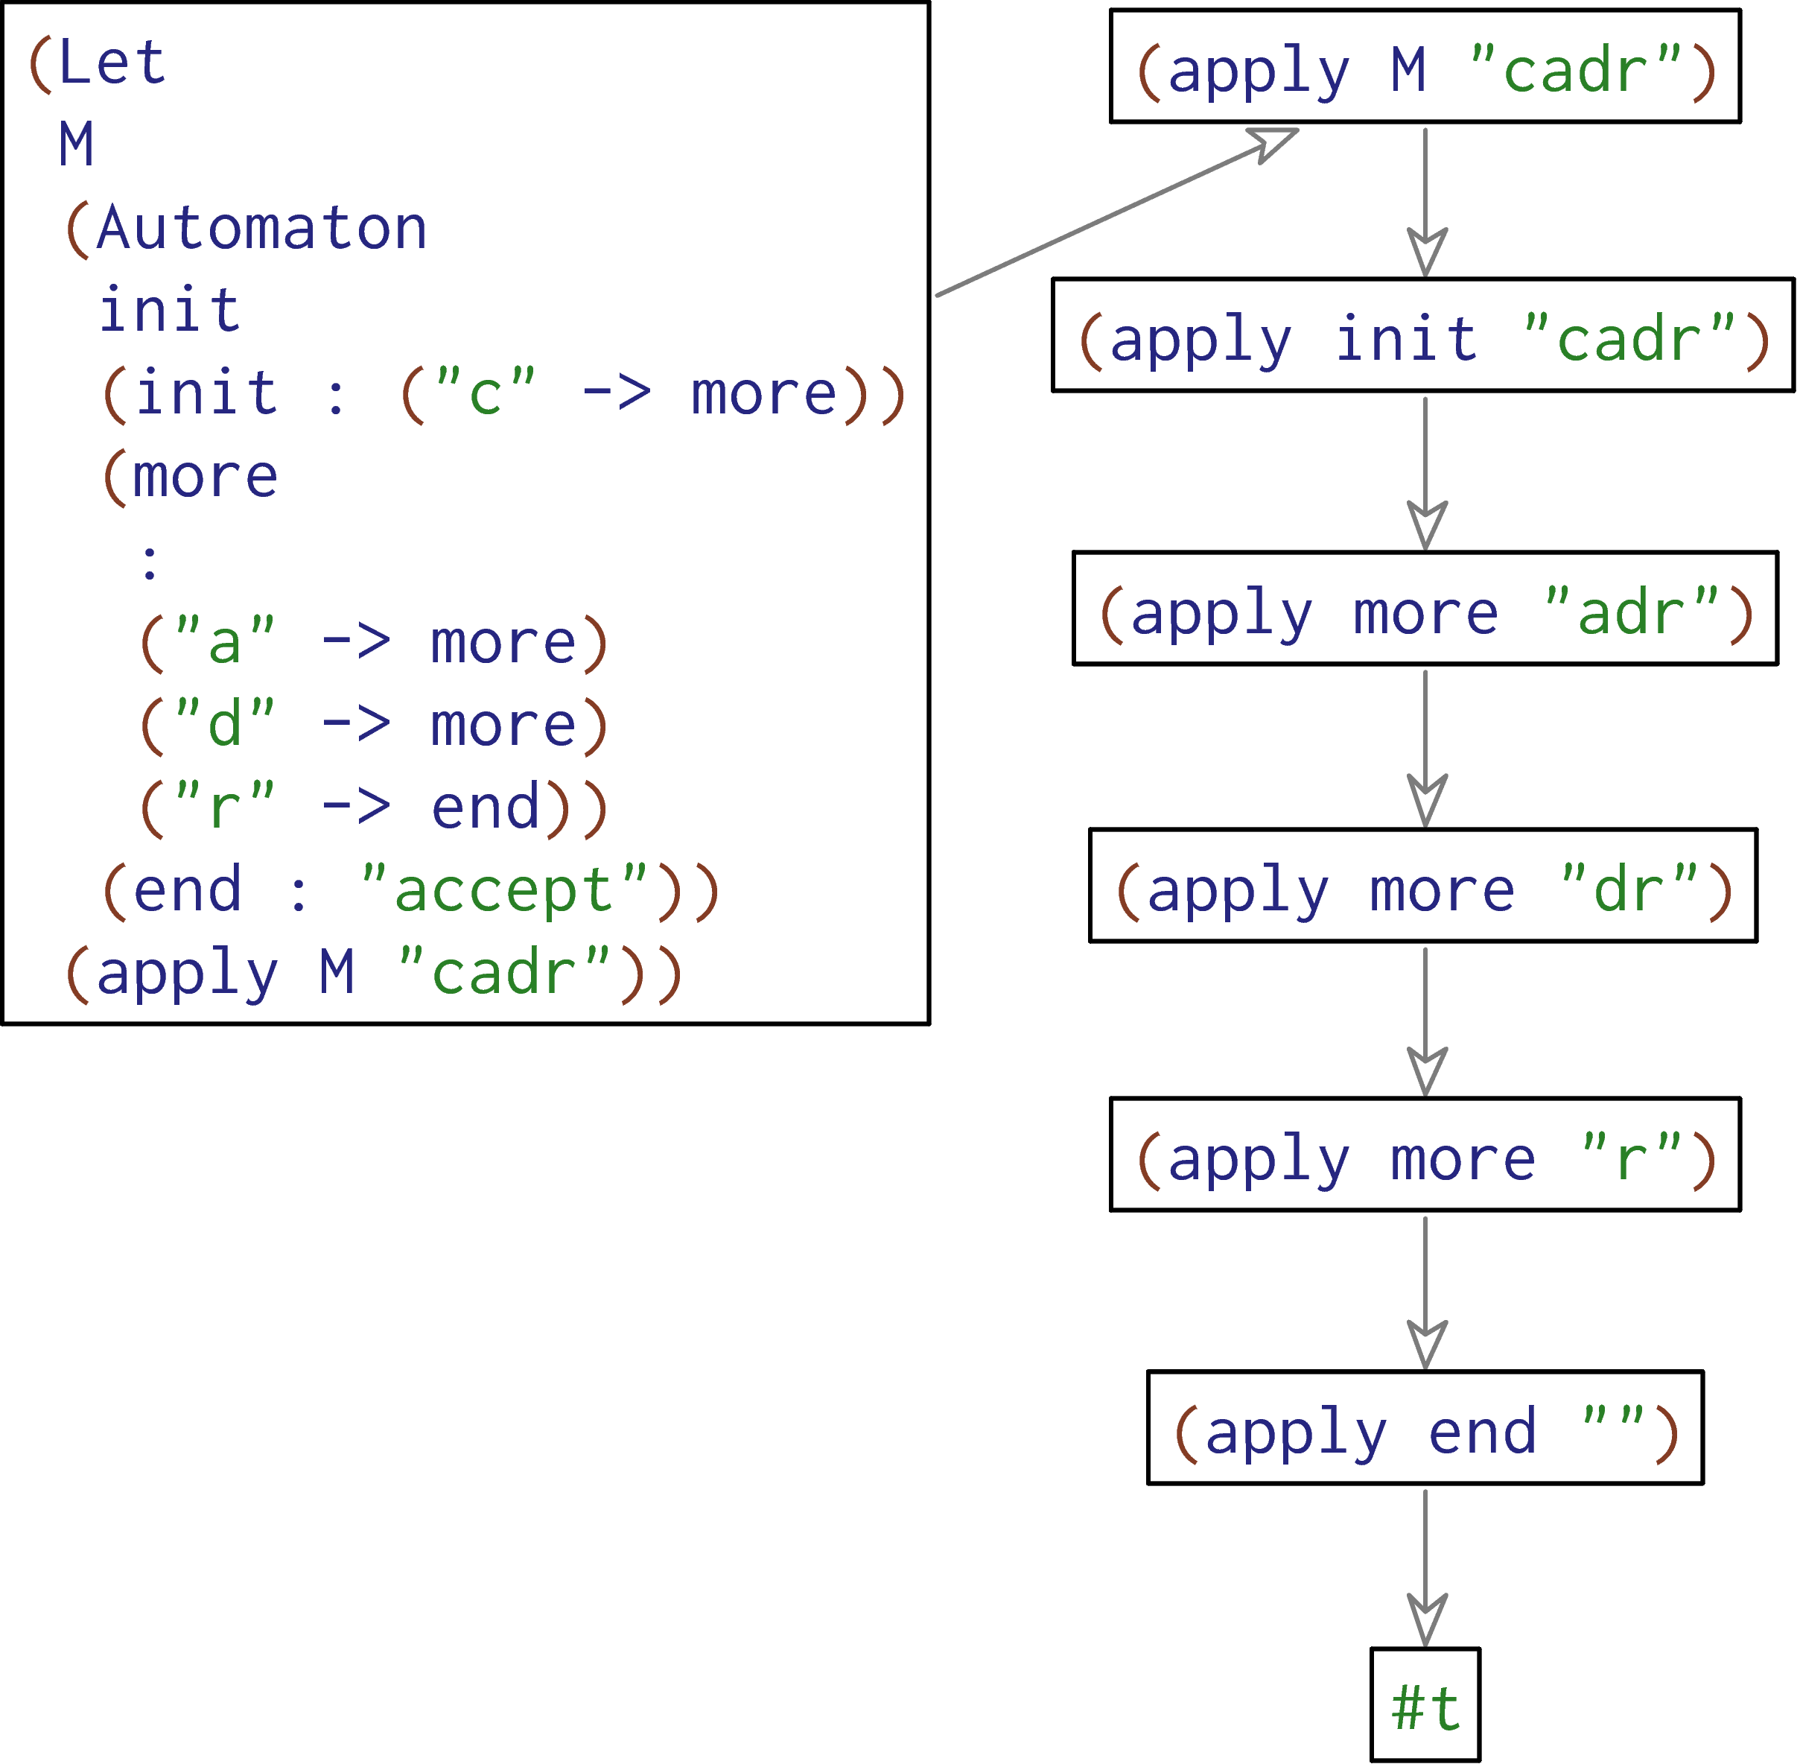
Notes:
SAY: core steps too small to read

Slide 22
my-list = [2]
cases(List) my-list:
| empty() => print("empty")
| link(something, _) =>
print("not empty")
end
desugar
my-list = list.["link"](2, list.["empty"])
block:
tempMODRIOUJ :: List = my-list
tempMODRIOUJ.["_match"]({
"empty" : fun(): print("empty") end,
"link" : fun(something, _):
print("not empty") end
},
fun(): raise("cases: no cases matched") end)
end
my-list = [2]
cases(List) my-list:
| empty() => print("empty")
| link(something, _) =>
print("not empty")
end
16 steps later…
cases(List) [2]:
| empty() => print("empty")
| link(something, _) =>
print("not empty")
end
"not empty"
<func>("not empty")
"not empty"
Notes:
Say: this was an old version of Pyret, back when it was simple and written in Racket. Resugaring for current Pyret: upcoming.

Slide 23
Resugaring Evaluation Steps
Resugaring Type Rules
Resugaring Scope Rules
Infer type rules for the surface language given type rules for core and sugar defs.

Slide 24
Thesis Statement
Many aspects of programming languages—in particular evaluation steps, type rules, and scope rules—can be non-trivially resugared from core to surface language, restoring the abstraction provided by syntactic sugar.
Infer type rules for the surface language given type rules for core and sugar defs.

Slide 25
Type Rules in 30 seconds
Γ ⊢ e : t
means e has type t in type environment Γ
A B C
D
means A ∧ B ∧ C → D

Slide 26
Why We Care
typedef map<int, double> valmap;
valmap m;
for (int i = 0; i < NVALS; i++)
m.insert(make_pair(values[i], pow(values[i], .5)));
valmap::iterator it = 100;
valmap::iterator it2(100);
m.insert(1,2);
rtmap.cpp: In function `int main()':
rtmap.cpp:19: invalid conversion from `int' to `
std::_Rb_tree_node<std::pair<const int, double> >*'
rtmap.cpp:19: initializing argument 1 of `std::_Rb_tree_iterator<_Val, _Ref,
_Ptr>::_Rb_tree_iterator(std::_Rb_tree_node<_Val>*) [with _Val =
std::pair<const int, double>, _Ref = std::pair<const int, double>&, _Ptr =
std::pair<const int, double>*]'
rtmap.cpp:20: invalid conversion from `int' to `
std::_Rb_tree_node<std::pair<const int, double> >*'
rtmap.cpp:20: initializing argument 1 of `std::_Rb_tree_iterator<_Val, _Ref,
_Ptr>::_Rb_tree_iterator(std::_Rb_tree_node<_Val>*) [with _Val =
std::pair<const int, double>, _Ref = std::pair<const int, double>&, _Ptr =
std::pair<const int, double>*]'
E:/GCC3/include/c++/3.2/bits/stl_tree.h: In member function `void
std::_Rb_tree<_Key, _Val, _KeyOfValue, _Compare, _Alloc>::insert_unique(_II,
_II) [with _InputIterator = int, _Key = int, _Val = std::pair<const int,
double>, _KeyOfValue = std::_Select1st<std::pair<const int, double> >,
_Compare = std::less<int>, _Alloc = std::allocator<std::pair<const int,
double> >]':
E:/GCC3/include/c++/3.2/bits/stl_map.h:272: instantiated from `void std::map<_
Key, _Tp, _Compare, _Alloc>::insert(_InputIterator, _InputIterator) [with _Input
Iterator = int, _Key = int, _Tp = double, _Compare = std::less<int>, _Alloc = st
d::allocator<std::pair<const int, double> >]'
rtmap.cpp:21: instantiated from here
E:/GCC3/include/c++/3.2/bits/stl_tree.h:1161: invalid type argument of `unary * ‘
Notes:
This is useful for educational purposes – to show students how their program runs.
It’s also useful for other tools:

Slide 27



Not very useful
Interesting part

Slide 28
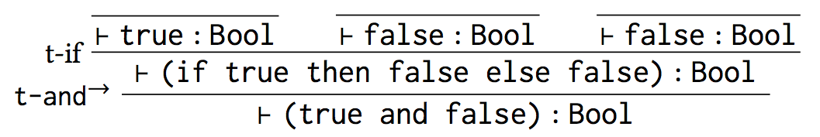
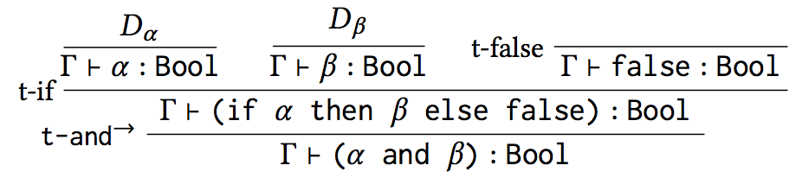
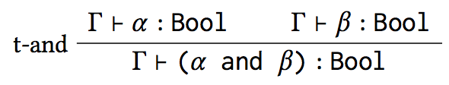

Slide 29
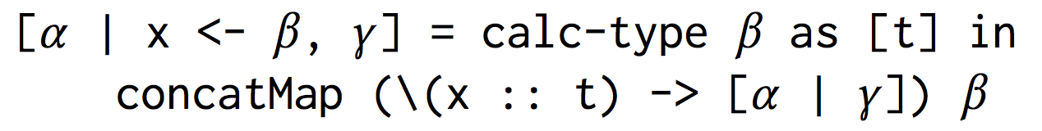
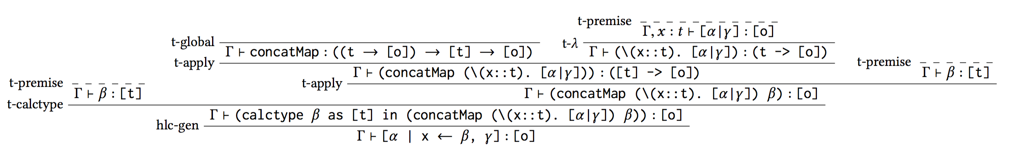
e.g. [x*y | x <- l, y <- l]
Notes:
SAY: in what lang are you allowed to use calc-type?

Slide 30
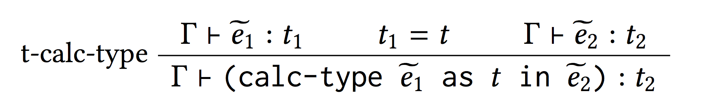

Slide 31
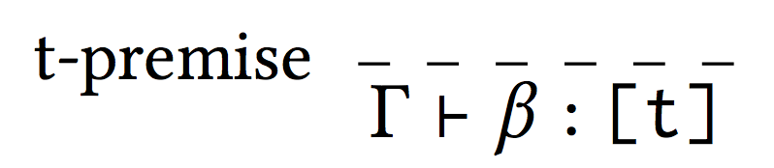
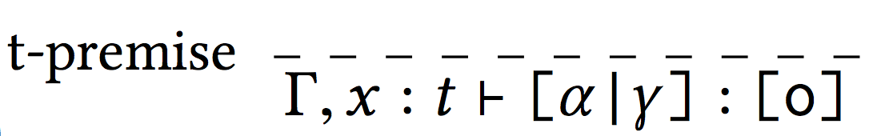
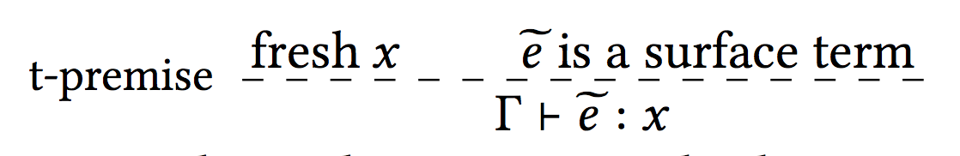
Notes:
SAY: why are these dashed?

Slide 32
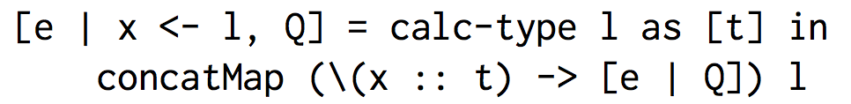
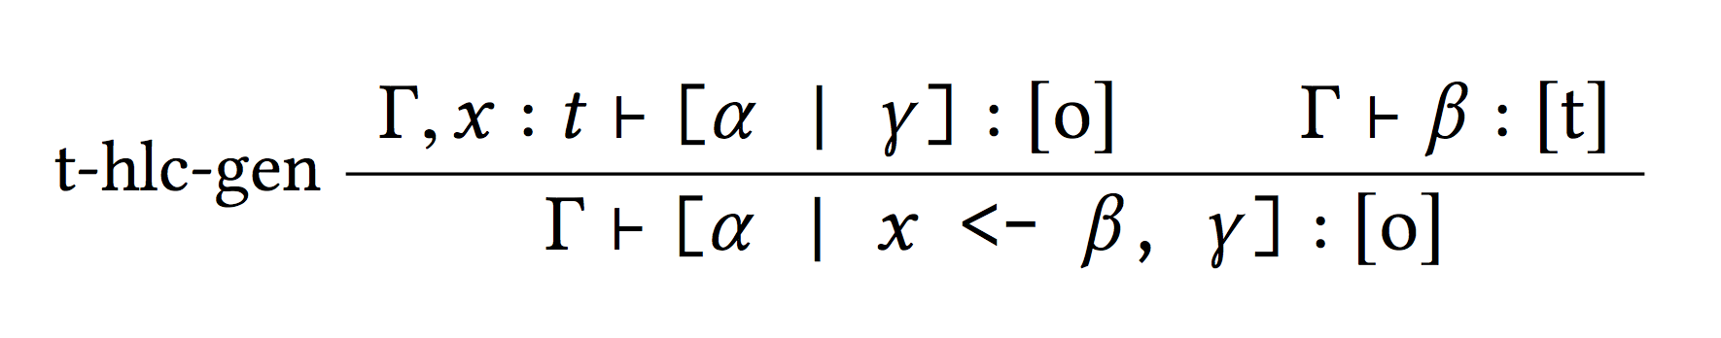

Slide 33
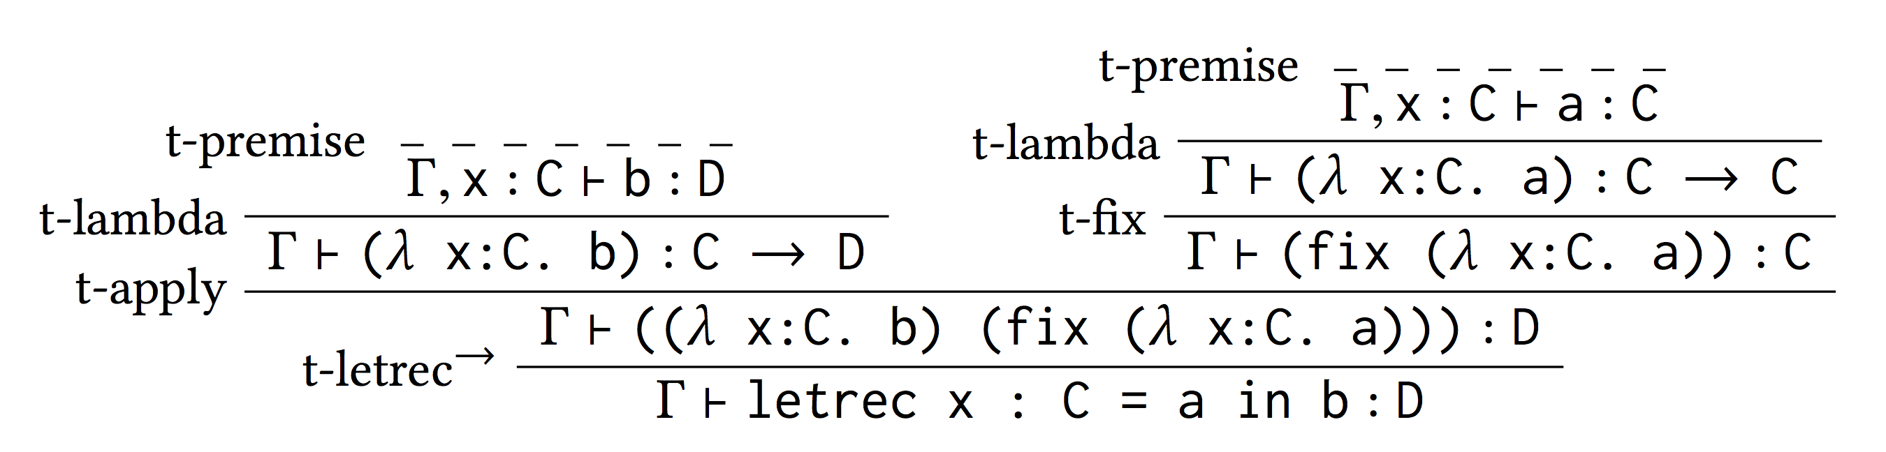
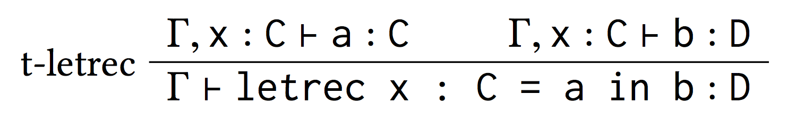
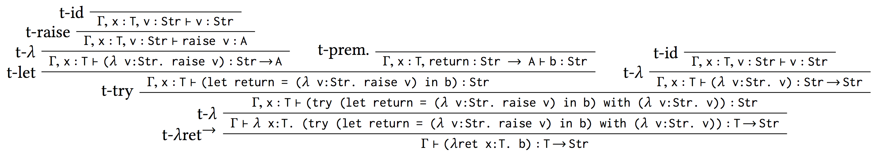
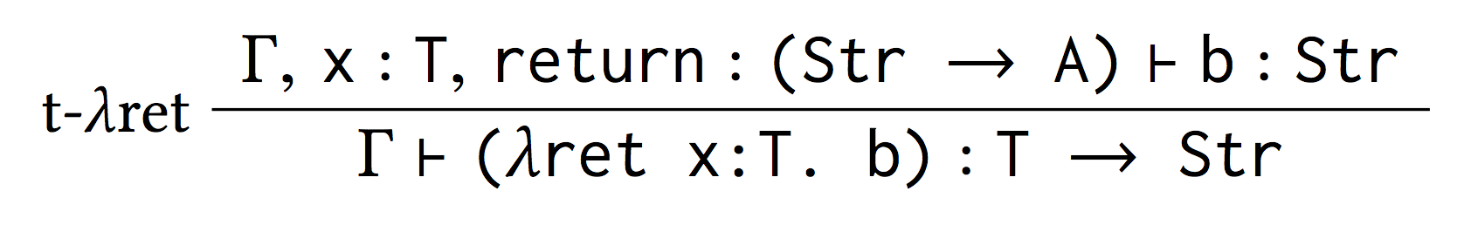

Slide 34
Thesis Statement
Many aspects of programming languages—in particular evaluation steps, type rules, and scope rules—can be non-trivially resugared from core to surface language, restoring the abstraction provided by syntactic sugar.
Notes:
Next, let me talk about resugaring scope rules.
Scoe rules are declarative rules that tell you where variables are bound

Slide 35
Resugaring Evaluation Steps
Resugaring Type Rules
Resugaring Scope Rules

Slide 36
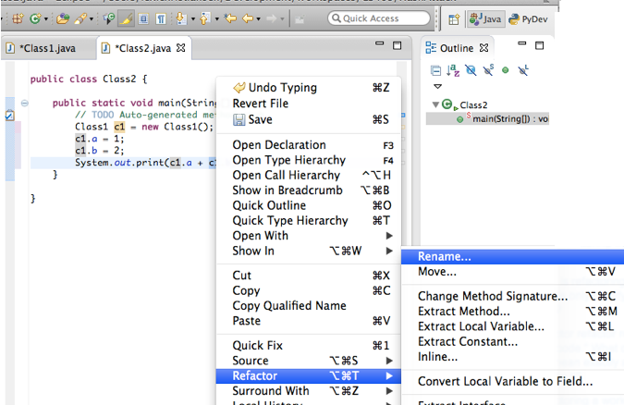
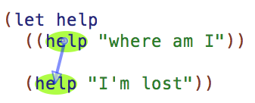
Why We Care

Slide 37
Must be distinct?
f shadows x?
x shadows f?
laborious
&
error-prone
Must be distinct!
{
?
(named-lambda f (x ...) body)
Within body, f is bound to the function.
Notes:
Attribution: macro from Alexandria project
; my attempt to define it, since the source code just calls out to something called ‘labels’?
(define-syntax-rule (named-lambda name (x ...) body)
(letrec ((name (lambda (x ...) body)))
name))
; (labels ((name args @body)) name))

Slide 38
Scope rules
(lambda (arg) body)
lambda
arg
body
If there is a path from A to B
then B is in scope of A

Slide 39
(named-lambda f (x ...) body)
(lambda (x ...) body)

Slide 40
(named-lambda f (x ...) body)
(lambda (f) (lambda (x ...) body))

Slide 41
(named-lambda f (x ...) body)
(Y (lambda (f) (lambda (x ...) body)))
apply
named-lambda
Y
lambda
f
(x …)
body
f
lambda
(x …)
body

Slide 42
(named-lambda f (x ...) body)
(Y (lambda (f) (lambda (x ...) body)))
apply
named-lambda
Y
lambda
f
(x …)
body
f
lambda
(x …)
body

Slide 43
(named-lambda f (x ...) body)
(Y (lambda (f) (lambda (x ...) body)))
apply
named-lambda
Y
lambda
f
(x …)
body
f
lambda
(x …)
body

Slide 44
(named-lambda f (x ...) body)
(Y (lambda (f) (lambda (x ...) body)))
apply
named-lambda
Y
lambda
f
(x …)
body
f
lambda
(x …)
body

Slide 45
(named-lambda f (x ...) body)
(Y (lambda (f) (lambda (x ...) body)))
apply
named-lambda
Y
lambda
f
(x …)
body
f
lambda
(x …)
body

Slide 46
Properties

Slide 47
Thm: If resugaring succeeds,
then desugaring will preserve scope.
Suppose Σ_{surf} = resugar(Σ_{core}, ds-rules)
Σ_{surf} ⊢ x → y in t
iff Σ_{core} ⊢ x → y in desugar(t)

Slide 48


Pyret
Haskell
Scheme
R5RS
for-loop
let-clustering
function decls
list comprehs:
-guards
-generators
-local bindings
let
let*
letrec
do
Notes:
SAY: describe these. Haskell: list comprehensions.
Tested on all of the binding constructs from three languages.
It worked immediately on all except for ‘do’, which needed a small modification.
* Overall, this was about 500 lines of test cases * and it all runs in 4ms.

Slide 49
Summary
I showed you:
Resugaring Evaluation Steps
Resugaring Type Rules
Resugaring Scope Rules
Ongoing work:
Resugaring evaluation steps for the latest version of Pyret

Slide 50
Thesis Statement
Many aspects of programming languages—in particular evaluation steps, type rules, and scope rules—can be non-trivially resugared from core to surface language, restoring the abstraction provided by syntactic sugar.

Slide 51
FILL
Resugaring for Pyret: in progress, but progressing nicely. Engineering work remaining.

