Slide 1
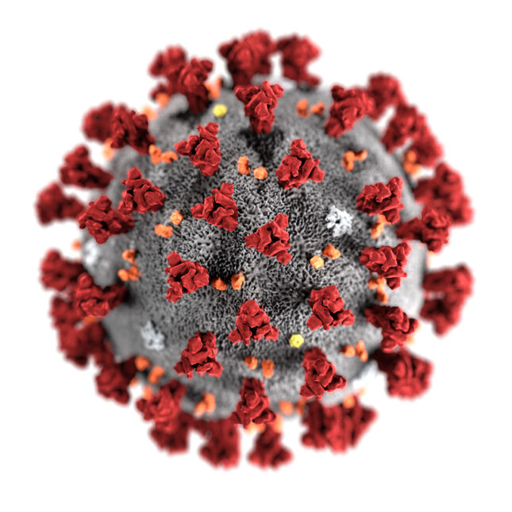
State-Based COVID-19 Vaccination Allocation Database Report
Justin Nichols
Andrew Kimball
Michael Gee
Cameron Gamble
https://www.statnews.com/2020/02/11/disease-caused-by-the-novel-coronavirus-has-name-covid-19/
Justin

Slide 2
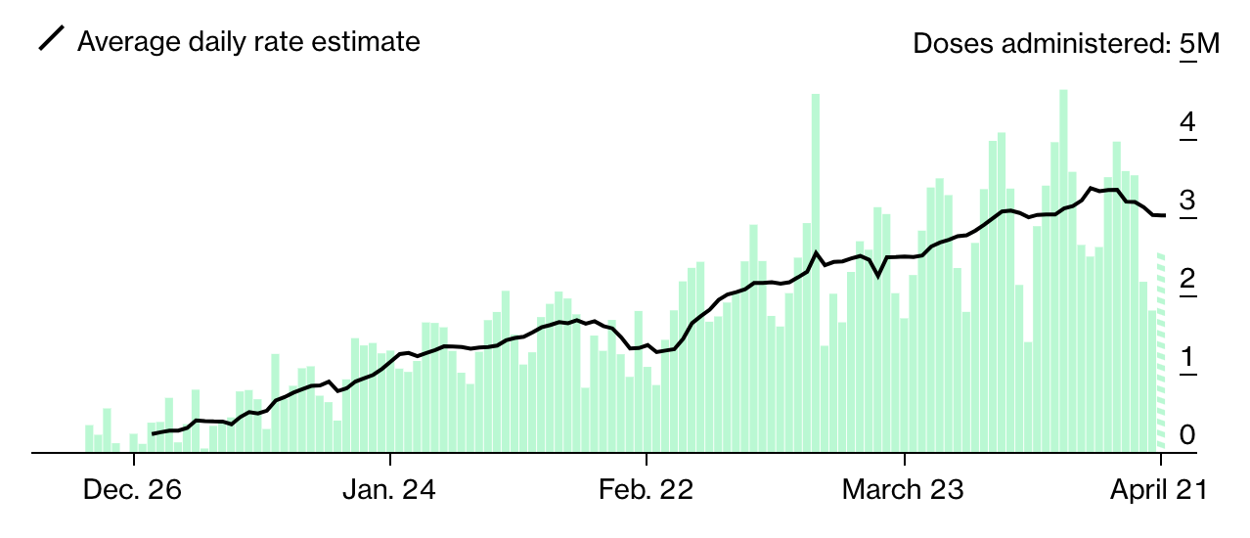
Goal and Motivation
The ultimate goal of this database application is to gather the current vaccination allocation, case count, and population of each U.S. state/territory to develop observations and make conclusions about the COVID-19 vaccine distribution around the country. The database gathers the number of allocated vaccines from the approved companies (Pfizer, Moderna, and Janssen) given to each state and compares it to the state’s population and total COVID-19 case count. Our group wanted to pick a topic that was not only relevant but also had a multitude of data to gather and obtain results from. COVID-19 was an obvious choice for us, considering how much it has impacted the country in the last year.
Note: This project was started before the
Janssen (Johnson & Johnson) vaccine was
indefinitely suspended and does not reflect
last week’s development.
https://www.bloomberg.com/graphics/covid-vaccine-tracker-global-distribution/
Justin

Slide 3



Raw Data
All data was gathered in a csv format during the first week of April 2021. The case count data for each state was obtained from https://www.cdc.gov/. The population data for each state was obtained from https://www.census.gov/. The vaccine data corresponding to Moderna, Pfizer, and Janssen was obtained from https://www.data.gov/. The final raw data set included, Moderna.csv (1008 total entries), Pfizer.csv (1071 total entries), Janssen.csv (315 total entries), Population.csv (59 total entries), Cases.csv (59 total entries).
Justin

Slide 4
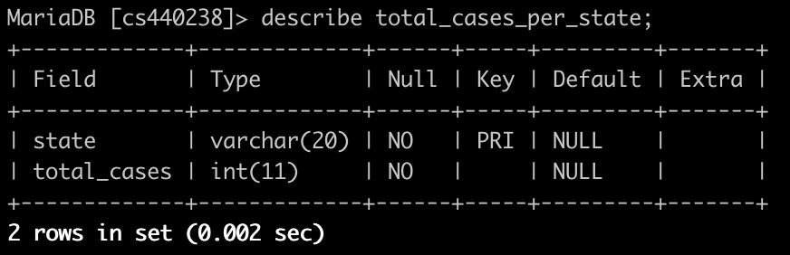
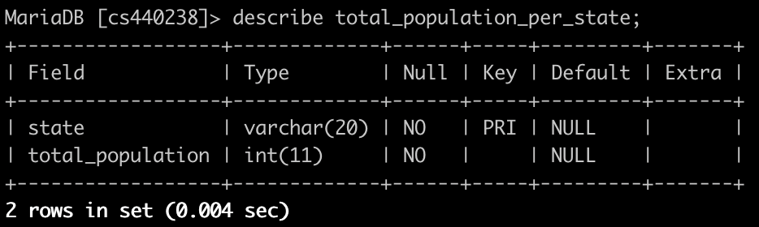
Tables
Primary Key: state
Functional Depencies: state → total_cases
Normal Form: The table schema is in BCNF.
Primary Key: state
Functional Depencies: state → total_population
Normal Form: The table schema is in BCNF.
Andrew

Slide 5
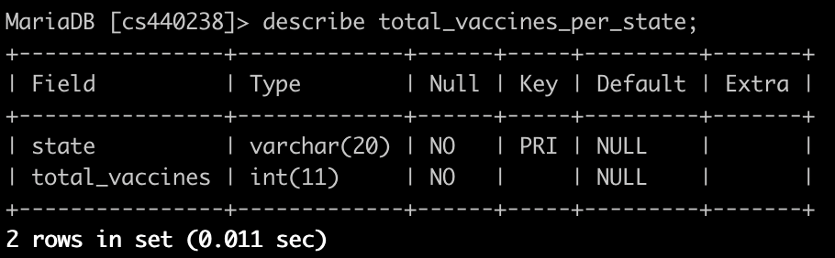
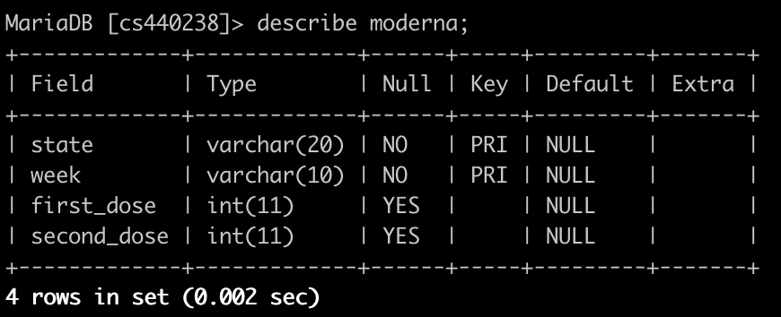
Tables (cont.)
Primary Key: state
Functional Depencies: state → total_vaccines
Normal Form: The table schema is in BCNF.
Primary Key: state, week
Functional Depencies: state, week → first_dose; state, week → second_dose
Normal Form: The table schema is in BCNF.
Andrew

Slide 6
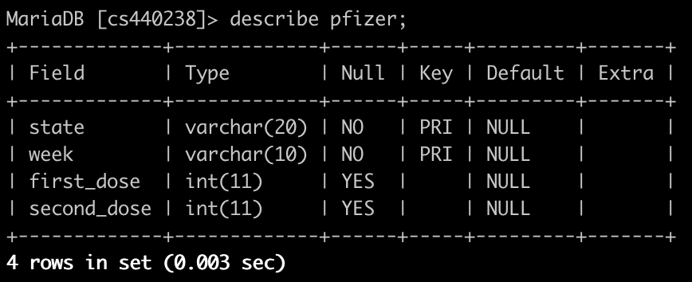
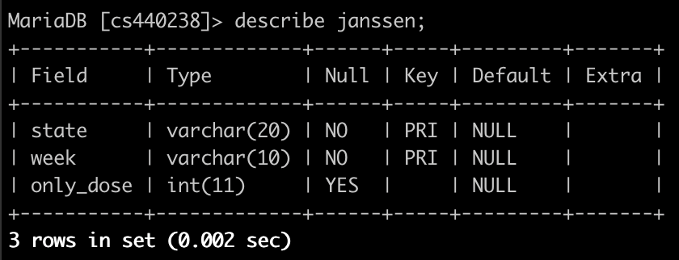
Tables (cont.)
Primary Key: state, week
Functional Depencies: state, week → first_dose; state, week → second_dose
Normal Form: The table schema is in BCNF.
Primary Key: state, week
Functional Depencies: state, week → only_dose
Normal Form: The table schema is in BCNF.
Andrew

Slide 7
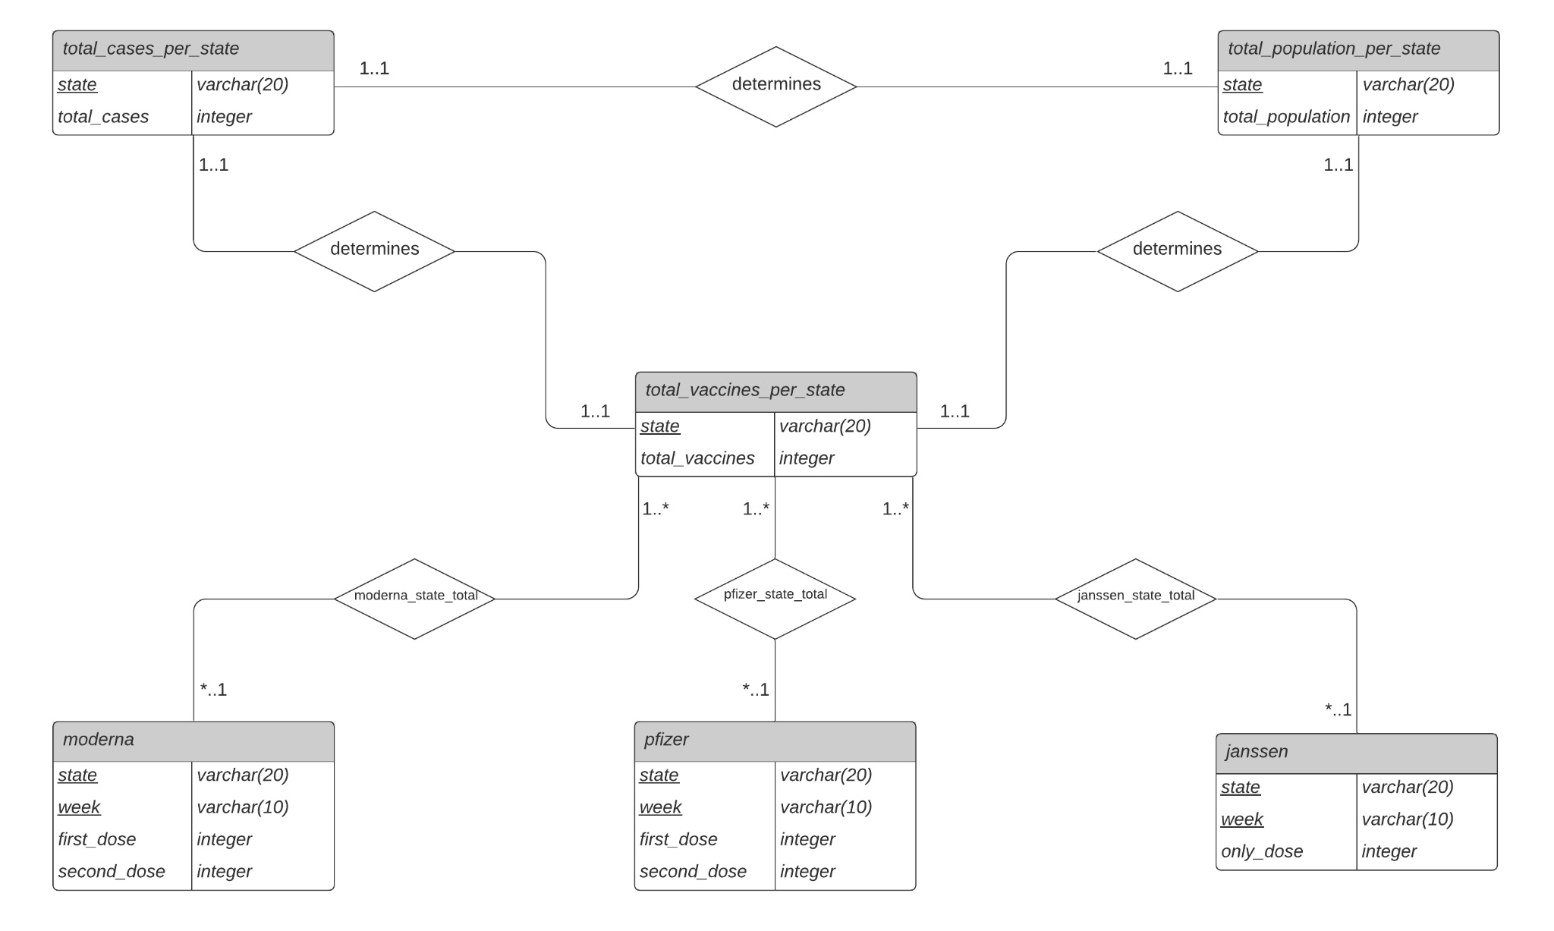
ER Diagram
Andrew

Slide 8
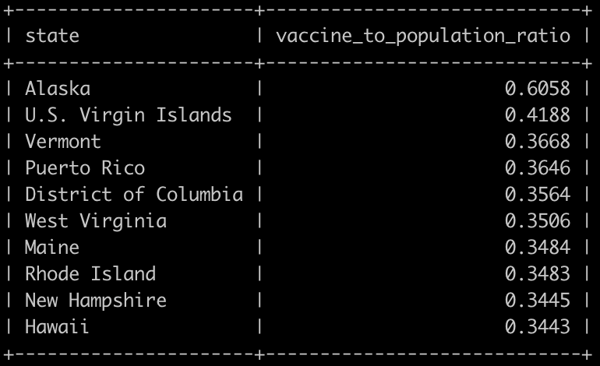
Query 1
This query finds the percentage of vaccines given to a state compared to its population and outputs the top ten states with the highest percentage.
Result:
Michael

Slide 9
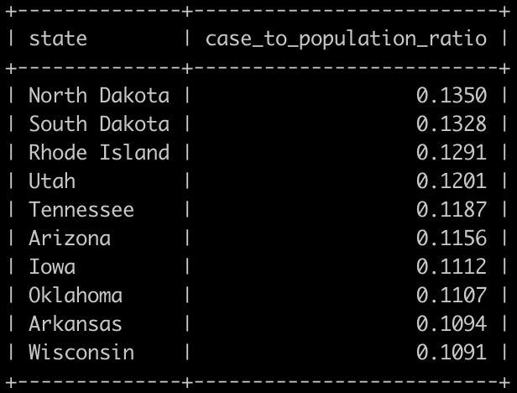
Query 2
This query finds the percent of each state’s cases compared to its population and outputs the top ten states with the highest percentage.
Result:
Michael

Slide 10
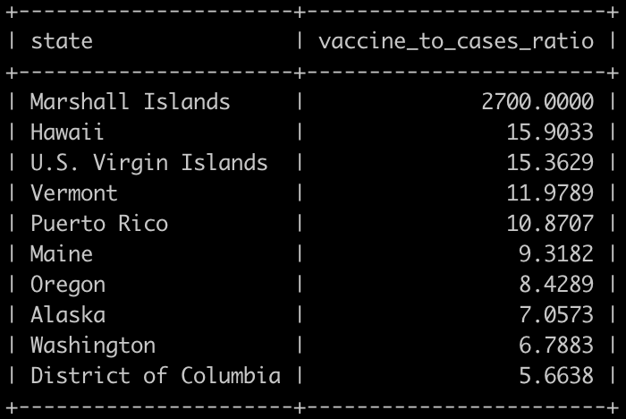
Query 3
This query finds the percentage of vaccines given to a state compared to its cases and outputs the top ten states with the highest ratio.
Result:
Michael

Slide 11
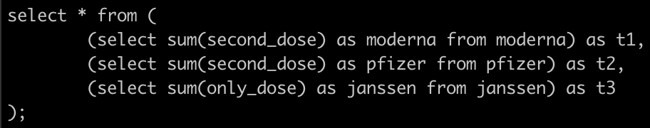
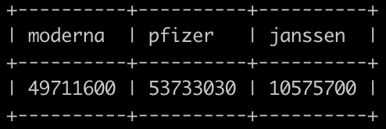
Query 4
This query finds the total number of Moderna, Pfizer, and Janssen vaccines distributed to fully vaccinate a person.
Result:
Michael

Slide 12
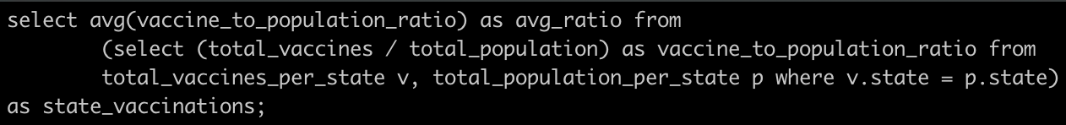
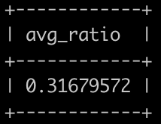
Query 5
This query finds the percent of vaccines given to each state compared to its population and takes the average. The output represents how much of the U.S. is covered by the number of current vaccines available.
Result:
Michael

Slide 13
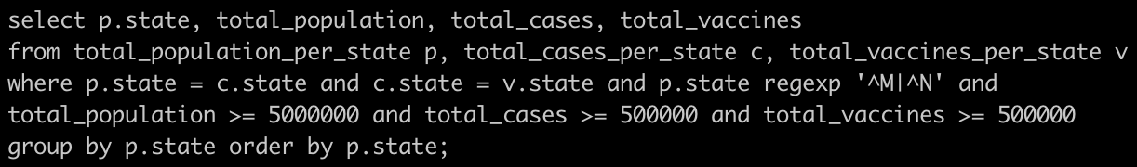
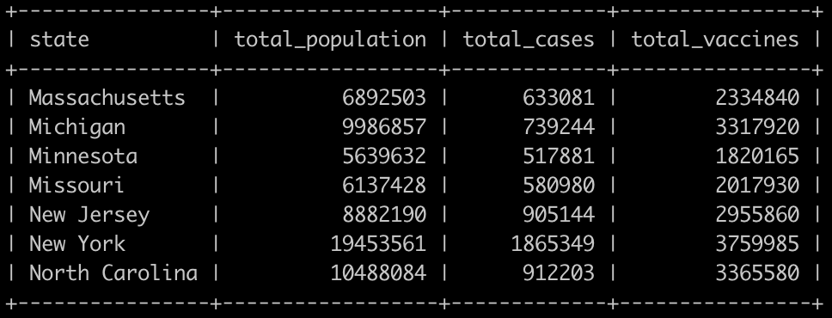
Query 6
This query finds the population, cases, and vaccines of states that start with ‘M’ or ‘N’ that have a population, case count, and vaccine number over 500,000.
Result:
Cam

Slide 14
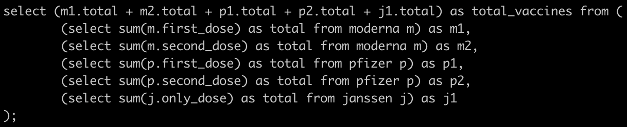
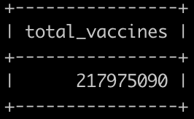
Query 7
This query finds the total numbers of vaccines distributed. This includes both first and second doses.
Result:
Cam

Slide 15
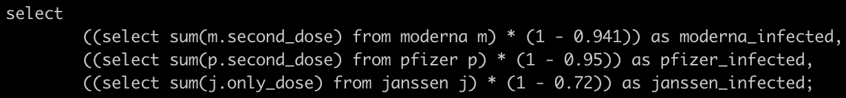
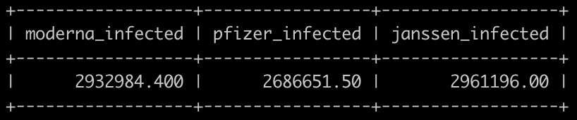
Query 8
This query uses each vaccine’s effectiveness to approximately find the number of people that still contracted COVID-19 after getting the vaccine.
Result:
Cam

Slide 16
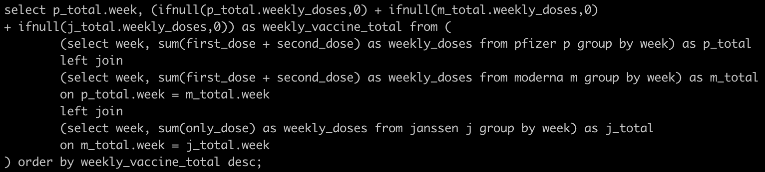
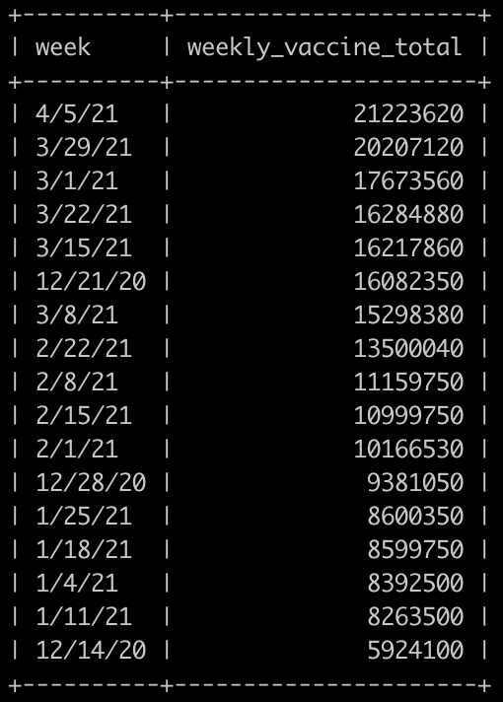
Query 9
This query finds the total number of vaccines distributed each week across the country.
Result:
Cam

Slide 17
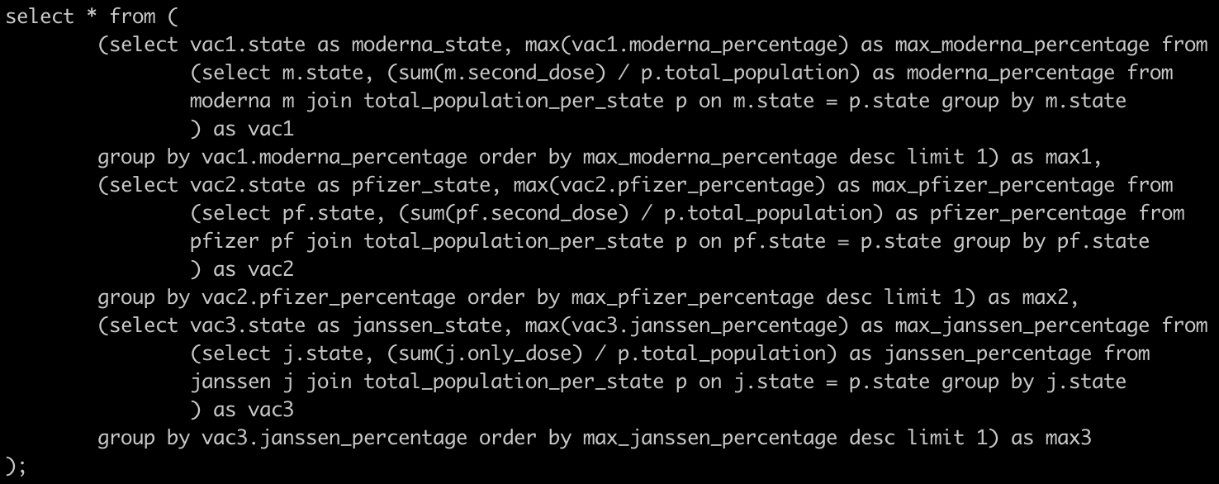
Query 10
This query finds the state that obtained the highest percentage of vaccines compared to its population for each of the three vaccines.
Result:
Cam

Slide 18

What Did We Learn
Throughout the development and implementation of this project, our team has learned the benefits of utilizing the database model and the theory of logical design to construct a complex database application.
Finding data on our subject matter led to some difficulties due to it being so recently available. We find that it would probably be beneficial to work with more complete data sets made after events have taken place. This could allow us to draw better insights from more fleshed-out data.
We also realize that coming up with good queries takes time and takes a good data set.
Justin

