Slide 1

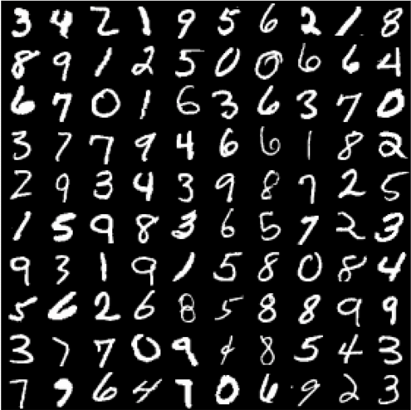
Machine Learning: Handwritten Digit Recognition using Singular Value Decomposition
Webster Gordon, Justin Nichols, Mollee Swift

Slide 2
Objective
Use machine learning to recognize handwritten digits.
Use SVD to train the model to learn digits 0-9 and reduce the dimensionality.
Use Linear Least Squares to classify the images.
Test the model's accuracy on a new data sample containing unseen images of digits.
Find the optimal rank (the one that generates the highest accuracy).
We used SVD over PCA because it is more efficient when working with dense data.

Slide 3
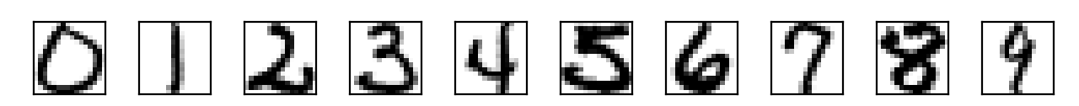
Data Set
Handwritten digit images come from USPS.
7291 training and 2007 testing images in h5 format.
Images are 16x16 matrices of 8-bit (0-255) grayscale values.
Training set is 80% of data set.
Testing set is 20% of data set.
Original image samples of each digit from dataset.

Slide 4
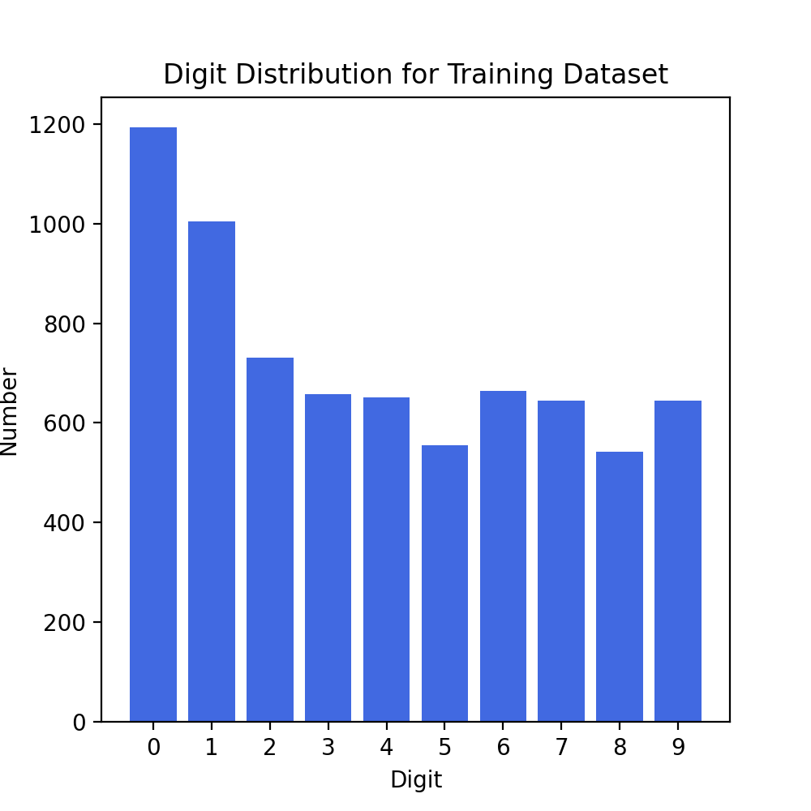
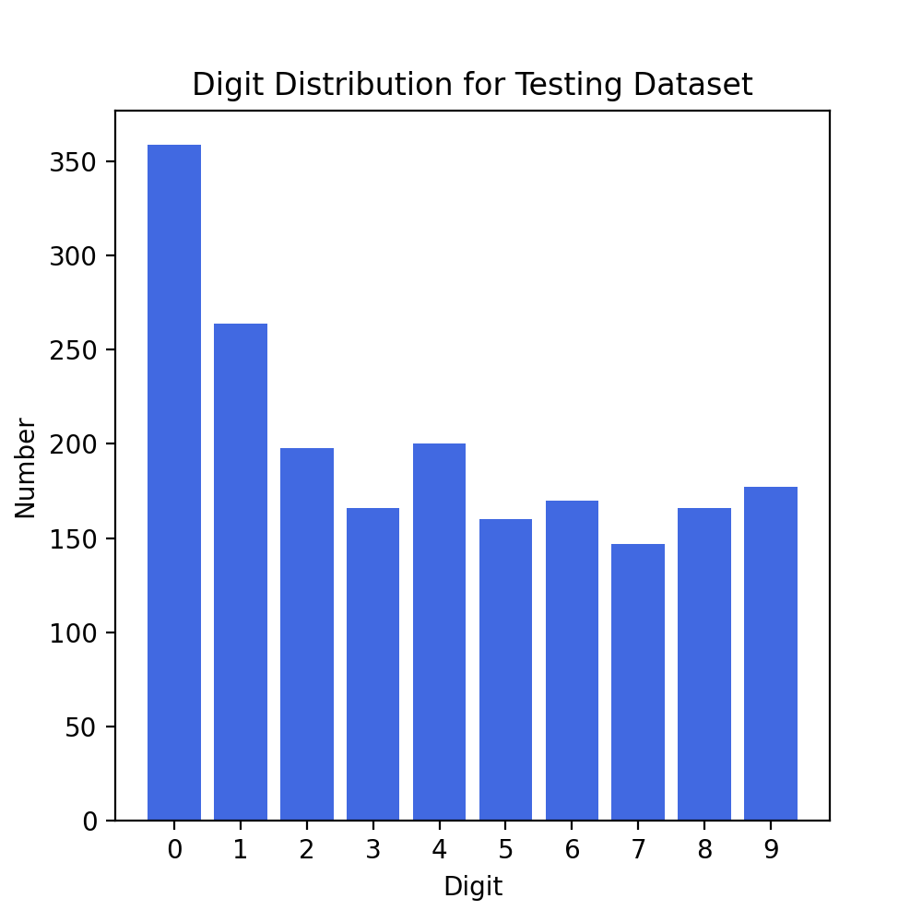
Digit distribution for training and testing dataset, respectively.

Slide 5
Splitting the data
Used a Python dictionary to store all matrixes for each digit.
The 16x16 matrices were flattened into 256x1.
All the matrices associated with each digit were stacked together in the dictionary.
For example, digit 0, with 1194 samples, has a shape of (1194, 256) in the dictionary.

Slide 6
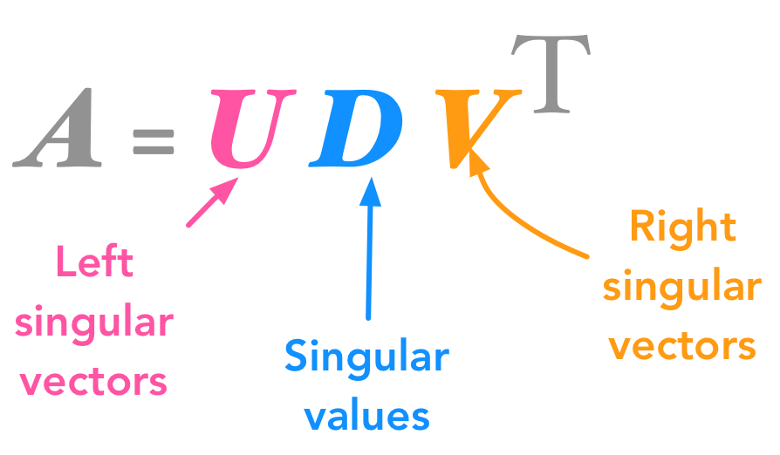
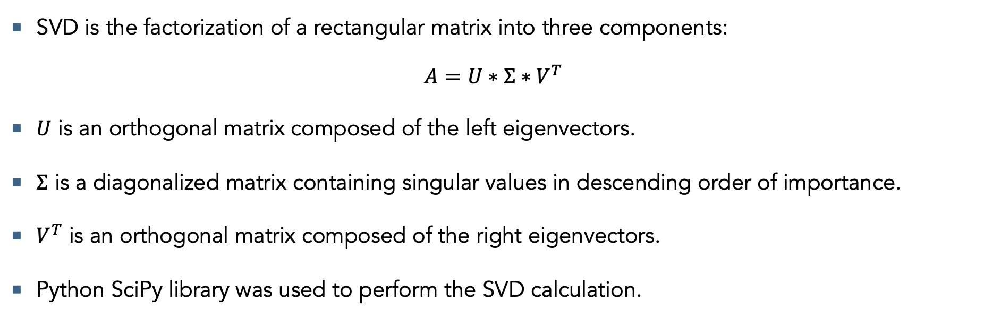
Singular Value Decomposition
SVD is the factorization of a rectangular matrix into three components:
$$A=U∗Σ∗V^{T}$$
$U$ is an orthogonal matrix composed of the left eigenvectors.
$Σ$ is a diagonalized matrix containing singular values in descending order of importance.
$V^{T}$ is an orthogonal matrix composed of the right eigenvectors.
Python SciPy library was used to perform the SVD calculation.

Slide 7
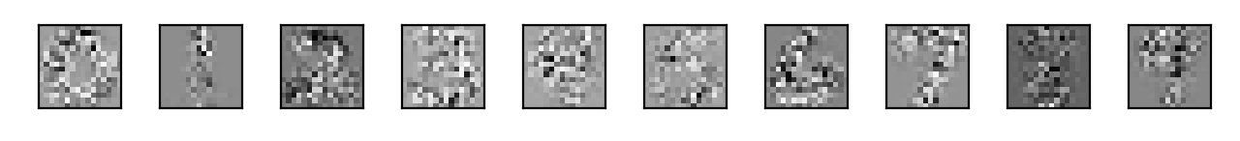
Rank-12 matrix approximations
SVD was performed on each separate digit set from the dictionary.
The rank-12 matrix approximations for each digit, while vague in precise form, are visible.
Rank-12 matrix approximations images for each digit.

Slide 8
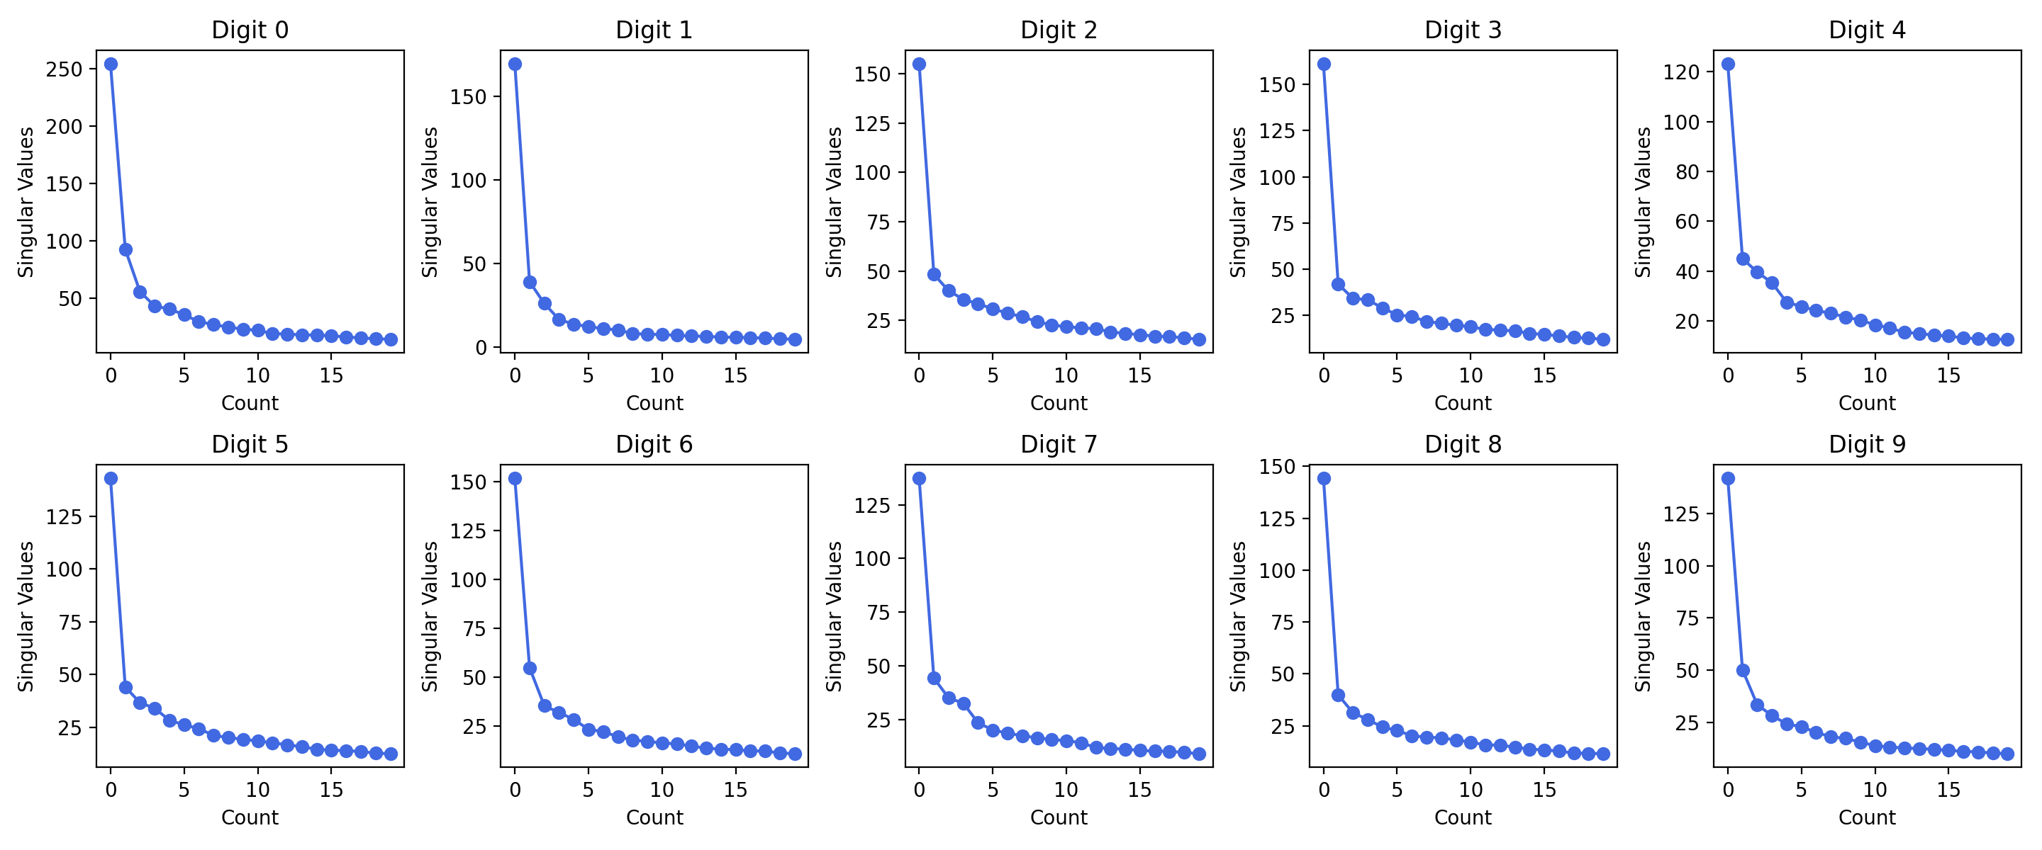
Plot of first 20 singular values for each digit, 0 through 9.

Slide 9
Selecting the OPTIMAL approximation Rank
Based on the singular value plots:
We sought to reduce the dimensionality of our data without sacrificing accuracy.
We conjectured that the desired peak accuracy was within the first 20 approximations.
Ran the Linear Least squares algorithm from ranks 1 to 20.

Slide 10
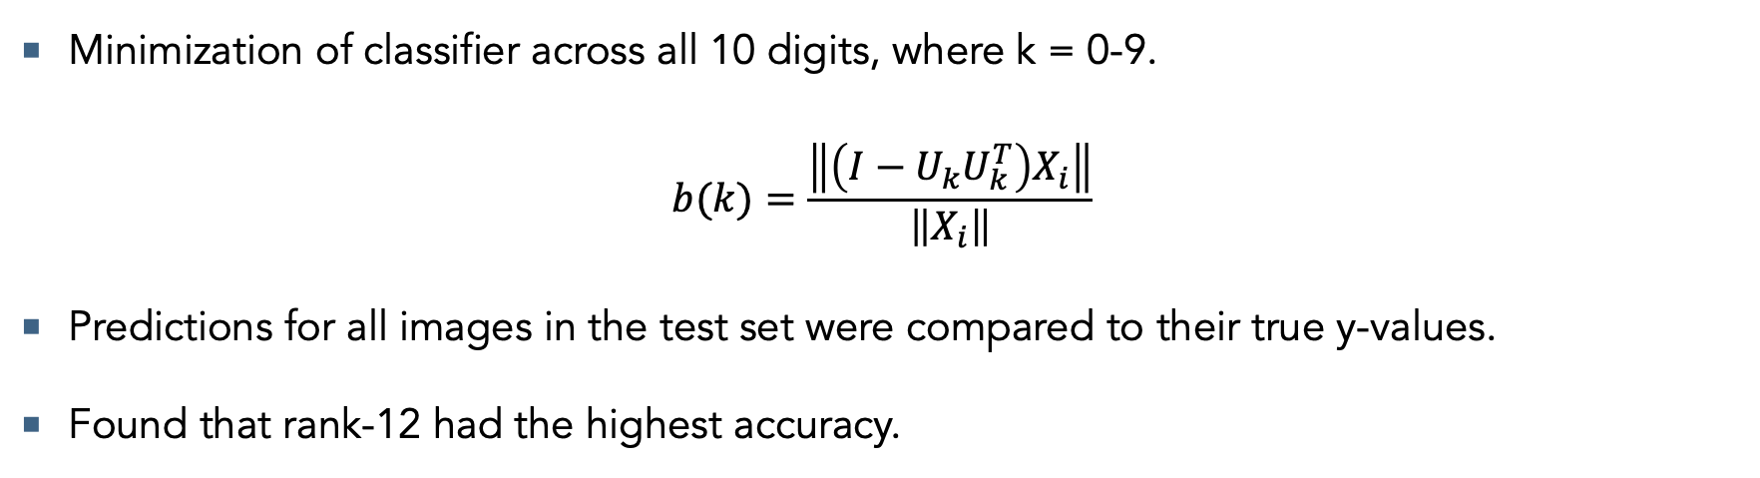
Linear least Squares
Minimization of classifier across all 10 digits, where k = 0-9.
$$b(k)=\frac{\left\|\left(I−U_{k}U_{k}^{T}\right)X_{i}\right\|}{\left\|X_{i}\right\|}$$
Predictions for all images in the test set were compared to their true y-values.
Found that rank-12 had the highest accuracy.

Slide 11
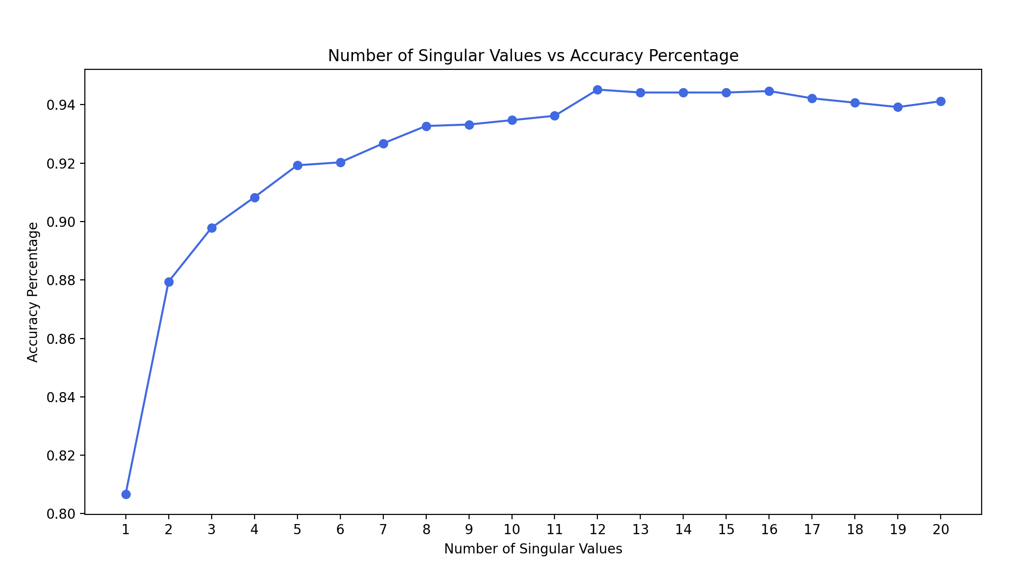
Plot comparing the classification accuracy percentage to the rank of the singular value approximations.

Slide 12




Overall Results
Technologies: Python Anaconda distribution.
Packages: SciPy, Scikit-Learn, NumPy, h5py, matplotlib.
Rank-12 accuracy was 94.52%.
1897 of 2007 test images were classified correctly.

Slide 13
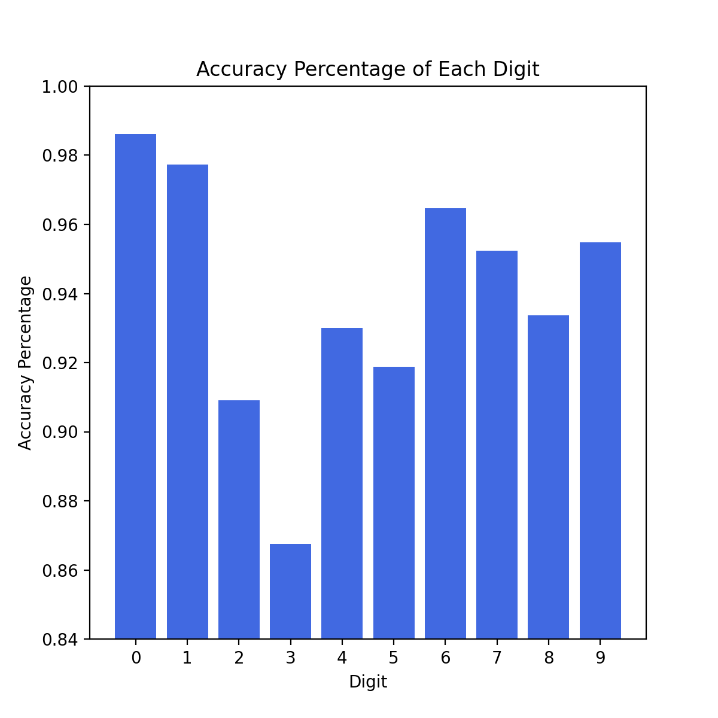
Individual Digit Accuracy
Success rate of each digit differs in accordance with the complexity of the digit and cleanliness of the rank-12 matrix approximations.
Accuracy of digit 3 was the lowest at 86.70%.
Digit 0, with the greatest number of samples, had the highest accuracy at 98.60%.

Slide 14
Error Analysis
110 total misclassified digits for the rank-12 matrix approximation.
Many misclassifications were a result of misplacement and skewedness.
Digits 3, 5, and 8 were often misclassified as the other.
Digits 1 and 7 were often misclassified as the other.
Digits with pronounced loops were often misclassified as Digit 0.
Digits with pronounced lines were often misclassified as Digit 1.

Slide 15
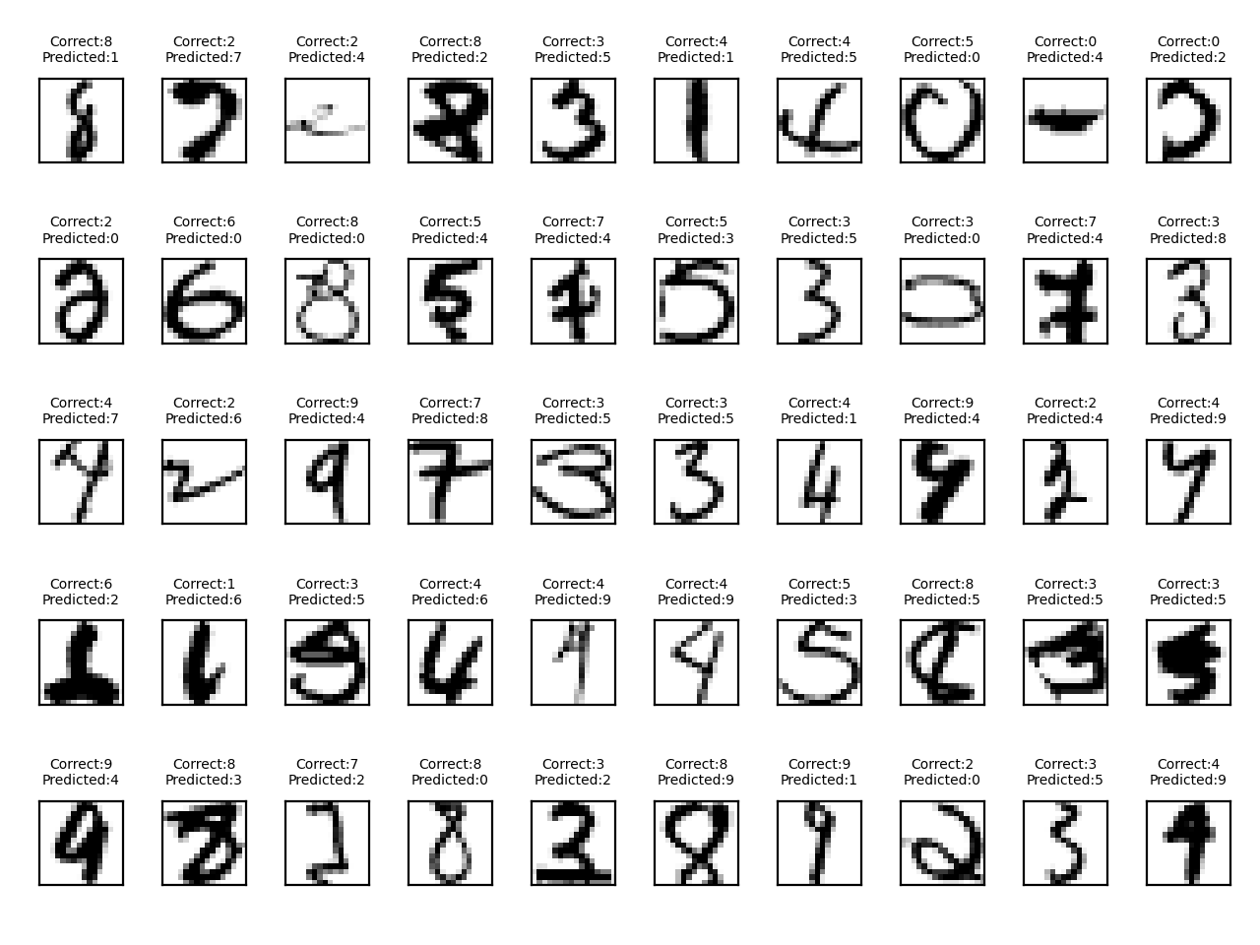
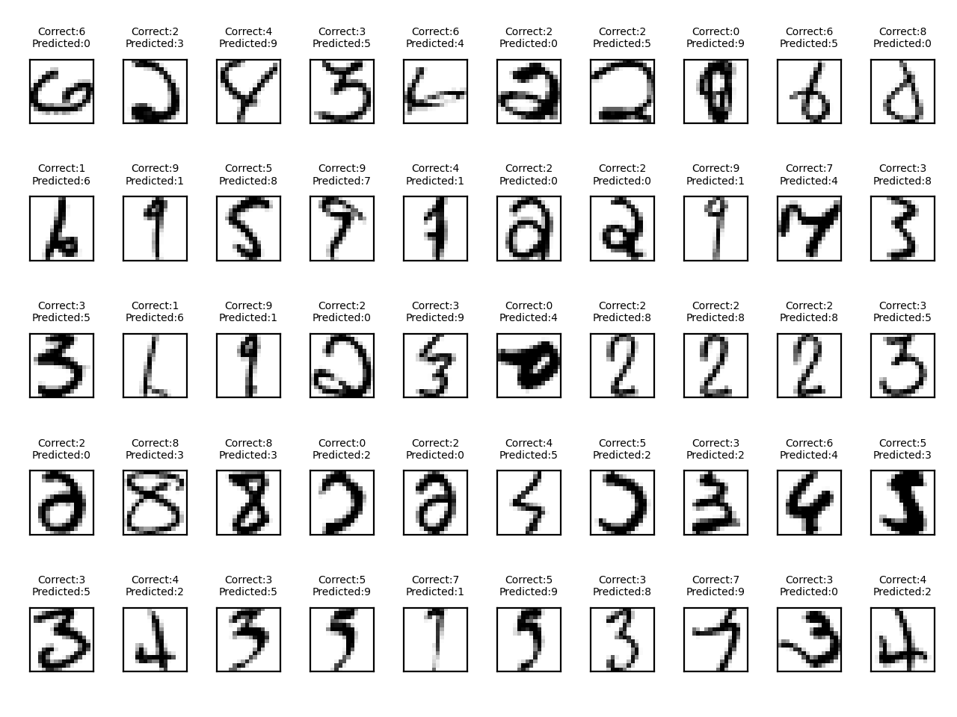
10 Misclassified digits.

Slide 16
Conclusion
SVD and Linear Least Squares were able to successfully predict handwritten digits.
Achieved a high accuracy greater than 94%.
The model can be applied to a variety of applications:
Quickly interpreting postal codes and addresses on mail and packages.
Recognizing any handwritten digits, like financial documents, mathematical writing, etc.
Augmented to learn not only digits, but also the modern Latin alphabet, or any language’s alphabet.

Slide 17
Takeaways
Learning the applications of SVD and its ability to perform dimensionality reductions.
Understanding how to classify using Linear Least Squares.
Learning how to gather and analyze data and then present findings cohesively.
Gathering everyday with great people and having lots of laughs.

Slide 18
Thank you!
We would like to extend our gratitude to Frederic Marazzato for his guidance and assistance.

