Slide 1

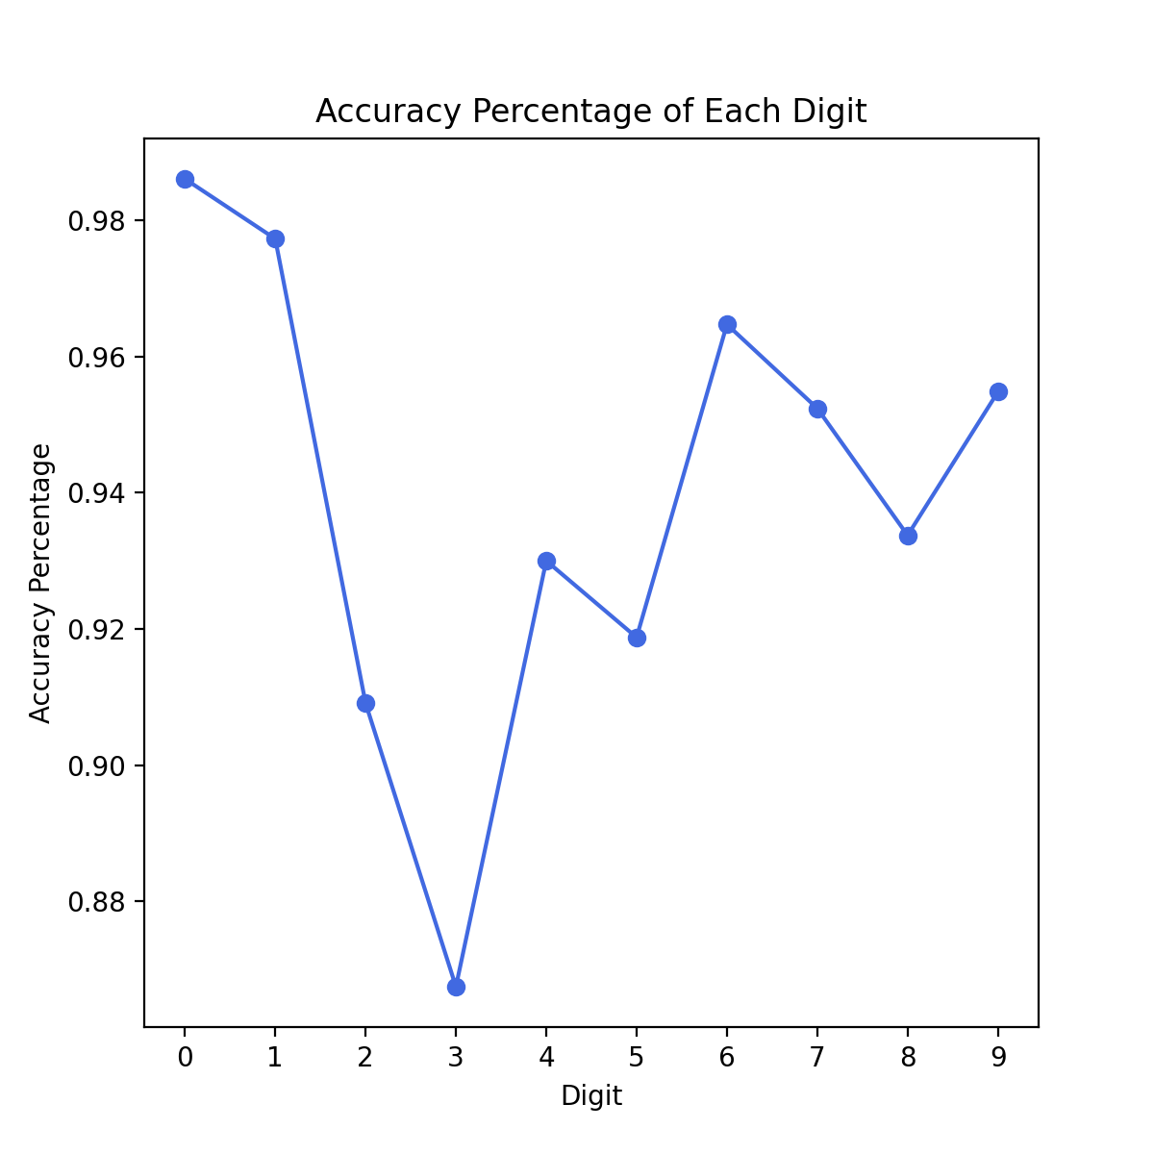
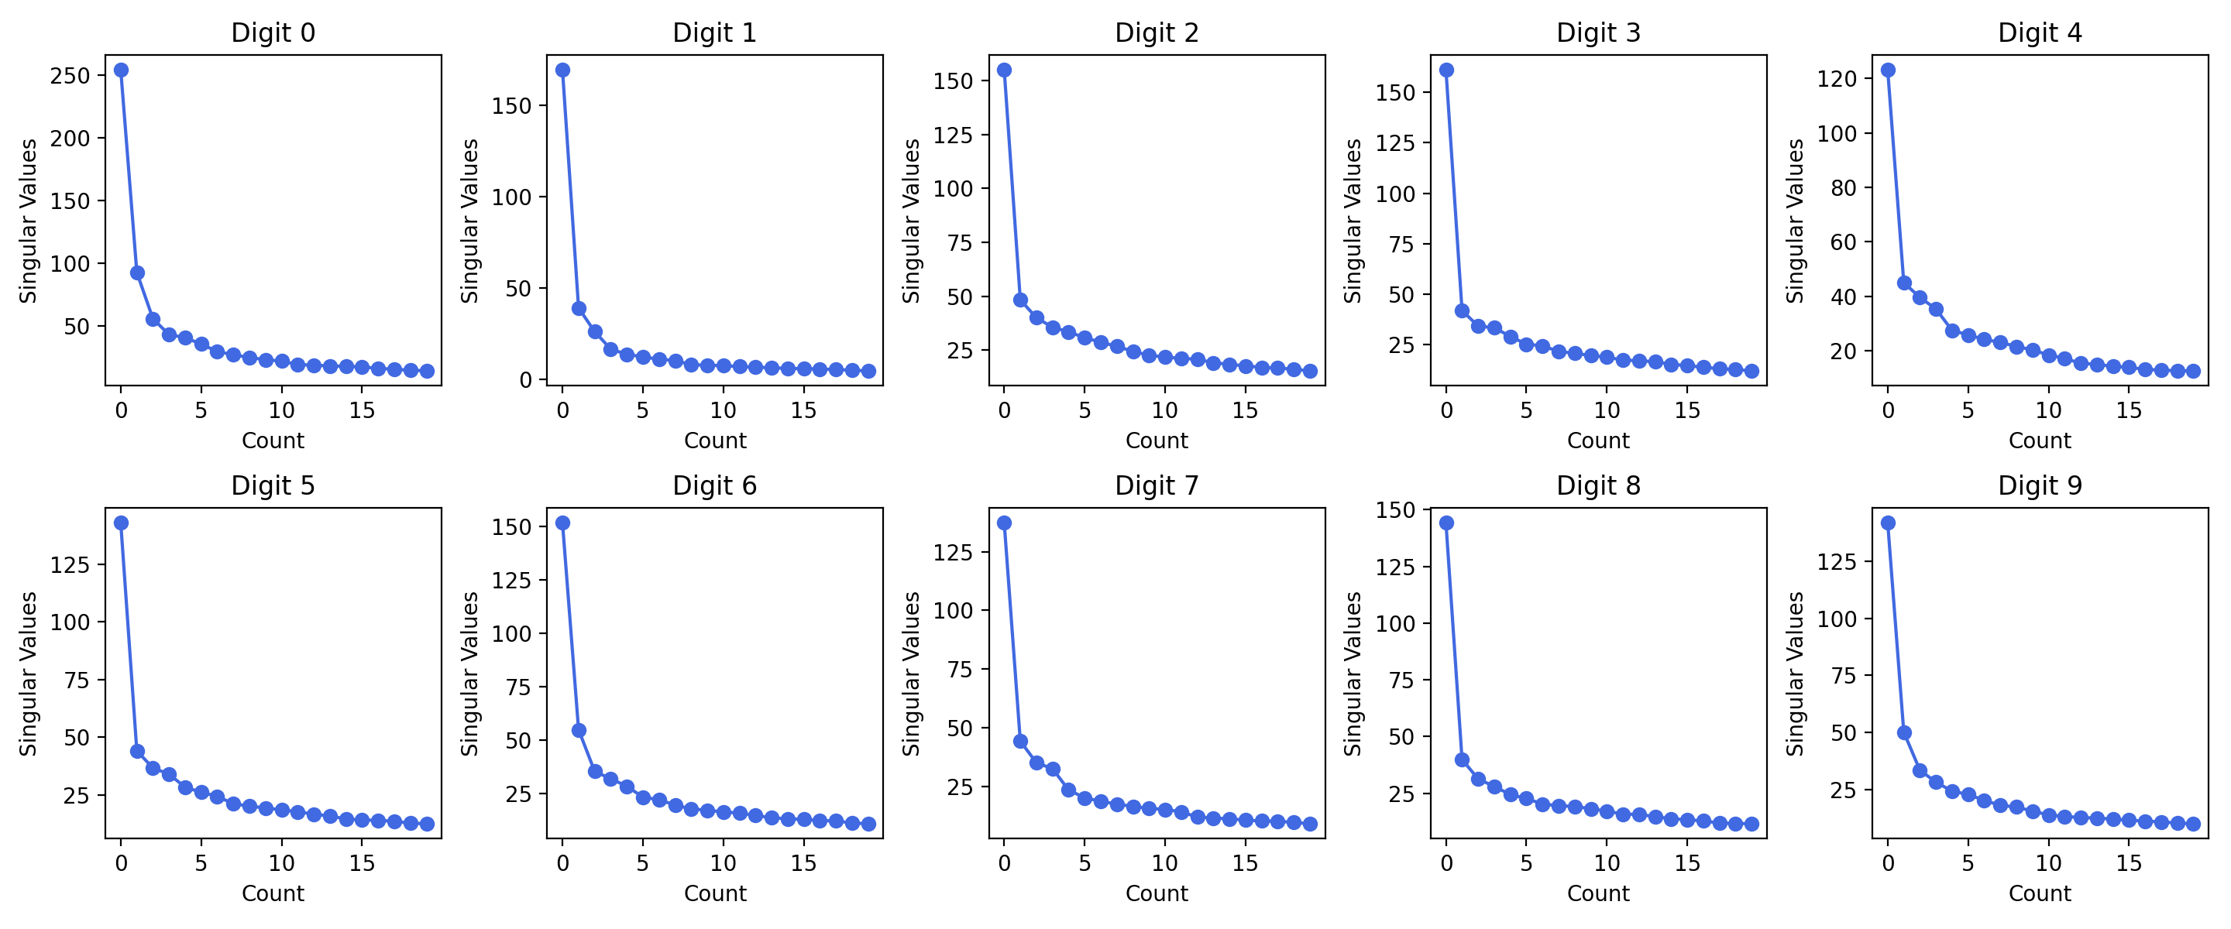
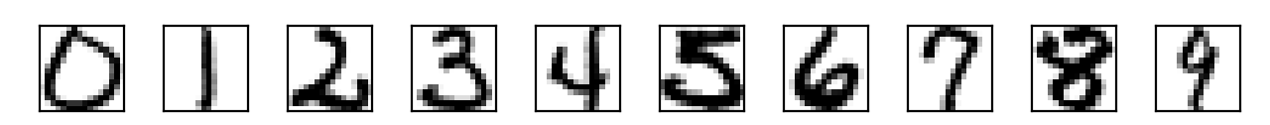
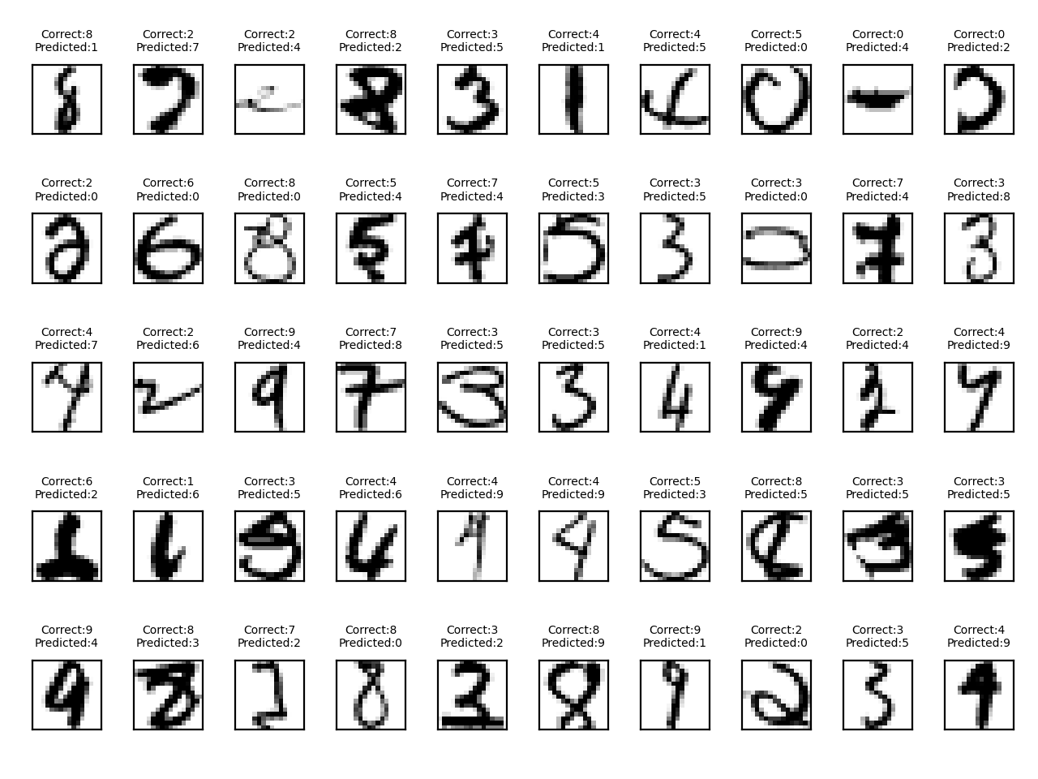
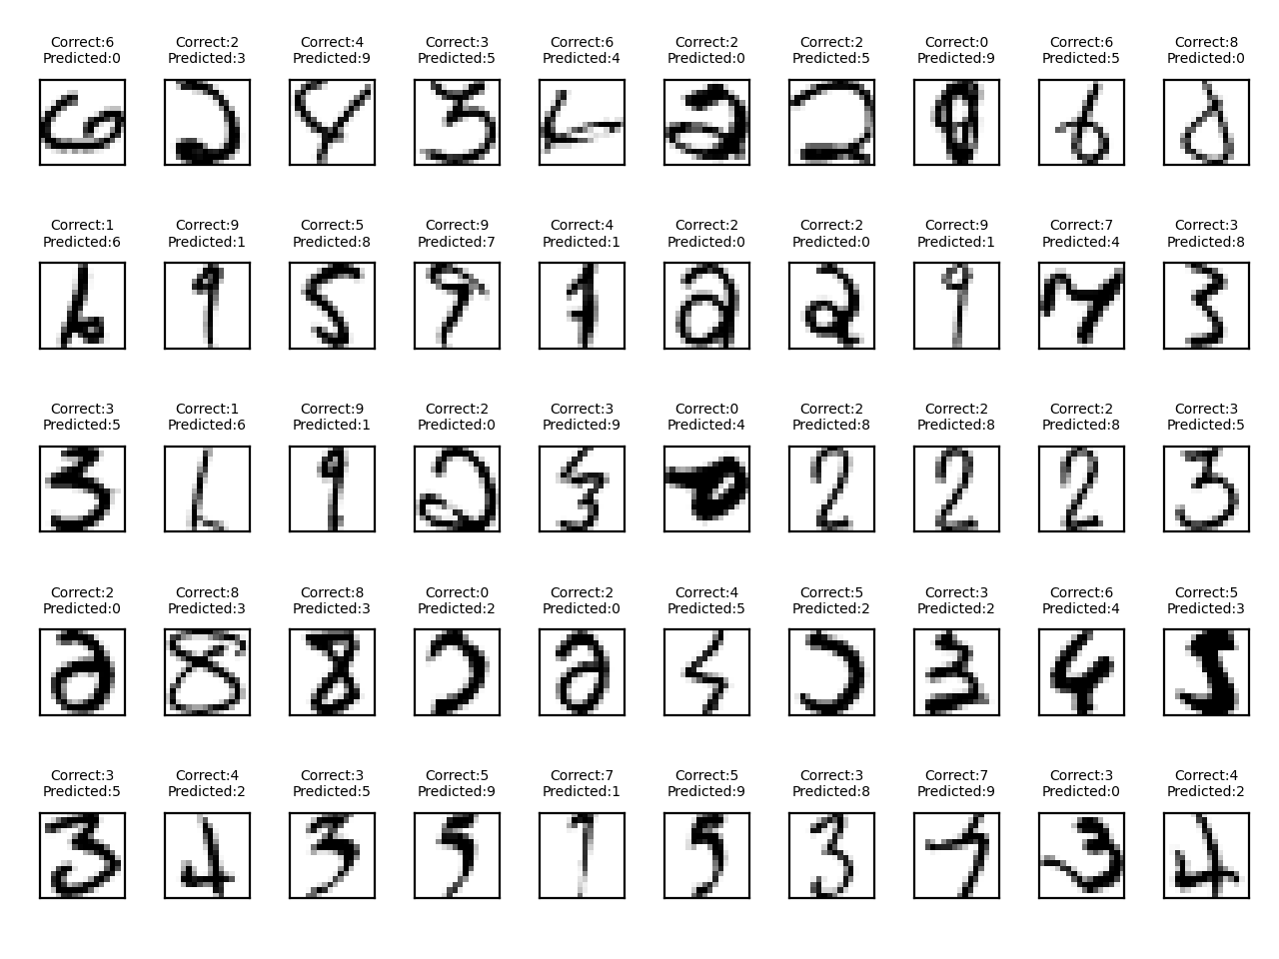
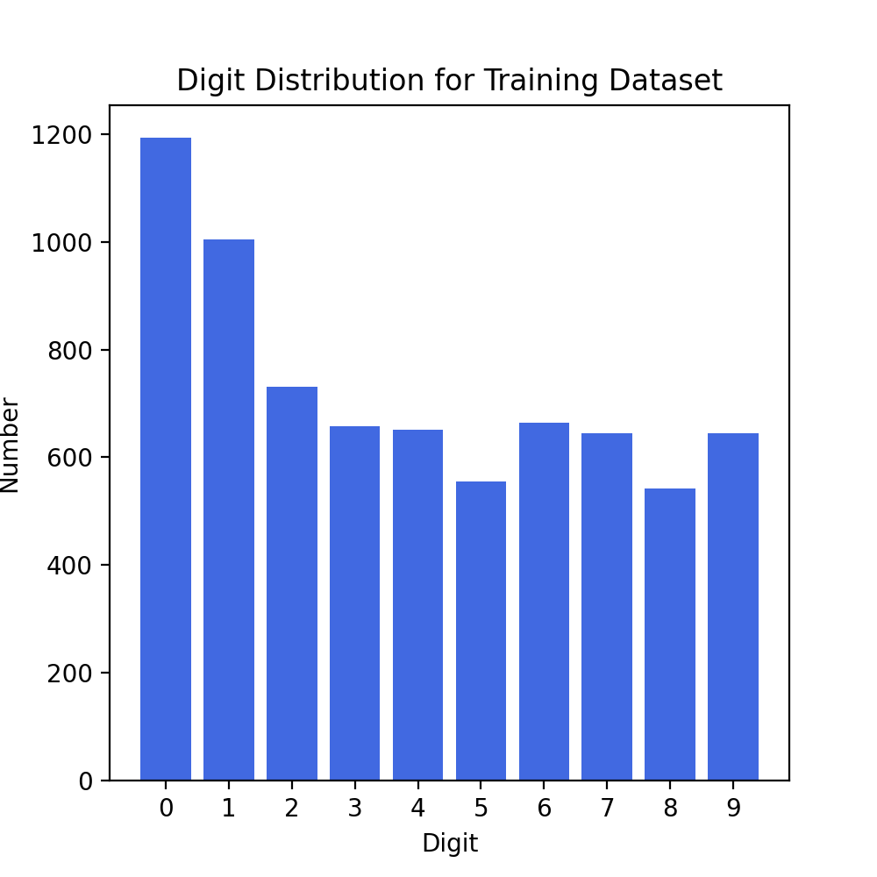
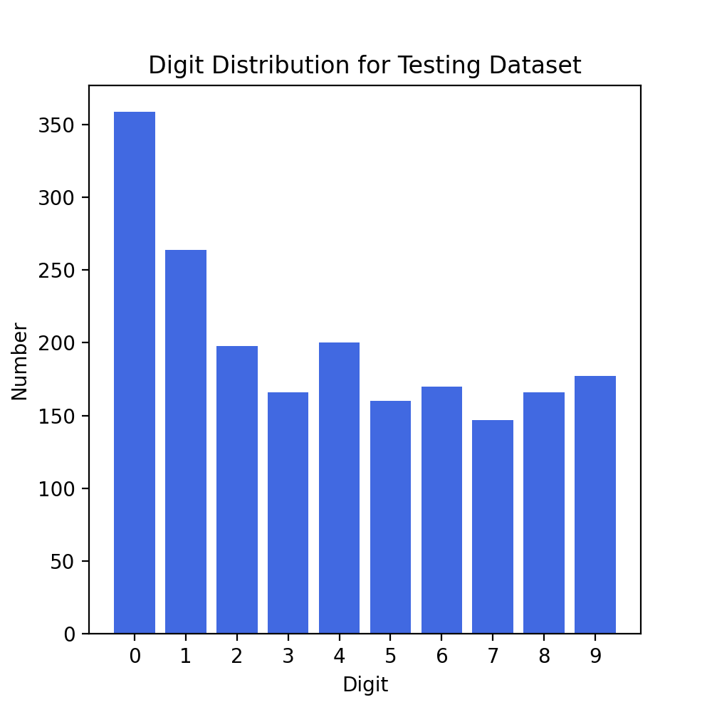
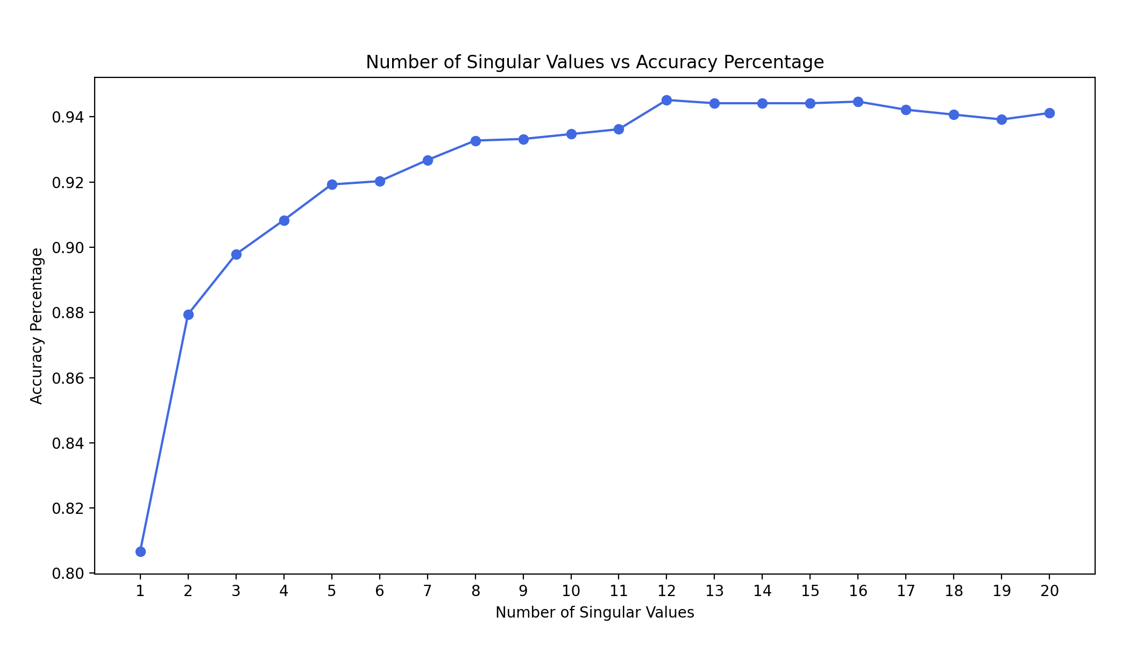
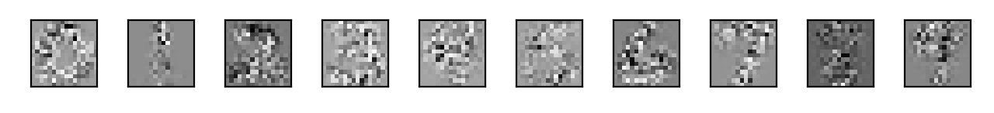

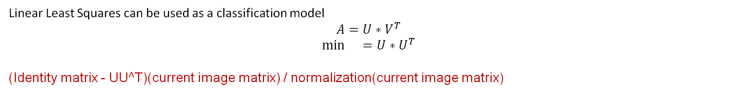
Machine Learning: Handwritten Digit Recognition Using Singular Value Decomposition
Webster Gordon, Justin Nichols, Mollee Swift
Overseen by: Frederic Marazzato & Peter Wolenski
Department of Mathematics, Louisiana State University, Spring 2022
Introduction
Methods
Results
Machine learning is a computer procedure in which an algorithm improves its accuracy through the process of iterative data analysis. Machine learning algorithms build a model on a given dataset (the training data) to then make predictions on an unseen dataset (testing data). Singular Value Decomposition (SVD) is an algebraic method that simplifies high-dimensional data for use in machine learning algorithms. In our analysis, we used SVD to reduce the dimensionality of our data and used Linear Least Squares as our classification method.
Singular Value Decomposition is the factorization of a rectangular matrix into three components:
$A=U∗Σ∗V^{T}$
$Σ$ is a diagonalized matrix containing singular values in descending order of importance. $U$ is an orthogonal matrix composed of the left eigenvectors, while $V^{T}$ is an orthogonal matrix composed of the right eigenvectors.
The matrices A which we decomposed with SVD were the result of grouping the 16x16 matrices from the training set by their label (0-9), converting to 256x1 row vectors, and stacking them into an Nx256 matrix, where N = number of data points with each label.
Technologies and packages used: Python using the Anaconda distribution, Skikit-Learn, Numpy, h5py, matplotlib.
We applied classification model Linear Least Squares in python to achieve an accuracy of 94.52% on the prediction of digit values from the testing dataset. Thus, out of 2007 test values, 1,897 were classified correctly.
The individual success rate of each digit
Data Set & Objective
Using handwritten digits from the United States Postal Service, we plan to use SVD to train our model to learn the numbers 0-9. The goal is to then given our model a new data sample containing an unseen written single digit and test if the model can accurately predict the value of the digit. We decided to use SVD over Principal Component Analysis (PCA), because SVD is more efficient than PCA when working with dense data.
We printed a sample of the 110 misclassified digits. When evaluating the correct digit versus the predicted values, there are many patterns in the misclassification. Any digit written with a larger inner circle was often recognized as a zero, while any digit extremely thin was recognized as a one. Many of the misclassifications were a result of placement and skewedness, the contrast visualized against the rank twelve matrix approximations.
Figure 1: Original image samples of each digit from dataset.
Figure 5: Plot of first 20 singular values for each digit, 0 through 9.
Our dataset comes from the USPS.¹ The dataset contains 7291 training and 2007 test images in h5 format, represented as 16 by 16 matrices of 8-bit (0-255) grayscale values. Our training set represents approximately 80 percent of the data, and the testing set is around 20 percent.
Linear Least Squares can be used as a classification model
$$A=U∗V^{T}$$
$$\min{}=U∗U^{T}$$
(Identity matrix - UU^T)(current image matrix) / normalization(current image matrix)
Figure 7: Misclassified digits.
Conclusion
CONCLUSIONNNNNN
Figure 2 & 3: Digit distribution for training and testing dataset, respectively.
We organized the data into different digit sets and performed SVD on each digit set and computed the rank twelve matrix approximations.
Figure 4: Rank twelve matrix approximations images for each digit.
Figure 6: Plot comparing the classification accuracy percentage to the rank of the singular value approximation.
We would like to extend our gratitude to Frederic Marazzato for his assistance.
1 - https://www.kaggle.com/bistaumanga/usps-dataset
Notes:
Still need to work on methods….SVD, LLS, and describing what the singular value plots are and their importance. For results…accuracy, etc. Need conclusion.

