Slide 1
Temporal Horizon Representations
as causal and online oversight signals
4
3
4
RQ47 final technical presentation
models
probe methods
causal tests

Slide 2
The Whole Story
A coherent path from representation evidence to oversight evidence.
1. Decode
2. Validate
3. Intervene
4. Monitor
Can a probe read short-term vs long-term horizon?
Does the signal transfer to explicit temporal examples?
Does changing the representation move model logits?
Does the signal move while behavior unfolds?
The claim grows only when each stage supports the previous one.

Slide 3
Experimental Map
The artifacts line up with the research progression.
Train probes
Validate probes
Select layers
Intervene
Monitor tokens
Probe training/validation creates layer-wise evidence and saved probes.
The notebooks 03.1 and 03.2 turn the method/model results into validation figures.
RQ47 intervention and trajectory scripts test whether the probe signal matters and moves online.

Slide 4
Dataset And Probe Setup
Implicit temporal CAA pairs train the probe; explicit temporal examples test semantic transfer.
Training
Validation
Why It Matters
Implicit AB-randomized temporal CAA examples
Immediate and long-term options become balanced labels
Pair-aware split avoids separating related examples
Reload saved implicit-trained probes
Score explicit temporal examples layer by layer
Choose best semantic layer by explicit accuracy
Success means the probe learned temporal horizon, not only one dataset's wording
Layer-wise results tell causal experiments where to intervene

Slide 5
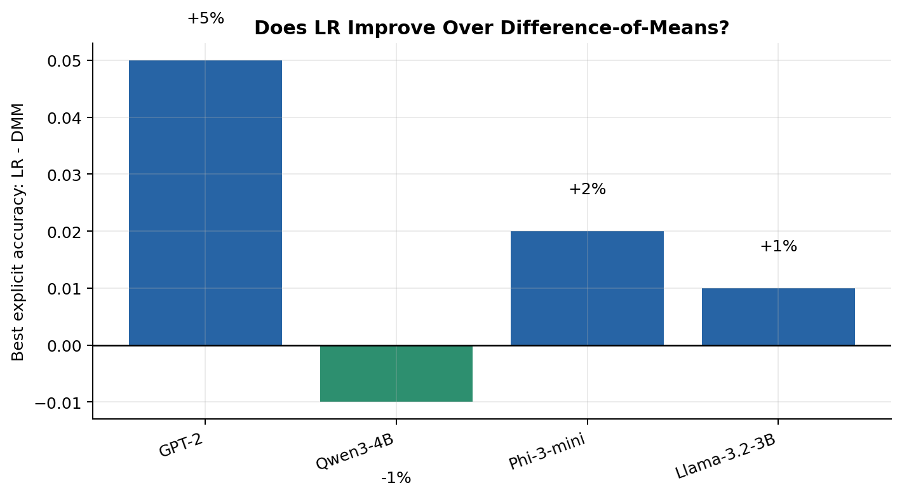
Probe Methods
Three probes ask whether temporal horizon is visible in hidden states or attention summaries.
Probe | Feature source | Interpretation
LR | Hidden state | Learned boundary; strongest flexible linear baseline
DMM | Hidden state | Simple temporal direction; useful as interpretable baseline
AttnProbe | Attention summaries | Tests whether attention distribution statistics carry signal
100%
70%-75%
Meaning
best hidden-state probe
AttnProbe range
LR and DMM both finding signal is important: one is a learned classifier, the other is a simple average-difference direction. Agreement makes the representation less likely to be an artifact of one probe family.

Slide 6
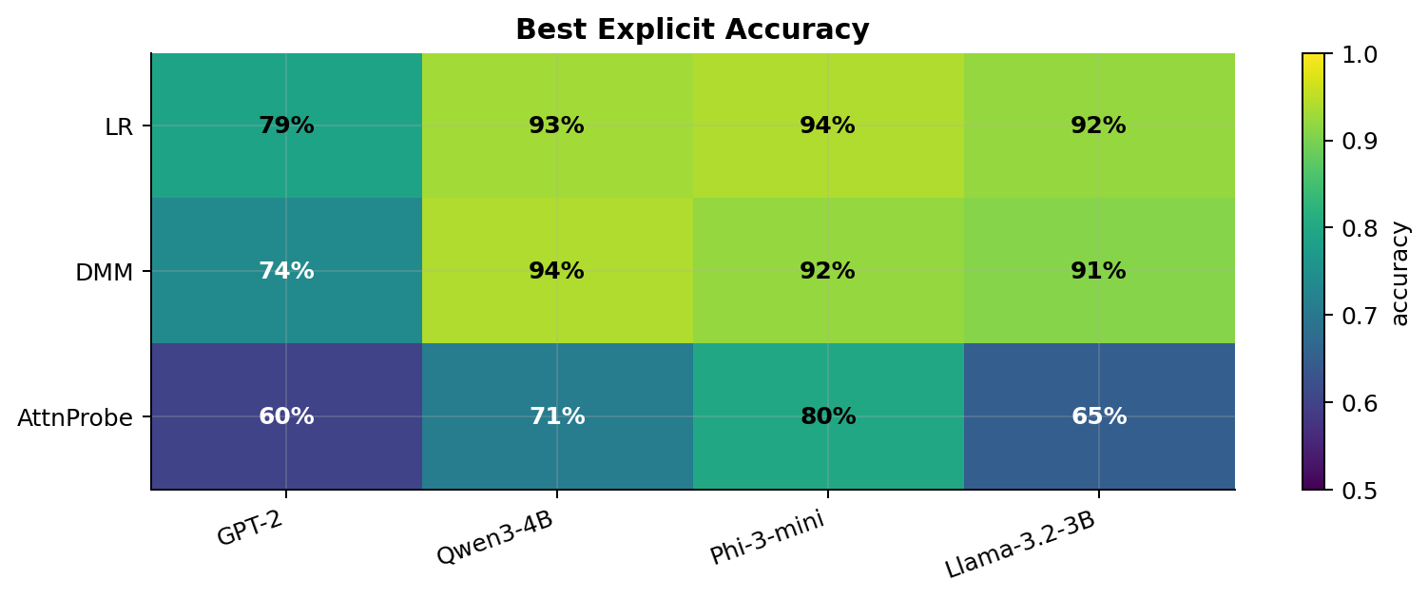
Finding 1: The Signal Generalizes
Best explicit validation accuracy across all model/method cases.
What The Heatmap Means
Each cell is the best explicit validation accuracy for one probe/model pair. The best case is LR on microsoft__Phi-3-mini-4k-instruct at layer 17, with 94% explicit accuracy.
Why It Matters
The probes were trained on implicit examples. High explicit accuracy means the representation transfers to a different temporal framing, so the probe is not merely memorizing superficial wording.
Validation threshold passed by all cases: no

Slide 7
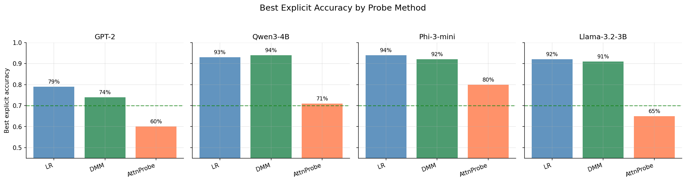
Finding 1 Detail: Method Comparison
The earlier all-method notebook shows which probe wins per model.
What The Bars Mean
For each model, the bars compare the best explicit accuracy reached by LR, DMM, and AttnProbe. The dashed line marks the 70% semantic-validation threshold.
Why It Matters
The highest average explicit accuracy by method is LR at 82%. Hidden-state probes usually dominate, while attention summaries still carry weaker but real signal.

Slide 8
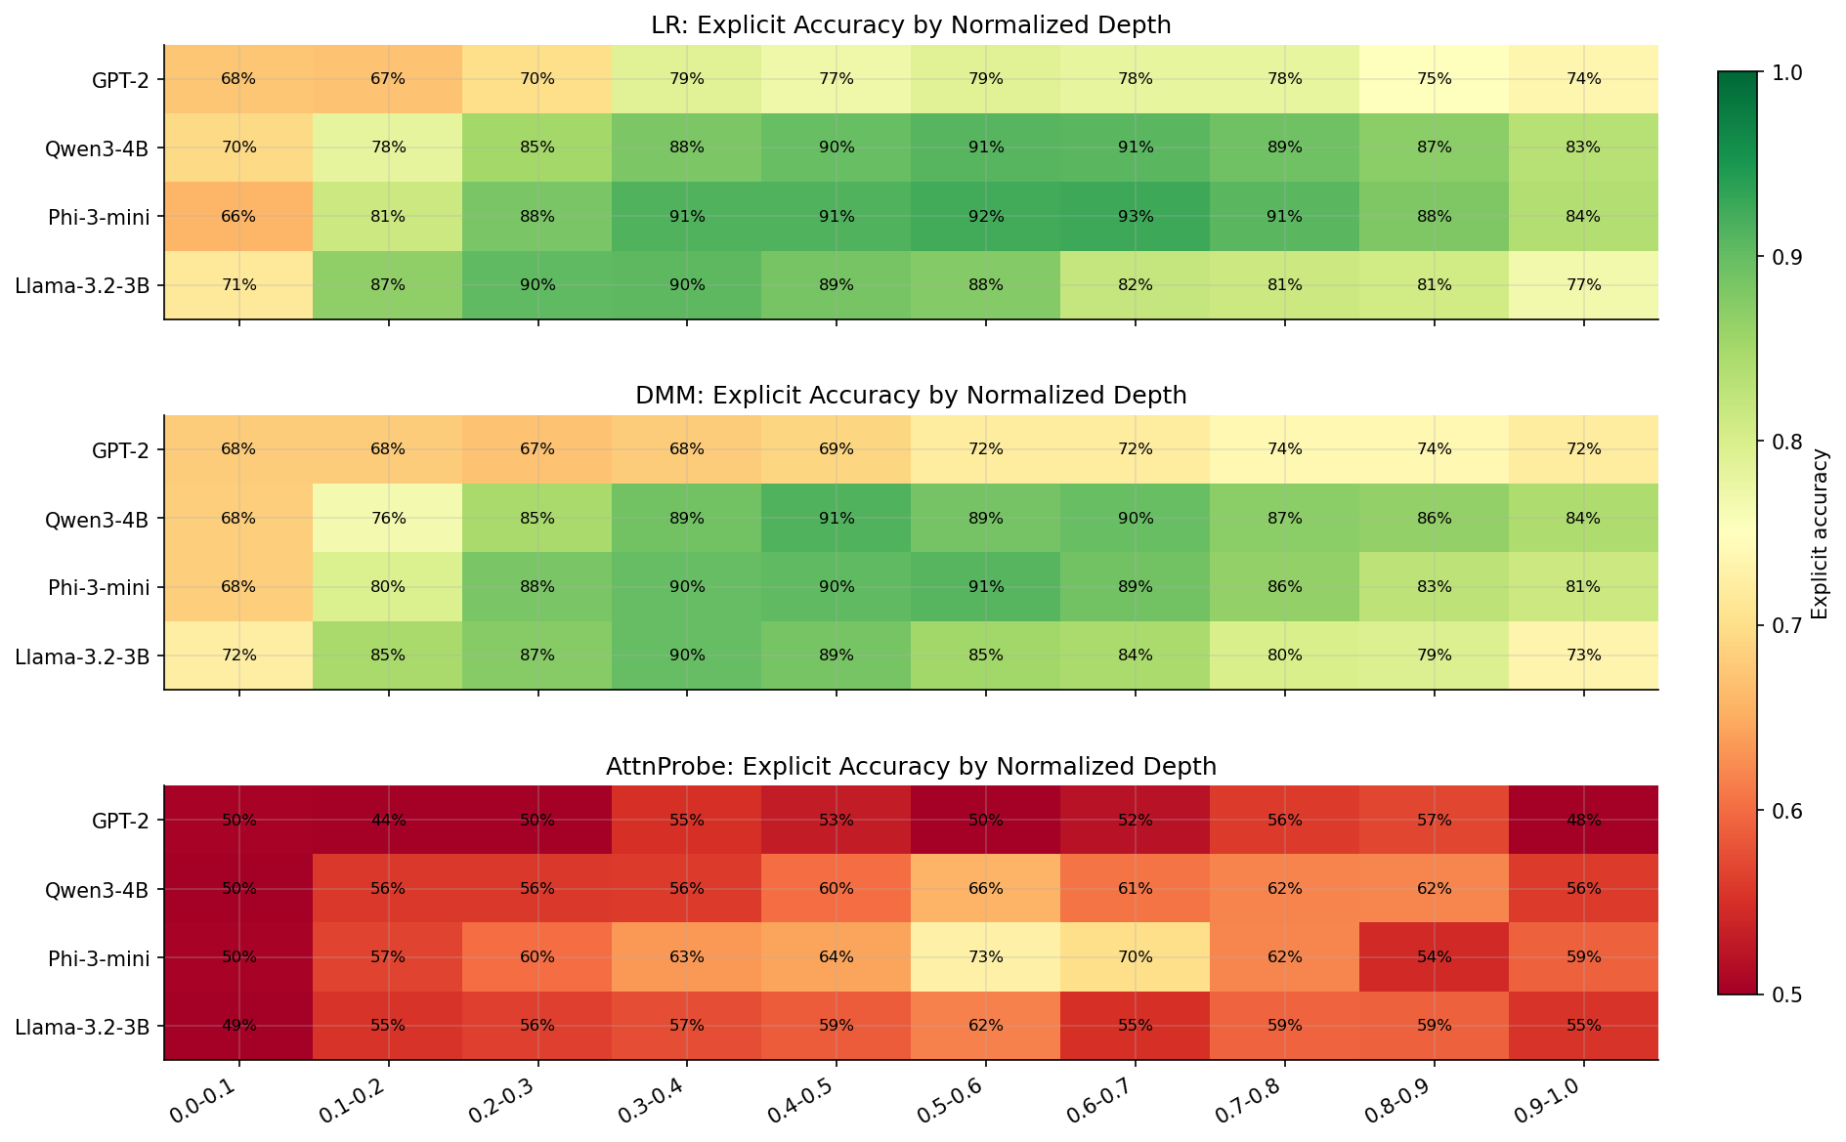
Finding 2: The Signal Has A Depth Profile
Normalized depth makes architectures with different layer counts comparable.
What This Means
Why It Matters
Each row is a model, each column is a normalized depth bin, and each panel is a probe method. Brighter cells mean stronger explicit temporal-horizon decoding at that relative depth.
This answers where to look. The causal experiments use probe-selected layers rather than arbitrary layer choices, so the validation analysis directly informs intervention design.

Slide 9
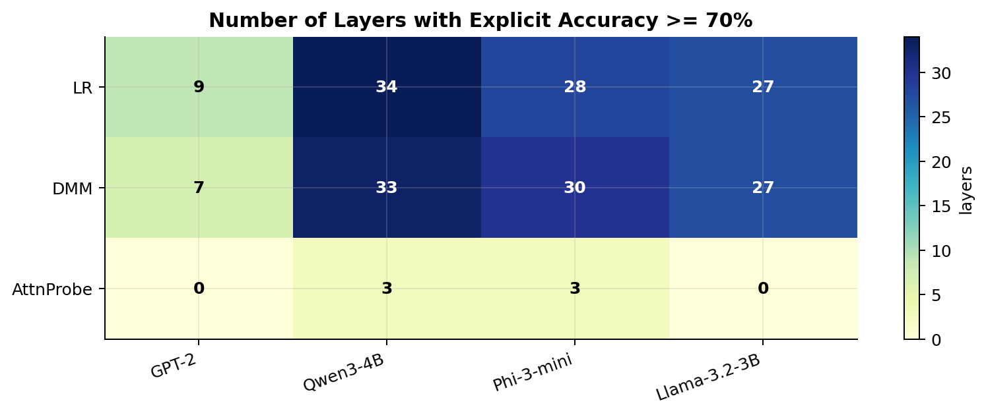
Finding 2 Detail: Semantic Layer Coverage
Some models have broad temporal-horizon bands; others have narrower windows.
What The Counts Mean
A higher count means more layers clear the 70% explicit validation threshold. Broad coverage means the representation is accessible across a larger depth range.
Why It Matters
If only one layer works, causal results may be fragile. If many layers work, the temporal signal is more distributed and layer selection is less brittle.

Slide 10
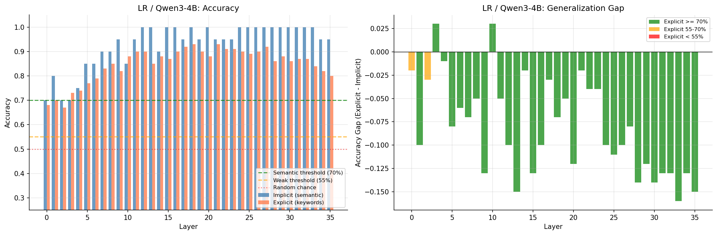
Finding 3: Explicit And Implicit Curves Track Layer Behavior
A single-case view shows what the layer curves are doing.
What To Look For
The left panel compares implicit training/test behavior with explicit validation by layer. The right panel shows the explicit-minus-implicit gap and colors layers by semantic strength.
Why It Matters
Layer curves reveal whether validation success is isolated, broad, or shifted relative to implicit training. That prevents a single best-layer number from hiding the shape of the result.

Slide 11
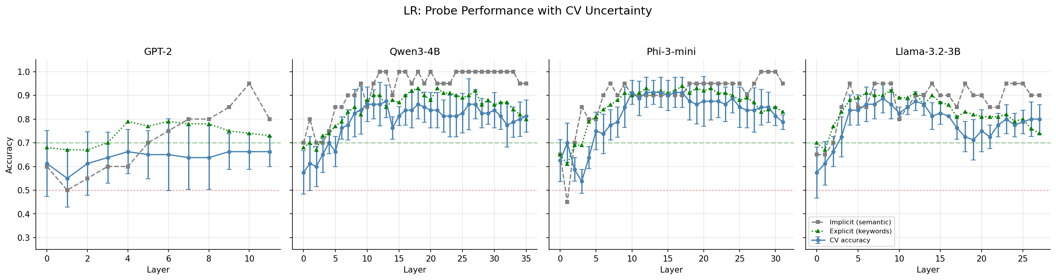
Finding 4: Cross-Validation Supports The Probe Signal
CV curves add uncertainty around the implicit-training probe performance.
What The Error Bars Mean
The LR CV figure reports pair-aware cross-validation on implicit examples, alongside implicit and explicit layer accuracy. Stable high CV reduces concern that a layer is just a split accident.
Why It Matters
The deck's later causal claims depend on choosing credible layers. CV diagnostics help justify those layer choices before interventions are run.

Slide 12
Bridge: From Reading A Signal To Testing A Mechanism
A probe can be accurate without being causal, so the next experiments intervene.
Steering
Activation patching
Add a temporal direction and measure short-vs-long logit shift
Patch clean activations into corrupted prompts and measure recovery
Attribution patching
Ablation
Use activation gradients as a first-order patch estimate
Remove or replace component outputs and measure drop
Interpretation rule: causal evidence is strongest when multiple intervention views point to the same model/layer/component pattern.

Slide 13
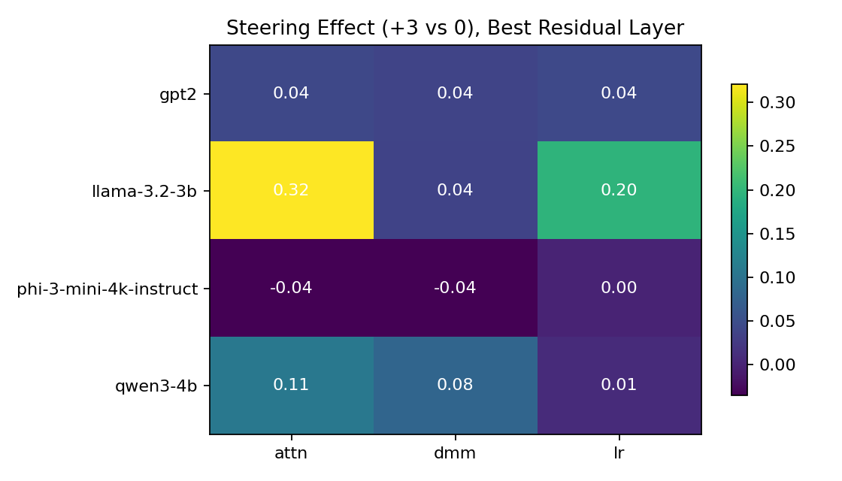
Causal Finding: Steering Moves The Logits
Adding the temporal direction tests whether the representation is behaviorally active.
What The Heatmap Means
Cells show the average logit shift from +3 steering versus no steering at the best residual layer. Larger positive values mean the temporal direction moves the model toward the targeted long-vs-short preference.
Why It Matters
Steering is a direct causal manipulation. If adding the direction changes logits, the probe direction is not only readable; it is connected to the model's decision surface.

Slide 14
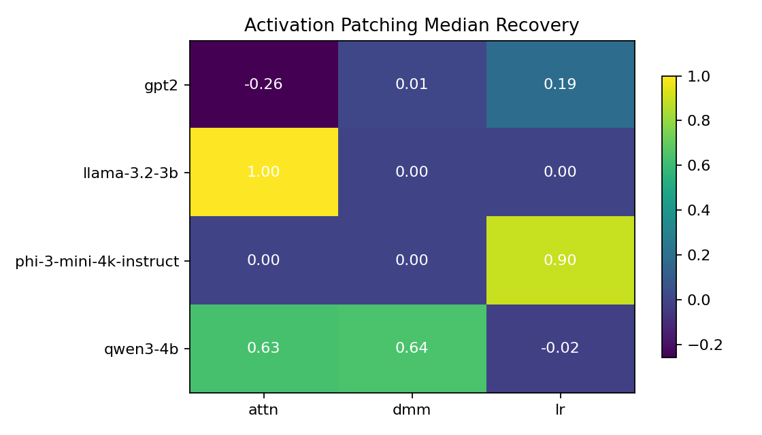
Causal Finding: Activation Patching Recovers Behavior
Clean activations can restore clean temporal choices on corrupted prompts.
What The Heatmap Means
Cells report median normalized recovery from patching clean residual activations into corrupted prompts. Values near 1 mean the patch recovers most of the clean-vs-corrupt logit difference.
Why It Matters
Patching localizes function. When clean activations repair corrupted behavior, that layer/component is carrying information used by the downstream computation.

Slide 15
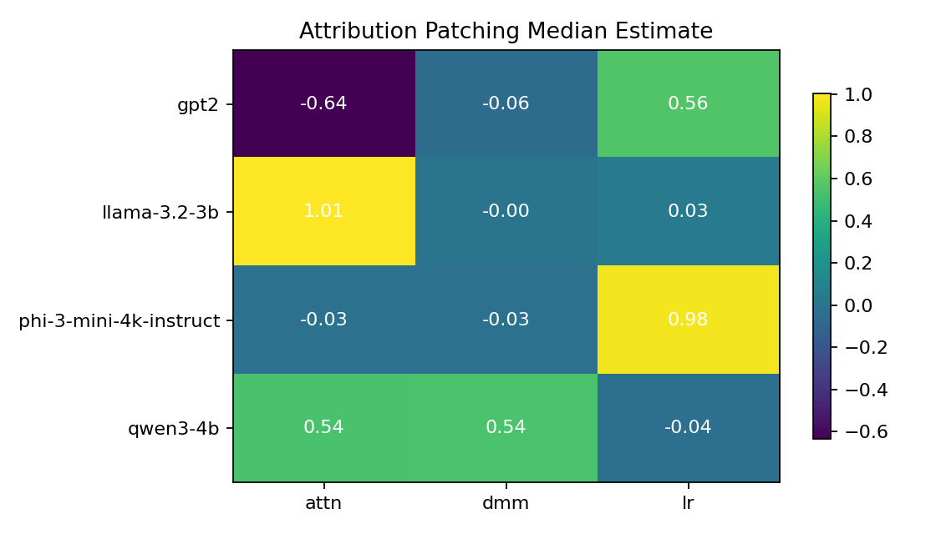
Causal Finding: Attribution Patching Is A Fast Cross-Check
Gradient estimates often highlight similar residual-stream effects.
What The Heatmap Means
Cells estimate the activation-patching effect using activation gradients. It is a first-order approximation rather than a full forward patched run.
Why It Matters
Agreement between activation patching and attribution patching is evidence that the identified layers are not a one-off artifact of one intervention method.

Slide 16
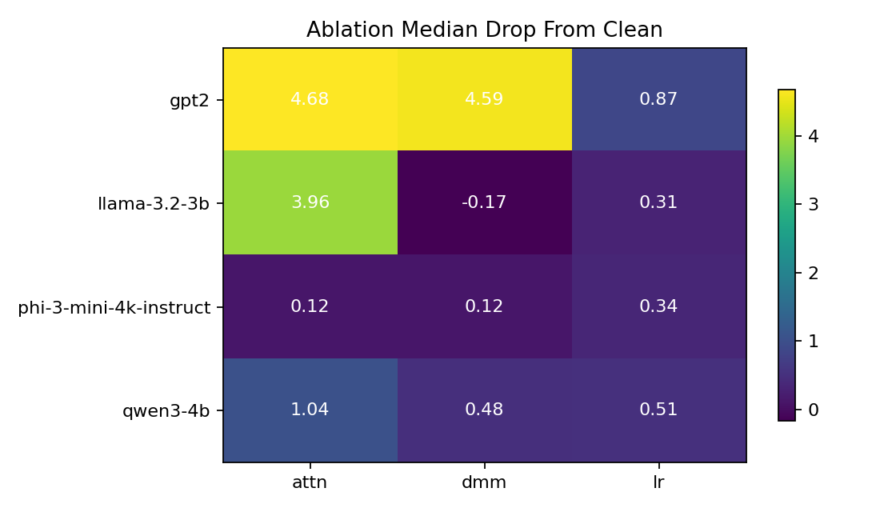
Causal Finding: Ablation Shows Dependence
Removing residual information can reduce clean temporal behavior, with noisy edge cases.
What The Heatmap Means
Cells show median drop from clean behavior after ablating the selected residual layer. Positive values mean removing the component damaged the clean temporal signal.
Why It Matters
Ablation asks the inverse question from patching: not can we add the signal back, but does removing it hurt? Together they make the causal story more complete.

Slide 17
Causal Synthesis
The result is not one universal layer; it is a repeated residual-stream pattern with model-specific strength.
Model | Selector | Activation recovery
llama-3.2-3b | attn | 1.00
phi-3-mini-4k-instruct | lr | 0.90
qwen3-4b | dmm | 0.64
qwen3-4b | attn | 0.63
gpt2 | lr | 0.19
Residual stream is the most consistent component-level site across steering, patching, and ablation.
Model and selector matter: Phi-3 LR, Llama Attn-selected, and Qwen DMM/Attn patterns are the clearest cases.
Top-k layer runs are best interpreted as robustness checks rather than the main headline.
Why This Is The Right Claim
The causal evidence is meaningful but heterogeneous. The careful conclusion is that temporal horizon is causally relevant in several settings, not that every model uses an identical circuit.

Slide 18
Online Oversight Setup
Probe scores are recorded at the prompt end and after every generated token.
Prompt
Generate token
Extract hidden state
Score probe
Detect event
What The Monitor Measures
Why It Matters
For each prefix, it records the probe score at selected layers and marks the first step where a lightweight event detector fires.
This turns a static representation into an online signal. If score drift precedes the event, the representation may provide early warning rather than post-hoc explanation.

Slide 19
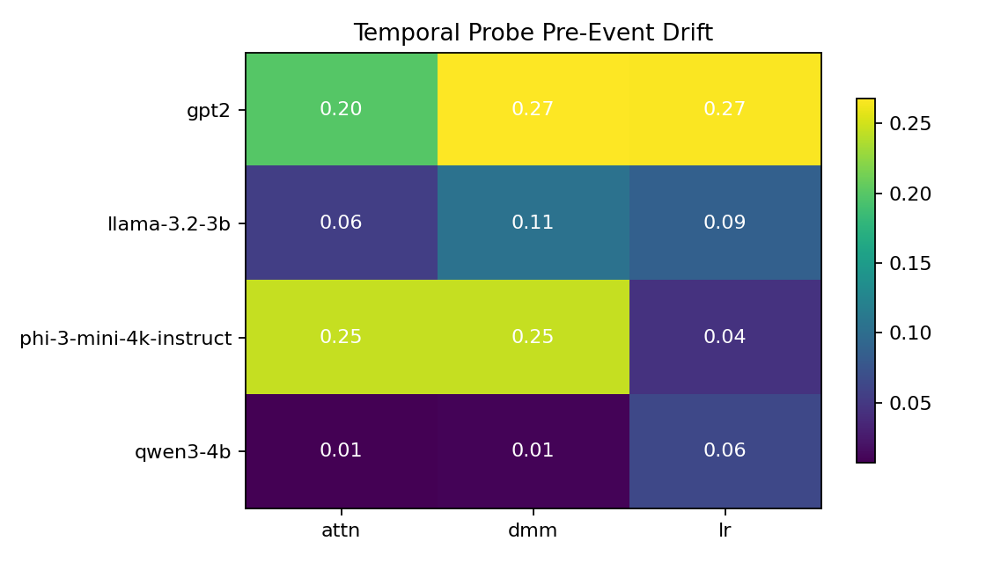
Online Finding: Pre-Event Drift Appears
The heatmap summarizes median score increases before keyword-detected events.
What The Heatmap Means
Each cell is the median increase from initial probe score to the maximum score before an event. Larger values mean stronger precursor drift.
Why It Matters
The strongest drifts show that the temporal signal can move before the detector fires. This is evidence for a monitoring pipeline, not yet a final safety detector.

Slide 20
Online Finding Detail: Top Pre-Event Drifts
Concrete examples make the heatmap easier to interpret.
Model | Prompt | Sel. | Drift | Event
gpt2 | sycophancy_budget_01 | lr | 0.65 | 12
phi-3-mini-4k-instruct | short_term_pressure_01 | dmm | 0.57 | 37
phi-3-mini-4k-instruct | short_term_pressure_01 | attn | 0.57 | 37
gpt2 | sycophancy_budget_01 | dmm | 0.46 | 12
gpt2 | sycophancy_budget_01 | attn | 0.29 | 12
gpt2 | deception_status_01 | dmm | 0.27 | 13
What The Rows Mean
Each row is one model/prompt/selector case where the probe score rose before the first keyword event. Drift is the pre-event score increase.
Why It Matters
Examples like GPT-2 sycophancy and Phi-3 short-term pressure show the monitor can surface specific precursor traces for deeper qualitative review.

Slide 21
Limitations
The evidence is useful, but the final safety claim needs stronger detectors and broader sampling.
Keyword event detector validates the pipeline, not a final safety classifier.
Online monitoring currently covers a small prompt set; more prompts are needed for confidence intervals.
Ablation is component-level across Hugging Face models; per-head ablation remains future work.
Some normalized patching and ablation scores are unstable when baseline denominators are small.
The trajectory monitor recomputes full prefixes for clarity and portability; a KV-cache version would be faster.

Slide 22
Conclusion And Next Work
Temporal horizon is decodable, causally relevant in several settings, and monitorable during generation.
Decodability: hidden-state probes validate across GPT-2, Qwen3-4B, Phi-3-mini, and Llama-3.2-3B.
Causality: steering, patching, attribution, and ablation identify meaningful residual-stream intervention sites.
Online monitoring: pre-event probe drift appears in several trajectories.
Next: replace keyword detector, join classifier scores, expand prompts, add per-head ablations, and quantify uncertainty.
Bottom line
The signal is readable, often causally relevant, and usable as a monitoring trace.

