Slide 1




A big thanks to NashDotNet’s sponsors!
Our “Rock Star” sponsors ($1,000 per year)
Our VIP sponsor ($500 per year)

Slide 2

Intro to RavenDB with NancyFX

Slide 3
A little about me
Justin Soliz
@justinsoliz
www.justinsoliz.com

Slide 4
Slides and Samples Available on Github
https://github.com/justinsoliz/ravendb_nancyfx_presentation

Slide 5

Before we begin...

Slide 6
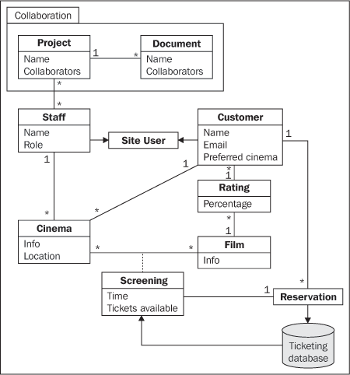
Relational Database

Slide 7

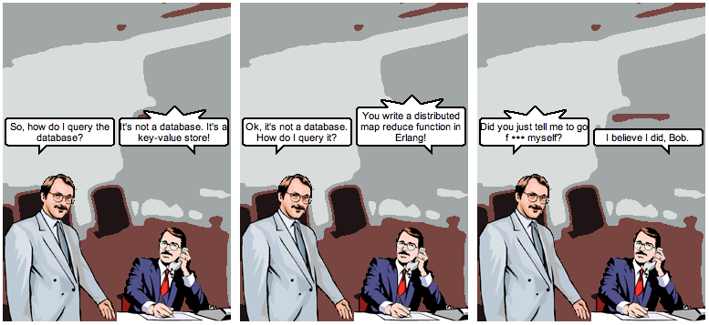
@jrecursive

Slide 8

So what’s out there?

Slide 9

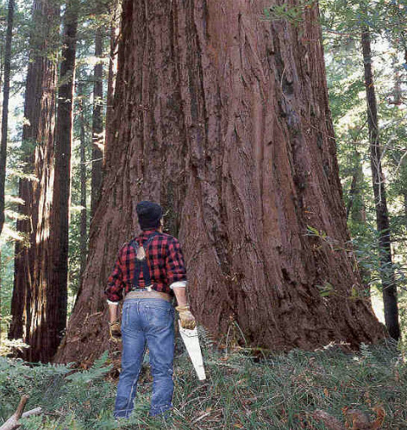

Slide 11
What is Raven?
Raven is a .NET Linq enabled Document Database, focused on providing a high performance, schema-less, flexible and scalable NoSQL data store for the .NET and Windows platforms.

Slide 12

Ok... So what does that mean?

Slide 13
What it offers
Linq
Transactions
Safe by default
Ad hoc queries
Extensibility
Live Projections
Replication
Replicate to RDBMS
Set based operations

Slide 14
RESTful Architecture
Documents - http://localhost:8080/docs/{document_id}
Attachments -http://localhost:8080/static/{attachment_path}
Index –
http://localhost:8080/indexes/{index_id}

Slide 15
The API
IDocumentStore
IDocumentSession
IDocumentQuery

Slide 16

Micro web frameworks
Use only what you need...

Slide 17

NancyFX a Sinatra inspired framework
require ‘sinatra’
get ‘/’ do
‘Hello World’
end

Slide 18
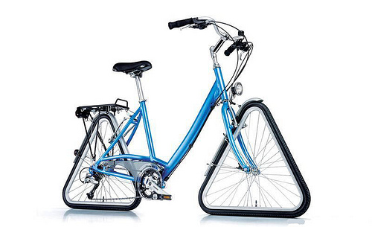
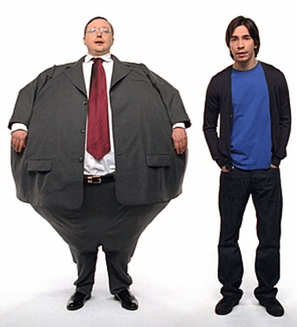
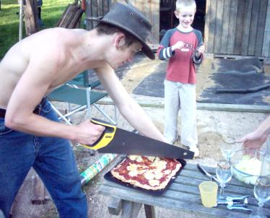
What it isn’t
Asp.Net MVC Nancy

Slide 19
Hosting options
Asp.Net
Self-hosted
Wcf
OWIN

Slide 20

The middleman
Some common middleware...
Rack
WSGI
OWIN

Slide 21
OWIN
Open Web Interface for .Net
Available Kayak, Mono etc..
Who uses it?

Slide 22
Bringing it together

Slide 23
Questions/Comments
Presentation Slide and Samples
https://github.com/justinsoliz/ravendb_nancyfx_presentation

