Slide 1
Budget Impact Analysis
Created by the School of Pharmacy Relations Committee for AMCP
Updated: October 2021

Slide 2
Overview
Introduction to budget impact analysis (BIA)
Differentiation between BIA vs. cost-effectiveness analysis (CEA)
Designing BIA
Considerations and models for conducting BIA
Helpful resources

Slide 3
Introduction of BIA

Slide 4
Definition of BIA
A budget impact analysis (BIA) is:
an evidence-based analysis used to assess the financial consequences of the adoption of a new intervention, given the available budget and resources.
Notes:
https://www.herc.research.va.gov/include/page.asp?id=budget-impact-analysis

Slide 5
Purpose of BIA
BIA is essential for budget and resource planning as it aids decision-making for reimbursement authorities/budget holders/payers.
Formulate a short term (typically 1 to 5 years) estimate of the changes in expenditure, cost, and healthcare utilization after the adoption of a new intervention.
Predict the budget impact of a new intervention in the population.
Predict the characteristics of the population and the healthcare system after adoption of the new intervention.
Notes:
Include different perspective (societal, payers [medicare, PBM, etc)

Slide 6
Differentiation between BIA vs. CEA
Budget impact analysis (BIA) | Cost-effective analysis (CEA)
BIA assesses the financial consequences of a new intervention given the available resources and budget. | CEA evaluates the value of a new intervention relative to current ones.
The time horizon is usually short (1 to 5 years). | The time horizon is long (can be a life-time horizon).
BIA estimates costs and changes in costs. | CEA estimates the cost per clinical outcome, such as life years (LY) and quality-adjusted life years (QALY) gained.
The results are reported in cost per member per month (PMPM). | The results are reported in incremental cost-effectiveness ratio (ICER).
Notes:
Cost-effective analysis is typically accompanied budget impact analysis and they are often used in regional or national health system decision making.

Slide 7
Designing BIA

Slide 8
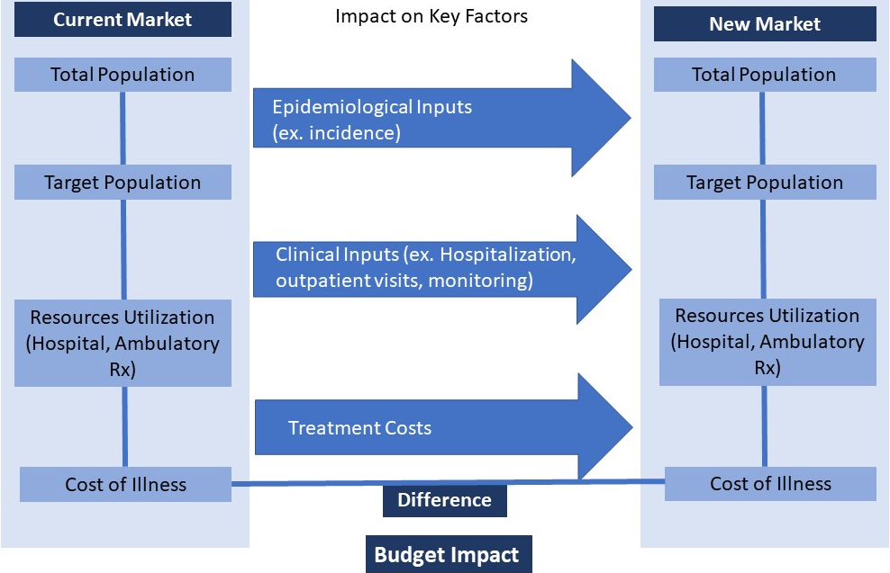
BIA Overview
Notes:
Sullivan SD, Mauskopf JA, Augustovski F, Caro JJ, Lee KM, Minchin M, Orlewska E, Penna P, Barrios JM, Shau WY. Budget impact analysis—principles of good practice: report of the ISPOR 2012 Budget Impact Analysis Good Practice II Task Force. Value in health. 2014 Jan 1;17(1):5-14. Available at: https://www.ispor.org/heor-resources/good-practices/article/principles-of-good-practice-for-budget-impact-analysis-ii

Slide 9
Identify budget holder/ perspective
Identify the budget holder for whom the BIA is conducted
- Is the budget holder a private payer or a regional/national healthcare system?
Consider the features that influence the budget and the coverage decision
- Who and what are being covered under the health system?
- What are the access restrictions to reimbursement?
Consider the perspective of the budget holder
- Should the BIA include healthcare costs only or other societal costs (travel expenses, lost productivity, unemployment benefits, etc.)?

Slide 10
What is the current intervention mix?
Identify the size of the total population (eg, plan size)
Identify the size of the target population (all patients eligible for the new intervention)
Identify the current interventions (comparators) being used and the market share of those interventions in the target population
- May include no intervention, alternatives, combination therapies, and off-label drugs.
- Often times nationally recognized treatment guidelines are a good source for identification of all potential comparators in a target population

Slide 11
Know the effect of the new intervention
Identify the role of the new intervention and its effect on the current market
Substitution: the new intervention replaces the current interventions.
Combination: the new intervention is used in combination with the current interventions.
Expansion: the new intervention is an alternative option for patients who have stopped or refused available interventions for any reasons.
Supportive care: the new intervention is used in a market where no active intervention is available.
Notes:
Possible roles of the new intervention in the current market:
Substitution: the new intervention replaces the current intervention(s).
Combination: the new intervention is combined with the current intervention(s).
Supportive care: the new intervention is used in a market with no active intervention currently.
Expansion: the new intervention is an alternative option for patients who have stopped or refused available interventions due to intolerance, adverse effects, etc.

Slide 12
Assumptions
Assumptions are often introduced when little or no data exist regarding various inputs in the model.
Assumptions must be stated clearly to ensure transparency.
Typical assumptions in a pharmacoeconomic study:
Cost considerations
Treatment mix (eg, market share)
Time horizon
Cycle length
Time dependency variables
Discount rate
Notes:
Diagnostic costs may not be included in the analysis if the costs are assumed to be same between the current and new scenario. Diagnostic costs may be considered if there are specific diagnostic costs related to the new intervention (eg, need for biomarker testing to identify patients eligible for a new drug).

Slide 13
Cost Considerations
Direct costs:
Cost in condition-related health care services; and any related diagnostic costs to identify these patients
This may include costs associated with the drug and each comparator (drug costs, costs of managing side effects, administration costs, monitoring costs)
Healthcare resource utilization/cost (any cost changes due to greater/fewer hospitalizations, ER visits, or outpatient visits)
Indirect costs:
Medical-related and non-medical related indirect costs (cost of social service, work productivity costs, and other costs)
Note that indirect cost is only considered if perspective of the BIA is from society or national healthcare system.
Notes:
Diagnostic costs may not be included in the analysis if the costs are assumed to be same between the current and new scenario. Diagnostic costs may be considered if there is a change in diagnostic tests for the new scenario.

Slide 14
Cost Examples
Direct Cost | Medical costs: •Medications •Medication monitoring •Medication administration •Patient counseling and consultations •Diagnostic tests •Hospitalizations •Clinic visits •Emergency department visits •Home medical visits •Ambulance services •Nursing services | Nonmedical costs: •Travel costs to receive health care •Nonmedical assistance related to the illness •Accommodations for patient or caregiver for out-of-town care •Childcare services
Indirect Cost | •Lost of productivity for patient •Lost of productivity for unpaid caregiver •Lost of productivity because of premature mortality •Intangible costs from pain, suffering, fatigue, and anxiety
Notes:
Rascati K. Essentials of pharmacoeconomics. Lippincott Williams & Wilkins; 2013 Nov 14.

Slide 15
Time horizon and Cycle Length
Time horizon
The time horizon for a BIA is directly relevant to the budget holder and is typically a short period of time (1 to 5 years).
Cycle length
The cycle length could be quarterly, annually, etc… depending on the needs of the budget holder.

Slide 16
Time Dependency and Discount Rate
Time dependency
Time-dependent variables (value of the currency, new intervention(s), new understanding of diseases, etc.) need to be captured in a BIA.
Discount rate
Most budget holders are interested in the budget/costs (dollar amount) at each point in time; therefore, discounting is not recommended in conducting a BIA.

Slide 17
Additional
Considerations

Slide 18
Budget Impact Model (BIM)
Provide detail description of the analysis in a recommended format
State all assumptions used in the model
Adopt inputs and data specific to the target population and the budget holder
Estimate average cost per member per month (PMPM) for the new intervention
Perform scenario analysis to account for different perspectives and scenarios

Slide 19
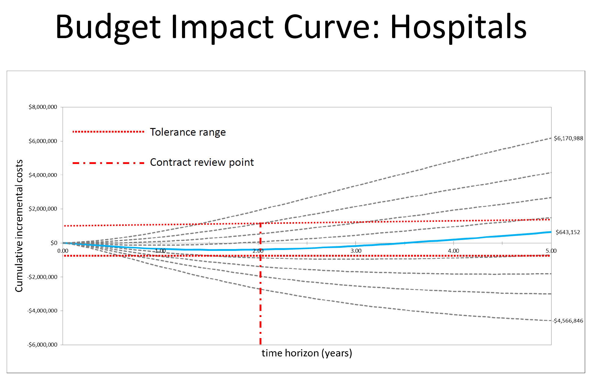
Example of a budget impact curve
Notes:
Example of a budget impact curve found at: https://noahe.ca/download/budget_impact_models.pdf

Slide 20
Uncertainty
Recognize that uncertainty may be present due to uncertainty in the input values and in introducing assumptions
Uncertainties in the input values
E.g.: efficacy and safety of the interventions, population size, costs, etc.
Uncertainties created by introducing assumptions
E.g.: changes in expected intervention patterns, introduction of new interventions, new restrictions for use, time to generic substitution, etc.
Notes:
May not need to include (summarize)
Frame different

Slide 21
Sensitivity Analysis
Assess the impact of assumptions made in a pharmacoeconomic study and the robustness of the data
Given the uncertainty of these assumptions, it’s important to understand which variables drive the biggest changes in the model to know where uncertainty might have the biggest impact on the model outcomes
Tests whether the outcomes are of the same direction or of a similar magnitude when these assumptions are varied (each assumption is varied higher or lower by a set percentage)
Tornado diagrams are commonly used to visually represent the impact of these variables

Slide 22
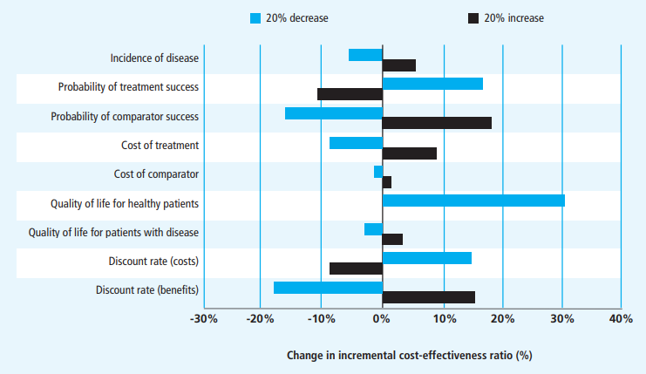
Tornado Diagram Example
Notes:
Typically in budget impact analyses, the X axis would be in dollars to show the variation in total budget impacted by the increase or decrease of each variable
http://www.bandolier.org.uk/painres/download/What%20is%202009/What_is_sens_analy.pdf
Taylor M. What is Sensitivity Analysis? York Health Economics Consortium. April 2009

Slide 23
Validation of BIM
Face validation with decision makers and verify the inputs, data, sources, and calculations.

Slide 24
Key Considerations
Ensure accurate inputs and data from the best available sources
Thoroughly cite references to enhance transparency and validity
Ensure customization to fit specific needs from a budget holder
Collect inputs and data from published clinical trials, published data, accredited national statistics, and data provided by the budget holder
Present the outcomes in the format of interest to the budget holder
Utilize visuals (e.g. budget impact curve with tolerance range) when presenting BIA

Slide 25
Helpful Resources

Slide 26
Helpful resources
ISPOR:
- Training courses: https://www.ispor.org/conferences-education/education-training/virtual/distance-learning/introduction-to-budget-impact-analysis-bia-part-ii
- Good practice guideline: https://www.ispor.org/heor-resources/good-practices/article/principles-of-good-practice-for-budget-impact-analysis-ii
NICE:
- Budget impact template (.xlsx): https://www.nice.org.uk/Media/Default/About/what-we-do/our-programmes/evidence-standards-framework/budget-impact-template.xlsx
- Budget impact analysis template (.docx): https://www.nice.org.uk/Media/Default/About/what-we-do/NICE-guidance/NICE-technology-appraisals/Company-budget-impact-analysis-submission.docx
- (Note: the currency unit in NICE templates is in Euro €)
Other sources:
- VA’s Health Economics Resource Center (HERC): https://www.herc.research.va.gov/include/page.asp?ID=home

Slide 27
References
Sullivan SD, Mauskopf JA, Augustovski F, Caro JJ, Lee KM, Minchin M, Orlewska E, Penna P, Barrios JM, Shau WY. Budget impact analysis—principles of good practice: report of the ISPOR 2012 Budget Impact Analysis Good Practice II Task Force. Value in health. 2014 Jan 1;17(1):5-14.
Antoñanzas F, Terkola R, Overton PM, Shalet N, Postma M. Defining and measuring the affordability of new medicines: a systematic review. Pharmacoeconomics. 2017 Aug;35(8):777-91.
Mauskopf J, Earnshaw S. A methodological review of US budget-impact models for new drugs. Pharmacoeconomics. 2016 Nov;34(11):1111-31.
National Institute for Health and Care Excellence (website). Accessed on: September 18, 2021. Available at: https://www.nice.org.uk/
https://www.nice.org.uk/about/what-we-do/into-practice/audit-and-service-improvement/costing-tools
https://www.herc.research.va.gov/include/page.asp?ID=home
https://noahe.ca/download/budget_impact_models.pdf

Slide 28
Thank you to Anh Ho, PharmD, and AMCP SOPRC members for updating this presentation for 2021.

Slide 29

Mission & Vision
To improve patient health by ensuring access to
high-quality, cost-effective medications and other therapies.

