Slide 1


Simple RAG Pipeline:
Your AI Librarian
Justin Tindle
Director, Software Development, eBlu Solutions

Slide 2



Fastest Path From
Order to Therapy
+
Driving outcomes for 90% of top 20 pharma and 120+ emerging Pharma companies
Partner Workflow Integration
Internal/Partner Hubs
Sales and field support
Co-pay support
EXCHANGE
HCP in workflow & orders
Customized fulfillment path to maximize conversion rates & adherence
Patient orchestration and analytics
Integrated specialty provider workflow
Secure messaging
Digital onboarding (Medical or pharmacy)
Provider product marketing
Hub-Lite Programs
Specialty Pharmacy (50 states)
End-to-end Patient Assistance
Cash Rx
Samples
Patient status tracker
PAP/Bridge/Free trial
Analytics embedded in HCP workflow
3PL Distribution
Confidential and proprietary. ©2025 Knipper Health and eBlu Solutions - All rights reserved. I 2

Slide 3
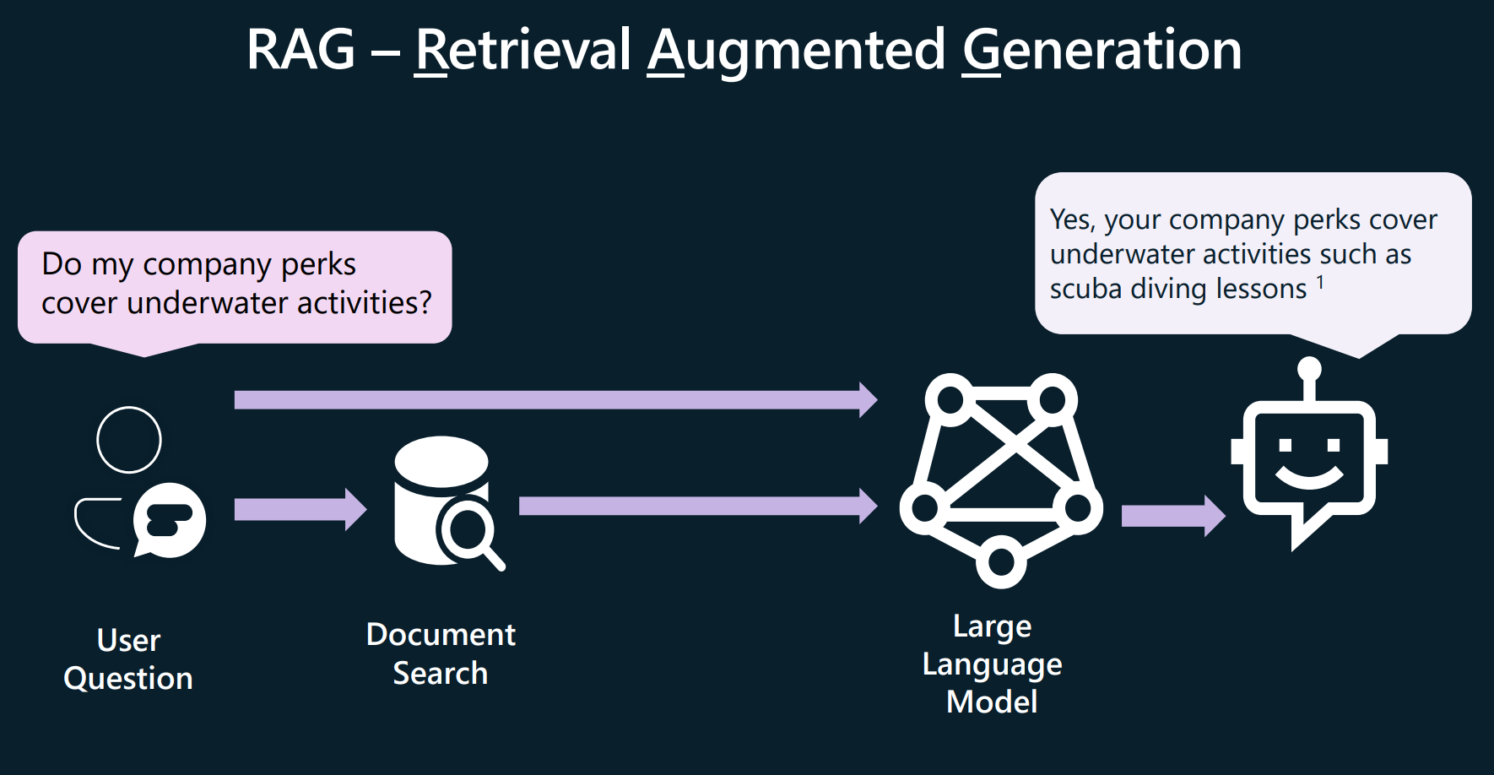
Retrieval Augmented Generation (in Plain English)
One Sentence
Like a librarian
RAG is a model that reads your documents first, then answers.
You ask a question.
Librarian finds the best content from the library.
Librarian reads, summarizes, and delivers an answer.

Slide 4



AutoRAG
Automatically sets up and manages a Retrieval-Augmented Generation pipeline for you, eliminating most manual configuration and maintenance.

Slide 5
Why build your own (vs. AutoRAG)?
Build or Configure?
Control
You control all aspects of the code, prompts, security, and cost.
Observability
You can view all logs, enable feedback loops, and better evaluate.
Portability
You can deploy it wherever and however you want with whatever data you have.

Slide 6
When AutoRAG Shines
Your data lives in one platform like M365, Salesforce, etc.
Need quick value with minimal setup.
End‑user productivity and ad‑hoc Q&A.
PRO
Faster setup
Less maintenance
Easier integration with common data sources
CON
Limited customization
Less transparency
Constraints on models or indexing strategies

Slide 7

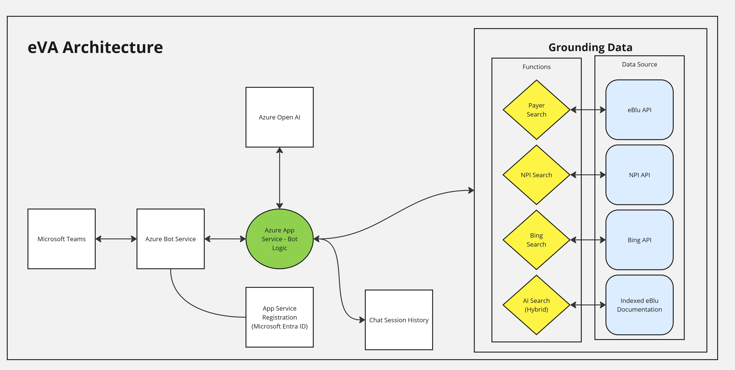
eBlu Virtual Assistant (eVA)

Slide 8
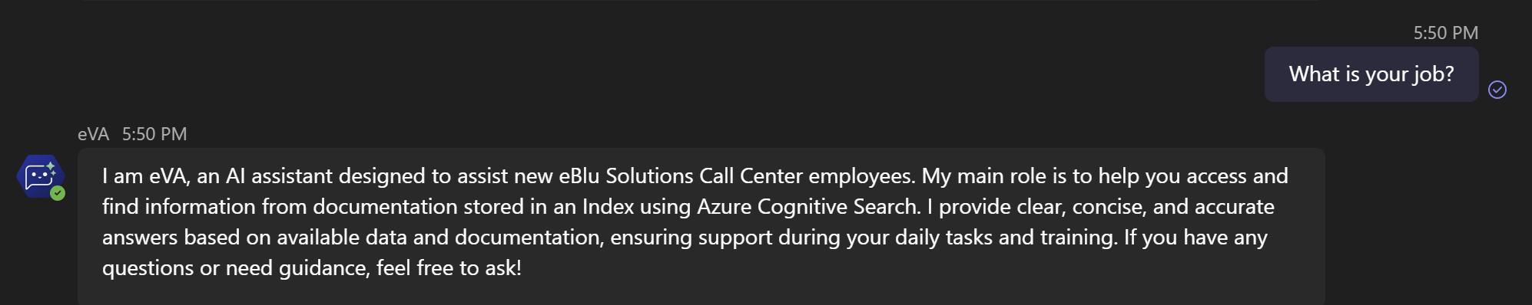
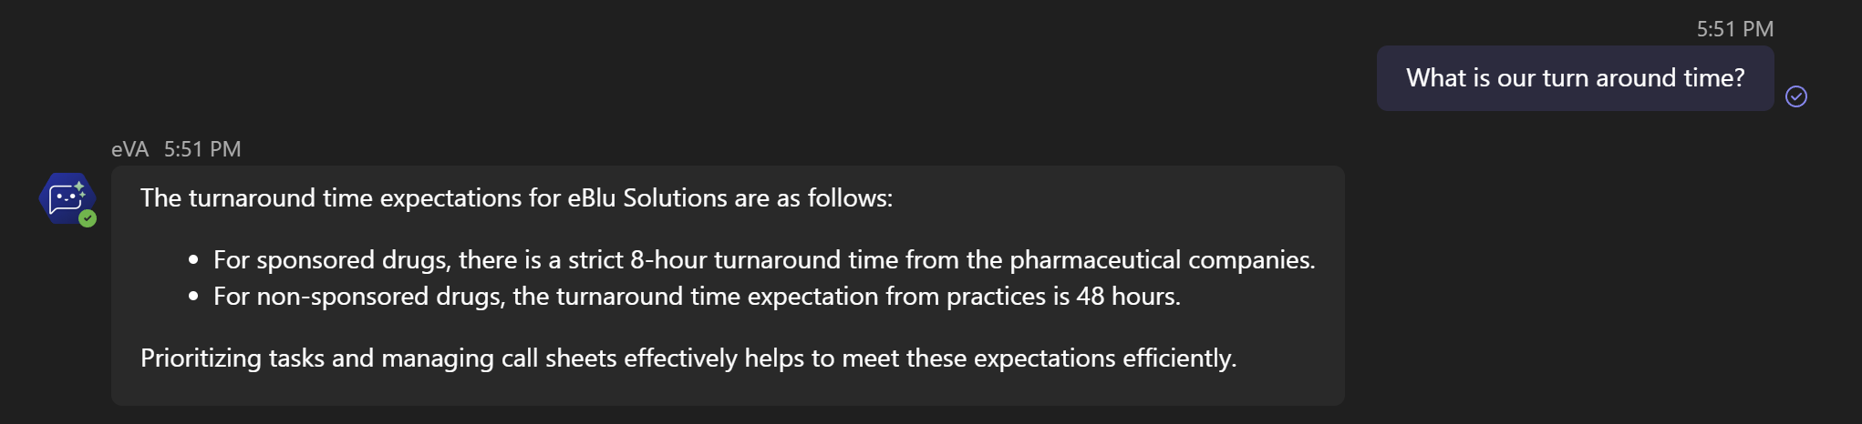
eVA Output

Slide 9
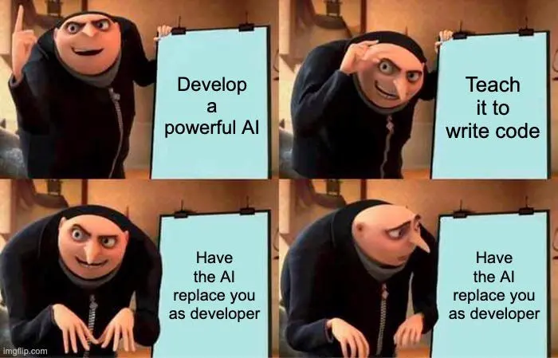

Slide 10

What We’ll Do Now
Walk the code: ingest → index → retrieve → generate
Run live queries against some docs
Q&A
Repo: simple-azue-rag-pipeline-2025
Cheat sheet + README in the repo
https://bit.ly/simplerag

