Slide 1

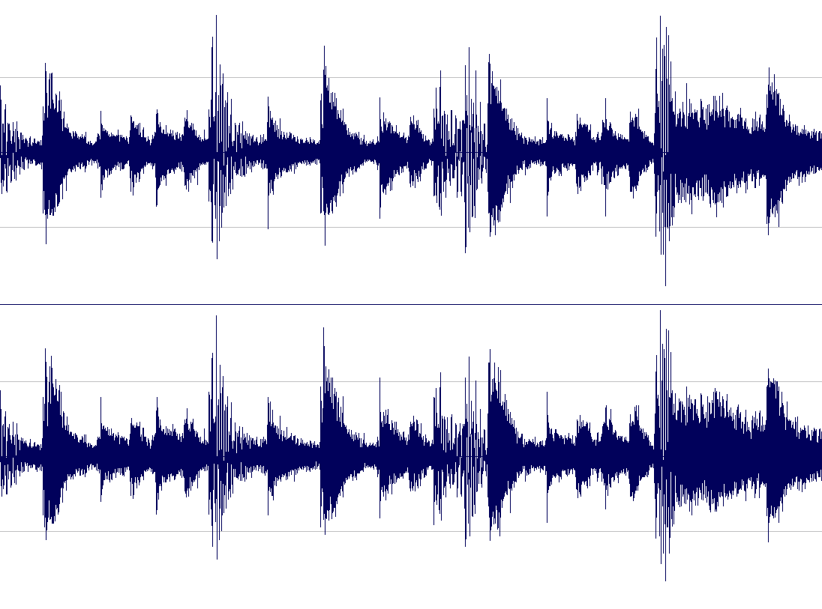

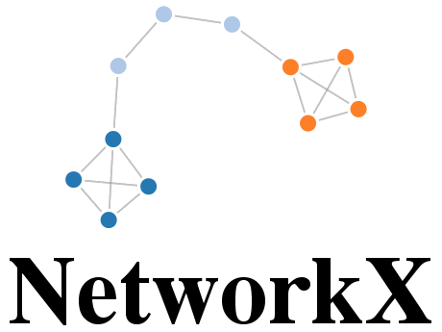
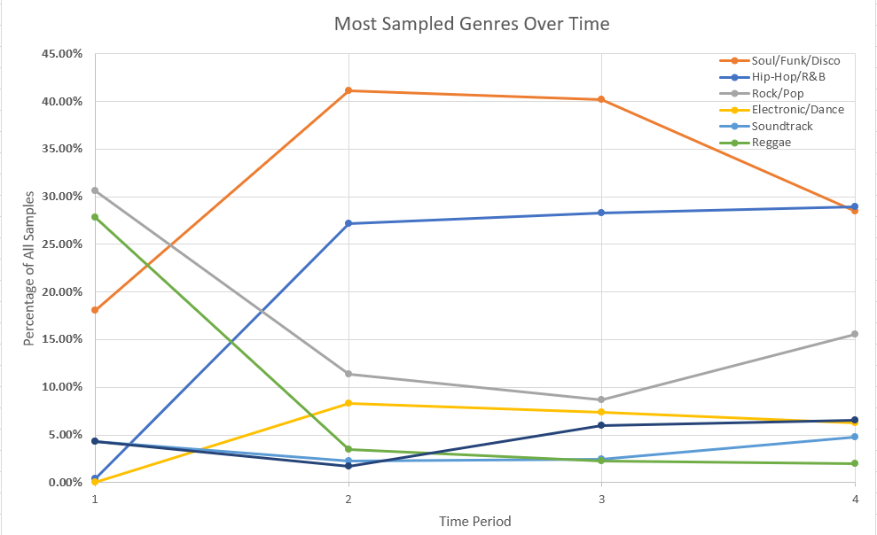
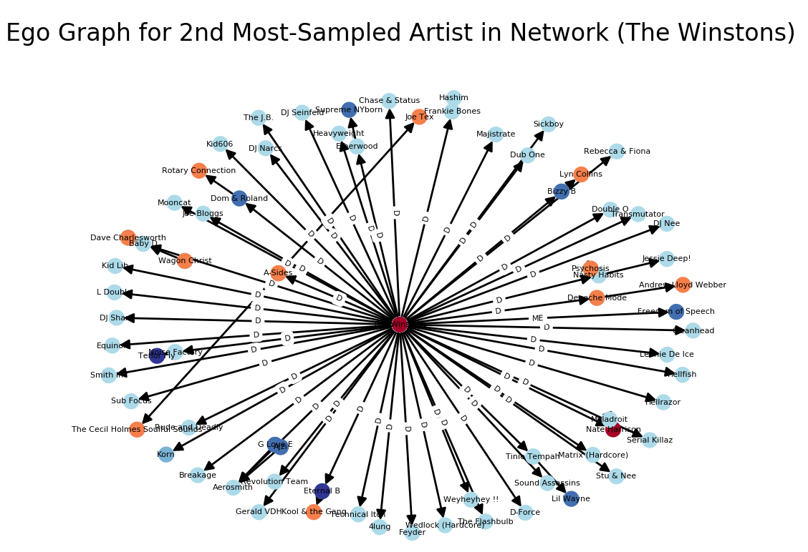
Measuring Musical Sampling Impact Through Network Analysis
Justin Tran ’20
Advised by Professor Andrea LaPaugh
Motivation and Goal
Implementation
Results (Centrality Influence)
Evaluate using:
Statistical Influence: Compare sampling properties like genres and temporally analyze for patterns
Centrality Influence: Measure artist influence as defined by type of centrality
In-Degree Centrality (Calculates the fraction of nodes from the entire graph that the node is connected to)
Year | Overall | 1980’s | 1990’s | 2000’s
Top 5 Artists | 1. James Brown | 1. James Brown | 1. James Brown | 1. James Brown
 | 2. The Winstons | 2. Beside | 2. Public Enemy | 2. The Winstons
 | 3. Public Enemy | 3. Run-DMC | 3. The Winstons | 3. The Notorious B.I.G.
 | 4. Lyn Collins | 4. Public Enemy | 4. Lyn Collins | 4. Beside
 | 5. Beside | 5. Kurtis Blow | 5. Run-DMC | 5. Public Enemy
Musical Sampling is the act of taking a portion of an existing recording and using it in a new recording.
Sampling can inform listeners of the artist’s level of influence on other musicians in the community
Explore relationships between influential artists/genres and determine which sample/are sampled the most
Use 30,000 data points from WhoSampled Database
Build directed graphs with artists + audio elements on edges
James Brown occupies 9/10 first-place rankings, implying great influence on neighbors and the community at-large
Hip-Hop/R&B and Soul/Funk/ Disco artists occupy all positions in the centrality rankings
Related Work
Results (Statistical Influence)
PageRank (Observes neighbor centrality and edge directionality)
Year | Overall | 1980’s | 1990’s | 2000’s
Top 5 Artists | 1. James Brown | 1. James Brown | 1. James Brown | 1. Run-DMC
 | 2. Lyn Collins | 2. Fred Wesley | 2. Lyn Collins | 2. Public Enemy
 | 3. Afrika Bambaataa | 3. The J.B’s | 3. Afrika Bambaataa | 3. The Notorious B.I.G.
 | 4. Public Enemy | 4. Afrika Bambaataa | 4. Public Enemy | 4. James Brown
 | 5. The Winstons | 5. Beside | 5. The Winstons | 5. Beside
Network Analysis and Rank of Sample-Based Music (Bryan and Wang, 2011) [1]
Found relative flow of samples between genres
No intra-genre vs. inter-genre analysis
Influence Networks in Popular Music (Alban, 2015) [2]
Built influence relationships based on harmonic features
No temporal analysis
The most popular sampling genre has become the most sampled genre
Conclusion
Approach
Audio Element data from WhoSampled was not detailed enough!
Soul/Funk/Disco is the most influential genre overall but Hip-Hop/R&B has recently challenged this
James Brown is one of the most influential artists throughout all eras of music
Intra-genre influences are strong!
Artists tend to sample Multiple Elements of a song OR just Vocals BUT no genre-based patterns emerged
Build directed graphs from WhoSampled database (categorized by genre and time period) to indicate sample usage
Analyze intra-genre and inter-genre sampling activity over time
Unique Edge Property: Sampled audio elements (new property in dataset)
Future Work
References
Acknowledgments
Predict the types of samples likely to be found in a song based on musical properties
Aid music sampling identification software by acting as a false positive check
[1] N. J. Bryan and G. Wang, “Musical influence network analysis and rank of sample-based music,” in ISMIR, 2011.
[2] M. G. Albán, V. Choksi, and S. B. Tsai, “Cs 224 w final report: Influence networks in popular music,” 2015.
Thanks to Prof. Andrea LaPaugh for advising this project and Bobray J. Bordelon and Darwin F. Scott of the Princeton University Library for WhoSampled API access.

