Slide 1
Measuring Musical Sampling Impact Through Network Analysis
by Justin Tran
IW 09: Information Discovery through
Analysis of Complex Networks
advised by Prof. Andrea LaPaugh

Slide 2
Motivation
Music sampling is the act of taking a portion of an existing recording and using it in a new recording.
Sampling informs listeners of the artist’s level of influence on other musicians in the community.
Notes:
Establish importance of your area or topic
The more sampled an artist is, the more influence they have on others in the community

Slide 3
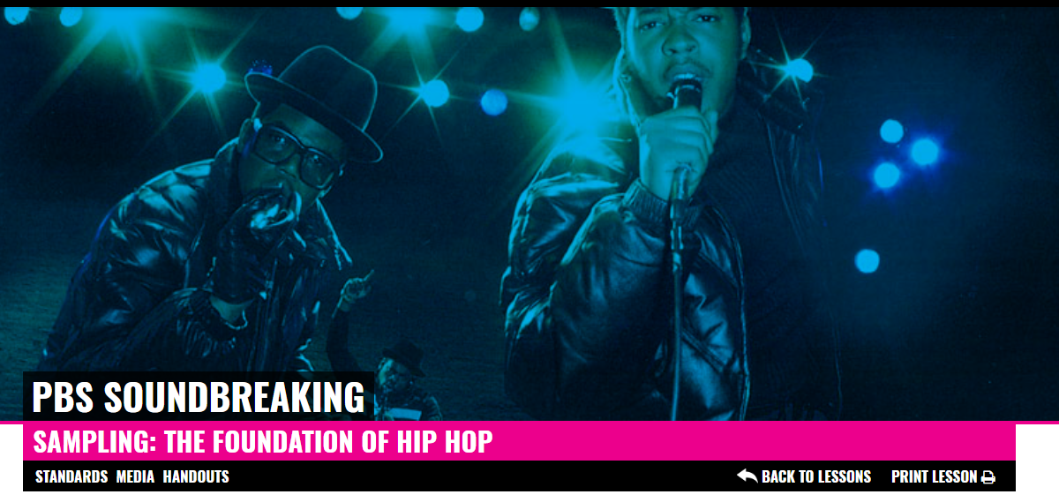
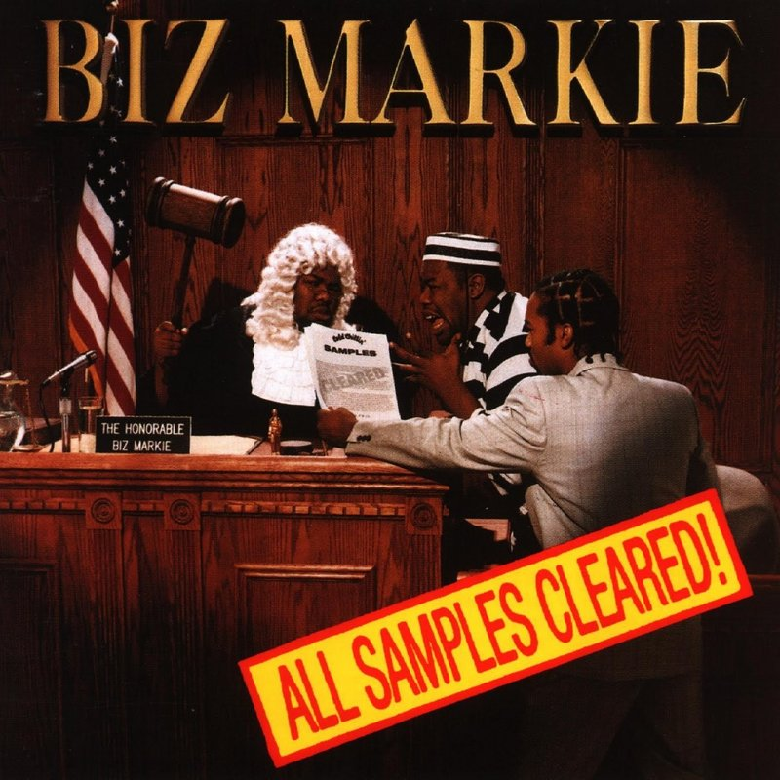
Goal
Explore relationships between influential artists/genres and determine which sample/are sampled the most
Verify popular music sampling claims
Notes:
Define problem: • Specify inputs and outputs • Define assumptions • Describe desirable properties • Provide concrete example(s)
The problem of determining influence lends itself nicely to network analysis as long as we take in songs as input and have a directed graph showing samples.
Verify Hip-Hop is genre that uses most sampling
Verify Grand Upright Music, Ltd. v. Warner Bros. Records Inc. 1991 drop

Slide 4
Background and Related Work
Network Analysis and Rank of Sample-Based Music (Bryan
and Wang, 2011) [1]
Found relative flow of samples between genres
No intra-genre vs. inter-genre analysis
Influence Networks in Popular Music (Alban, 2015) [2]
Built influence relationships based on harmonic features
No temporal analysis
Notes:
Harmonic features = Dominant 7th chords or Minor 7th chord changes. This study was geared more towards a music theory audience

Slide 5
Approach
Build directed graphs from WhoSampled database (categorized by genre and time period) to indicate sample usage
Analyze intra-genre and inter-genre sampling activity over time
Unique Edge Property: Sampled audio elements (new property in dataset)
Notes:
Present novel idea (Eureka!) Explain why it is a good idea (describe rationale) Provide simple example showing how your idea achieves your goal in situation where previous approaches would not
The past studies simply did not have data this nuanced to conduct this research using the sampled audio elements
Temporal data analysis was largely ignored. Sampling within a genre was ignored as it was assumed genres sampled within their genre the most.

Slide 6
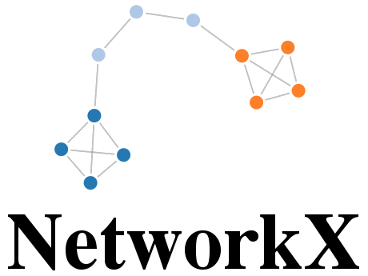

Implementation
Use 30,000 data points from WhoSampled
Build directed graphs with artists + audio elements

Slide 7
Implementation (Metrics)
Statistical Influence: Compare sampling properties like genres and temporally analyze for patterns
Centrality Influence: Measure artist influence as defined by type of centrality
Notes:
Provide overview: • System organization • Sequence of steps (flow chart) For most important steps (or issues): • Challenge • Approach • Implementation

Slide 8
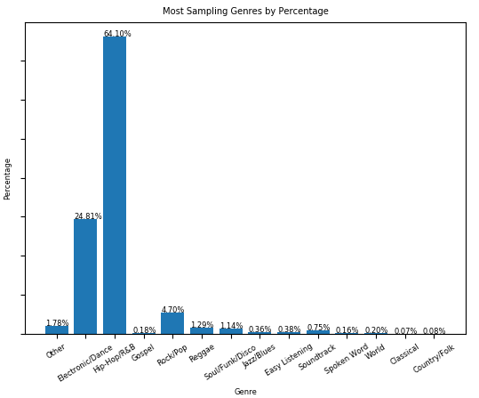
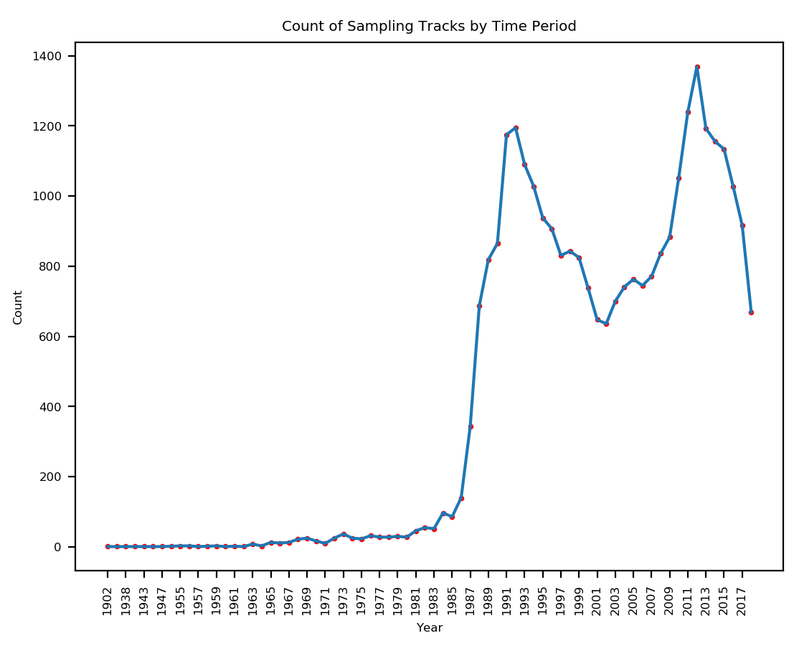
Most Sampling Genres by Percentage
Count of Sampling Tracks by Time Period
Notes:
Correlation between 1991 Grand Upright Music case and dip in sampling

Slide 9
What are the most influential genres?

Slide 10
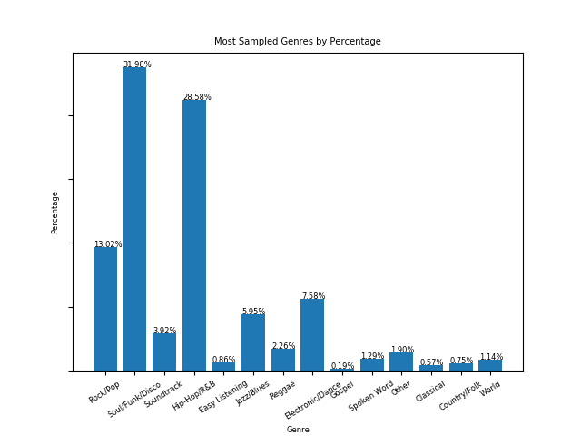
Most Sampled Genres by Percentage
Notes:
Clarify title means for most sampled genres based on songs that use samples

Slide 11
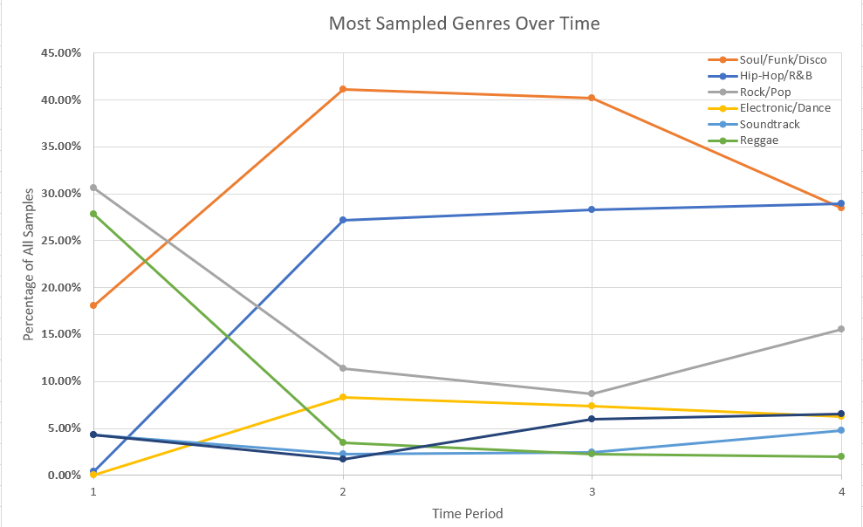
1970’s
1980’s
1990’s
2000’s

Slide 12
How strong is intra-genre sampling?
Notes:
In fact, 32.6% of samples are intra-genre which is quite a significant number when there are so many genres to sample from and Soul/Funk/Disco and Hip-Hop/R&B both together comprise 60% of all sampled genres.
Reject the null hypothesis that the observed distribution and a 50/50 distribution of samples between intra-genre and inter-genre is the same. because p=1.9415172958895564e-05

Slide 13
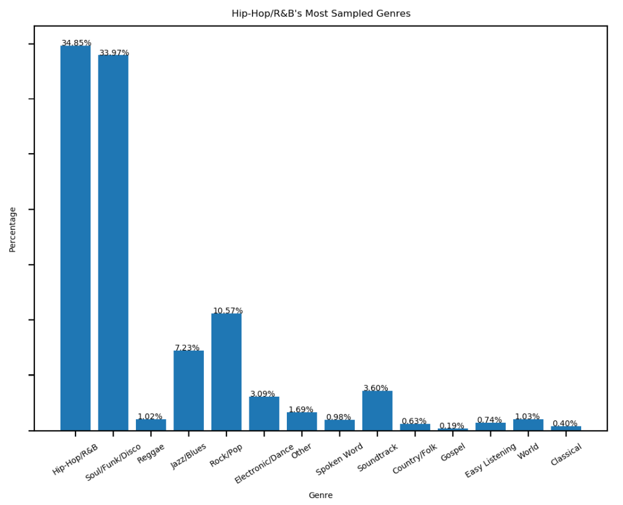
Hip-Hop/R&B’s Most Sampled Genres
Notes:
The null hypothesis is that this distribution and your observed distribution (hip hop and soul are equally distributed) are the same
pvalue=0.9155204631808644 so we fail to reject the null hypothesis
Clarify title means for most sampled genres based on songs that use samples

Slide 14
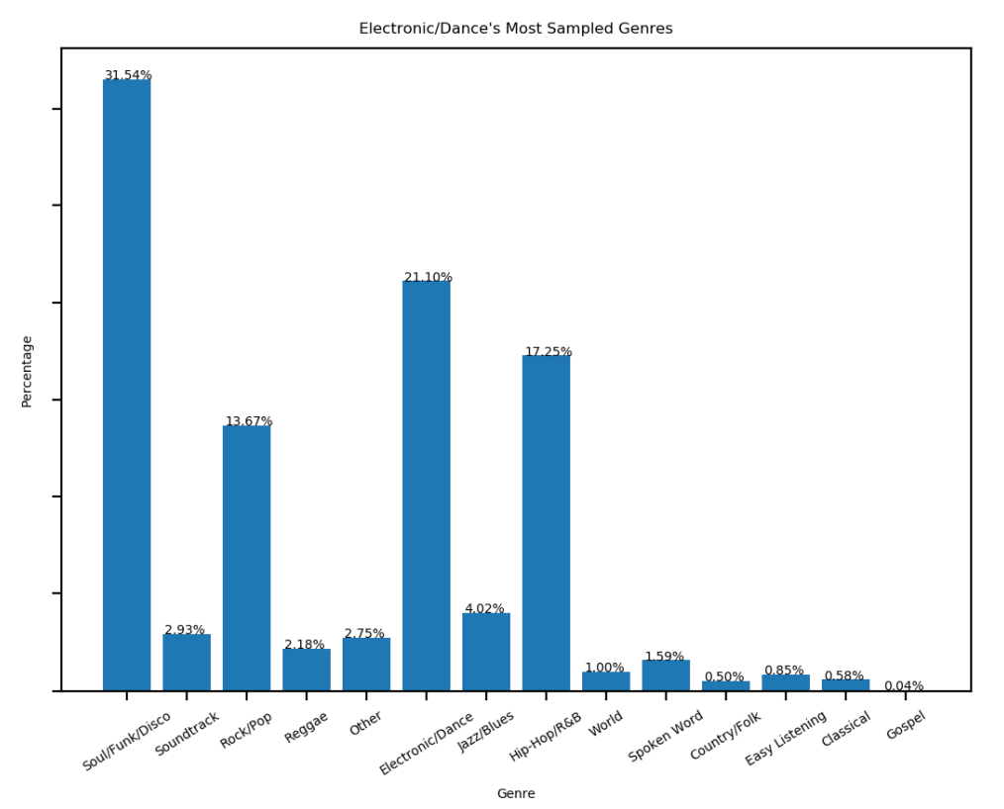
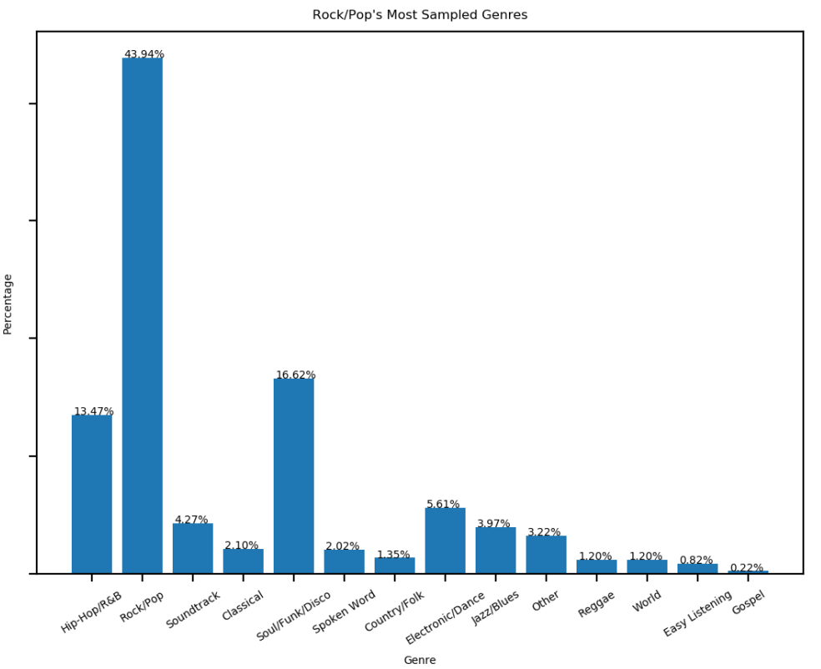
Electronic/Dance’s Most Sampled Genres
Rock/Pop’s Most Sampled Genres
Notes:
278 + 204 + 613 + 1553 + 6647 = 9295
383 + 337 + 1394 + 7360 + 19018 = 28492
The null hypothesis is that this distribution and your observed distribution are the same
pvalue=0.5341418084619267 so we fail to reject the null hypothesis

Slide 15
Audio Elements were not the most telling property...

Slide 16
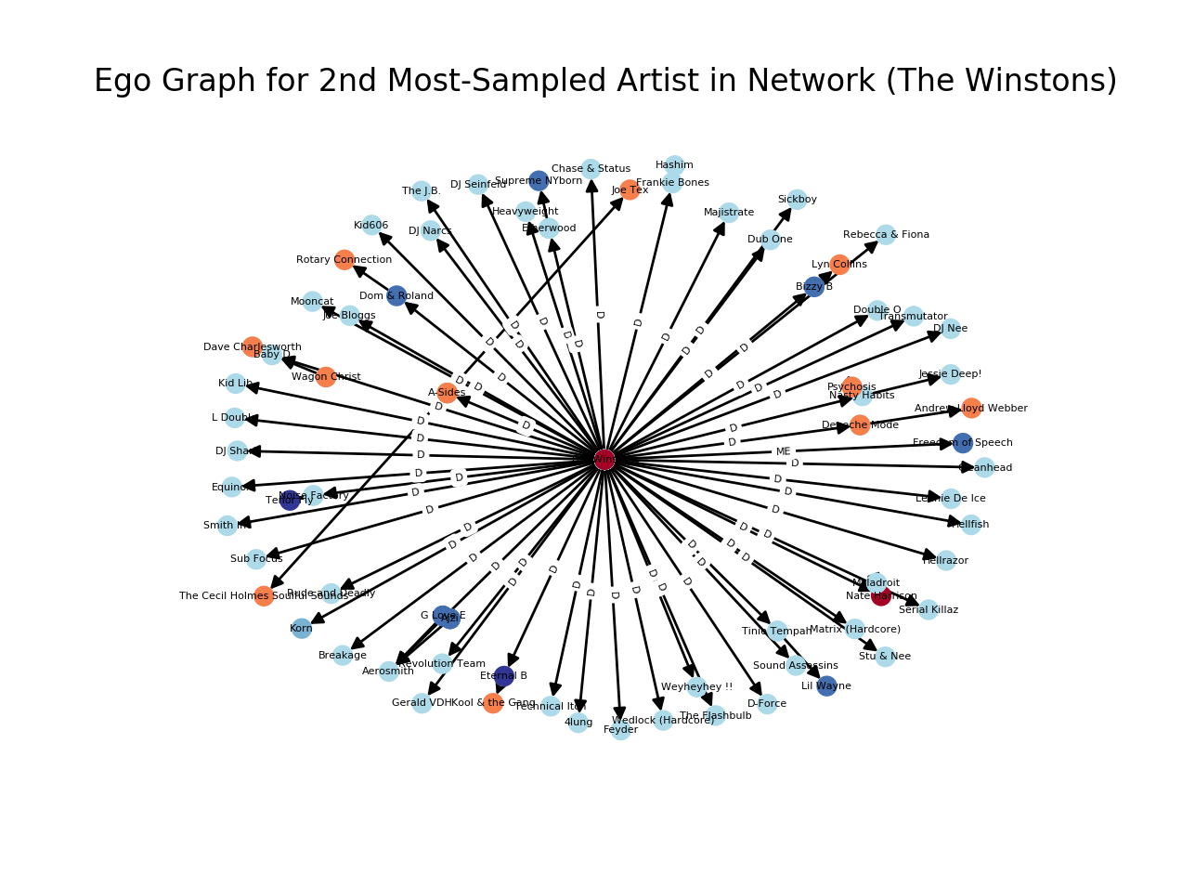
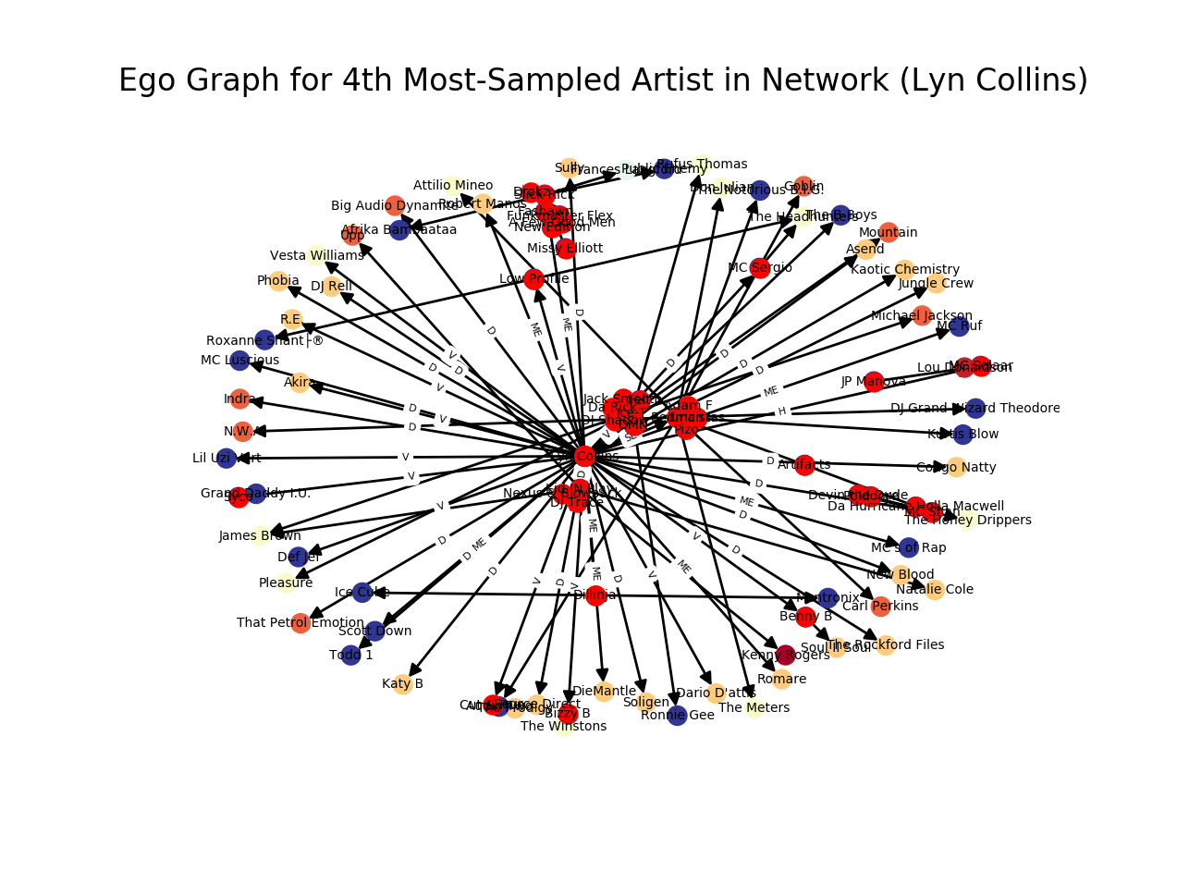
*Matching colors (respective to each graph) indicate the same genre

Slide 17
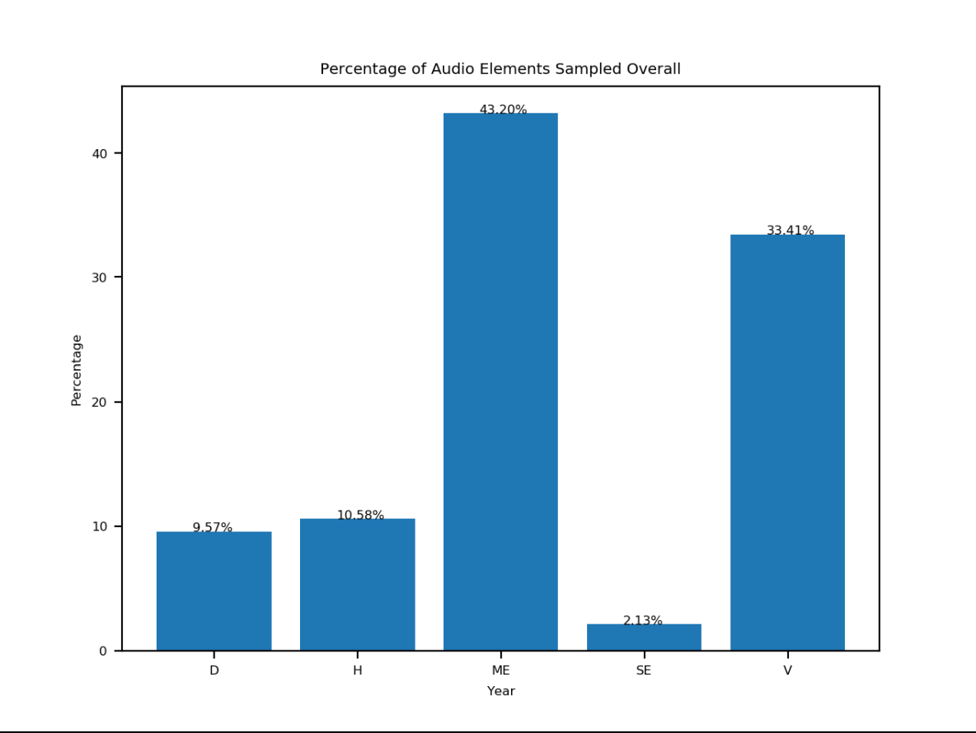
Percentage of Audio Elements Sampled Overall
Drums
Hook/Riff
Multiple Elements
Sound Effects
Vocals

Slide 18
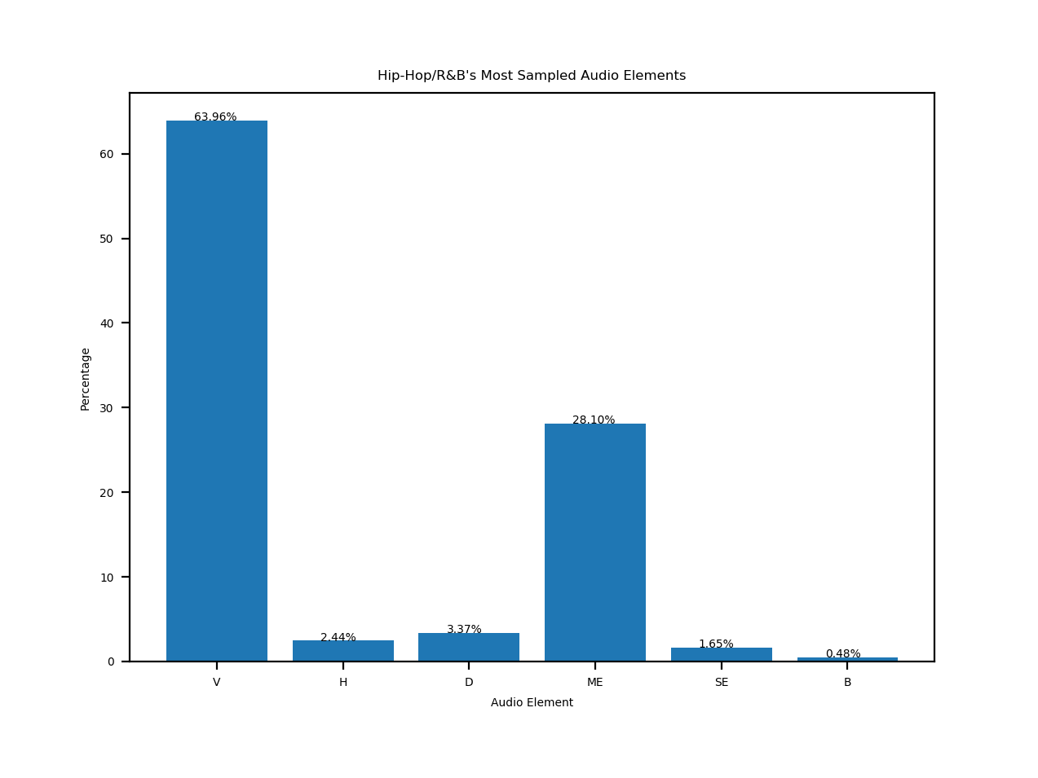
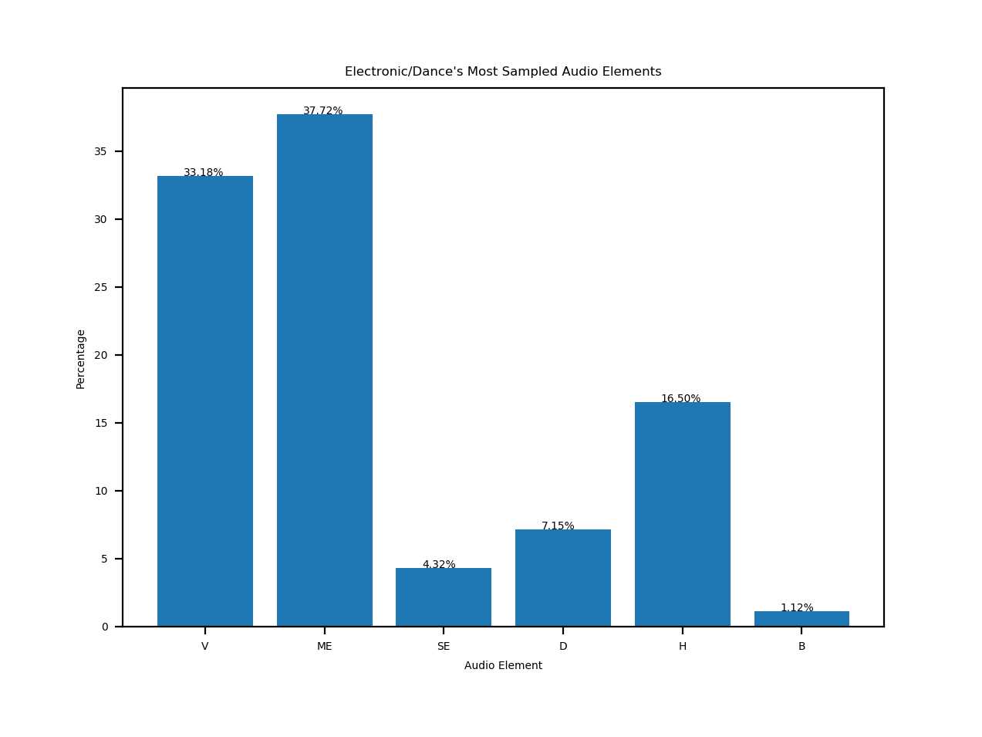
Hip-Hop/R&B’’s Most Sampled Audio Elements
Electronic/Dance’s Most Sampled Audio Elements
Vocals
Hook/Riff
Drums
Multiple Elements
Sound Effects
Bass
Vocals
Multiple Elements
Sound Effects
Drums
Hook/Riff
Bass
Audio Element Sampled
Audio Element Sampled

Slide 19
What about Centrality Influence?
Notes:
Present results of evaluation aimed at testing whether met goal
For each evaluation: • State goal of evaluation • Describe evaluation setup • Describe evaluation metric(s) • Present results • Discuss success/failure cases • Explain implications
Soc. network analysis: Centrality measures
In-Degree: For finding very connected artists, popular artists
Katz: Can identify nodes with influence over the whole network, not just those directly connected to it
PageRank: This measure uncovers nodes whose influence extends beyond their direct connections into the wider network.

Slide 20
In-Degree Centrality
(Calculates the fraction of nodes from the entire graph that the node is connected to)
Year | Overall | 1980’s | 1990’s | 2000’s
Top 5 Artists | 1. James Brown | 1. James Brown | 1. James Brown | 1. James Brown
 | 2. The Winstons | 2. Beside | 2. Public Enemy | 2. The Winstons
 | 3. Public Enemy | 3. Run-DMC | 3. The Winstons | 3. The Notorious B.I.G.
 | 4. Lyn Collins | 4. Public Enemy | 4. Lyn Collins | 4. Beside
 | 5. Beside | 5. Kurtis Blow | 5. Run-DMC | 5. Public Enemy

Slide 21
Katz Centrality
(Determines a node’s centrality based on the centrality of its neighbors)
Year | Overall | 1980’s | 1990’s | 2000’s
Top 5 Artists | 1. James Brown | 1. James Brown | 1. James Brown | 1. The Notorious B.I.G.
 | 2. Public Enemy | 2. Beside | 2. Public Enemy | 2. James Brown
 | 3. Lyn Collins | 3. Run-DMC | 3. Lyn Collins | 3. Public Enemy
 | 4. Run-DMC | 4. Kurtis Blow | 4. N.W.A | 4. Beside
 | 5. LL Cool J | 5. Public Enemy | 5. Run-DMC | 5. The Winstons

Slide 22
PageRank
(Similar to Katz Centrality but uses the directed nature of the network)
Year | Overall | 1980’s | 1990’s | 2000’s
Top 5 Artists | 1. James Brown | 1. James Brown | 1. James Brown | 1. Run-DMC
 | 2. Lyn Collins | 2. Fred Wesley | 2. Lyn Collins | 2. Public Enemy
 | 3. Afrika Bambaataa | 3. The J.B’s | 3. Afrika Bambaataa | 3. The Notorious B.I.G.
 | 4. Public Enemy | 4. Afrika Bambaataa | 4. Public Enemy | 4. James Brown
 | 5. The Winstons | 5. Beside | 5. The Winstons | 5. Beside

Slide 23
Conclusion
Soul/Funk/Disco is the most influential genre overall but Hip-Hop/R&B has recently challenged this
James Brown is one of the most influential artists throughout all eras of music
Intra-genre influences are strong!
Artists tend to sample Multiple Elements of a song OR just Vocals BUT no genre-based patterns emerged
Notes:
Summarize key points Restate main results Describe implications
Soul/Funk/Disco is the most sampled genre but from the temporal analysis we see that the number of hip-hop samples has equalized the gap slowly
James Brown’s influence as shown by the centrality measurements crosses all time periods. Most influential artists are from Soul/Funk/Disco or Hip-Hop/R&B as shown earlier
Intra-genre influences are strong! For most genres even if soul/funk/disco or hip-hop/R&B are sampled the most often, the intra-genre is always near the top
Because the audio element data wasn’t as nuanced as originally hoped we couldn’t map any patterns between genres and their likelihood to sample a certain audio element. But, we did find that artists tend to sample Multiple Elements from songs or just vocals.

Slide 24
Acknowledgements
Professor Andrea LaPaugh
Princeton University Library
WhoSampled Support
Notes:
Summarize key points Restate main results Describe implications

Slide 25
Citations
[1] N. J. Bryan and G. Wang, “Musical influence network analysis and rank of sample-based music,” in ISMIR, 2011.
[2] M. G. Albán, V. Choksi, and S. B. Tsai, “Cs 224 w final report: Influence networks in popular music,” 2015.

