Slide 1
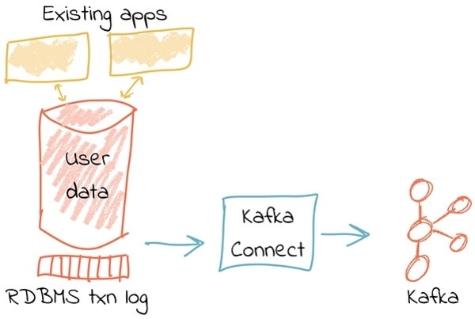
Scope of this Demo
MS SQL
(Data Source)
Debezium (Kakfa Connect)
Azure Event Hubs (Kafka)
Base image credit: http://weekly.sfdata.io

