Slide 1
CS 501 Project for the Cornell LII
PDF Versions of
the United States Code

Slide 2
Introduction
Presenters: Kohsuke Kawaguchi, Justin Tung
Other Members: Tsee Yuan Lee, Tsung-Yueh Chiou, Soyeon Kim
Client: Prof. Thomas Bruce
Project Sponsors: Prof. William Arms
Teaching Consultant: Matthew Harris
Thanks to everyone for a great semester!

Slide 3
Context of the Project
Objective
To provide Internet users (mostly legal professionals) with the ability to easily print out portions of the U.S. Code
Current situation
The House of Representatives offers the Code in ASCII, which is converted to HTML via LII LDMS project.
HTML is hard to print, but lawyers like to print
HTML is difficult to be viewed without access to the server

Slide 4
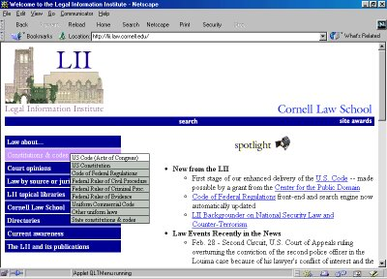
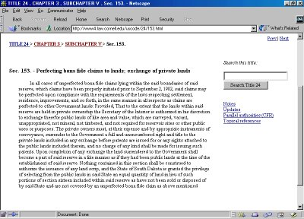
Views of the Current Website

Slide 5
Requirements
Produce PDF behind the scenes (pre-generation) using existing XML
Allow the web user to select them through a shopping cart system
Process them as “orders” for delivery to users while using certain generation and pricing policies
Deliver PDFs which closely resemble the HTML version of the Code

Slide 6
Delivered System
PDF generation
  Convert XML version of the Code to PDF
Order selection
  Based on existing shopping cart system
  Integrated into the website
Order fulfillment
  Process orders asynchronously behind the curtain
Order delivery
  Allow users to download their orders through browser

Slide 7
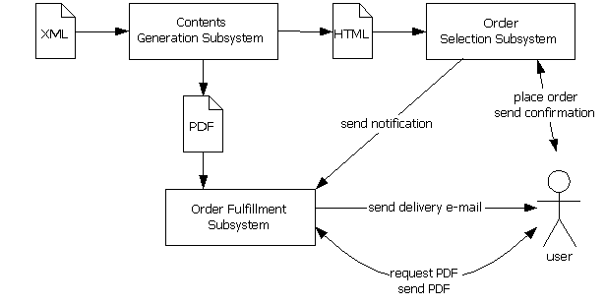
System Design

Slide 8
Other Outputs
Documents
  Help document for users (walk-through)
  Maintenance document for admin and developers
Deployment
  Rough migration plan from the current website to PDF-capable version
  System partially deployed to the target environment

Slide 9
Blank Screen

Slide 10
Demonstration
Show the system in action:
http://lula.law.cornell.edu/uscode/pdf/

Slide 11
Part 1: PDF Generation
Functionality
  PDF appearance reasonably resembles original document with consideration PDF readability and formatting
Interface
  Accepts XML data from LII LDMS
  Contents generation is run and contents deployed to the server
Performance: runs under
  512MB memory
  < 10 hrs for all 50 titles (machine and VM dependent)

Slide 12
Part 2: Order Selection
Document selection
  Click on PDF icon in Table of Contents for a selected division or “Add to Cart” link on the division’s page
Shopping cart
  Allows standard cart functions with information on price and purchases
  Review, remove, recalculate, empty, and checkout
Performance
  Quick response as seen in demo; little waiting time

Slide 13
Part 3: Order Fulfillment
Functionality
  Confirmation email sent when credit card payment is confirmed, if not failure email is sent by OFE
  Order email sent when schedule job is executed
    Link does not expire, except when the selected portion of the Code is removed due to changes or repeal
    Link includes pdf file info in encrypted format and order info is in clear text to thwart casual misuse
    Overcomes size limits placed by most email services

Slide 14
Order Fulfillment (cont’d)
Performance
  Since PDF files are pre-generated, users can download immediately upon receipt of second email
Logging
  Each email is also sent to the system admin
  Apache records download link usage, and its log can be used to detect excessive use
Invalid Information
  Users cannot alter links to download files they did not order
  Refund and other support requests will be handled manually by LII support staff

Slide 15
Blank Screen

Slide 16
Using the System
Automatically
  Crontab for periodically processing new orders
Manually (shell script)
  xmlsplt: splits title XMLs into smaller chunks to reduce resource hogging
  xml2pdf: converts XML to PDF
  xml2html: generates website pages
  xml2catalog: creates catalog files for PDG shopping cart

Slide 17
Quality Assurance
PDF files viewed by client
System running on Lula as a pre-production machine
Not enough testing (stress, capacity, etc) can be done, so it is not put in production
Support documentation casually reviewed

Slide 18
Known Problems
Instability of Java VM
  An unexplained error relating to JVM on Linux and configuration stops PDF generation at random times
  No direct workaround is known except to run the processes on a Windows PC, then transferring files.
Conformance of FOP to XSL/FO
  In some cases it renders PDF inappropriately

Slide 19
Problems in the Existing System
Code structure is not a strict tree
  Some code divisions are shared by multiple parents
  (bug of LII LDMS project?)
File name convention has a problem
  Some file names get too long
Suspicious structure
  Such as subtitle 1 contains subtitle 2 and 3
  http://lula.law.cornell.edu/uscode/pdf/46/stI.html

Slide 20
Current Status
Contents generation
  Running on Windows
  Update is not automated
Order selection (website), Order fulfillment/delivery
  Fully up and running
  But still on an evaluation system

Slide 21
Deployment
System deployed manually
  Need to co-exist with the current website
  Necessarily complex, since it needs to work with many existing systems
  Instruction provided in the document
Configuration
  Centralized in a single file

Slide 22
Blank Screen

Slide 23
Future Work
Enable PDF generation at higher levels of Code hierarchy
Replacing pre-generation with on-the-fly generation
Fine-tune ordering process
  accepting online checks
Implement different pricing policies
  prices depend on processing time and space utilization
Logging to database to improve fraud detection and easier system evaluation and maintenance

Slide 24
Discussion of Presentation
Question and Comments?

