Slide 1

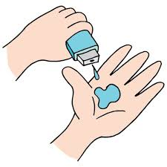
Albatrozz
(Health monitoring system)
STU ID: STU62dcecb5c7fa61658645685
Submitted by,
Justin v kalappura
Amal Jyothi college of engineering

Slide 2

IOT-Cloud Integrated Patient Temperture Monitoring System -using Tinkercab and Thingspeak platforms
PROJECT TITLE

Slide 3

AGENDA
1.Problem statement
2.Project overview
3.Who are the end users?
4.Your solution and its value proposition.
5. Procedure of the project
6. Results
7. Conclusion
8. Future scope

Slide 4

PROBLEM STATEMENT
• In the present scenario, many lives are getting affected because of the untimely diagnosis of the diseases or the untimely decline in the health status.
•In most cases, it happens because of the limitation in measuring the real time parameter values of the people. Continuous monitoring of the health parameters are not practical in many life-threatening situations, such as when a individual/patient is far from the hospital.
•Especially for the critical patients like one in ICU, Continuous monitoring is very difficult.
•In this module, the forementioned problems are solved.

Slide 5

PROJECT OVERVIEW
• To overcome the problem discussed in the previous slide, we bring our project which is designed as if we can use it in hospitals and homes.
•Our proposed project has Sensors which measures various real time parameters like temperature etc.
•Using these values the results can be presented graphically.
•Therefore, we can conclude that this project holds a significant place in today's world.

Slide 6

WHO ARE THE END USERS?
As this is something related with the health, this module can be used by every humans irrespective of their age.
Mostly the users will be the patients who need constant assistance of the doctor.

Slide 7
Work submission of Week 1
1.BACKGROUNG OF THE PROBLEM
These days, disease is on the rise to alarming levels, which affects the people very badly. It is challenging to continuously monitor the patient, and doctors may not be able to do so for the entire working day. That is continuous monitoring is not that practically possible.
2.USER/CUSTOMER
Every human can use this module irrespective of the age. Mostly the users will be the patients who need constant assistance of the doctor.
3.PROBLEM STATEMENT
IOT-CLOUD INTEGRATED HEALTH MONITORING SYSTEM
Week 1 Document Link:
https://docs.google.com/document/d/1645iJM5da7LBRcPT-KgTT8fkD94SyL9K/edit?usp=share_link&ouid=113179446857022601220&rtpof=true&sd=true

Slide 8
Work submission of Week 2
1.WHAT IS THE PROPOSED SOLUTION?
The solution proposed in my project is that to develop a IOT device for measuring the real time parameters, storing the data and evaluating its result based on the reading.
The value proposition of my project is that each and every individual can easily and continuously get well cared about their health with ease and low cost with our project.
2.HOW IS IT UNIQUE COMPARED TO ANY EXISTING SOLUTIONS?
When comparing with the present existing solution our system is very much unique in its simpleness and low of implementing the system.
Week 2 Document Link:
https://docs.google.com/document/d/1uE1hFu-gq7qmKyfV7f0KDNcXXMbL1ReZ/edit?usp=share_link&ouid=113179446857022601220&rtpof=true&sd=true

Slide 9
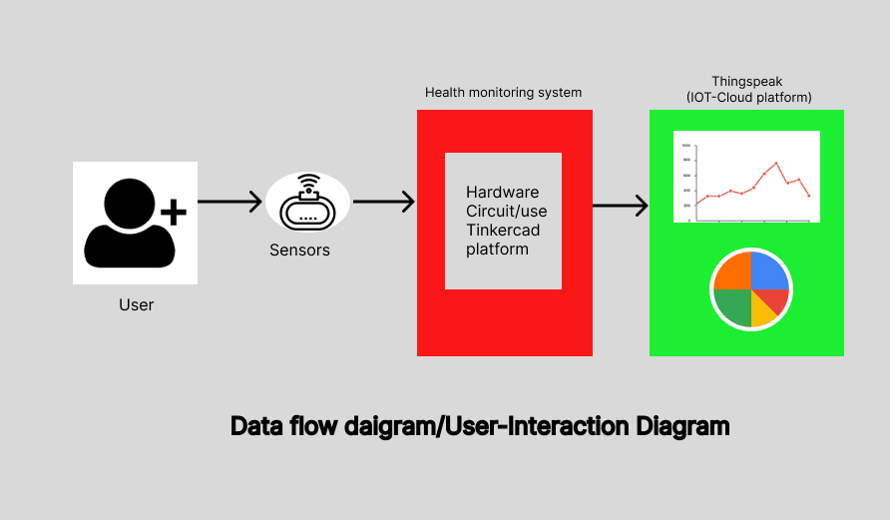
Work submission of Week 3
Week 3 Document Link:
https://docs.google.com/document/d/1hcc84D5mO30A24mNPc3CbUZKnjM2nGTp/edit?usp=share_link&ouid=113179446857022601220&rtpof=true&sd=true

Slide 10
Procedure of the project
Virtual IOT circuit is built in the tinkercad platform.
And the Data we get from the tinkercad platform is saved and made visualized into a graph on ThingSpeak application, which is easily accessible from any part of the world via internet.

Slide 11
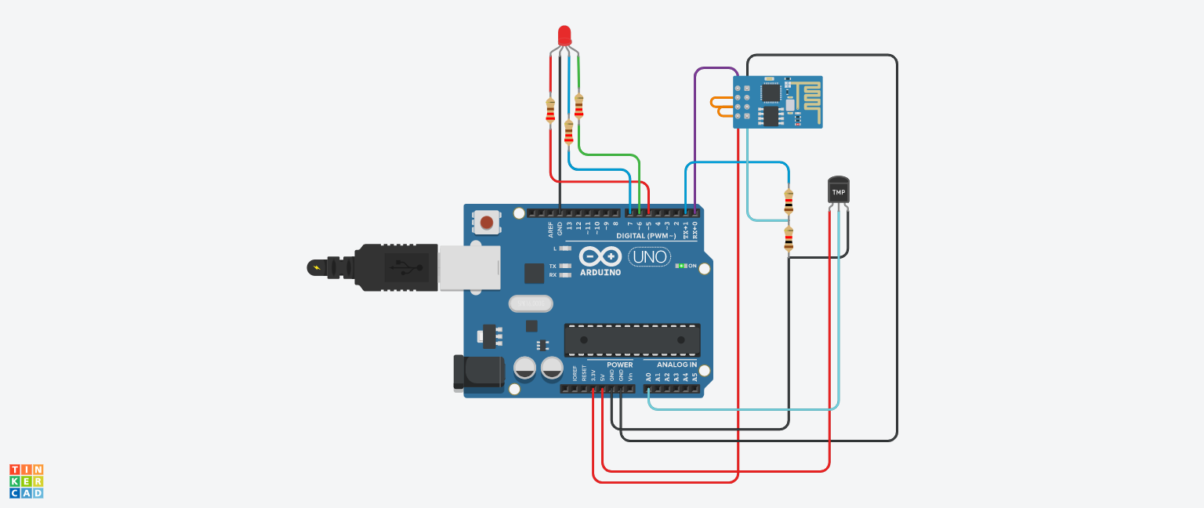
1.Tinkercab Platform(Circuit)
Link:
https://www.tinkercad.com/things/fM34DZPGU8Z-copy-of-patient-temperature-monitoring-system/editel?sharecode=gh7EpQMHhjkFLVSuUe0yQvmeLCAQ7Ld2A5n_S2p8rms

Slide 12
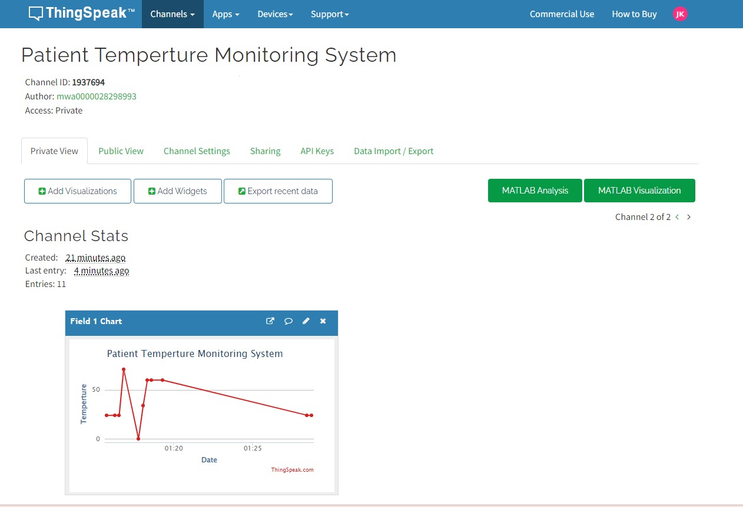
2.Thingspeak Platform(Iot cloud)
Link:
https://thingspeak.com/channels/1937694

Slide 13

YOUR SOLUTION AND ITS VALUE PROPOSITION
The solution proposed in my project is that to develop a iot device for measuring the real time parameters, storing the data and evaluating its result based on the reading.
The value proposition of my project is that each and every individual can easily and continuously get well cared about their health with ease and low cost with our project.

Slide 14
RESULTS
Therefore in this project we have successfully implemented a live real time temperature readings from the virtual circuit in tinkercad.
Store and vistualize those real data lively in the form of graph in the Thingspeak Iot-cloud platform.
From this we successfully completed the project of continuous temperature evaluation of a human.
Video presentation link:
https://drive.google.com/file/d/1BOz2uSjvnwiUUwifY-KO_S09QxFiWAVf/view?usp=share_link

Slide 15
Future scope
Significantly important to have on-time diagnosis of the patient current health.
More ideas to be introduced to make it efficient and less time taking connect with other sensors and devices.
Future the healthcare will have an greater use with like these iot device which can help the people lives very much.

Slide 16
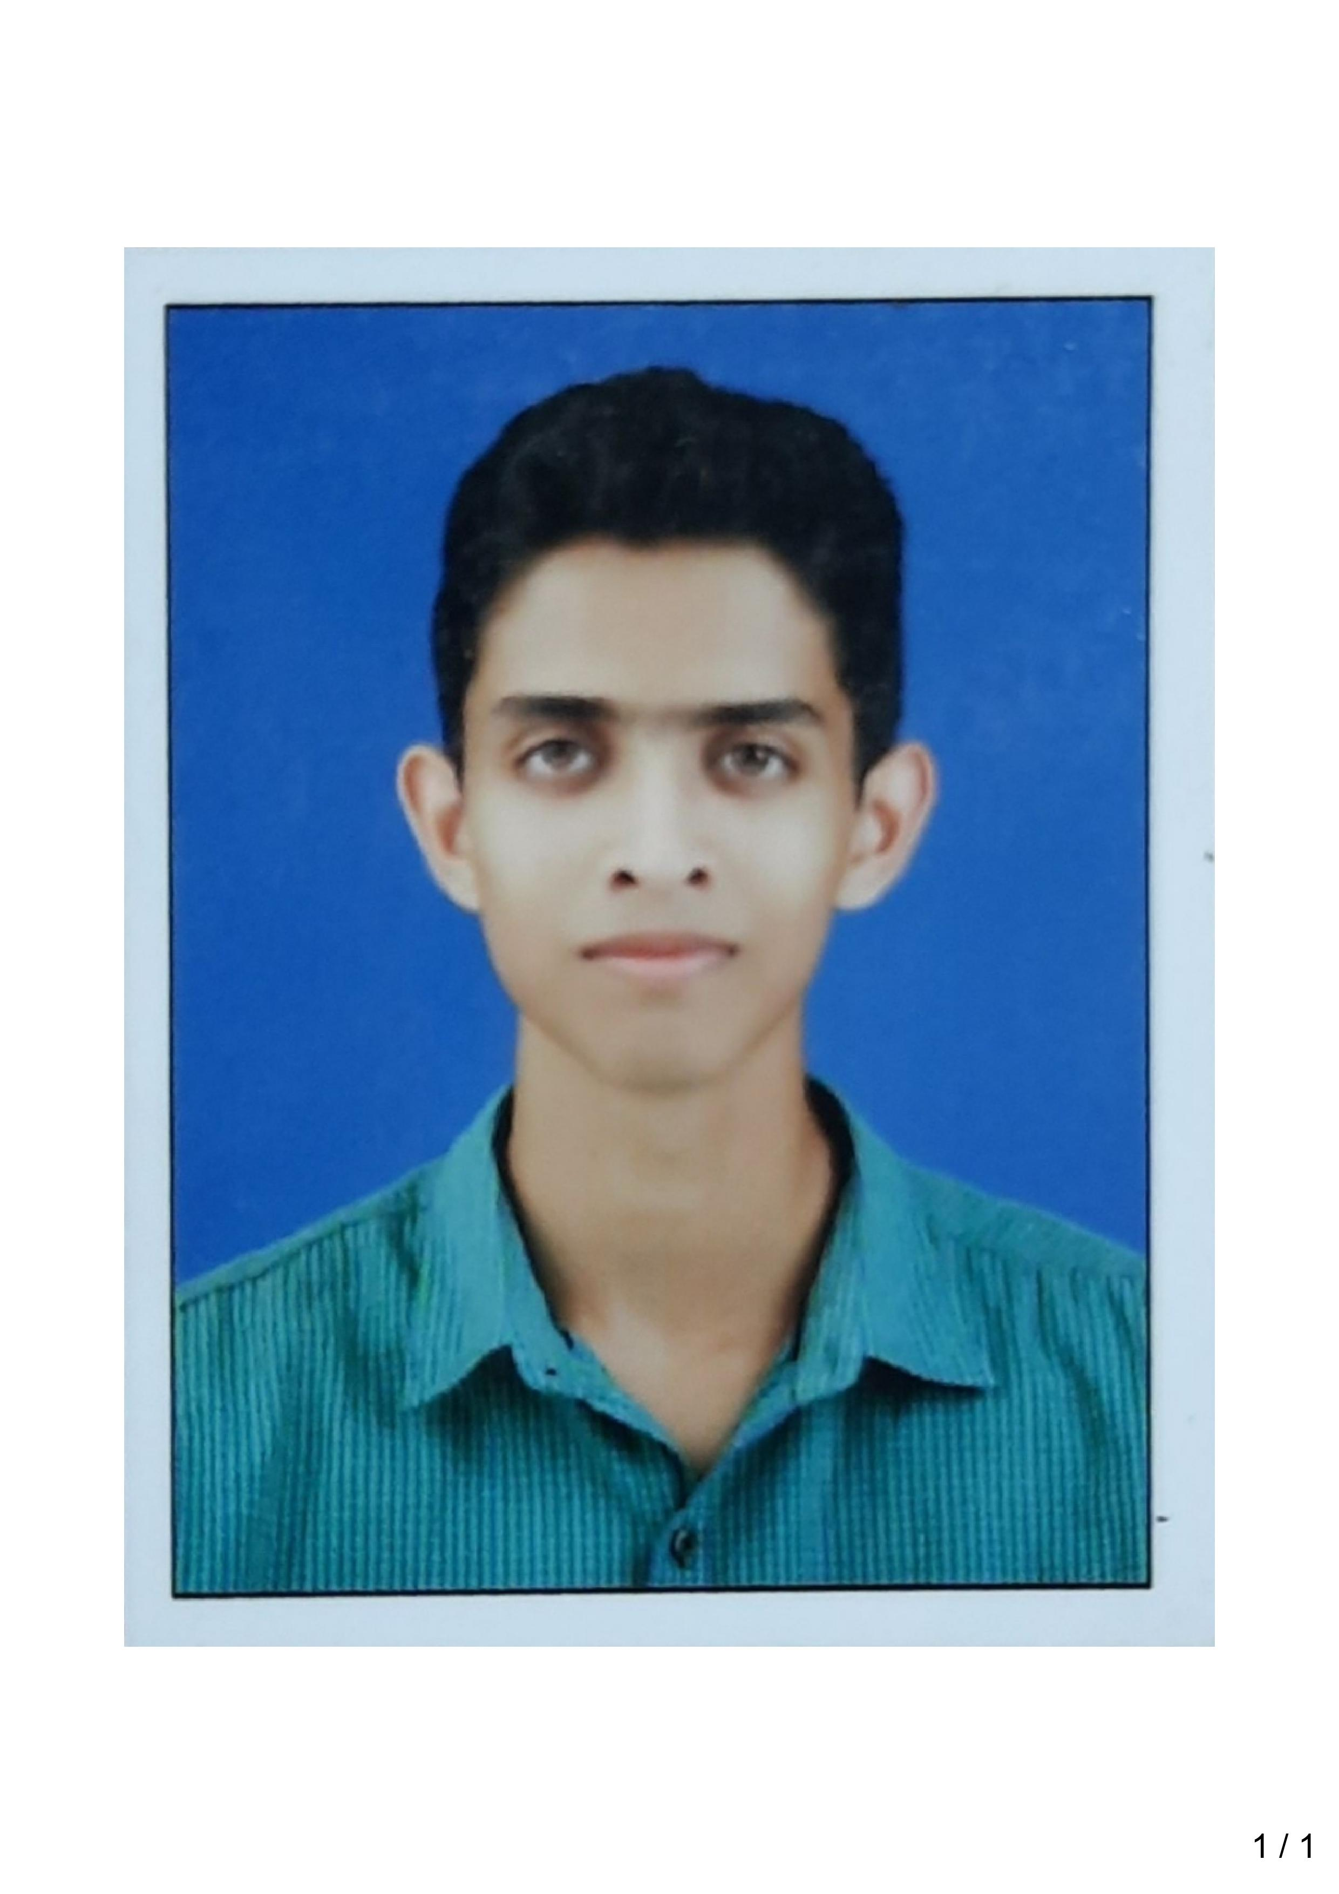
Meet Myself
Justin v kalappura
STU ID: STU62dcecb5c7fa61658645685
MCA Regular
Amal Jyothi college of Engineering, Koovapilly
Kerala

