Slide 1

Sentiment Analysis of iPhone 13 Release
By justin weible
Notes:
Hello! My name is Justin Weible, and I’m presenting a sentiment analysis of tweets related to the iPhone 13 release.
Apple’s market share in the global smartphone market remained steady at 15% in Q2 2021, so gauging consumer response to the newest product release could prove important in maintaining Apple’s position in the market.

Slide 2
Business Case Overview
The purpose of this analysis is to look at tweets about the iPhone 13, determine if the tweet is positive, negative, or neutral, and then use this information to determine the public’s response to various iPhone features.
This information can be used to analyze how consumers respond to the key features of iPhone 13 to be used by marketing and product development in order to identify improvements that could be highlighted for future iPhone models.
Notes:
The purpose of this analysis is to look at tweets about the iPhone 13, determine if the tweet is positive, negative, or neutral, and then use this information to determine the public’s response to various iPhone features.
This information can be used to analyze how consumers respond to the key features of iPhone 13 to be used by marketing and product development in order to identify improvements that could be highlighted for future iPhone models.

Slide 3
Data Collection
Tweets were collected via Twint over a two-week period from 09-26-21 to 10-09-21.
63,799 tweets were analyzed, limited to just those tweets in the English language.
Collection of tweets is limited by the Twitter API which only keeps tweets for seven days.
Notes:
The dataset was sourced from Twitter and obtained via Twint.
These tweets were collected over a two-week period from September 26, 2021, to October 9, 2021, coinciding with the two-week period following the release of the iPhone 13 on September 24.
Tweets were collected two days after release in order to account for sales over opening weekend.
An overall total of 129,344 tweets were collected from Twitter encompassing all languages, but the number of tweets was reduced to 63,799 tweets to include only the tweets in English.
Twitter’s API only makes tweets available for seven days, and Twint currently also has this restriction.

Slide 4
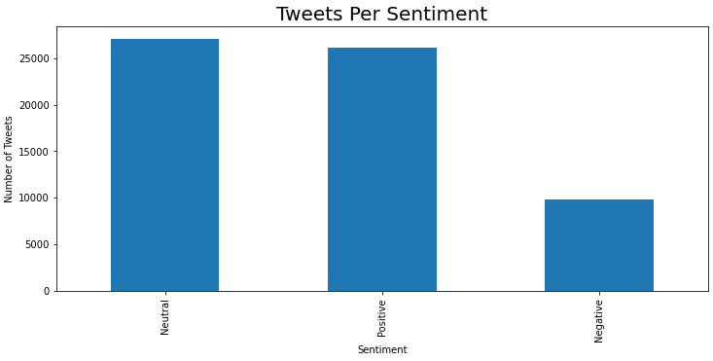
Sentiment Analysis
Notes:
VADER was used for the sentiment analysis in order to determine the classification of the tweet.
The overall reaction to the iPhone 13 was positive or neutral.

Slide 5
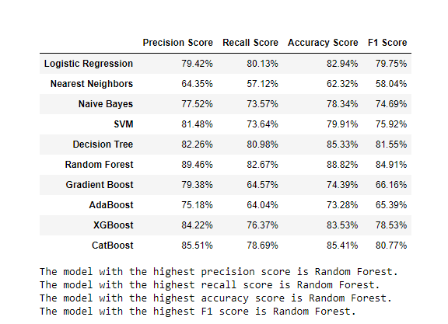
Model
Notes:
Each tweet was cleaned in order to remove articles, prepositions, pronouns, conjunctions, and other common words, as well as hashtags and mentions.
These cleaned tweets were run through a number of classification models in order to achieve the most balanced model that would predict whether a tweet would be classified as positive, negative, or neutral.
The best overall model in all categories was a Random Forest model with Decision Tree coming in second.
A Logistic Regression model also proved to be useful for a very specific situation.

Slide 6
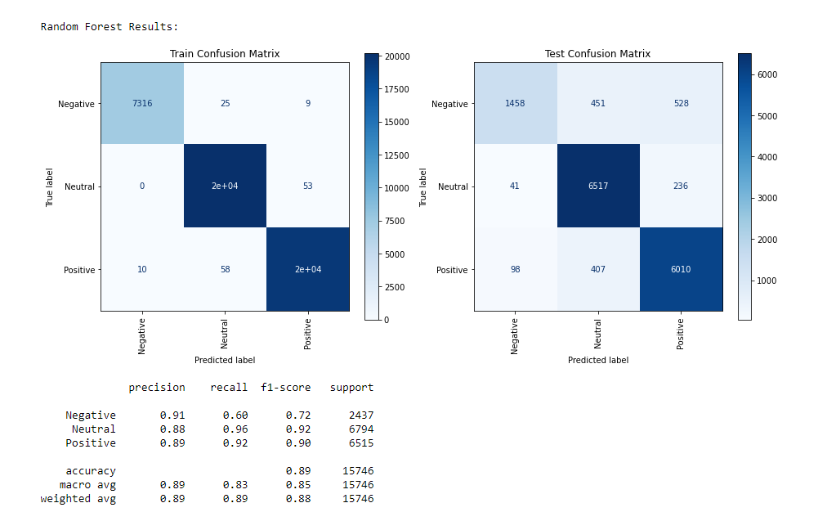
Model
Notes:
Random Forest generated the best overall scores out of any model.
However, the Random Forest model proved to not be good at predicting negative tweets likely due to the class imbalance of the data used.
A very high number of false negatives were generated, which could be acceptable since the model is predicting a number of tweets will be negative although they’re actually positive.
If you’re looking to predict positive opinions on the iPhone, this model is much more useful because positive and neutral F1 scores are 0.90 and 0.92 respectively, showing that the model does a good job of predicting positive tweets and neutral tweets, despite not being as accurate at predicting negative tweets.

Slide 7
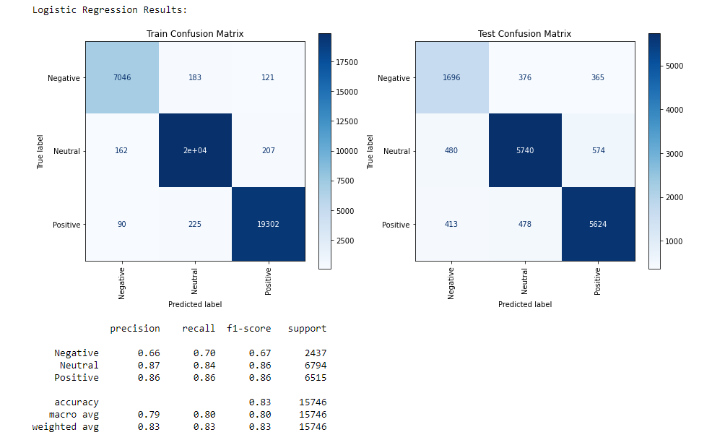
Model
Notes:
-Logistic Regression is another good option for a model.
-Logistic Regression was not as accurate with all three classifications as Random Forest.
-However, Logistic Regression did a better job of reducing the number of false negatives in model prediction with a Recall score of 0.70 compared to Random Forest’s recall score of 0.60.
-Both models are viable depending on what situation you want to analyze.
-Logistic Regression is a better option if you’re trying to predict negative tweets while reducing the number of false negatives, but overall, the Random Forest model is more accurate than Logistic Regression.

Slide 8
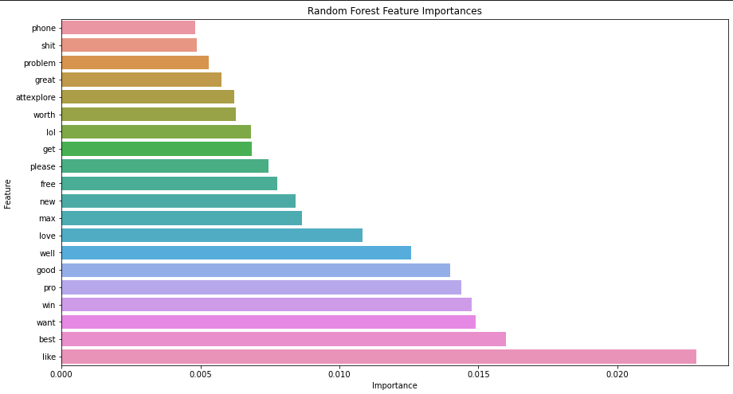
Feature Importances
Notes:
I used the Random Forest model to analyze feature importance since that model produced the most balanced results.
After analyzing feature importances, it became clear that a number of words were deemed important by the model that weren’t directly related to the actual features with a number of adjectives being highlighted, as well as AT&T Explore, which is not pertinent to Apple.

Slide 9
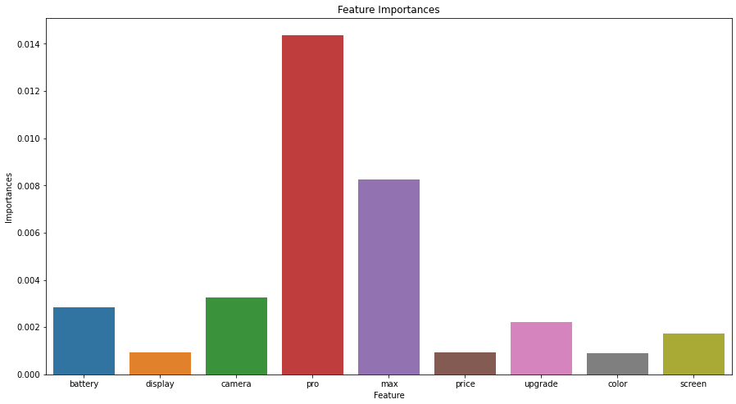
Feature Importances
Notes:
-A second analysis was done on feature importances, but this time, just the key features of the iPhone were isolated in order to see their importances to the model in order to remove words that were unrelated to the features.
Battery, display, camera, pro, max, price, upgrade, color, and screen were chosen as those are features that are commonly updated in each model.
Pro and Max were used to identify the Pro and Pro Max models of iPhone.
- The model predicts that the top features were pro and max, which shows that consumers are more interested in the iPhone Pro Max model than the other models on offer.
- The model also predicts that consumers pay attention to the battery and the camera more than other features like the display or color.
- Predictions also show that consumers also focus on whether they need to upgrade their phones to the newest model.

Slide 10
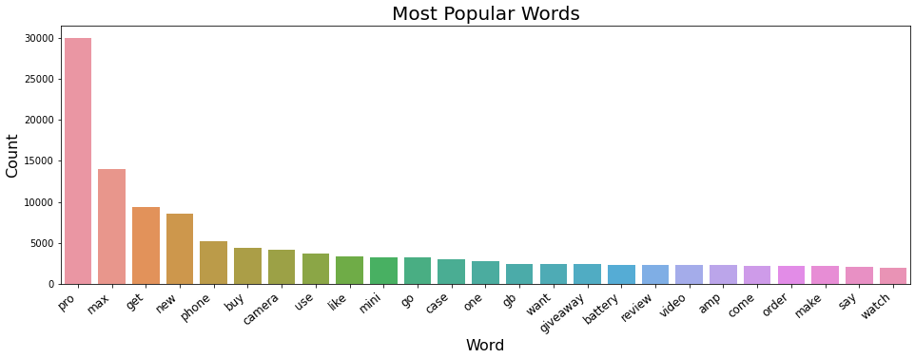
EDA
Notes:
Analysis of the number of words in tweets shows that the model predictions are accurate in terms of the Pro Max, camera, and battery.
All three features appear among the most popular words in the tweets that were analyzed.

Slide 11
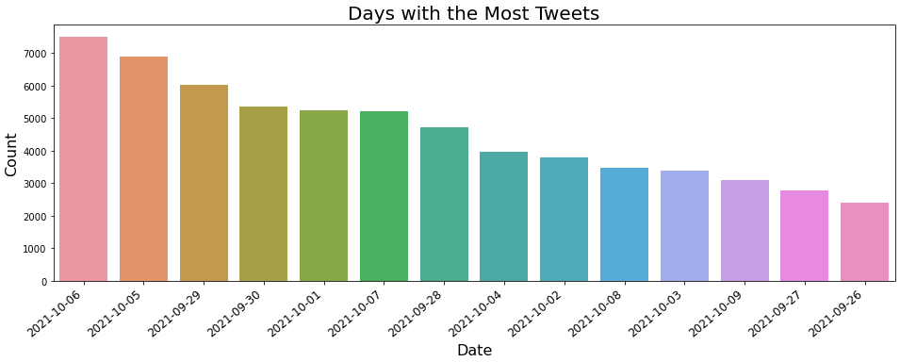
EDA
Notes:
This graph shows the days that have the most tweets.
October 5 and October 6 were the days that had the most tweets about the iPhone 13.
There were more tweets per day as the date was further from the iPhone 13 release date of September 24th,
This could be explained by shipping times and reflects when consumers received their product.

Slide 12
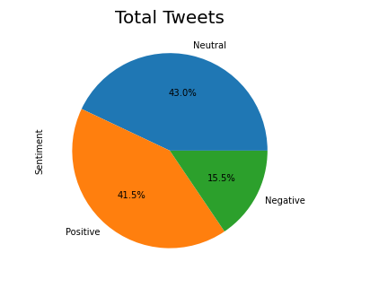
EDA
Notes:
Twitter sentiment analysis shows most people were pleased with iPhone 13.
Sentiment analysis shows that most tweets were classified as positive or neutral.
Almost 85% of tweets were classified as positive or neutral.

Slide 13
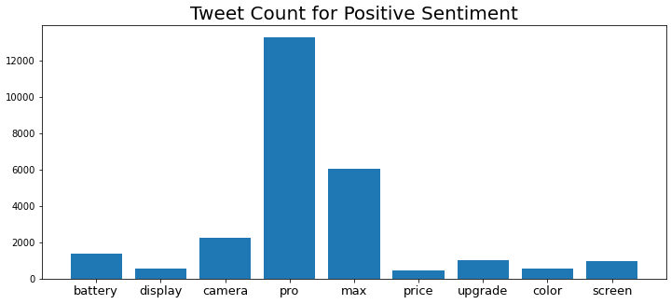
EDA
Notes:
Using the information from feature importances and the sentiment analysis, I looked at the number of tweets about each of the key features in order to identify customer engagement with each feature.
The Pro Max is clearly the most tweeted about out of all the features, reflecting that people react to the top-of-the-line model.
Other features that consumers react to positively are the battery life and the camera, showing that further product development on these features is being well-received.

Slide 14
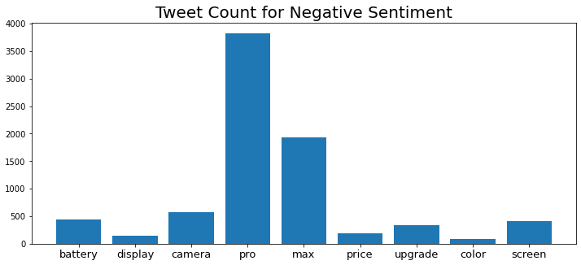
EDA
Notes:
However, there was also a negative reaction to the Pro Max model, the battery life, and the camera.
Deeper analysis may need to be done, as that could also be affected by there being negative reactions to both

Slide 15
Conclusions
The most talked about aspect of the iPhone on Twitter is the Pro Max model, showing that features of the model such as a larger screen and better camera are favored by consumers.
People are more focused on improvements to battery life and the camera and react accordingly.
Overall reaction on the iPhone 13 was positive or neutral, showing that consumers were relatively pleased.
Upgrading is also talked about on Twitter and negative reactions to upgrading could be due to updated features
Notes:
b

Slide 16
Future Recommendations
Analysis of how Twitter sentiment affects stock market price could be looked at in order to get a better sense of how public opinion impacts Apple’s financial profile.
Time series modeling could also be used to see how Twitter sentiment changes over time, as well as use that to compare with financial data.
This analysis was just done over a two-week period immediately after release. Further analysis could be done over a longer period of time.
Modeling Twitter sentiment is limited to current trends because of the Twitter API only allowing you to gather tweets that are seven days old. Historical Twitter data is no longer available.

Slide 17
Thank You!
CONTACT INFORMATioN:
Email: jweible23@gmail.com
Github: https://github.com/justinweible/iphone_13_analysis

