Slide 1
Syriatel customer churn analysis
By justin weible

Slide 2
DATA:
Data was analyzed from 3333 customers
The data included information on:
Account length
International plan
Voicemail plan
Number of voicemail messages
Customer Service calls
Customer charges (total, day, evening, night, international)
Number of customer calls and length of calls (total, day, evening, and international)
Of the 3333, 2850 customers were retained (86%) and 483 churned (14%)

Slide 3
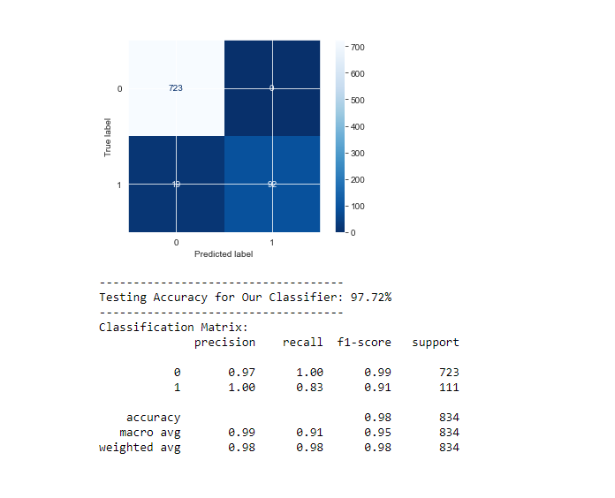
Model
Customer data was run through various models in order to find the most accurate model.
The model used was chosen based on precision in order to predict if a customer churns with accuracy.
Our model has a precision score of 0.97 when predicting customers that retain their service and a precision score of 1.00 when predicting customers that churn.
The model correctly predicted all customers that were retained but predicted customers that churn with a 17% error.
Notes:
The purpose of the model was to predict customers that churn and identify factors that might influence that decision. If a customer is predicted to churn but actually is retained, that’s simply a bonus.

Slide 4
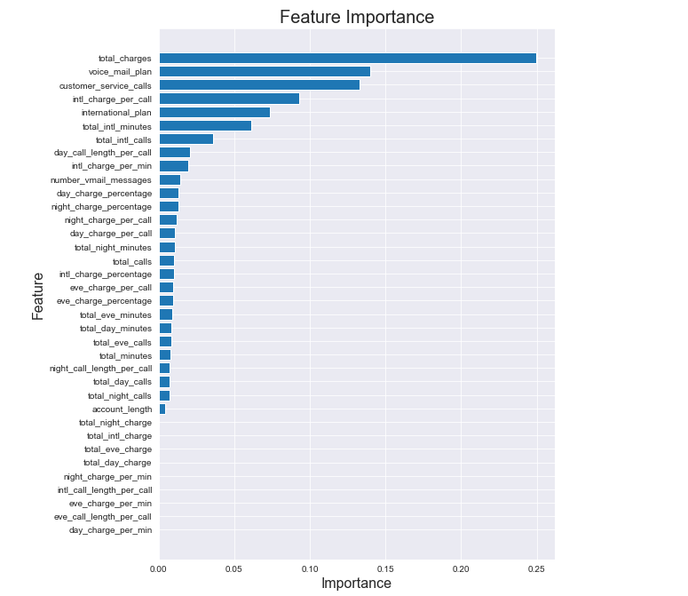
Top factors affecting churn
Using the model as a starting point for data exploration, the top factors affecting churn are:
Total charges
Voicemail plan
Customer Service calls
International plan

Slide 5
Total charges
Customers who pay more for their service tend to churn at a higher rate.
Customers who churn pay $65.35 on average.
Customers who don’t churn pay $58.45 on average.
Customers who pay higher day charges also churn at a higher rate compared to charges at other times.

Slide 6
Voicemail plan
Only 28% of our customers have a voicemail plan.
72% of the customers that churn do not have a voicemail plan.
28% of the customers that churn have the voicemail plan.

Slide 7
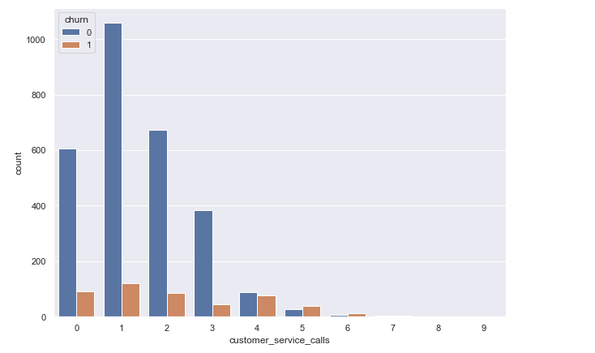
Customer service calls
52% of customers who have made 3 or more calls to customer service churn.
79% of customers have made at least 1 call to customer service.

Slide 8
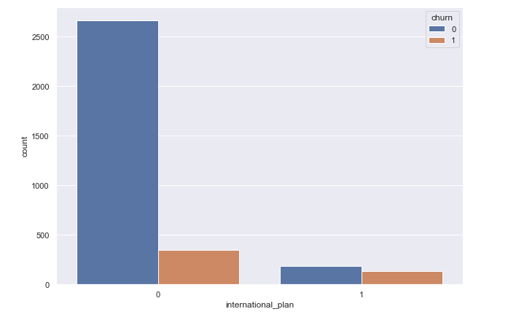
International plan
Only 10% of our customers subscribe to the international plan.
There is virtually no difference in international charges per minute between those with an international plan and those without an international plan.
26.8 cents per minute for those without an international plan.
27 cents per minute for those with an international plan.

Slide 9
Recommendations
Evaluate the rates we’re charging our customers.
Customers seem to be displeased with the high rates, as those who are charged the most tend to be more likely to churn.
Give more advertisement to our voicemail plan.
With the low number of people that are subscribed to our voicemail plan, it seems that some customers might simply be unaware that we offer one.
Evaluate customer service and what we might be able to do better to assist the customer.
Customers making more than 3 service calls are churning at over 50%.
Additional training for customer service staff might be needed, but it also could be related to other factors.
Research whether an international plan is worth providing, and if it is, look at ways that the service might be improved.
Very few customers are using an international plan
Those that are using it are seeing no cost reduction to their service.

Slide 10
Thank you
Contact information:
Justin Weible: jweible23@gmail.com

