Slide 1

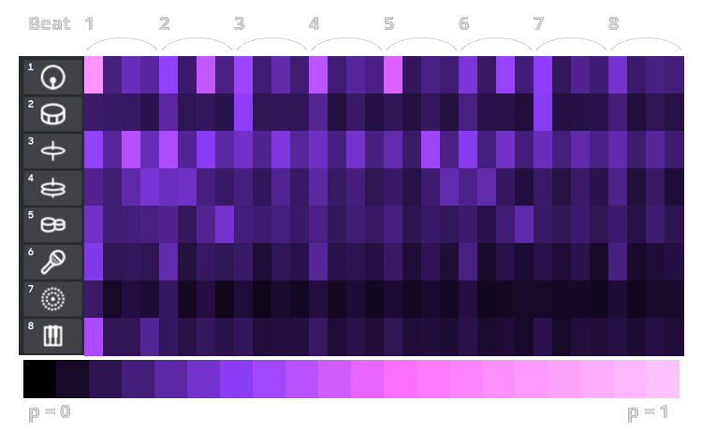
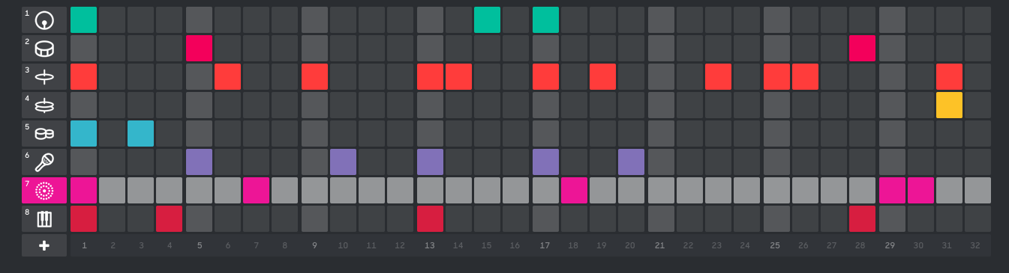
Robot Music: Beat Generation with Factor Graphs
Han Lin Aung, Justin Xu, Sicheng Zeng
Background
Method 3
BACKGROUND
BACKGROUND
BACKGROUND background
Method
Method
Method
K-means
Description
Stuff
methods
Method 1
BACKGROUND
BACKGROUND
BACKGROUND background
Results
Results
Results
Conclusion
Method 2
Results
Results
Results
Conclusion
BACKGROUND
BACKGROUND
BACKGROUND background

Slide 2
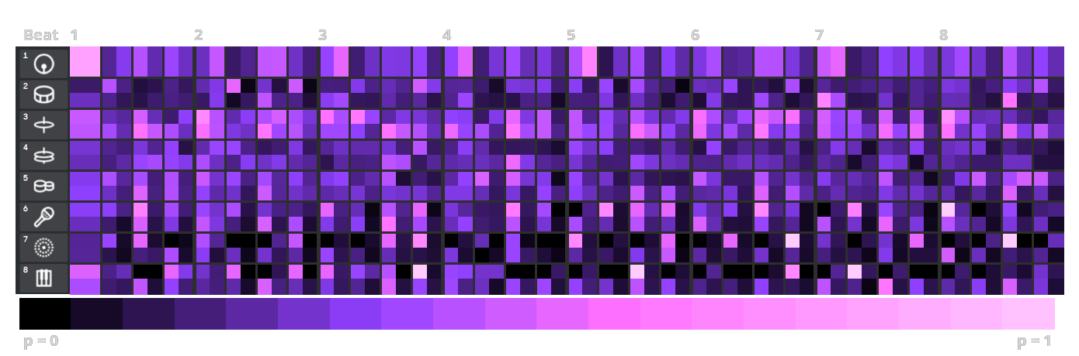
1
1
1
1
0
1
0
0
0
0
1
0

