Slide 1

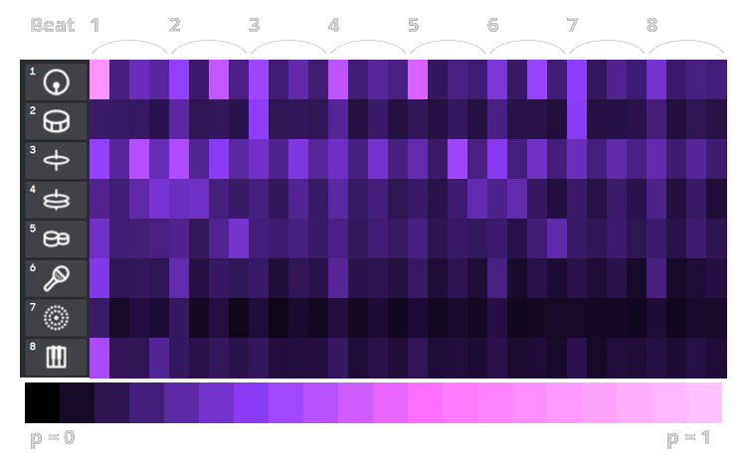
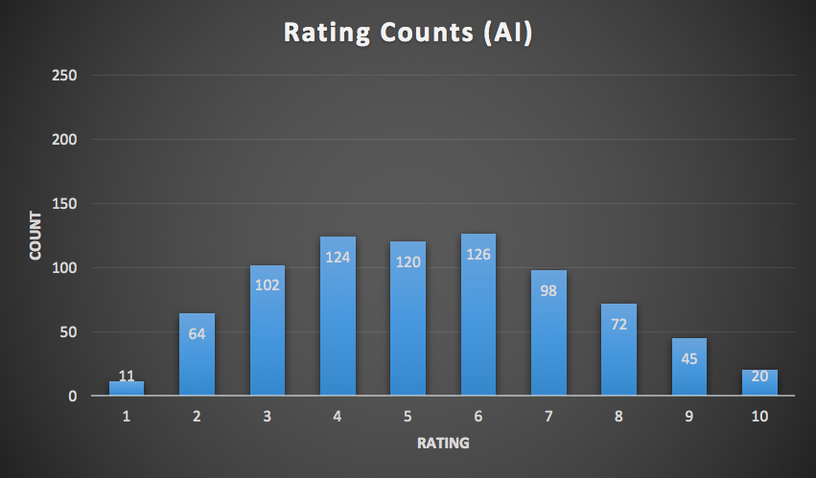
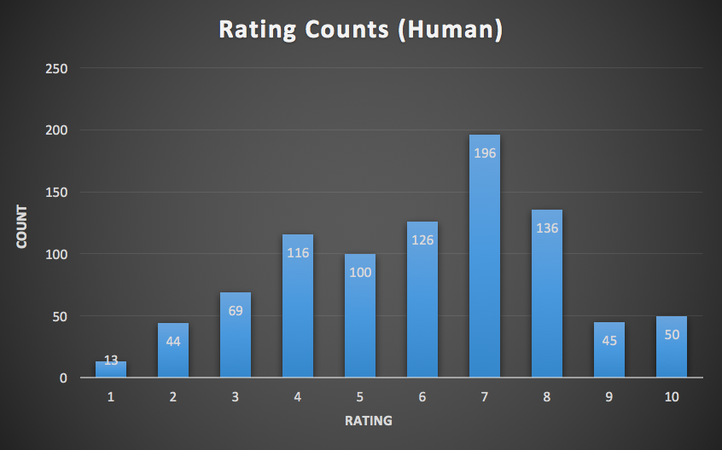

Robot Music: Beat Generation with Factor Graphs
Han Lin Aung, Justin Xu, Sicheng Zeng
Background
Method 3
BACKGROUND
BACKGROUND
BACKGROUND background
Method
Method
Method
K-means
Description
Stuff
methods
Method 1
BACKGROUND
BACKGROUND
BACKGROUND background
Results
Mean: 4.273 Std: 2.126
Mean: 4.891 Std: 2.362
Method 2
Conclusion
BACKGROUND
BACKGROUND
BACKGROUND background
Results
Results
ResultsConclusion

