Slide 1

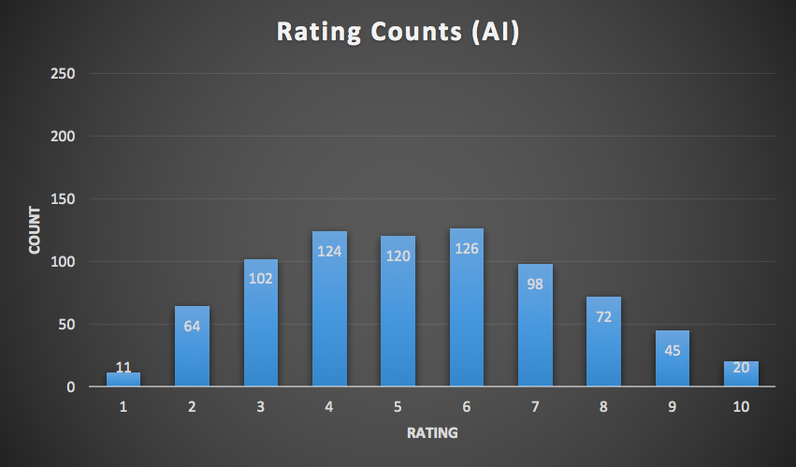
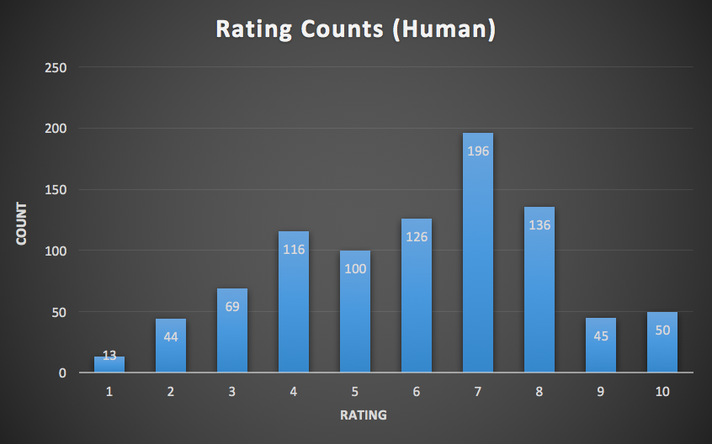
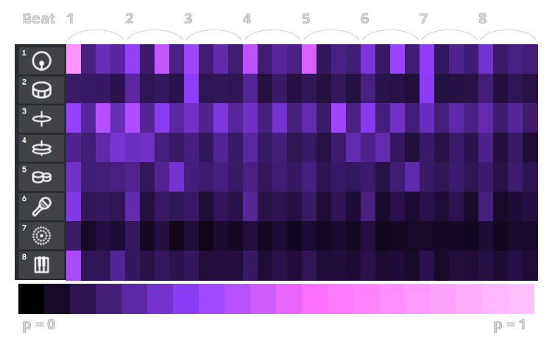
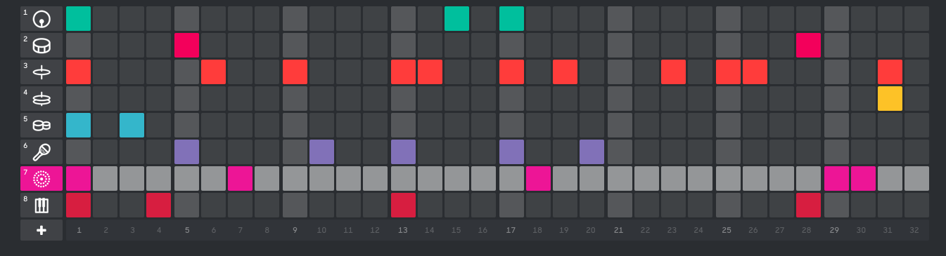
Robot Music: Beat Generation with Factor Graphs
Han Lin Aung, Justin Xu, Sicheng Zeng
Background
Method 3
Automatically generate and create new music beats, focusing on rap and hip-hop beats
See if machine generated music is comparable to that of the humans
Creative domain - splice beatmaker defined a 2 measure beat structure as an 8x32 grid that can be turned on or off
Ran a k-means algorithm on the note density of the example beats to separate each set into a group of low, medium, and high density clusters.
Centroid weights were approximately (12,50,100) out of 256 possible blocks
Without k-means, the data had too much variance, so the separation made the generation of music more segmented and clearer
Ran a maximum likelihood estimation likelihood over each cluster of example beats to get an estimation of the conditional probabilities of Bayesian networks.
Simulated a creation of a new beat by iteration through the blocks and assigning the block to on with probability given by the Bayesian graph.
Method 1
Scraped ~700 example beats from twitter and converted to a set of standardized instrumentations
Ran a maximum likelihood estimation likelihood over all the beats to get an estimation of the probabilities of each beat
Results
Mean: 4.273 Std: 2.126
Mean: 4.891 Std: 2.362
Surveyed people to give ratings(on a scale of 1-10)
There does not seem to be a significant difference between the ratings of beats produced by AI or by the humans
Method 2
Conclusion
Constructed a Bayesian network such that each node depended on the beat right before and right above it.
These dependencies were chosen for similar reasons as the car modeling assignment. There is a time dependency to the flow of a beat, as well as an interaction with the instrument right above it
Promise in using MLE, and factor graphs to generate beats, or even melodies
Our algorithm produced beats at a quality that is at least comparable to that of an average casual beatmaker
After using K-means to classify dataset into different densities of beats, beats trained on low-density dataset scored higher ratings
Future: Gather more data and ratings on low, medium, high densities of beats to dive deeper into mechanics of generating better sounding music

