Slide 1
Lab 05 Component based Game
Software Studio
DataLab, CS, NTHU
2017 spring

Slide 2
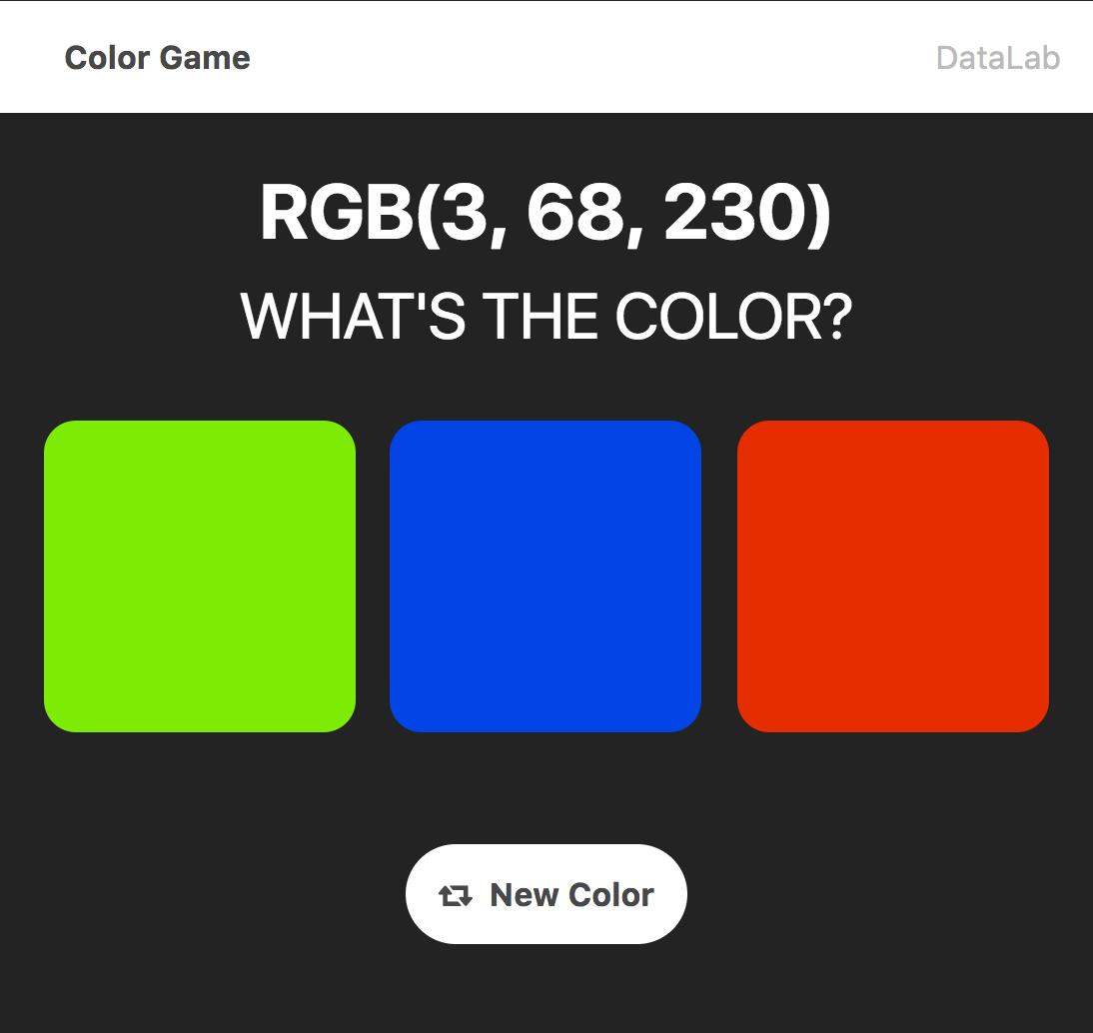
Color Game component
Navbar
Board
Main
Card
Card
Card
Deck
Reset

Slide 3
Main
Navbar
Board
Deck
Reset
Card
Notes:
那這邊有一點要特別注意的是，
和user有直接互動的通常是越底層的object

Slide 4
Main
Reset

Slide 5
Main
Fire event
Reset

Slide 6
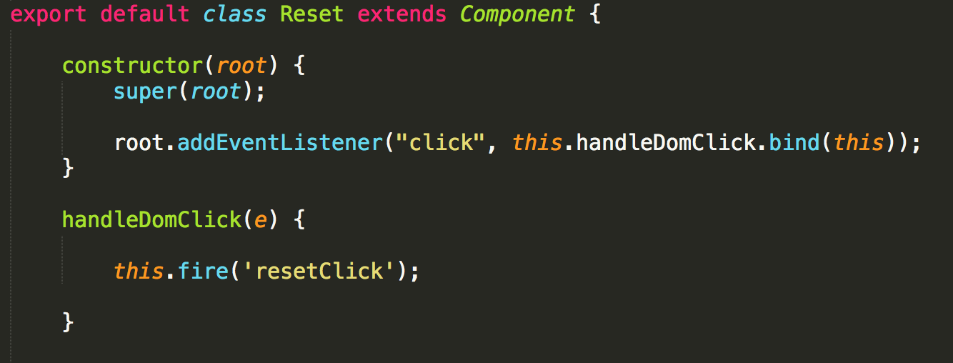

Slide 7
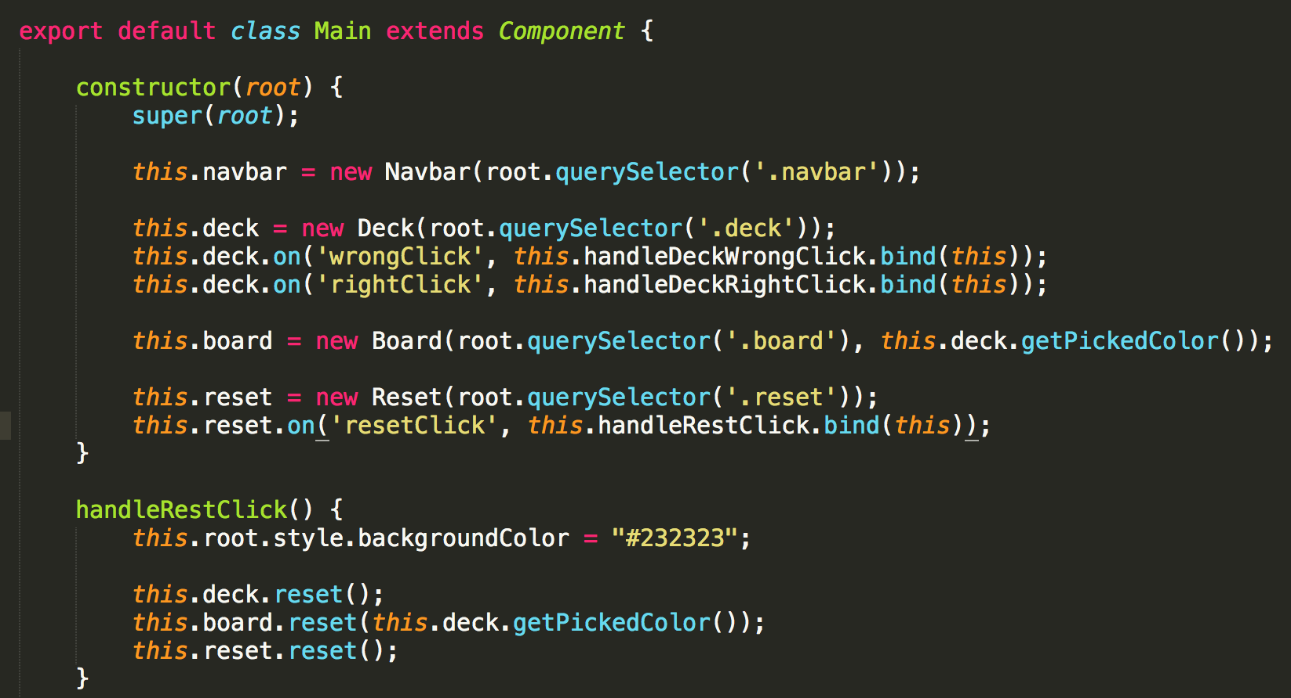

Slide 8
Main
reset.method()
Reset

Slide 10
How about click card?

Slide 11
Main
Deck
Card

Slide 12
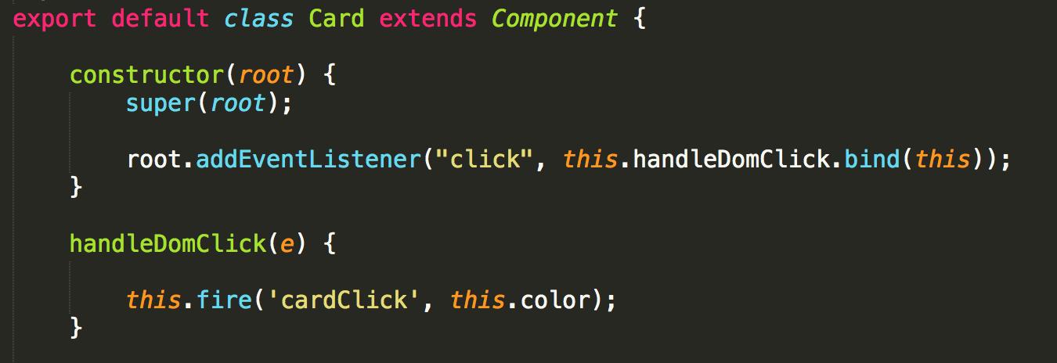

Slide 13
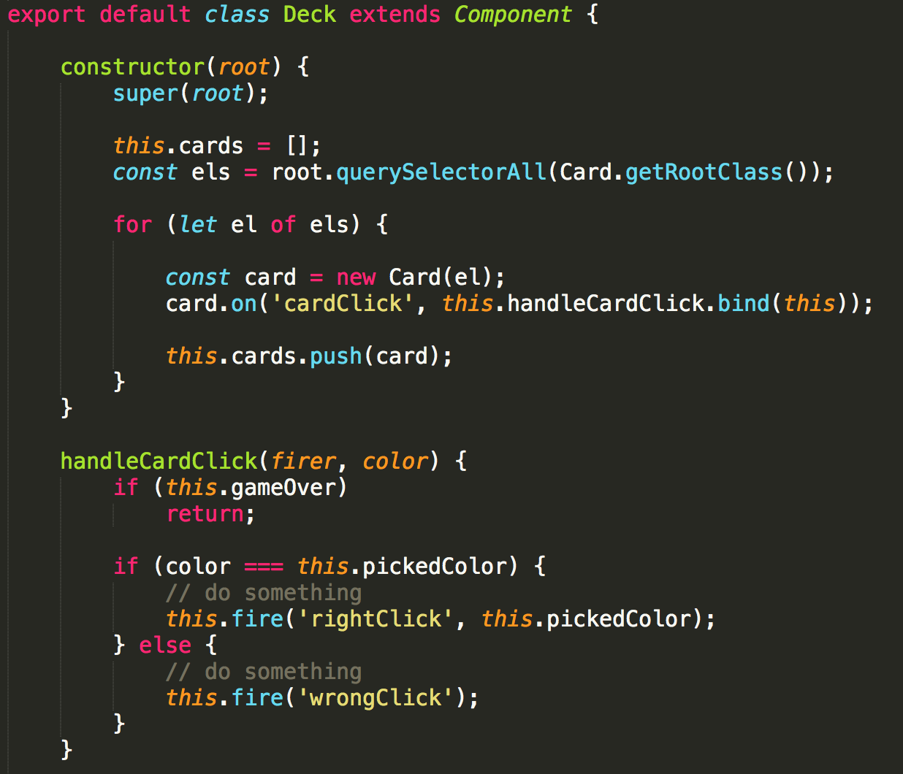

Slide 14
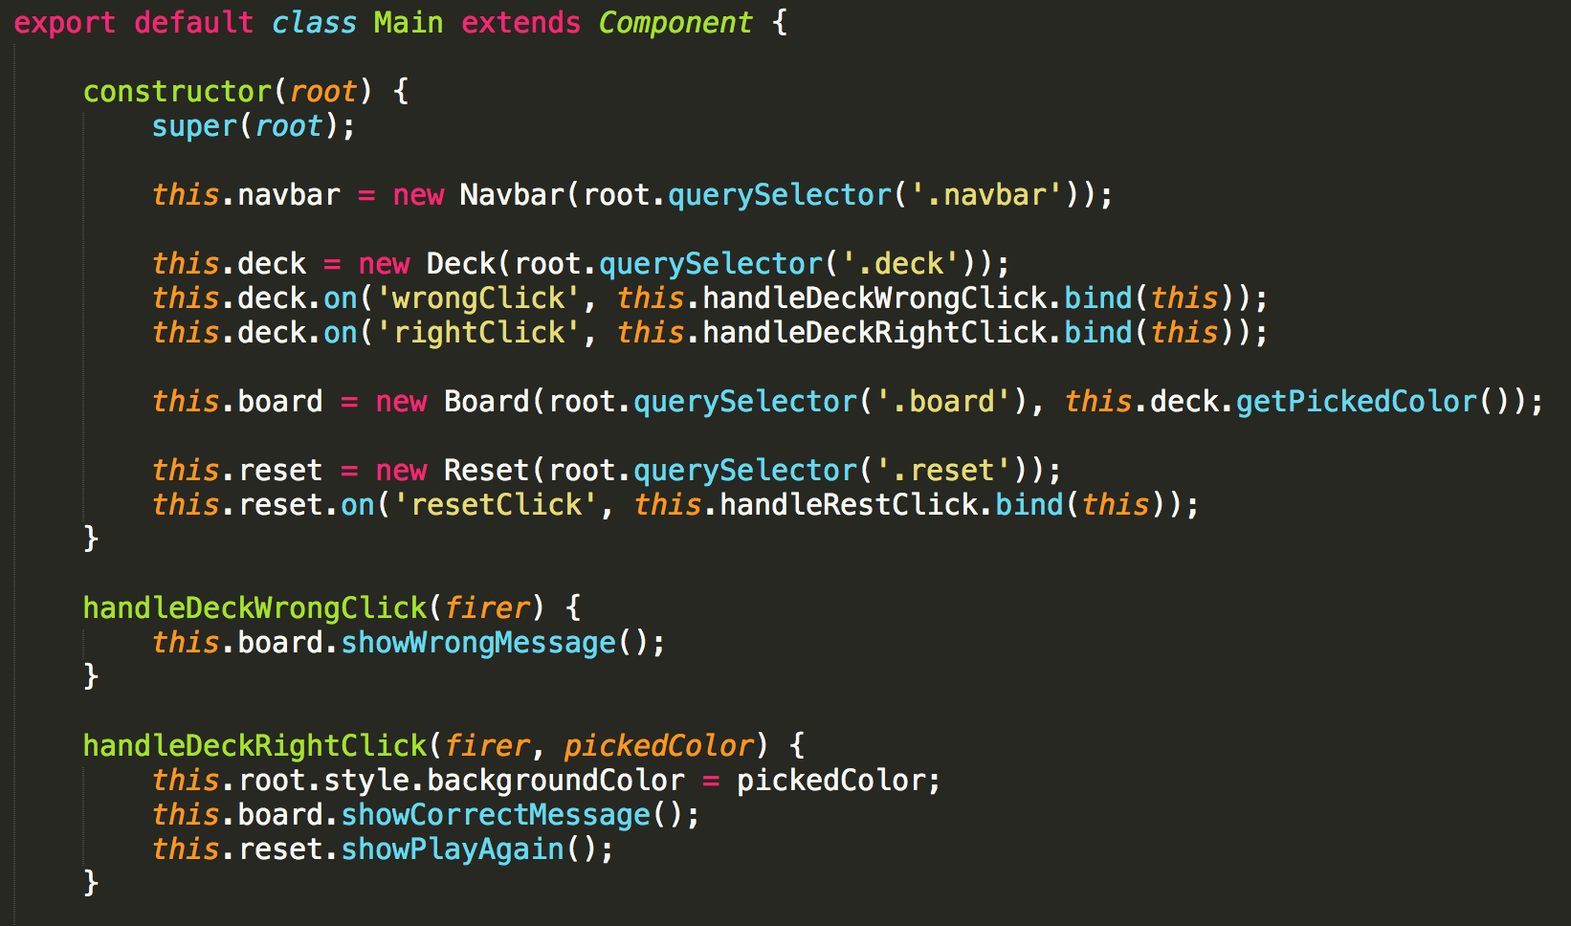

Slide 16
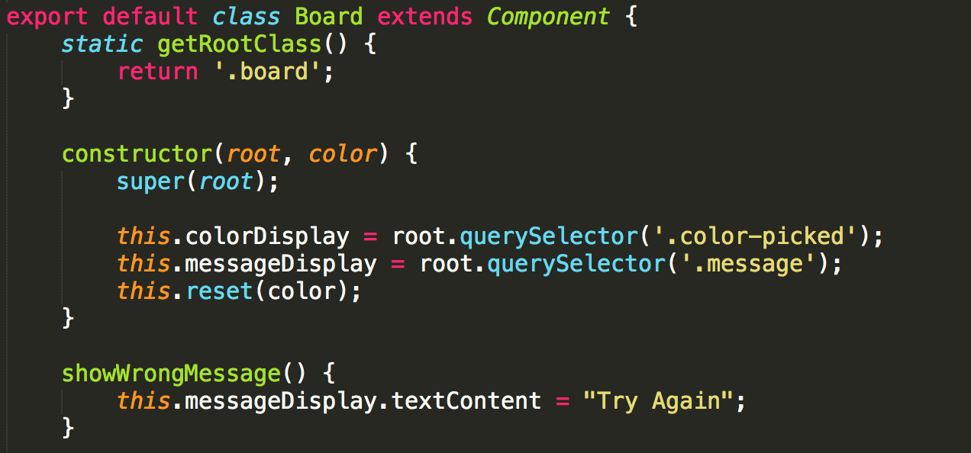

Slide 17
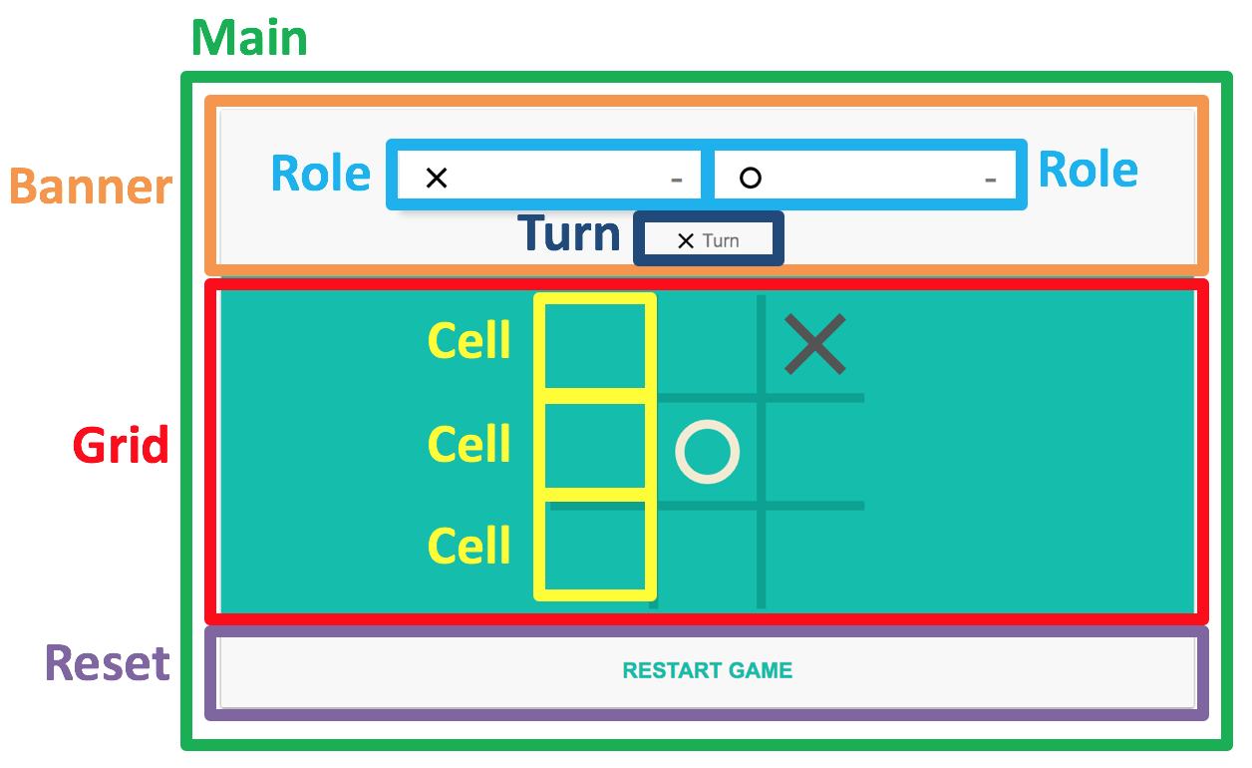
Tic-Tac-Toe

Slide 18
Main
Banner
Grid
Reset
Role
Turn
Cell

Slide 19
Hint (1/3)
In the Cell component you may have following functions :
constructor
maybe you need to add an event listener here
reset
when finish game or reset button clicked you need to reset cell
handleDomClick
when cell is clicked maybe you need to fire up
occupyCell
maybe you need to change the cell content when the cell is clicked
isOccupied
maybe you need to judge whether the cell is occupied
isMatch
maybe you need to judge whether the cell is occupied by O or X

Slide 20
Hint (2/3)
In the Grid Component maybe you need to do following tasks :
Reset all cell
Handle cell click
Check whether the game is over (someone win / draw)

Slide 21
Hint (3/3)
You don’t need to follow our template.
You don’t need any css decoration.
You can use <table></table> to present container of cell.
Be sure you have all component .js file.
You can reuse the code of component based Color Game.
If you want to use Object.on() / Object.fire(), make sure you extend Component.
Good Luck!

Slide 22
離開前請簽名！！！！

