Slide 1

WEB FARES
INFARE
AIRCUBE
PLP integration
PRM @ Hanoi, March 2019

Slide 2
WEB FARES – OVER VIEW
OAL Published fares
GDS
PLP (Fares List/Fare Queue)
VN Published& Private fares
GDS
OAL Private &
VN Private fares
Infare (Pharos/Aircube).
PLP (Fares List/Fare Queue)
Website (VN/OAL/Agt)
Fares as filed, with no Availibilty
Fares as available

Slide 3
AIRLINES PRICING PROCESS
Analysis +
Strategy
Market info
Fares
Monitoring
Decision –
Making
RM
Decision-
Making
Flight
opening status

Slide 4
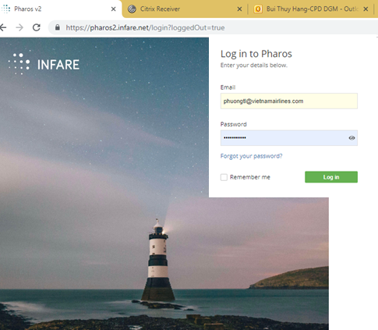

Sign in
https://pharos.infare.net
User: PhuongTL@vietnamairlines.com
Pass: PRM@cpd2019
Sign out when idle.
SHARE THE RESOURCE
Key users: DuongDT/LienLTH/
NgaVV/Hangbt

Slide 5
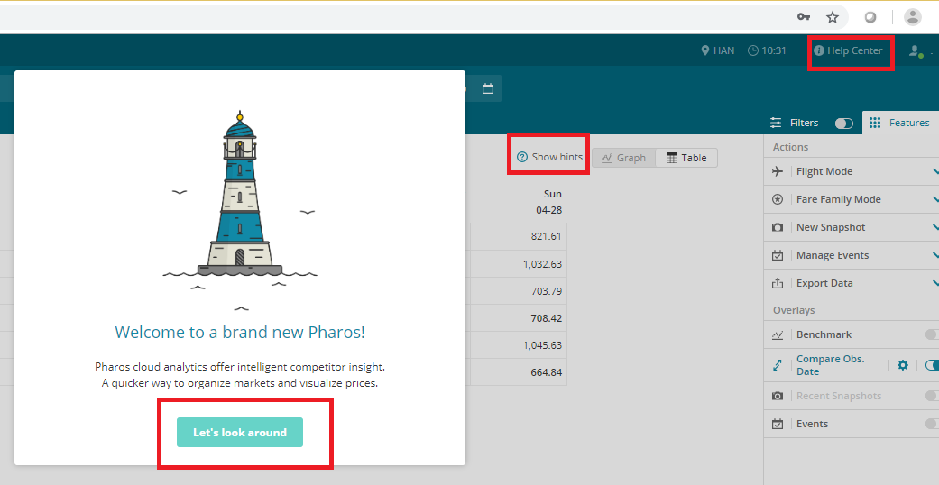
Help is all around

Slide 6
Basic functions
Latest Price
Price Evolution
Average Price
Price Distribution

Slide 7
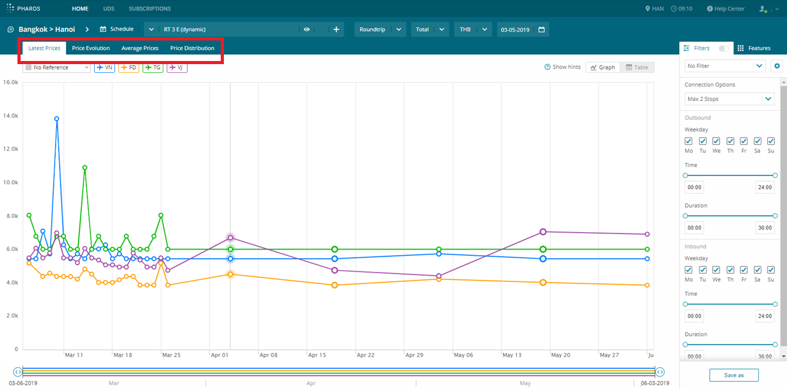
Basic functions

Slide 8
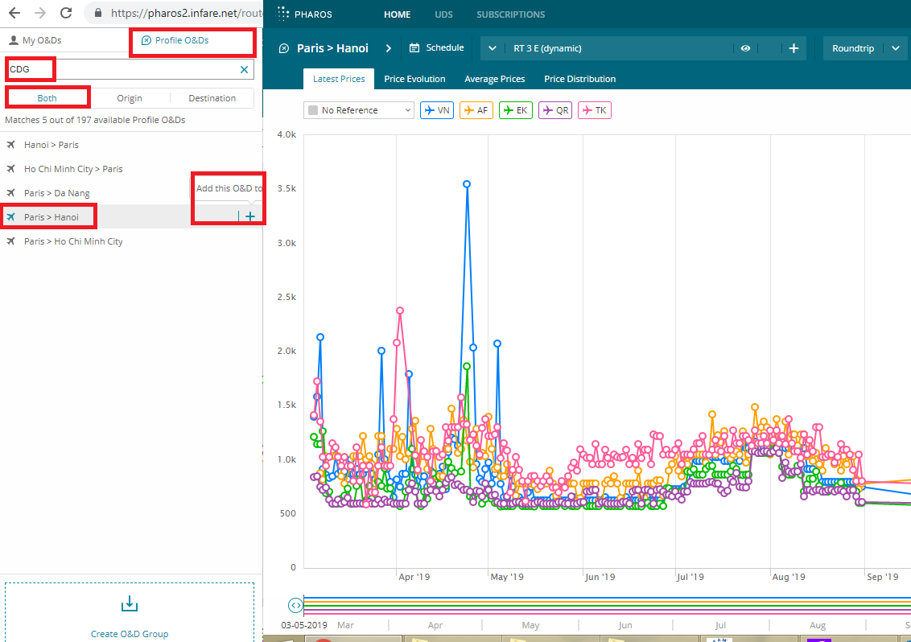
Basic Function: Latest Price

Slide 9
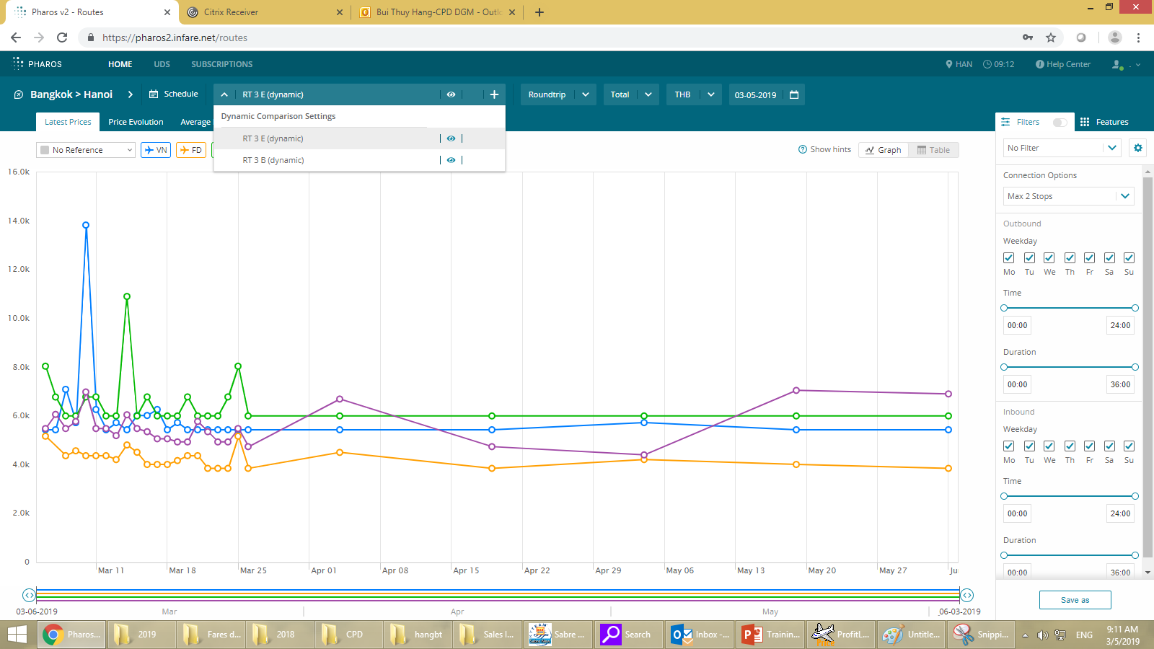
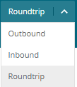


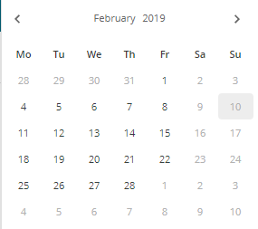
Basic Function: Filter conditions
O&D
RT: Round trip fares
3: Max stay 3 days.
Black: Date with data
Gray: Date without data
Departure dates

Slide 10
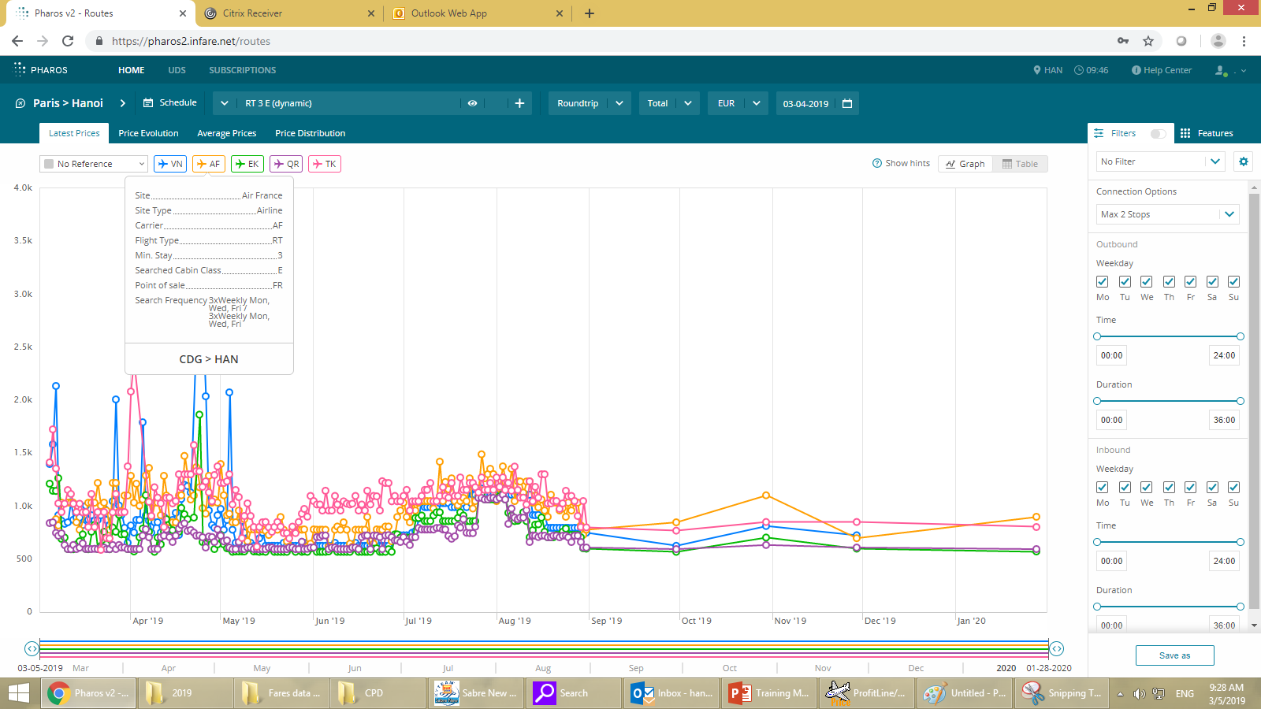
Basic Function: Latest Price
Click on Airlines to Elimite/Add Airlines

Slide 11
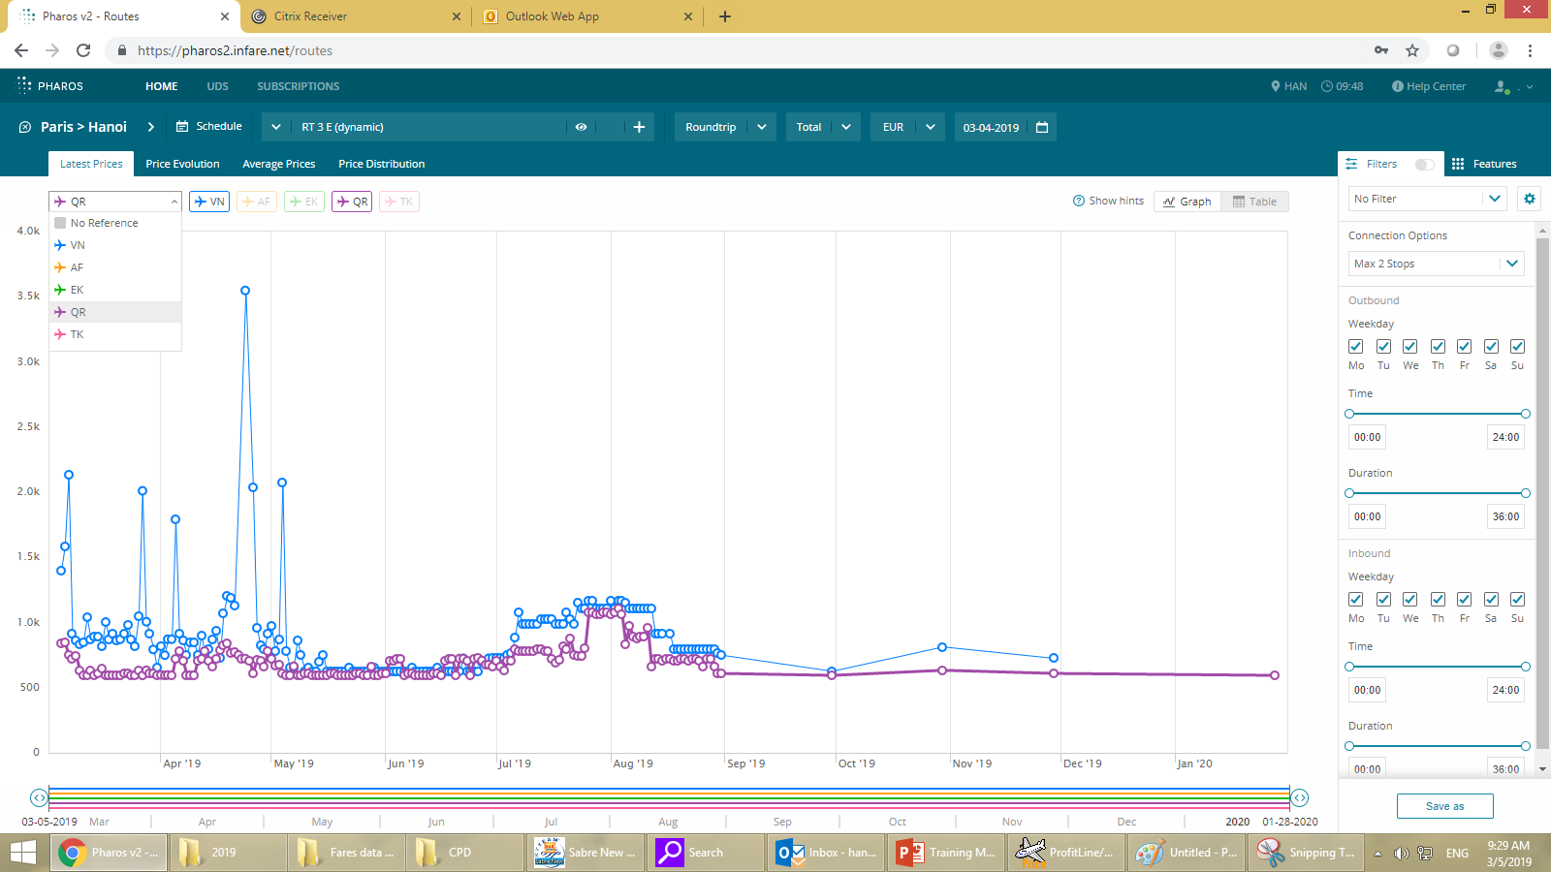
Basic Function: Latest Price
Choose Reference to BOLD the fare line

Slide 12
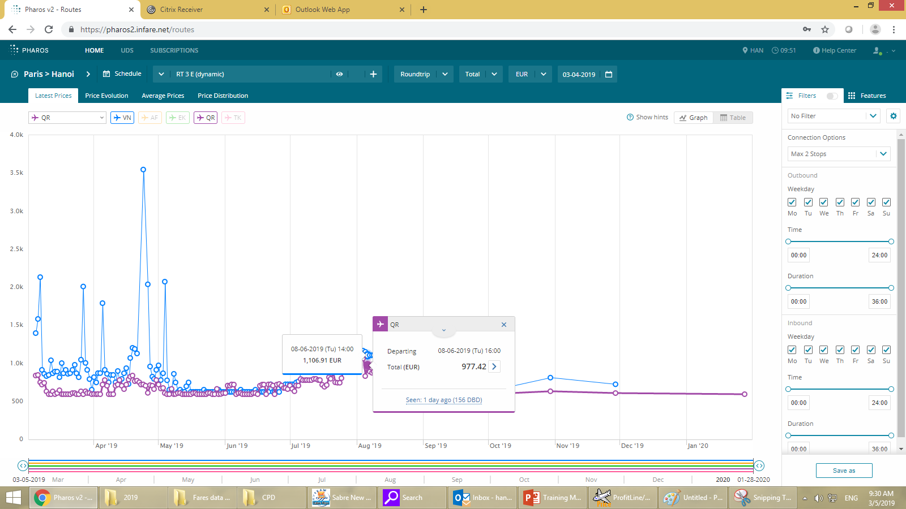
Basic Function: Latest Price
Click on Fares to see details

Slide 13
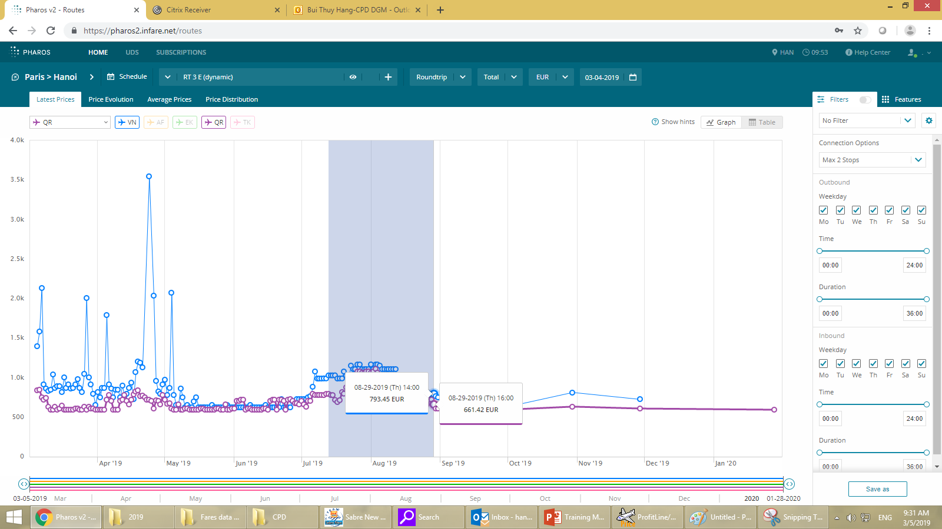
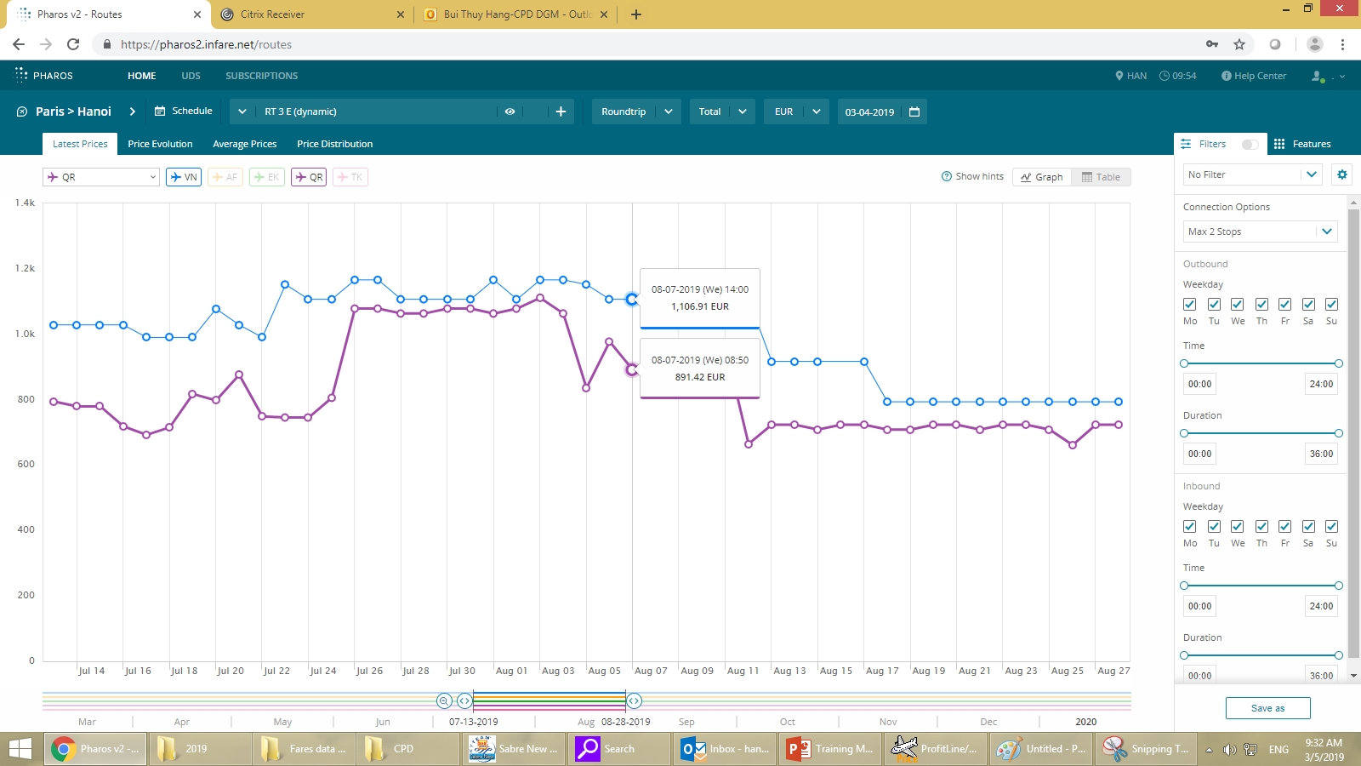
Basic Function: Latest Price
Slides between 2 points to zoom out
Before
After

Slide 14
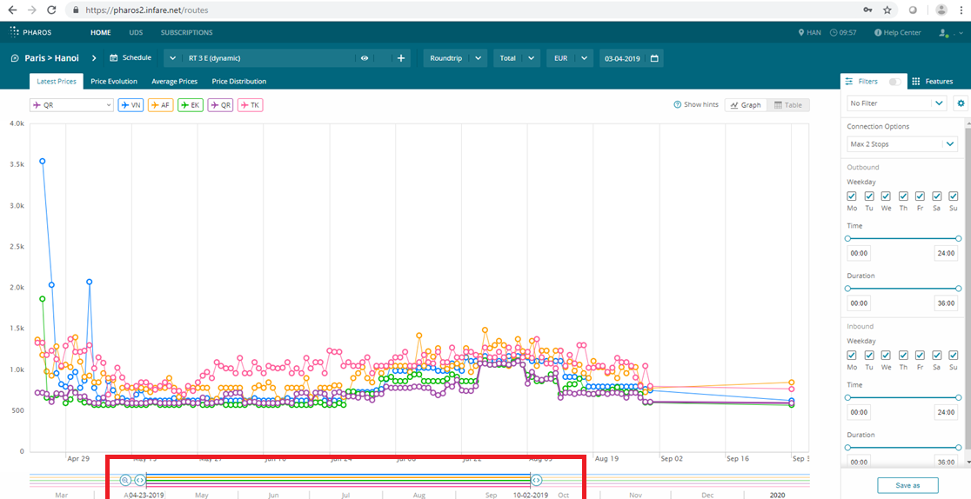
Basic Function: Latest Price
Pull Slider below to extend/shrink the travel date range

Slide 15
Basic Function: Latest Price
Pull Slider below to extend/shrink the travel date range

Slide 16
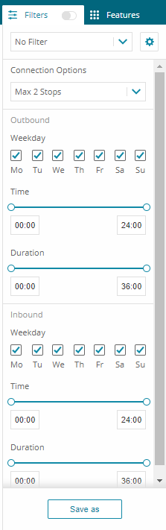
Basic Function: Latest Price
Filter Options
Number of Stop over: Only direct flights, Max 1 stop or Max 2 stops.
Outbound Date of week
Time of Outbound/Departure
Duration: total flight time
Same for inbound
Save and Name filters for later use

Slide 17
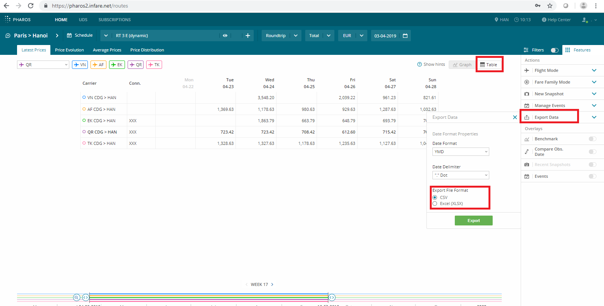
Basic Function: Latest Price
Show data in Table and Export to Excel/CSV

Slide 18
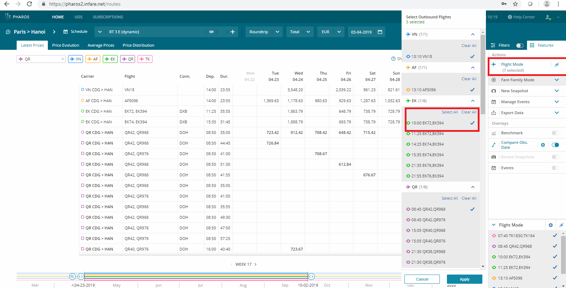
Basic Function: Latest Price
Use flight mode to select/narrow/shortlist flights and schedule

Slide 19
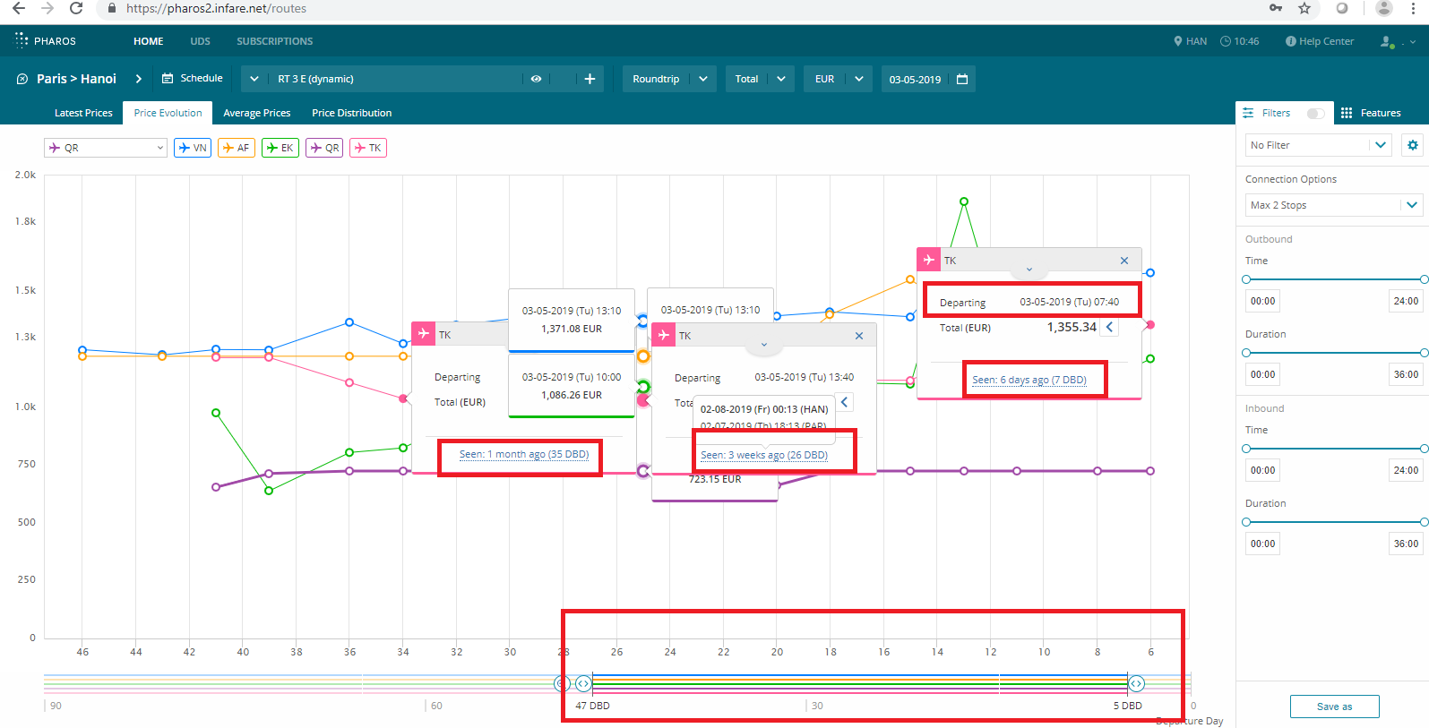
Basic Function: Price Evaluation
Fares by Days before departure: How Price changes closer to departure date for the same departure date

Slide 20
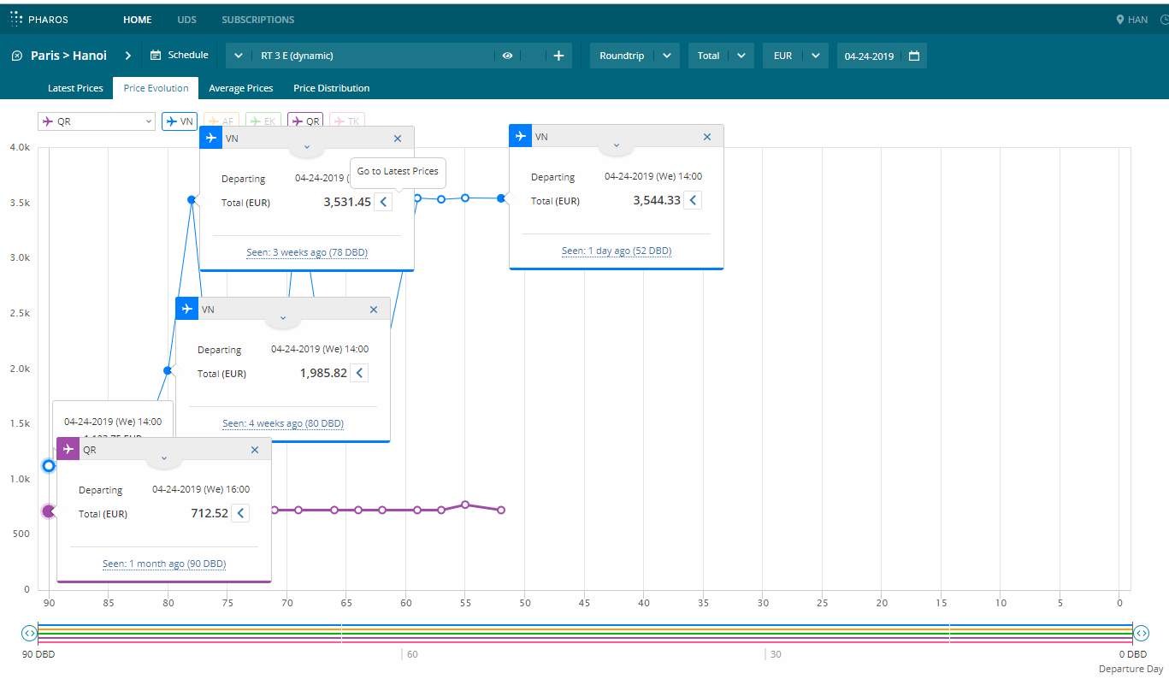
Swap between Price Evaluation and Latest Price

Slide 21
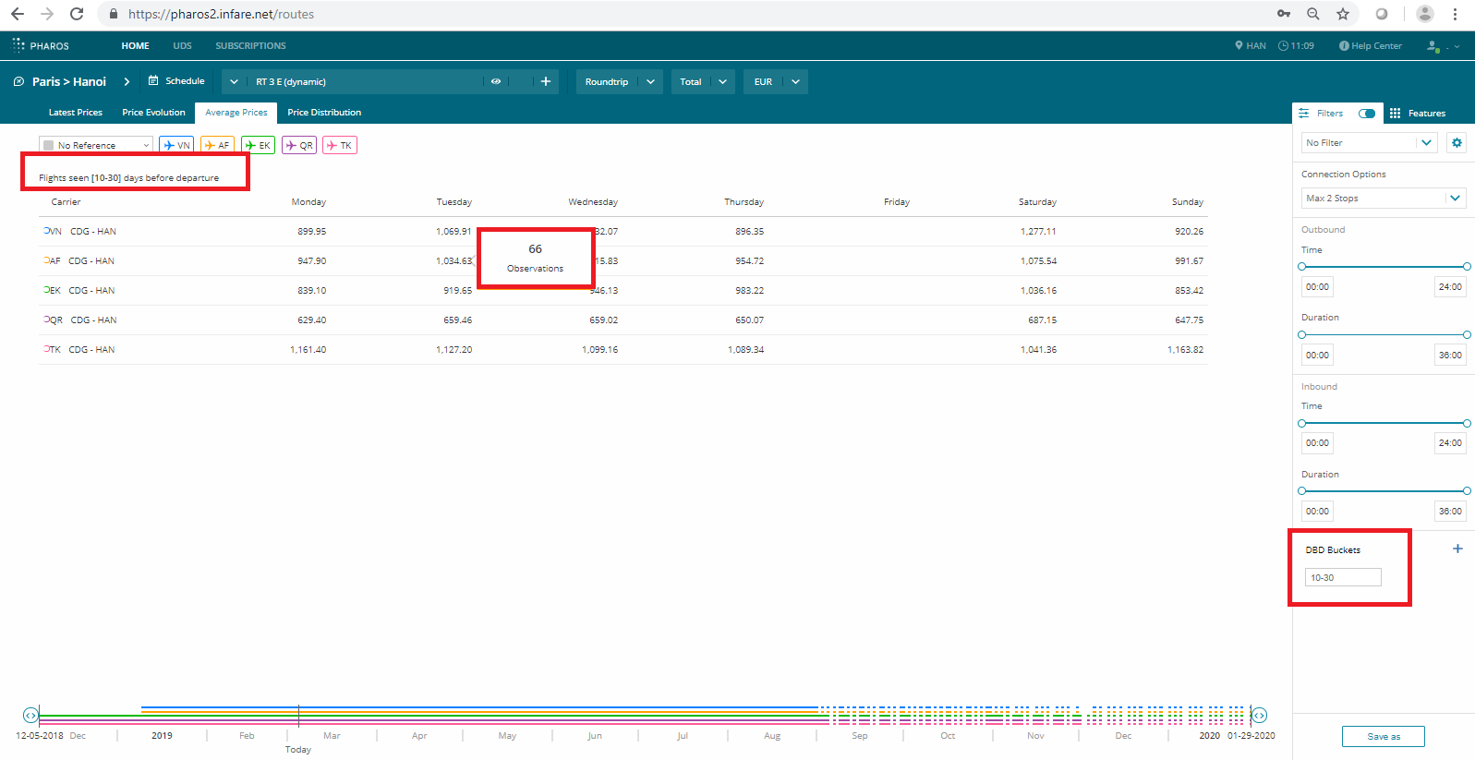
Basic Function: Average Price.
Change Day before departures to see Average Fares for respective Numbers of observation

Slide 22
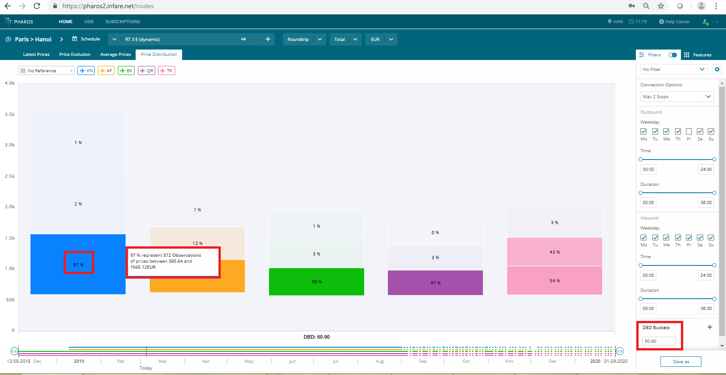
Basic Function: Price Distribution
Statistics of how many times fares fall into Low/Mid/High range base on DBD Bucket (day before departure)

