Slide 1


Study Progressing
Understand the project’s requirements
Process the data set
Analyze and filter the data set
Study papers about Vector Field
Study papers about Tensor Field
Focus on Asymmetric Tensor Field
Focus on relevant methods i.e. $Γ$ Function
Notes:
Optical Methods

Slide 2
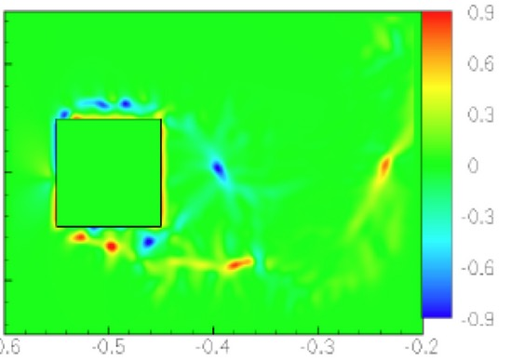
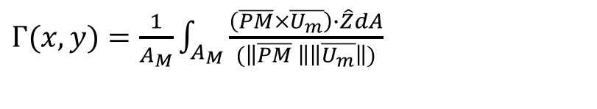
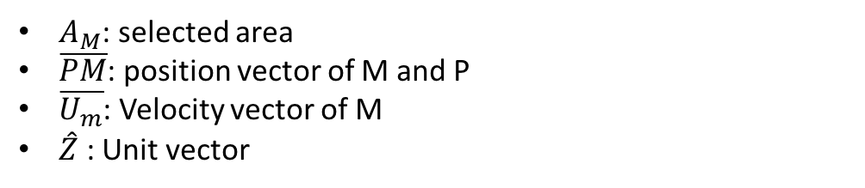
Flow Analysis Techniques
1. The Gamma Function
Be proposed as Swirl strength parameter
To Calculate the vector orientation
$Γ(x,y)=\frac{1}{A_{M}}\int_{A_{M}}{\frac{\left(\overline{PM}×\overline{U_{m}}\right)∙\hat{Z}dA}{(\left\|\overline{PM} \right\|\left\|\overline{U_{m}}\right\|)}}$
By paper MULTISCALE FEATURE DETECTION IN UNSTEADY SEPARATED FLOWS
GUONING CHEN, ZHONGZANG LIN, DANIEL MORSE, STEPHEN SNIDER, SOURABH APTE, JAMES LIBURDY, AND EUGENE ZHANG
$A_{M}$: selected area
$\overline{PM}$: position vector of M and P
$\overline{U_{m}}$: Velocity vector of M
$\hat{Z}$ : Unit vector
Notes:
Optical Methods

Slide 3
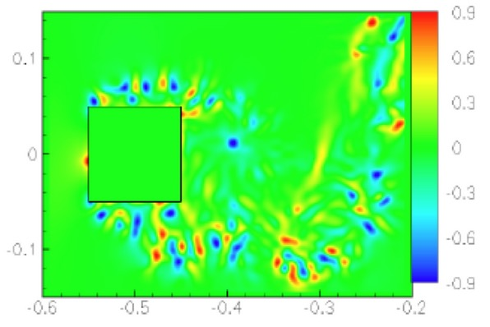

Flow Analysis Techniques
2. The Gamma Function --- Gamma P
The previous equation is based on Velocity Vector
This one is based on pressure- gradient vector
$$Γ_{p}\left(x,y\right)=\frac{1}{A_{M}}\int_{A_{M}}{\frac{(\overline{PM}×\overline{{P`}_{M}})∙\hat{Z}dA}{(\left\|\overline{PM}\right\|\left\|\overline{{P`}_{M}}\right\|)}}$$
$\overline{{P`}_{M}}$ : the pressure gradient field rotated by $90°$
By paper MULTISCALE FEATURE DETECTION IN UNSTEADY SEPARATED FLOWS
GUONING CHEN, ZHONGZANG LIN, DANIEL MORSE, STEPHEN SNIDER, SOURABH APTE, JAMES LIBURDY, AND EUGENE ZHANG

Slide 4
Visualization
LIC visualization
We have implement this in project 2
how LIC visualization combined with a bunch of real vector data

Slide 5
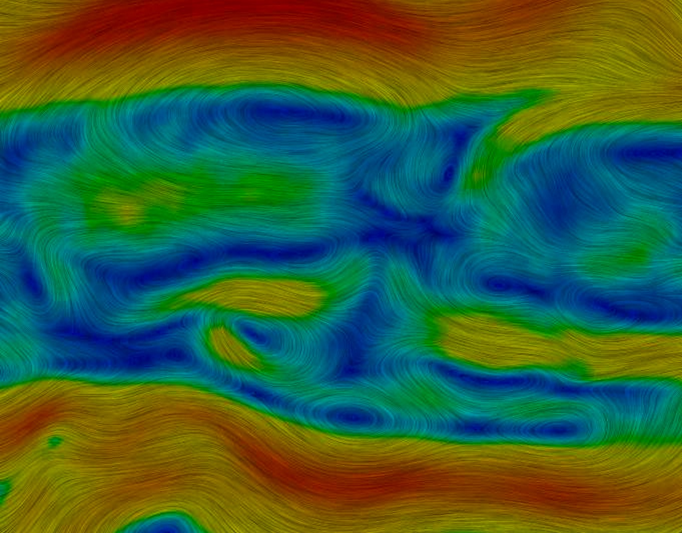
Color Mapping
Good way to see more details about vectors
Rainbow color mapping
Color mapping depends on curl or velocity values
Red indicates larger magnitudes
Blue indicates small magnitudes
By Pingliu Zhan Magnitude-based color-mapped LIC.

