Slide 1
PHISHING DETECTION USING MACHINE LEARNIG
SUBMITTED BY- Sagar Patel (0859196)
INSTRUCTOR- Dr. R. Wei

Slide 2
Index
Phishing
Types of phishing
Current threat
Existing system VS proposed system
Model architecture
Conclusion
Future work
Question

Slide 3
What is phishing?
Phishing is the fraudulent attempt to obtain sensitive information such as usernames, passwords and credit card details by disguising as a trustworthy entity in an electronic communication.
Typically carried out by email spoofing or instant messaging, it often directs users to enter personal information at a fake website, the look and feel of which are identical to the legitimate site.

Slide 4
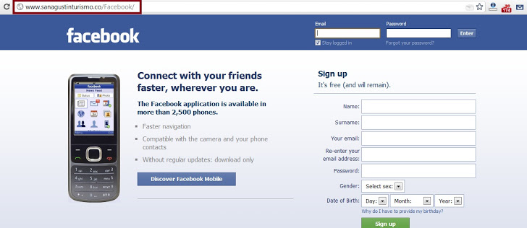
Examples of phishing

Slide 5
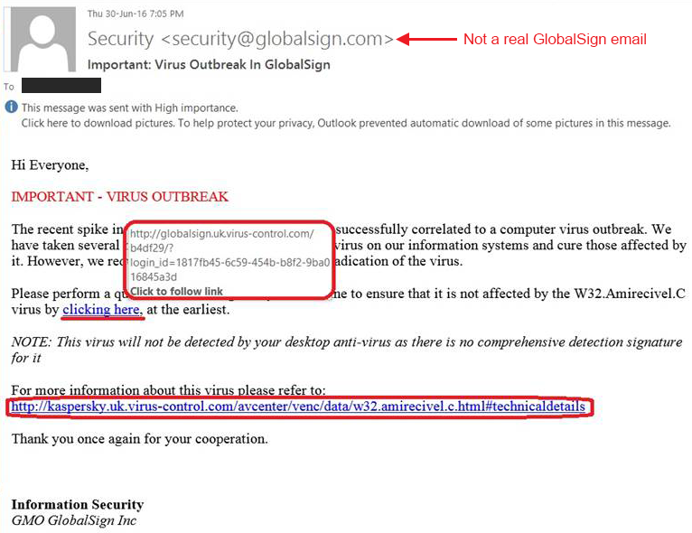
Copy and paste URL

Slide 6
Once you click on that link it redirects you to the other phishing site, as shown in the example above.

Slide 7
Types of phishing
Spear phishing: Phishing attempts directed at specific individuals or companies have been termed spear phishing. In this type attackers often gather and use personal information about their target to increase their probability of success.
Clone phishing: Clone phishing is a type of phishing attack whereby a legitimate, and previously delivered, email containing an attachment or link has had its content and recipient address(es) taken and used to create an almost identical or cloned email. The attachment or link within the email is replaced with a malicious version and then sent from an email address spoofed to appear to come from the original sender.

Slide 8
Types of phishing
Whaling: The term whaling has been coined for spear phishing attacks directed specifically at senior executives and other high-profile targets. In these cases, the content will be crafted to target an upper manager and the person's role in the company. The content of a whaling attack email may be an executive issue such as a subpoena or customer complaint.

Slide 9
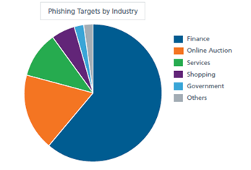
Current threat of phishing
Increase of 46% than last year
Study says 263,538 new phishing websites detected
For highly-targeted industries including
Payments Processing 39.4%
SaaS / Webmail 18.7%
Financial Institutions 14.2%
Cloud Storage / File Hosting 11.3%
Other 16.4%

Slide 10
Existing system VS proposed system
Existing system: The old method was incomplete and was using very few methods to detect the malicious content. Also the users were not that confident of using internet being unaware of the possible threats.
Proposed method: Many research papers have been studied and the new system has been introduced. Added the security protocols for email phishing and more than 20+ methods have been used to analyze a given URL.

Slide 11
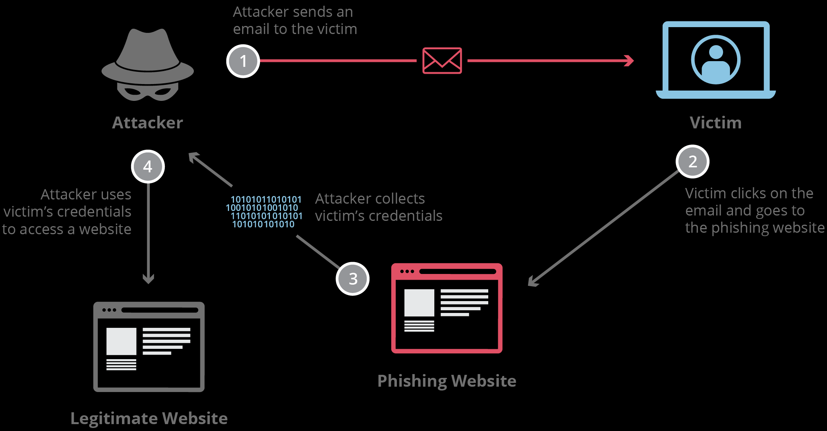
How phishing happens?

Slide 12
How the developed system works?
Machine learning algorithms have been used to train the model using ML algorithm such as Random Forest (97% accuracy) Support vector machine (96% algorithm) and Logistic regression (93% accuracy)
The data has been scanned through process called data cleaning then it trained based on 1 and -1
-1 means the website is legitimate and 1 means its phishing
The output shown on the home page and for mail phishing G-box toolkit has been used.
The main feature is server location for website searched by user

Slide 13
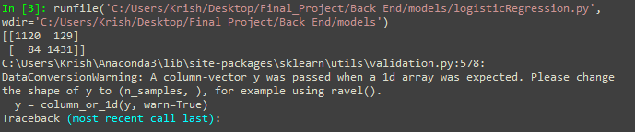
Results

Slide 14
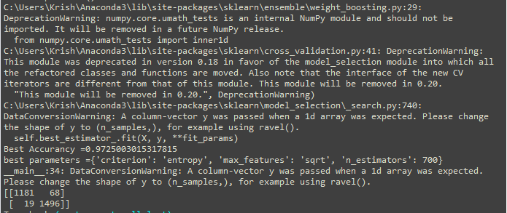
Results

Slide 15
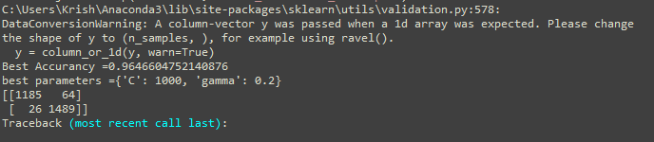
Results

Slide 16
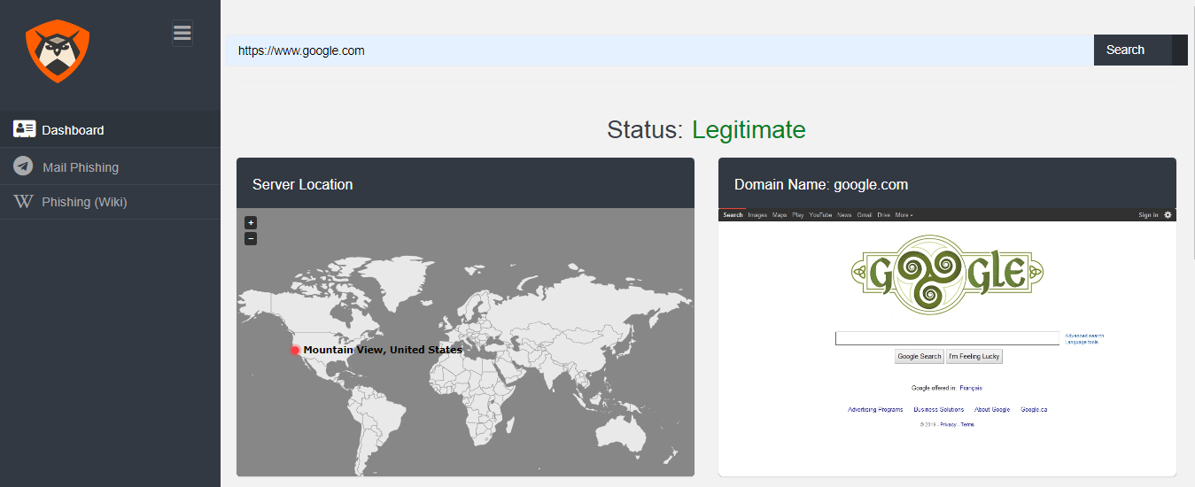
URL detection

Slide 17
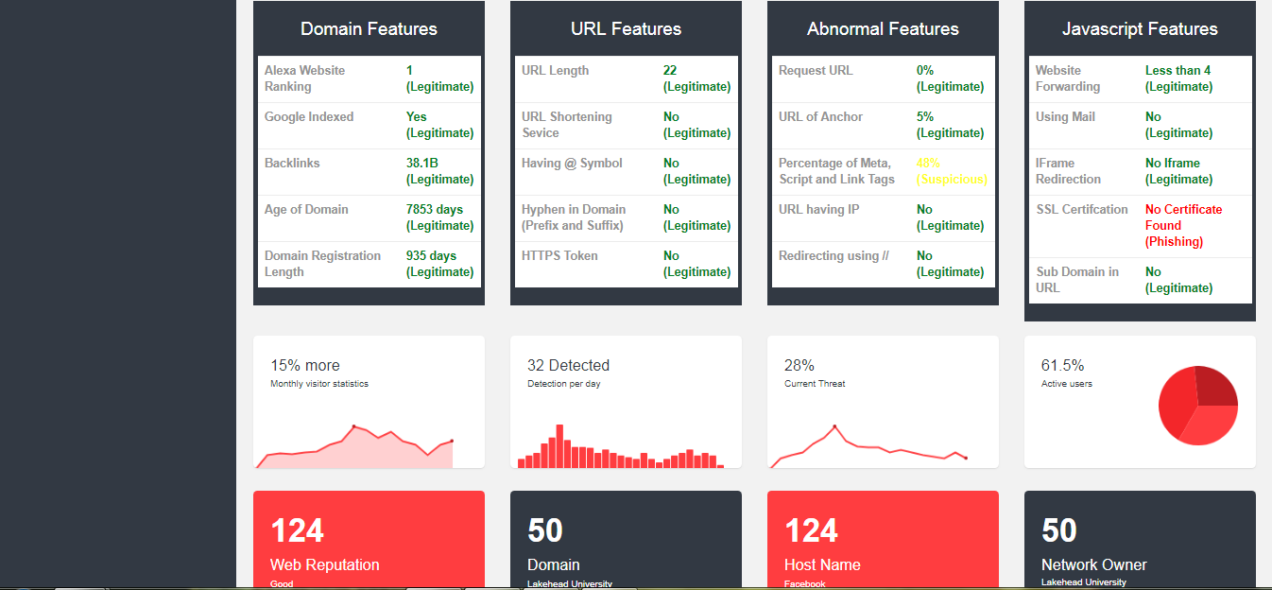
URL detection

Slide 18
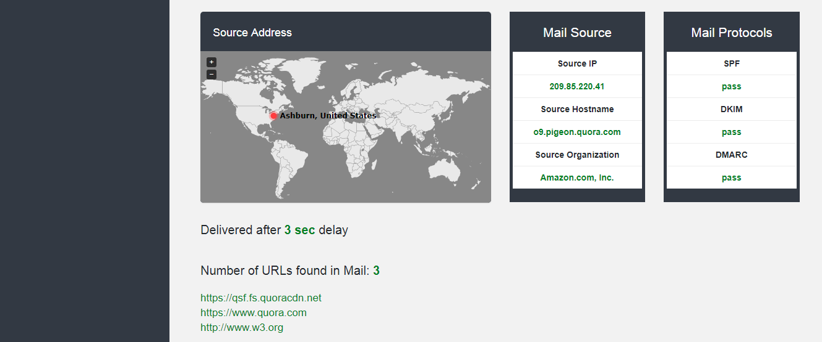
Mail header analyze

Slide 19
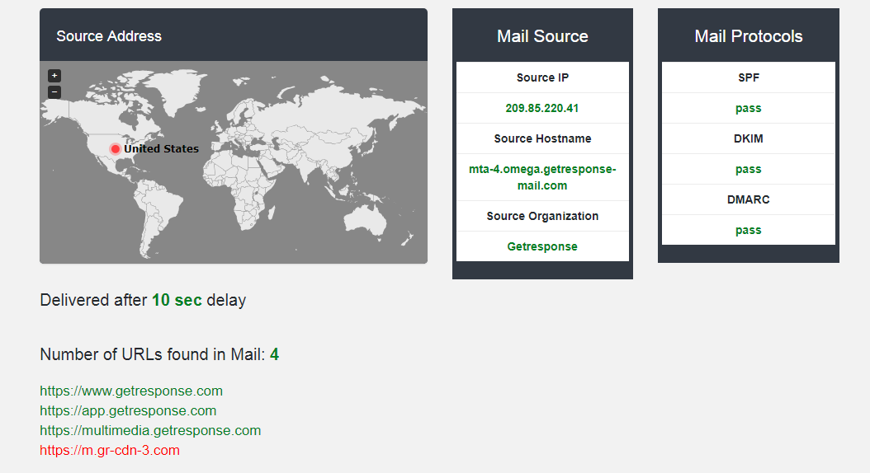
Mail header analyze

Slide 20
Conclusion
Phishing detection using ML is modern technique for all users.
It is very fast and uses NN for better results, also focus on the main types of phishing such as spear and clone phishing.
Uses more than 20 methods to analyze URL. So it is reliable method to check URL first and then proceed
Save user from very common attack through email link manipulation.
Time to time machine trains itself for better outcome because of NN architecture and the train VS test ratio is 80:20. The algorithm used for the NN gives 97% of accuracy.

Slide 21
Future work
Can deploy the website on cloud for easy to use.
A Google Chrome extension can be made for the purpose of saving time and it can check every website by default.
The admin can handle the home page and make updates if necessary
We can add the comment box on the home page so user can add comments for admin side
We can add other types of phishing techniques in future

Slide 22
Questions?

Slide 23
Thank You

