Slide 1
Analysis of Algorithms
Spring semester 2002
Uri Zwick
zwick@post.tau.ac.il

Slide 2
A Gentle introduction to Randomized Algorithms
Randomized, or probabilistic, algorithms are algorithms that make random choices.
They come in several flavors, according to the type of errors allowed.
For many problems randomized algorithms are faster, or simpler, than the corresponding deterministic algorithms, or both.
They serve as a very powerful tool even in the design of deterministic algorithms.

Slide 3
Some famous examples
Quicksort
Primality testing
(No deterministic poly. time algorithm is known)
Perfect Matchings in parallel
(No deterministic polylog time algorithm is known)

Slide 4
Finding simple paths and cycles (A not so famous example [Alon,Yuster,Zwick])
Given a (directed) graph G=(V,E), and a number k, find a simple path (cycle) of length k in G, if there is one.
A simple path (cycle) is a path (cycle)
that does not intersect itself.
The problem is NP-hard.
What can we do for a fixed k?

Slide 5
Some thoughts/attempts
v₀
v₁
v₂
…
v_{k-1}
v_{k}
How do we prevent the path from
intersecting itself?
BFS/DFS do not seem to work.
We can easily solve the problem using
dynamic programming in O(n^{k+1}) time.
How much better than this can we do?
Can we do it in O(m) time, for every fixed k?

Slide 6
An easy special case
v₀
v₁
v₂
…
v_{k-1}
v_{k}
If the graph is acyclic,
then all paths are simple!
The longest path in a DAG (Directed Acyclic Graph) can be found in O(m) time using dynamic programming.

Slide 7
A randomized algorithm
1
2
0
3
Choose a random permutation on the vertices and hope that the vertices of the simple path appear in this permutation in order.
0
1
2
3
Delete the edges going backward, and find the longest path in the resulting DAG.

Slide 8
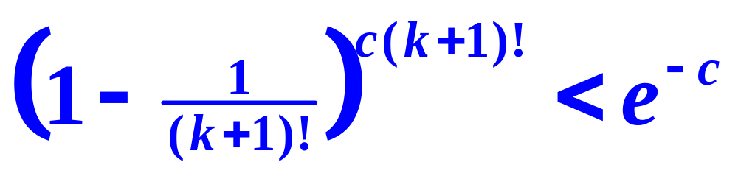
Analysis
The running time of the algorithm given in O(m)
The probability of success is
If we repeat the algorithm c(k+1)! times, then the probability of missing a simple path of length k, if one exists is at most
1/(k+1)!

Slide 9
Algorithms for finding simple paths
The running time O((k+1)! m) is polynomial for k=O(logn / loglog n).
An improved algorithm with an expected running time of 2^{O(k)}m will appear in the homework. This is polynomial for k=O(logn).

Slide 10
Algorithms for finding simple paths (Continued)
There is a deterministic algorithm with a running time of O((k+1)!*m) but it is more complicated. [Monien ’85]
The 2^{O(k)} m time algorithm can be derandomized into a deterministic algorithm with a running time of
2^{O(k)} m log n

Slide 11
Fixed Parameter Tractability
A parametrized problem is a problem that involves an integer parameter k.
A parametrized problem is fixed parameter tractable if there is an algorithm for it that runs in O(f(k)n^{c}) time, where n is the size of the input, f(k) is an arbitrary function, and c does not depend on k.

Slide 12
Types of Randomized Algorithms
A Las Vegas algorithm always returns the correct answer. The complexity if the expected running time.
A Monte Carlo algorithm always returns `no’ when the answer is `no’. If the answer is `yes’, then it returns `yes’ with a probability of at least ½.
An Atlantic City algorithm returns the correct answer (‘yes’ or `no’) with a probability of at least 2/3.

Slide 13
Complexity Classes of Randomized Algorithms
P – Deterministic polynomial time.
ZPP – Las Vegas algorithm with expexted polynomial time.
RP – A Monte Carlo algorithm with worst case polynomial running time.
BPP – An Atlantic City algorithm with worst case polynomial running time.
P ⊆ ZPP ⊆ RP ⊆ BPP

