Slide 1
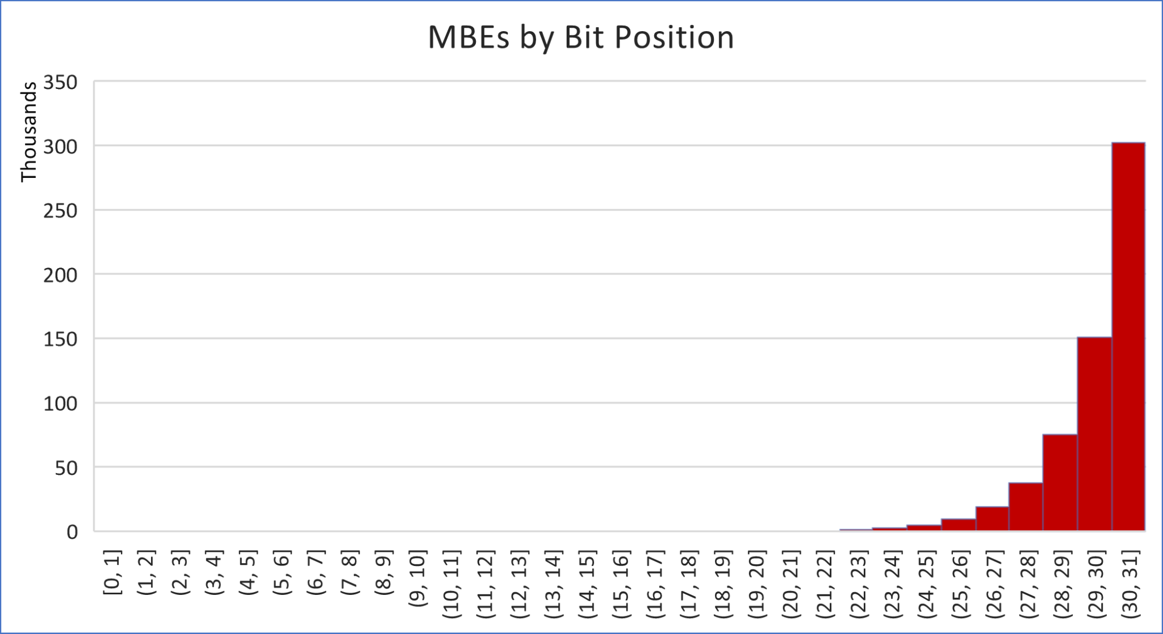
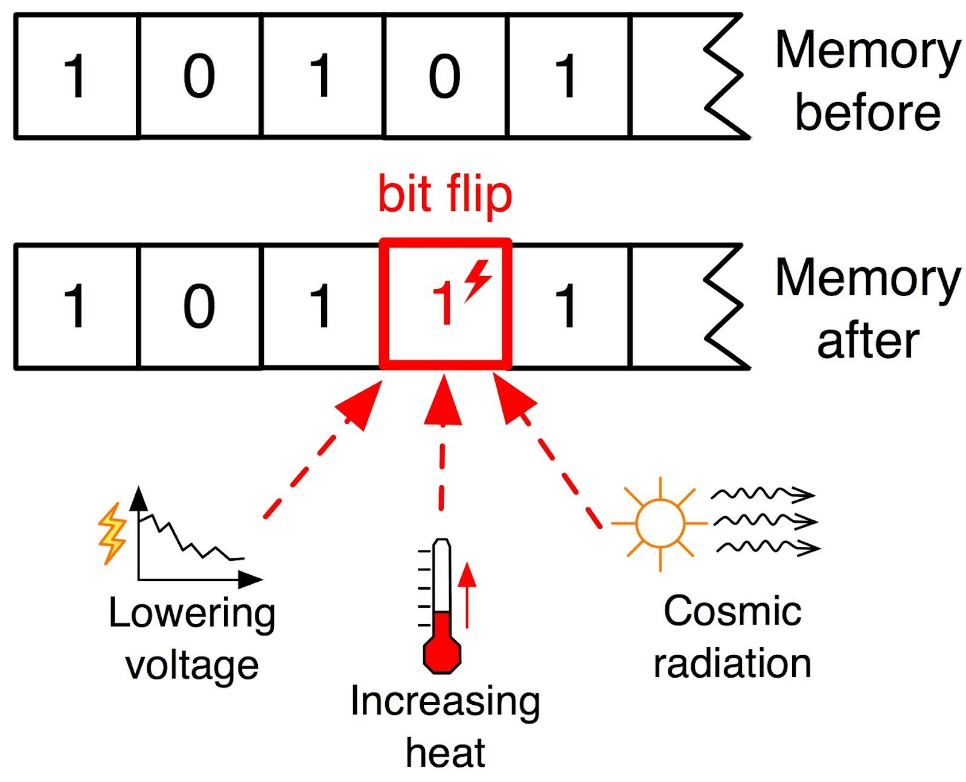
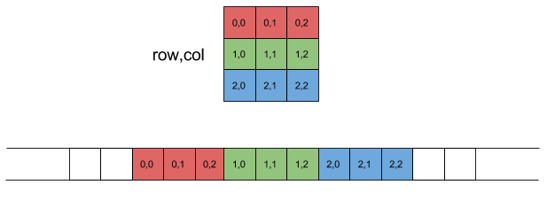
Algorithmic Based Fault Tolerance Project
Justin LaForge

Slide 2
Introduction
Computers are exceptionally at risk to error and corruption, in this project we will focus on matrix libraries and how they are at risk to corruption and how this could affect us.
The overall use of matrix libraries is abundant in all computer technology, the protection of these libraries is even more important, this is where we come in.
Our main goals are to:
Discover the functions of the matrix library
Address the problem of bit corruption
Implement a way to recover the data

Slide 3
The Matrix Library
Matrices are used throughout all computer technology making the matrix library something we computer scientists love to focus on.
Our matrix library consists of program drivers that:
Create matrices of a given size with given values
Checksum of the rows
Checksum of the columns
Checksum of both rows and columns
Matrix multiplier: Multiplies two matrices together using basic matrix multiplication.
In this project we will dive into each of these programs and see how we can use them to perform Algorithmic Based Fault Tolerance procedures.

Slide 4
Algorithmic Based Fault Tolerance
Algorithmic Based Fault Tolerance is the process of detecting and correcting errors in computational tasks. These tasks are performed whilst a program is running to prevent any possible bit corruption that may occur during the process of important data.
There are a couple of methods you can use to test fault tolerance. The methods we will be focusing on are the methods that use matrix multiplication and checksums and the method that uses the hamming technique, both of which are created to detect single bit corruptions.

Slide 5
Bit Corruption
Since bit data is physically just a sequence of voltage and electricity, it can have changes to the physical hardware that affect the meaning of the data. Bit corruption occured when the physical voltage of a bit is inverted changing the value into something completely different.
Ex: 0101(bin) = 5 - flip - 1101(bin) = 13
Bit corruption can happen in many ways, changes in voltage, increase in temperature, or even cosmic radiation. All hardware is at risk of bit corruption so we just need to learn to detect and correct it.

Slide 6
Program Design
Our program will consist of program drivers that create matrices, checksum matrices, perform matrix multiplication, prints matrix data to the console, corrupt data both during and after matrix multiplication, a driver that detects these corruptions, and a program that corrects the corrupted data.
We also have a driver program that tests for Masked Benign Errors, and one that performs the Hamming method to detect and correct errors.
Each of these programs are implemented using getOpt which allows for users to input arguments via the command line for easy testing. We also have our program printing out the runtime of each driver to determine how long it takes to run the segment of code in each program.

Slide 7
Program Drivers
Our Project consists of the following Program-Drivers:
“make_data_2d.c”: Creates 2D Arrays
“Cs_rows_data_2d.c”: Check sums the row data of a given array.
“Cs_cols_data_2d.c”: Check sums the column data of a given array.
“cs_data_2d.c”: Check sums the row data and column of a given array.
“add_data_2d.c”: Adds the corresponding data of two given arrays.
“mul_data_2d.c”: Implements matrix multiplication on the two given arrays.
“Corrupt_data_2d.c”: Creates a fake corruption given a check summed array.
“detect_data_2d.c”: Detect where the corruption occurred.
“correct_data_2d.c”: Corrects the corruption and gives us our desired value.
“mul_data_2d_faulty.c”: A program which simulates random data corruption during
matrix multiplication to show the possibilities of Masked Benign Errors.
“read_data_2d.c”: Reads a 2D array from a file.
“Utilities.c”: Methods and functions for the above programs.
“utilities.h”: Contains prototypes of our methods.
“timer.h”: Contains the timer function used to create randomness

Slide 8
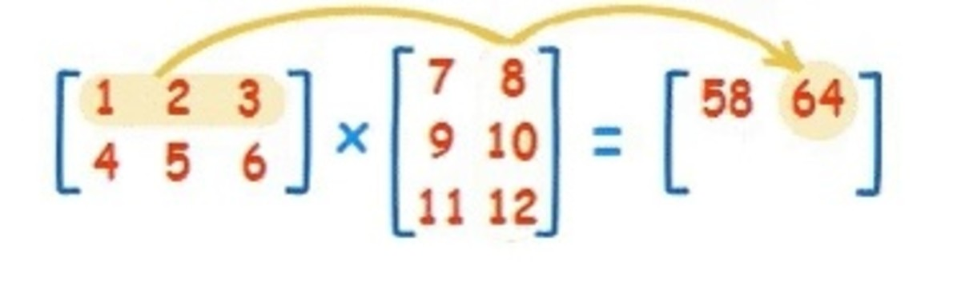
What is Matrix Multiplication
Matrix multiplication is the standard process for multiplying 2 matrices, or 2-dimensional arrays. For standard multiplication, the two arrays must be of correct size, the criteria for this is the number of rows of matrix A must match the number columns of matrix B. To multiply them, we start at the first row of matrix A and multiply its values with the corresponding values in the first column of row B, then the second column, then third, until the end of the columns, then we do the same with the second, third, etc, rows of matrix A. Here's a look at the process:
A B Product

Slide 9
Masked Benign Errors
Masked Benign errors are errors that go unnoticed by an error detector. This can happen when data is tampered with in a way that nothing changes. We can see this when multiplying a corrupt matrix with another matrix and bit overflow occurs causing the corrupted bit to have no effect on the actual data.
Though these errors have no effect on our data it is still a problem when we get them because you never want your data to be being corrupted without you even knowing it.
Ex. Let’s say we can only represent numbers in 2 digits, and we have 5x10 = 50, but then let’s say that 10 becomes a 90, now we have 5x90 = 450, but because we can only use 2 bits, that 450 becomes 50, equal to the result from the other computation. This is an example of a Masked Benign Error only we would be seeing much bigger numbers since we have up to 32 bits in our results.

Slide 10
Experimentations, Pt. 1
Our project consisted of multiple experimentations around Algorithmic Based Fault Tolerance, first we started with a Corrupt-Detect-Correct experiment, then we made a simple Masked Benign Error testor, a faulty matrix multiplier and lastly we experimented with the hamming design for correcting data.
Corrupt-Detect-Correct:
For our basic corrupting program we created a driver that would take in a checksummed matrix and it would flip the bit of a value to change it completely. We would do this randomly or have the user input their own value and bit position to flip. After doing this we created two more drivers, a detect driver which would detect where the error occurred using the checksummed values of the matrix, and then a correct driver that would flip the bit back to its original value by calculating the original value from the checksum.

Slide 11
Experimentations, Pt. 2
Simple MBE Test:
For this we made a program to run all possible integers of 32 bits and multiplied them with a random 8 bit number, saving that value, and then corrupting that random number, and multiplying it again, to test if the new value is equal to the new supposedly corrupted value, in which case if it is not equal, then that is a normal corruption, however if they are the same value, we know that a masked Benign Error has occurred, meaning that we multiplied a number with two completely different numbers and yet it still ended up being the same thing. This only occurs when bit overflow occurs, meaning that two numbers are multiplied together resulting in a number that does not fit within the range of a 32 bit unsigned integer, which is what we are using.

Slide 12
Experimentations, Pt. 3
Matrix Multiplication Corruption:
To further testing corruption we also created another program that would corrupt our matrix, only this time it would corrupt a value in the middle of a matrix multiplication, this may sound tedious but what we just discovered with masked benign errors is that one number A multiplied with a number B could be the same as A multiplied with a number C, given that overflow occurs. So this test provides an example of how we can get masked benign errors while multiplying to matrices together. So our code flips the bit in a random value of the second matrix while multiplying them together and this gives us a corrupted multiplier, one that is subject to resulting in masked benign errors.

Slide 13
Experimentations, Pt. 4
Hamming:
Our final experiment was with the hamming method, which takes a single hex character and adds a 3 bit layer of protection over it which will be used to decode its original value if corrupted. The program takes the binary version of the hex number and puts it into a vertical matrix with 4 rows and 1 column and then multiplies it with a so called G-Transpose matrix which is a fixed matrix that is used for the hamming process and doing this will give us a matrix of the protected hex value. Then we would print this value and its binary representation to the screen.

Slide 14
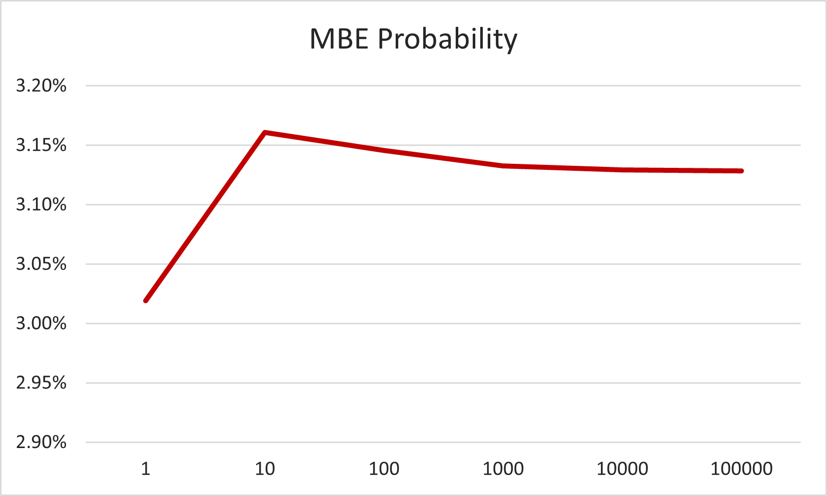
Results
From running our experiments we picked up a bit of data. From running the Simple MBE Test we were able to tell the probability of a masked benign error by running the test multiple times over, each time increasing the sample size (The amount of times a integer was multiplied by a random value). We also took the data given from the program to determine how likely each bit position is to cause a MBE if flipped. The data is as recorded below:

Slide 15
Behind the Program
While implementing this project we followed a couple of procedures to keep our programming nice and organized and free of memory leaks and errors. To start we implemented our programs with the ability to enter arguments via the command line, this is done using the GetOpt function in C, which is used to take command line arguments and set them equal to actual values in our program. However allowing for user input requires a lot of error checking in our code. To prevent users from breaking our code, we used fail safes to detect any sort of error and halt the code when it suspects the user entered a value outside of our parameters. We also checked for errors when allocating any sort of memory or when accessing files we need to use. We also made sure to free any allocations that may have been created to prevent any memory leaks in our programs. Finally to confirm our program had no memory leaks, we used a command called valgrind which will scan our program for memory leaks and report anything dangerous.

Slide 16
Conclusion
In conclusion, this report has delved into the creation, manipulation, and analysis of 2D matrices using a set of programs designed for matrix generation, reading, and addition and multiplication. These programs have been implemented to handle matrix operations effectively while ensuring data integrity. Additionally, the report introduced the concept of fault creation and tolerance using programs that simulate data corruption caused by random bit flips in crucial conditions.
In summary, this project acknowledges the importance of data integrity and error detection in the realm of 2D matrices, demonstrating the effectiveness of modular code and fault tolerant mechanisms in addressing these challenges. It sets the stage for the continued development of advanced matrix tools and data manipulation techniques.

