Slide 1

Home Oversight
Online Home Energy Monitoring
And Power Sockets
Control System

Slide 2

The Internet of Things, or IoT, refers to
the billions of physical devices around
the world that are now connected to the
internet, collecting and sharing data.
Internet
Of
Things
It is a computing concept that describes the idea of everyday physical objects
being connected to the internet and
being able to identify themselves to
other devices.
The term IoT is mainly used for devices
that wouldn't usually be generally
expected to have an internet connection, and that can communicate with the
network independently of human action.

Slide 3

THE PROBLEM
Fire Hazards
Additional Expenses
Unattended appliance is one of the common causes of fire incidents.
Leaving appliances unattended while consuming electricity will cost unnecessary addition to people’s electric bill.
Lack of Transparency
Appliance Negligence
People are unaware on how much electricity is consumed by each of their appliance each month.
At times, people forget to unplug the appliance they used and remember it when they are already far from home.
Unauthorized Use of Electricity at Home
Some people use electricity at the user’s home without consent.

Slide 4
INTRODUCING…

Slide 5


HOME OVERSIGHT
An Online Home Energy Monitoring and
Power Sockets Control System

Slide 6


SIGNIFICANCE
Of the Project
Future Researchers
Maybe used as future reference.
Electricity Consumers
You can simply impress your audience and add a unique zing.
Industries
Which practices energy footprint reduction and efficiency.
Home Oversight
Electricity Providers
Online Home Energy Monitoring and Power Sockets Control System
Reduced electricity consumption may prolong their supply of energy

Slide 7

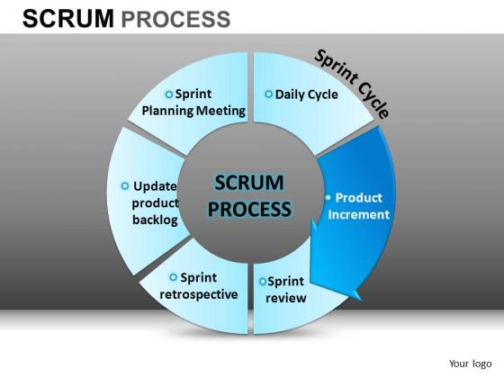
METHODOLOGY
Of the Project

Slide 8
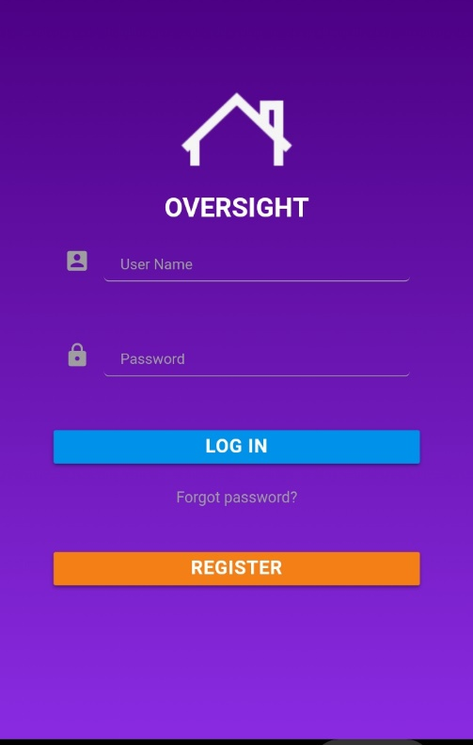
Online Home
Energy
Monitoring
and
Power
Sockets
Control
01
RFID Integration for Appliance Registration
02
Appliance Consumption Limiter and Monitoring
03
Unauthorized Electricity Usage Notification
Has the following features…
04
Power Socket Control
05
Monthly Electric Bill Estimation

Slide 9





SOFTWARE DEVELOPMENT TOOLS
LAMP
MATERIALIZE CSS
It acts as a local server and a real time server in the system. Its main use is it acts as a database with the use of phpMyAdmin.
It is used for designing the user interface of the project.
PHP
Apache Cordova
It is used for the back-end programming of the system.
It is the framework used for making cross-platform mobile applications.
ARDUINO IDE
It is used for the programming of Arduino devices.

Slide 10
RESPONDENTS
Respondents of the Evaluation
37.5%
50%
12.5%
IT Experts
Household Owners
IT Students

Slide 11
RESEARCH METHODS
Research
Survey
Observation

Slide 12
RESULTS AND DISCUSSION
Mean Distribution of Respondent Rating on Software

Slide 13
RESULTS AND DISCUSSION
Software Evaluation
Functionality
Maintainability
01
04
General Weighted Mean: 4.29 Response Description: Very Good
General Weighted Mean: 4.3 Response Description: Very Good
Reliability
Portability
02
General Weighted Mean: 4.42 Response Description: Very Good
05
General Weighted Mean: 4.29 Response Description: Very Good
Usability
Training and Documentation
03
06
General Weighted Mean: 4.46 Response Description: Very Good
General Weighted Mean: 4.38 Response Description: Very Good

Slide 14

RESULTS AND DISCUSSION
Mean Distribution of Respondent Rating on Hardware

Slide 15
RESULTS AND DISCUSSION
Hardware Evaluation
Functionality
Portability
01
05
General Weighted Mean: 4.31
Response Description: Very Good
General Weighted Mean: 4.17 Response Description: Very Good
Reliability
Workability
02
06
General Weighted Mean: 4.36
Response Description: Very Good
General Weighted Mean: 4.35 Response Description: Very Good
Usability
Safety
03
07
General Weighted Mean: 4.39 Response Description: Very Good
General Weighted Mean: 4.37 Response Description: Very Good
Maintainability
Training and Documentation
04
General Weighted Mean: 4.35 Response Description: Very Good
08
General Weighted Mean: 4.43 Response Description: Very Good

Slide 16
RECOMMENDATIONS
01
More stable means of connection
05
Deployment in iOS Devices.
02
Search for a better way of detecting plugged in appliances
03
More secure way of accessing device
04
Make the form factor of the Power Socket Prototype as compact as possible.

Slide 17
THANK YOU!

