Slide 1

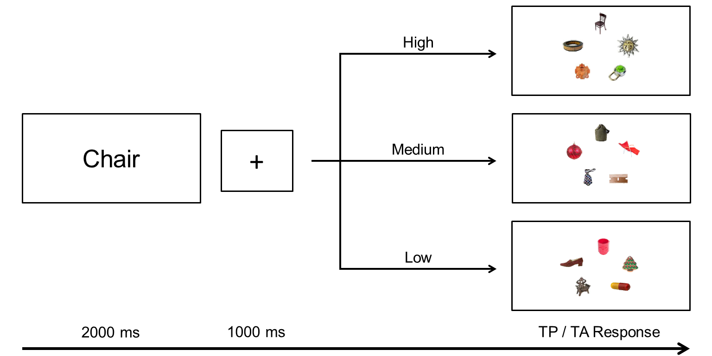
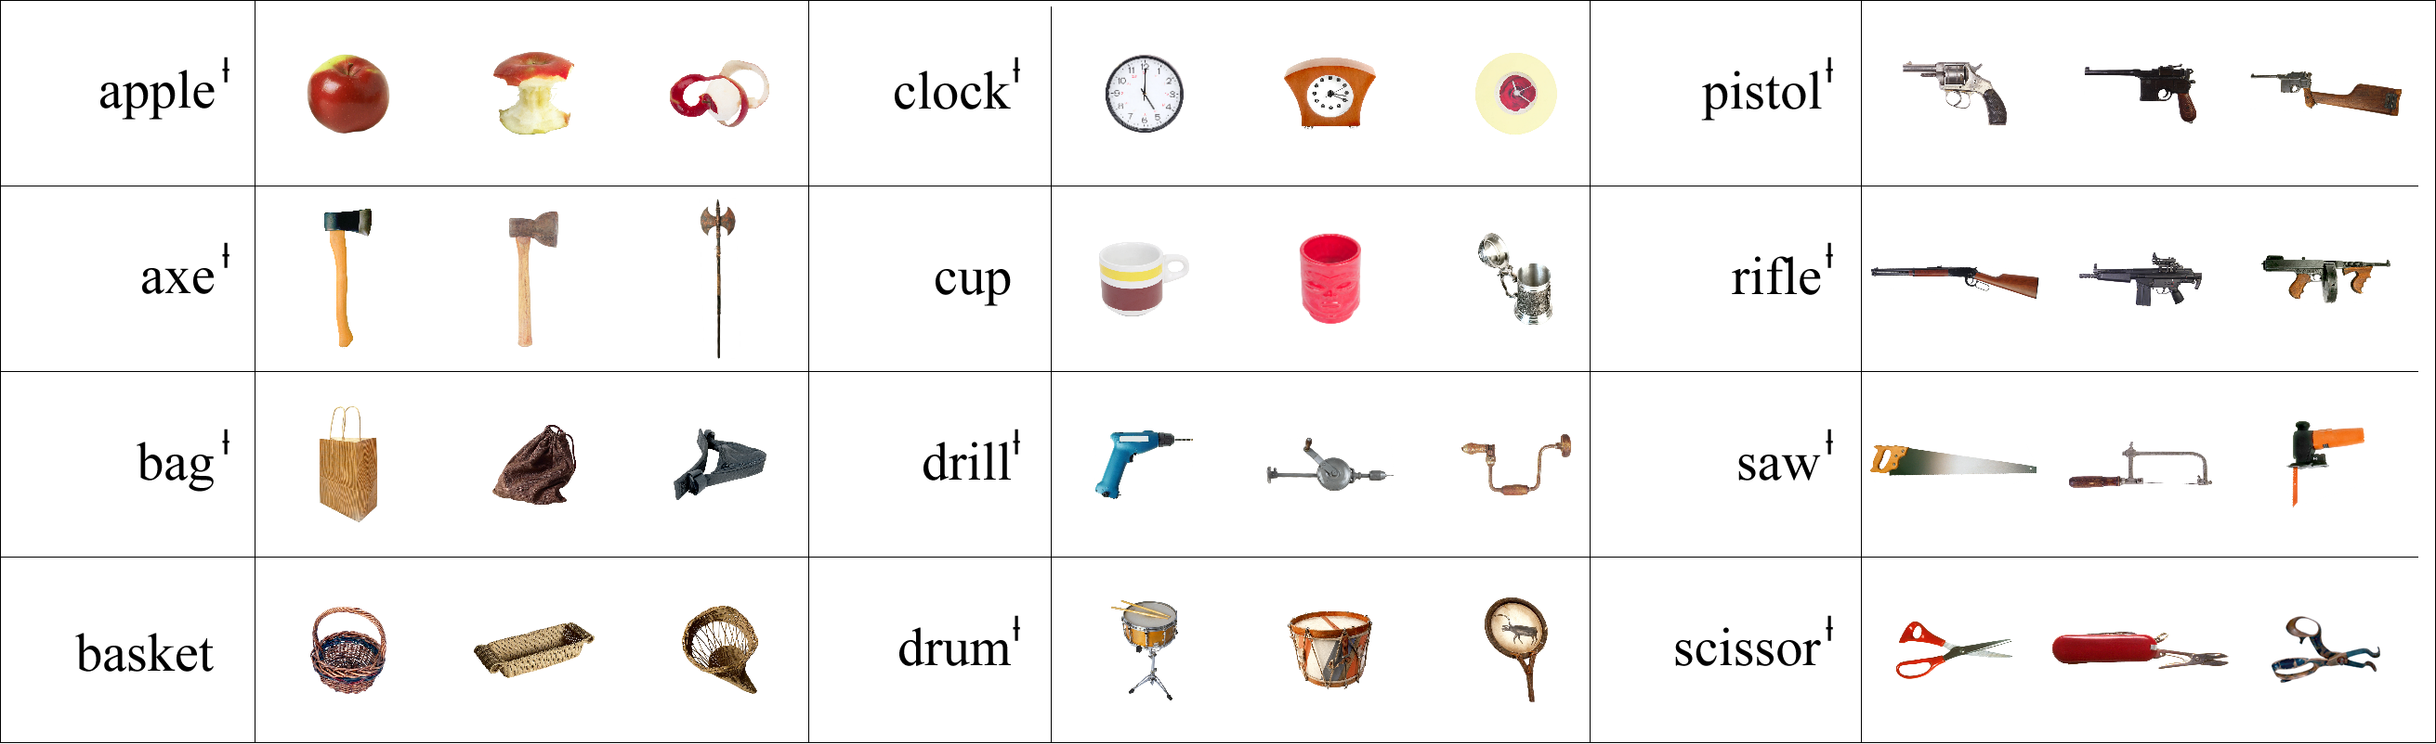

The Effects of Target Typicality on Guidance and Verification in Categorical Search
Justin Maxfield, Westri Stadler, & Gregory Zelinsky Department of Psychology; Stony Brook University
THE EYE MOVEMENTS AND
VISUAL COGNITON LAB
Introduction
Procedure
SVM Classification
How does object typicality affect visual search?
Previous work has shown that typical objects yield advantages in a wide range of tasks (Murphy, 2002).
With respect to visual search, typicality has been demonstrated to affect the time needed to verify target objects, but not the time needed to find these objects (guidance) (Castelhano, Pollatsek, & Cave, 2008).
Our goals were therefore to:
Replicate the previous results, and to test whether search guidance is indeed unaffected by typicality
Use computer vision methods to better understand the representation underlying typicality effects in a search task.
Can SVM-based classifiers predict the observed ratings and effects of typicality?
SIFT features (Lowe, 2004) were extracted for a 19-object subset of our target categories, and linear SVM classifiers were trained on these categories using 1,000 positive samples and 10,000 negative samples (from ImageNet).
Distances were then found between the specific target objects from the behavioral experiment and the classification boundaries for the respective classifiers.
Significant correlations between classification confidence and the effects of target typicality on both guidance and verification (r’s < -.36, p’s < .007); as typicality increased, so too did classifier confidence.
Results
High
Medium
Low
Time to
Target
Stimuli
Discussion
Object typicality ratings (1 – 7) obtained from 16 participants
A High, Medium, and Low typicality exemplar was chosen for 36 target categories
Mean typicality ratings differed by group, p < .01
Target Fixated
First
Typicality has an effect on search guidance as well as verification. Target-distractor similarity may have masked this effect on guidance in previous work. Building on the premise that nearly all search tasks are categorical (i.e., not benefiting from a picture preview), we are finding that the factors known to affect categorization difficulty also affect categorical search.
Simple computer vision classifiers are able to capture these typicality effects. This suggests that the features representing the target categories might be those that best discriminate targets from non-targets.
Methods
N = 18; 216 trials/subject
50% Target-Present
Objects were ~2.5°
5 Item arrays at 8° eccentricity
Analyses divided into two epochs:
Onset of search display until
target is fixated (Guidance)
Target fixation until button
press (Verification)
Verification
Time
References
Castelhano, M. S., Pollatsek, A., & Cave, K. R. (2008). Typicality aids search for an unspecified target, but only in identification and not in
attentional guidance. Psychonomic Bulletin & Review, 15, 795–801.
Lowe, D. G. (2004). Distinctive image features from scale-invariant keypoints. International Journal of Computer Vision, 60(2), 91-110.
Murphy, G. L. (2002). The big book of concepts. Cambridge, MA: MIT Press.
Acknowledgements. This work was funded by NIMH R01-MH063748 awarded to G. Zelinsky.
Effects of typicality on search guidance as well as verification (all p < 0.008).

