Slide 1

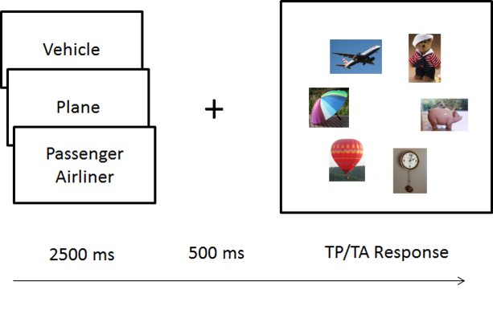
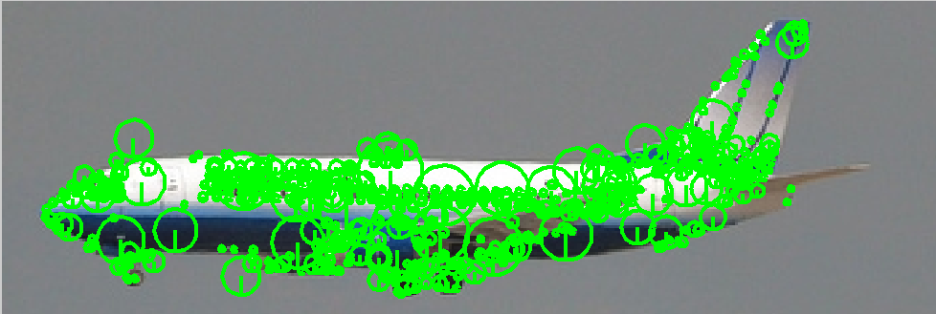
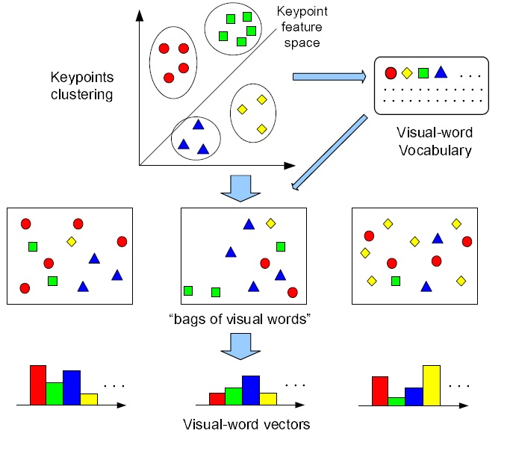
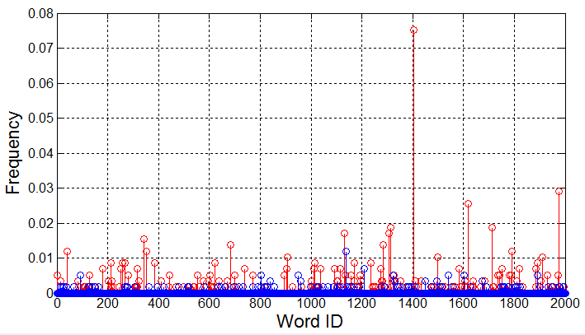

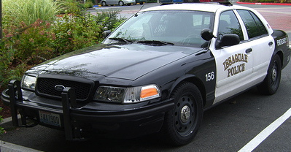

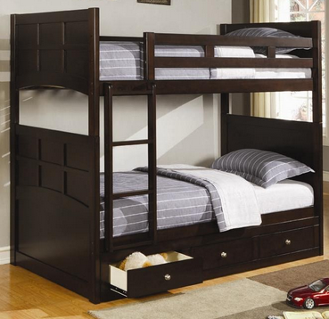
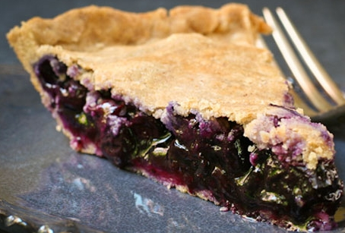


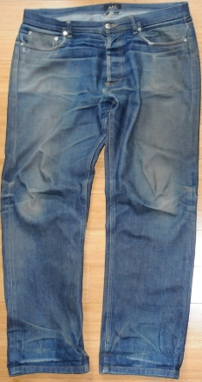
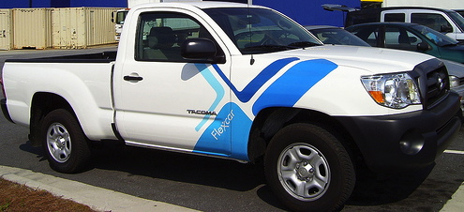


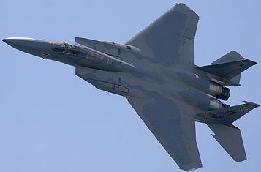

Searching Through the Hierarchy: A Behavioral and Computational Approach to Understanding Categorical Search
THE EYE MOVEMENTS AND
VISUAL COGNITON LAB
Justin Maxfield¹, Chen-Ping Yu¹, & Gregory Zelinsky^{1,2} ¹Department of Psychology; ²Department of Computer Science; Stony Brook University
Introduction
Procedure
Computational
Basic level categories are verified faster than both superordinate and subordinate level categories, what has been referred to as the basic-level advantage [1].
In previous work [2] we varied the hierarchical level of a target cue in a categorical search task and showed that a similar basic-level advantage exists in the time taken by people to verify a target after it has been fixated. However, targets cued at the subordinate level were more often fixated first, demonstrating a subordinate-level advantage with respect to search guidance.
Current Goals
Replicate our previous results using even more realistic stimuli.
Will the previously observed data patterns generalize to stimuli consisting of images with complex backgrounds rather than segmented objects? It is possible that the previous effects were predominantly driven by the strong guidance to shape features made readily available by segmented objects.
Exploit computer vision methods to quantify the number of category
specific features and their overlap with those of other categories.
Feature overlap is believed to underlie the basic-level advantage; there is too much overlap between subordinate level categories and too little overlap within superordinate level categories. Can visual feature overlap and the number of category specific features explain both the basic-level advantage for verification and the subordinate-level advantage for guidance?
SIFT features [3] were computed for 100 images (from ImageNet [4]) for each of our 48 subordinate-level categories.
The visual features of an image were quantified
using a Bag-of-Words histogram model (k = 2,000).
Figure taken from
http://www.ifp.illinois.edu/~yuhuang/sceneclassification.html
Category-specific features (shown in red)
were defined as any feature in the
histogram having a frequency greater
than the average of all the non-zero
features.
For all categories we computed the number of category-specific features and their mean overlap to the other same-level categories sharing a parent.
The average number of category-specific features was smallest at the subordinate level, consistent with the strong guidance observed in that condition; fewer features means a more precise target template. Feature overlap at the superordinate level was lower than at the other levels, which had similar overlap.
Results
Methods
Representative Stimuli (n = 144)
48 subordinate level categories with 3 exemplars each (counterbalanced over subjects) were used to construct 16 basic level categories and 4 superordinate categories.
Vehicle
Discussion
SUPERORDINATE (Vehicles, Furniture, Desserts, Clothing)
Our previously reported subordinate-level guidance advantage and basic-level verification advantage did not hinge on the use of segmented objects in a categorical search task.
A model based on the number of category-specific features can capture the guidance effect, and their overlap with neighboring categories (those sharing a parent) points to an explanation for the verification effect. A classifier built on subordinate category-specific features will likely perform poorly when tested on images spanning several basic level categories, as the classifier would require training on negative samples of subordinate categorical neighbors. In future work will explore the role of negative training samples on classification and the demonstration of a basic-level advantage.
This model highlights the use of feature number and overlap as common underlying factors that may unify the categorization and search literatures.
BASIC (Planes, Cars, Trucks, Boats)
SUBORDINATE (Fighter jets)
We observed a subordinate-level advantage for search
guidance and a basic-level advantage for verification
(all p < 0.05).
These effects are robust enough to generalize to the
complex real-world images used in this experiment.
References and Acknowledgments
12 Participants performed a target present/absent (50/50) categorical search task. Objects were ~2.5° and were presented in a 6-item array at 8° eccentricity.
Eye tracking analyses were divided into two epochs: Guidance (onset of search display until target is fixated) & Verification (target fixation until button press).
Rosch, E.H., Mervis, C.B., Gray, W.D., Johnson, D.M., & Boyes-Braem, P. (1976). Basic objects in natural categories. Cognitive Psychology, 8, 382-439.
Maxfield, J. T., & Zelinsky, G. J. (2012). Searching through the hierarchy: How level of target categorization affects visual search. Visual Cognition, 20(10), 1153-1163.
Lowe, D. G. (1999). Object recognition from local scale-invariant features. InComputer vision, 1999. The proceedings of the seventh IEEE
international conference on (Vol. 2, pp. 1150-1157). Ieee.
4. Deng, J., Dong, W., Socher, R., Li, L. J., Li, K., & Fei-Fei, L. (2009, June). Imagenet: A large-scale hierarchical image database. In Computer Vision
and Pattern Recognition, 2009. CVPR 2009. IEEE Conference on (pp. 248-255). IEEE.
5. Fei-Fei, L., & Perona, P. (2005, June). A bayesian hierarchical model for learning natural scene categories. In Computer Vision and Pattern
Recognition, 2005. CVPR 2005. IEEE Computer Society Conference on (Vol. 2, pp. 524-531). IEEE.
This work was funded by NIMH R01-MH063748 awarded to G. Zelinsky.
Notes:
Fix Chart and table colors / Axes
Add refs and superscript in text
Add sample images
1.(Rosch et al., 1976).
2. Maxfield & Zelinsky (2012)
3. SIFT
4. IMageNEt
5.BoW

