Slide 1

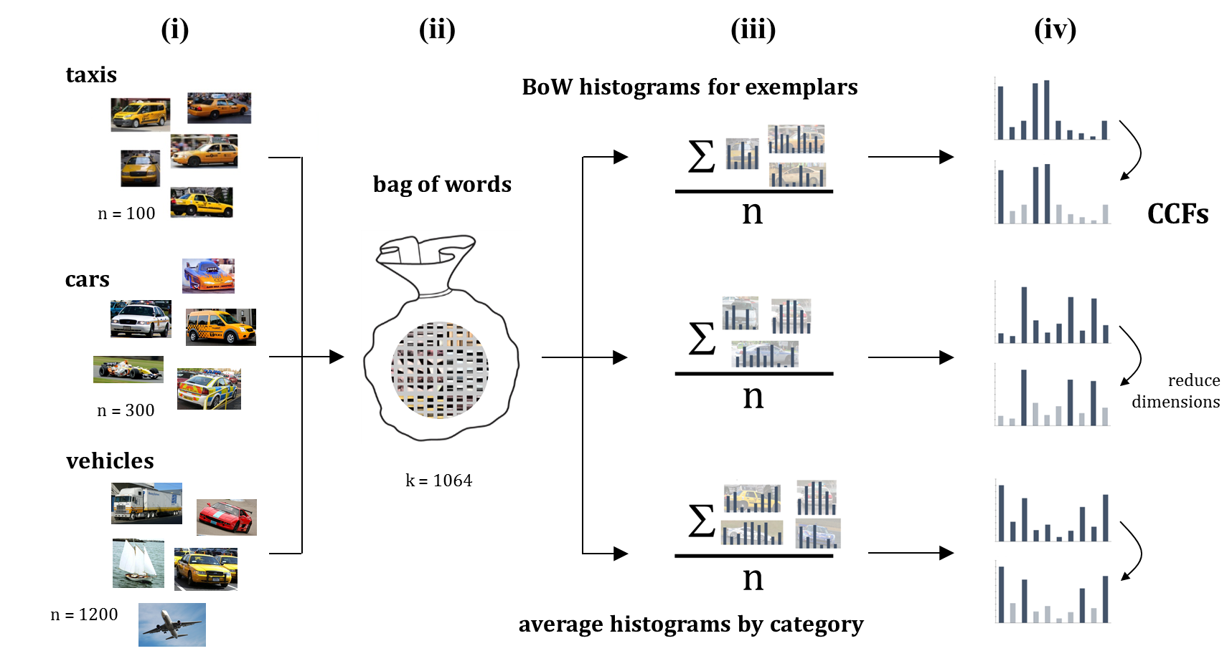

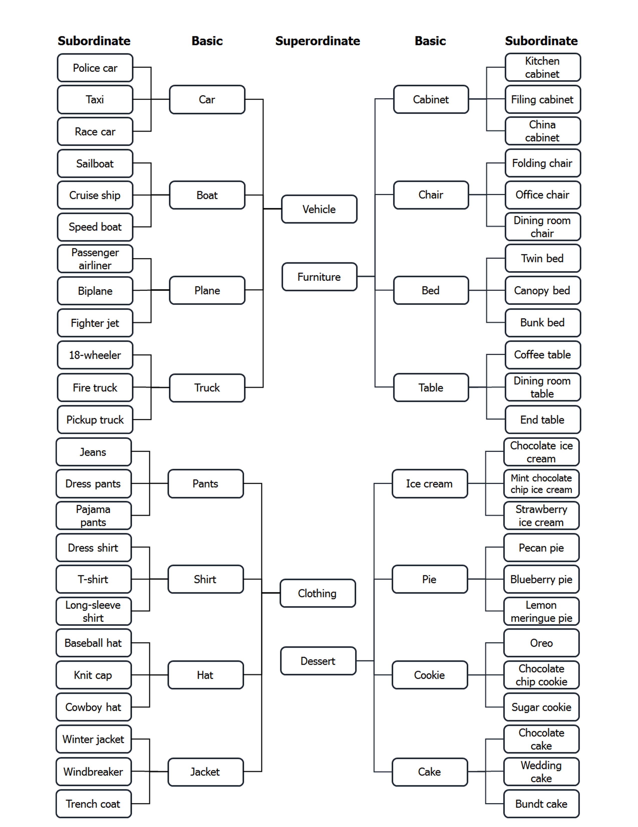
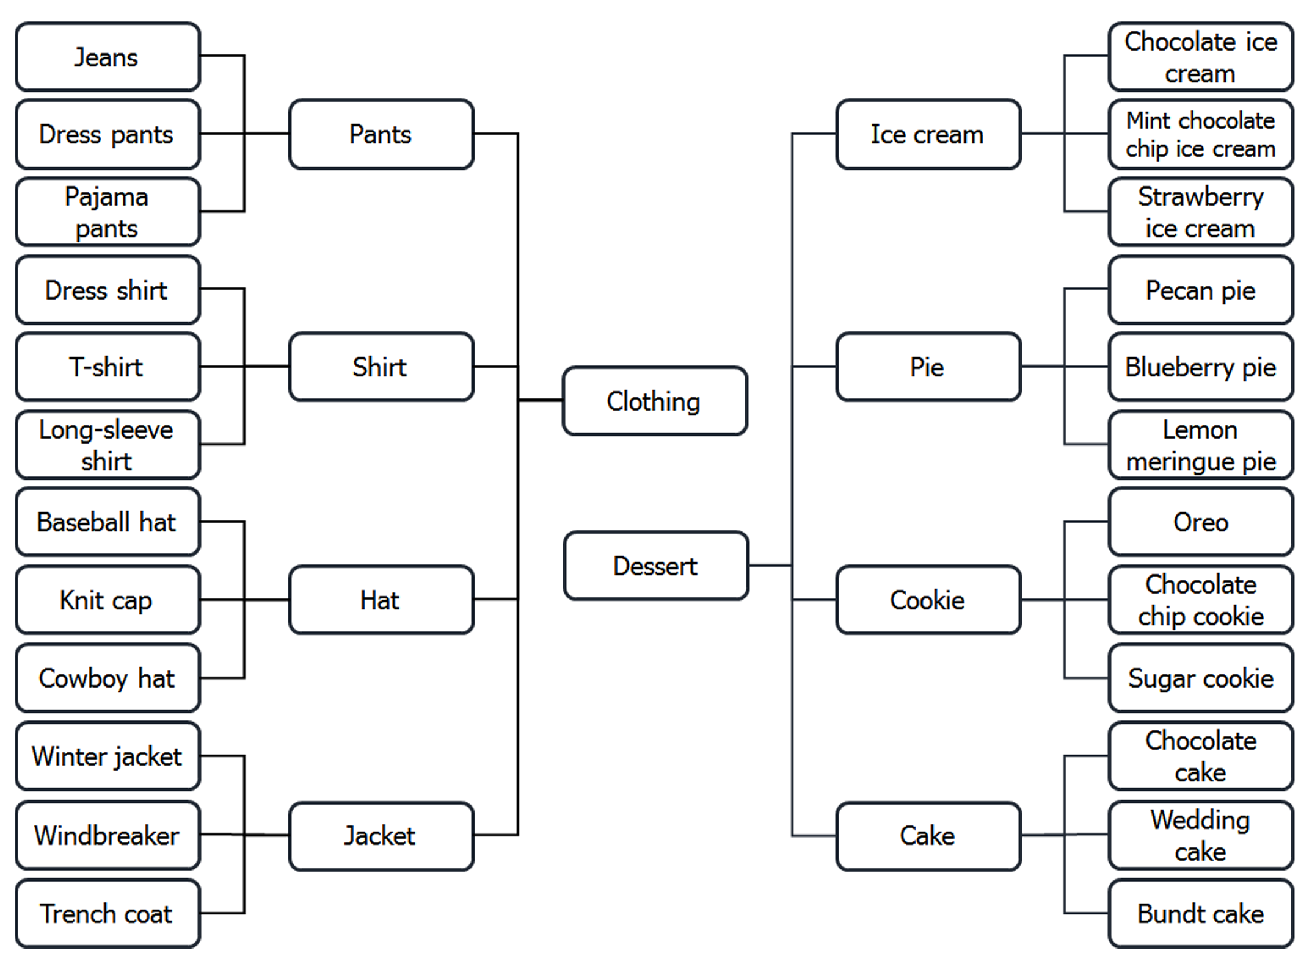

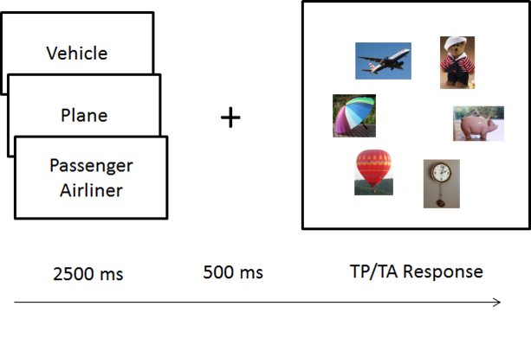
Predicting Categorical Search Behavior on Individual Trials Using Category-Consistent Features
THE EYE COG LAB
Justin Maxfield¹, Chen-Ping Yu², & Gregory Zelinsky^{1,2} ¹Department of Psychology; ²Department of Computer Science; Stony Brook University
EYE MOVEMENTS AND
VISUAL COGNITON
Introduction
Category-Consistent Feature Model
Of the countless times each day that we seek out an object in the world, it is almost never the case that we get to see a picture of this object before engaging in our search. Far more common is to have only fuzzy knowledge of the target’s appearance, with often only the features of the target category to guide us. We are constantly learning and updating visual representations of object categories throughout our lives, and having efficient representations for guiding search to categorical targets is highly consequential; tumors and weapons are both target categories in cancer and baggage screening categorical search tasks, respectively.
Recently, we introduced a computational model that is able to quantify categorical representations (Yu, Maxfield, & Zelinsky, 2016, Psychological Science). The Category-Consistent Feature (CCF) model is a new and validated tool for studying the visual representation of common object categories. It adopts a generative approach, learning categories from exposure to many category exemplars. Our CCF model successfully predicted differences in search guidance and target verification across three levels of a category hierarchy. Specifically, it captured a subordinate-level advantage in the initial guidance of gaze to a target, followed by a basic-level advantage when verifying the target object. Here we ask whether the CCF model can also predict search guidance on individual trials, essentially using the model to create categorical priority maps for guiding search to specific object categories.
(v)
Categorical Target Map from CCF Model
.72
.94
.91
(i) SIFT and color histogram features are extracted from 100 exemplars for each of the 48 subordinate-level categories. (ii) Bag-of-Words is used to create a common 1064-dimensional feature space. (iii) BoW histograms were averaged by category; features (bins) in these averaged histograms now have a mean frequency and variability across exemplars. (iv) Features having low frequency and high variability are removed from the averaged histograms, leaving 68 histograms of CCF features. (v) Chi-squared distances are computed between each search display object and the CCFs of the cued target category. Lower scores indicate greater similarity and higher priority.
Behavioral Methods
Results
Stimuli were images of objects from 68 categories spanning three hierarchical levels: 4 superordinate categories, each having 4 basic categories, which each had 3 subordinate categories. There were 3 exemplars at each subordinate level for a total of 144 unique, high-typicality objects serving as targets in the search task.
r = -.54; p = .032
Chi-Squared Distance
Proportion of First Fixated Object
Chi-Squared Distance
Time to Target (ms)
Analyzing distances between the cued target category and the target exemplar in the search displays revealed the same subordinate-level advantage found in guidance behavior (p < .001). This extends the method from Yu et al., which explained guidance in terms of the number of CCFs rather than distance.
We also analyzed the target-absent data, dividing these into trials having a lure (a sibling of the target category) and those that did not. We found that lures had a smaller mean distance to the target category than random-category distractors (p < .001), consistent with the fact that lures were fixated preferentially (p < .001).
For each trial, distances were found between the target category and each distractor, which we averaged over distractors and subtracted from the cue-target distance to obtain a target guidance score (TGS). We found that mean TGS, (by individual category), correlated reliably at the basic level (but not at the subordinate or superordinate levels).
Participants (n=26) performed a target present/absent (50/50) categorical search task. Objects were ~2.5° and were presented in a 6-item array at 8° eccentricity.
Discussion
Object categories likely differ with respect to the “goodness” of their visual representations in guiding behavior. Recently, we introduced our CCF model that predicted search guidance to targets at different levels of the category hierarchy. This work extends our CCF model to the prediction of guidance by individual target categories. Although these predictions were only reliable at the basic level, future work using more powerful CCFs will aim to predict performance at the subordinate and superordinate levels as well.
These finer-grained behavioral predictions stem from the computation of target-distractor distances on a trial-by-trial basis using a CCF-derived categorical target map. By computing the distance between target category CCFs and the visual features of all objects appearing in a search display, this method takes into account the role of search display distractors on guidance efficiency—another extension to our CCF model.
Future work will continue to develop the CCF model by learning features using deep neural networks inspired by the ventral stream.
We measured categorical guidance as: time to fixate the target and the proportion of first search fixations on lures versus non-lures.

