Slide 1
Roles of a Manager
- 25^{th,} November, 2015

Slide 2
Lesson Objective
Roles of a Manager

Slide 3
Roles
Interpersonal
Informational
Decisional
The “figurehead”
The leader
The liaison
The monitor
The disseminator
The spokesperson
The entrepreneur
The disturbance handler
The resource allocator
The negotiator

Slide 4
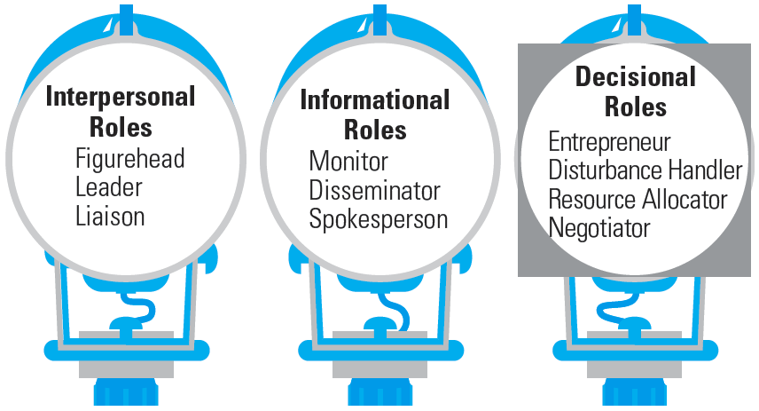
Exhibit 1–4 ● Ten Roles Managers Play

Slide 5
ROLES OF A MANAGER
Henry Mintzberg (1973), a well-known management theorist, described ten different roles of a manager. These ten roles are grouped into three broad and distinct but related categories:
Interpersonal roles
Figurehead role
Leader role
Liaison role
Informational roles
Monitor role
Disseminator role
Spokesperson role
Decisional roles
Entrepreneurship role
Disturbance handler role
Resource allocator role
Negotiator role

Slide 6
Interpersonal role
Managers assume interpersonal roles in order to coordinate and interact with organizational members. Managers develop contacts and build relationships with people inside and outside the organization.
Figurehead role consists largely of such ceremonial work as greeting and receiving visitors, chairing board meetings, and symbolically representing the organization.
Leader role indicates directing, coordinating, motivating, staffing, and controlling activities.
Liaison role involves maintaining relations internally with different units and externally with the society for building the image, gathering resources etc.

Slide 7
Informational roles
It is the managerial role that involve receiving, collecting, and disseminating information. Managers handle a great deal of information in connection with their work.
Monitor role relates with the assessment and watching over the activities taking place in and around the organization.
Disseminator role provides information to subordinates and keep them informed of what is going on around the organization and the precautions to be taken.
Spokesperson role involves representing the unit of work to explain to organizational members and outsiders about the related issues of their interest

Slide 8
Decisional role
Decisional roles are closely associated with the methods managers use to plan strategy and utilize resources. Decision-making involves negotiations and compromises with competing or conflicting interests.
Entrepreneurship role is concerned with planning and initiating change within the organization.
Disturbance handler role is related with maintaining congenial working environment and organizational stability by containing problems of disagreements and conflicts.
Resource allocator role deals with the managerial function of allocating resources (money, people, time, equipment, etc) to different units and subordinates.
Negotiator role involves representing as well as protecting organization’s interest in dealing with insiders and outsiders to add value to work.

Slide 9
THANK YOU

