Slide 1
Communication
Presented by Shishir thapa

Slide 2
What is Communication??

Slide 3
According to Oxford Dictionary:
The imparting or exchanging of information by speaking, writing, or using some other medium.

Slide 4
Two-way process
mutual understanding
Two-way process of reaching mutual understanding, in which participants not only exchange (encode-decode) information, news, ideas and feelings but also create and share meaning.
exchange
create and share meaning

Slide 5
Two-way process
Mutual understanding
Exchange information, news, ideas and feelings
Create and share meaning

Slide 6
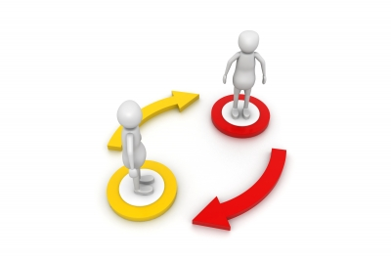
Two-way process

Slide 7
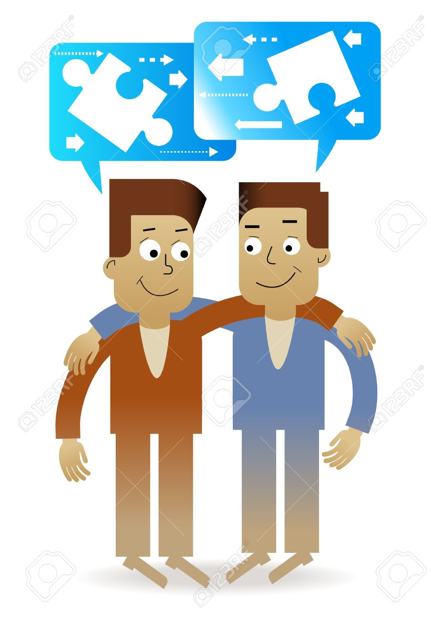
Mutual understanding

Slide 8
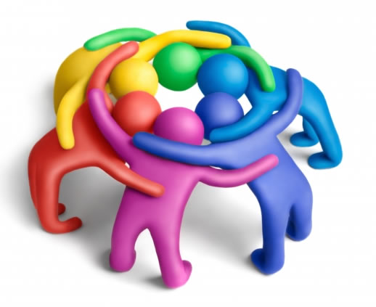
Exchange information, news, ideas and feelings

Slide 9

Create and share meaning

Slide 10
Two-way process of reaching mutual understanding, in which participants not only exchange (encode-decode) information, news, ideas and feelings but also create and share meaning.

Slide 11
Types of communication
Verbal communication
Non-verbal communication

Slide 12

Verbal Communication
Verbal communication is the use of sounds and words to express yourself.
It includes oral and written communication.

Slide 13

Non verbal communication
Non verbal communication is the use of facial expressions, gestures, eye contact, posture, and the tone of the voice to express yourself.
The difference between the words people speak and our understanding of what they are saying comes from non-verbal communication.

Slide 14
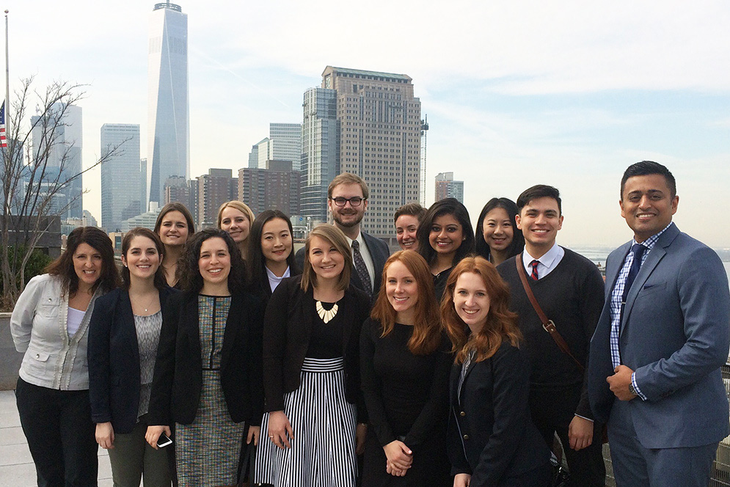


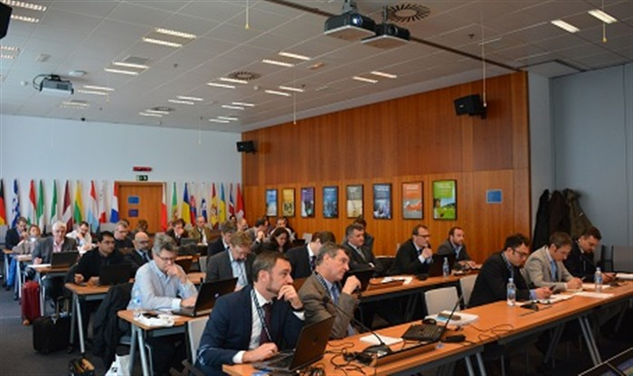

Importance of communication
Promotes motivation
Source of information
Altering individual’s attitude
Helps in socializing
Controlling process

Slide 15
Conclusion
To summarize, communication is way to connect between people or places.

Slide 16
Thank you..!!

