Slide 1
Protractor
End-to-end test framework for Angular applications
Michaela Ďuranová
29.8.2017

Slide 2
Agenda
Introduction Demo
Cook Book
Installation
Lessons learned
When to use Protractor
Usefull links
Questions and Answers

Slide 3


Slide 4
Cook Book

Slide 5
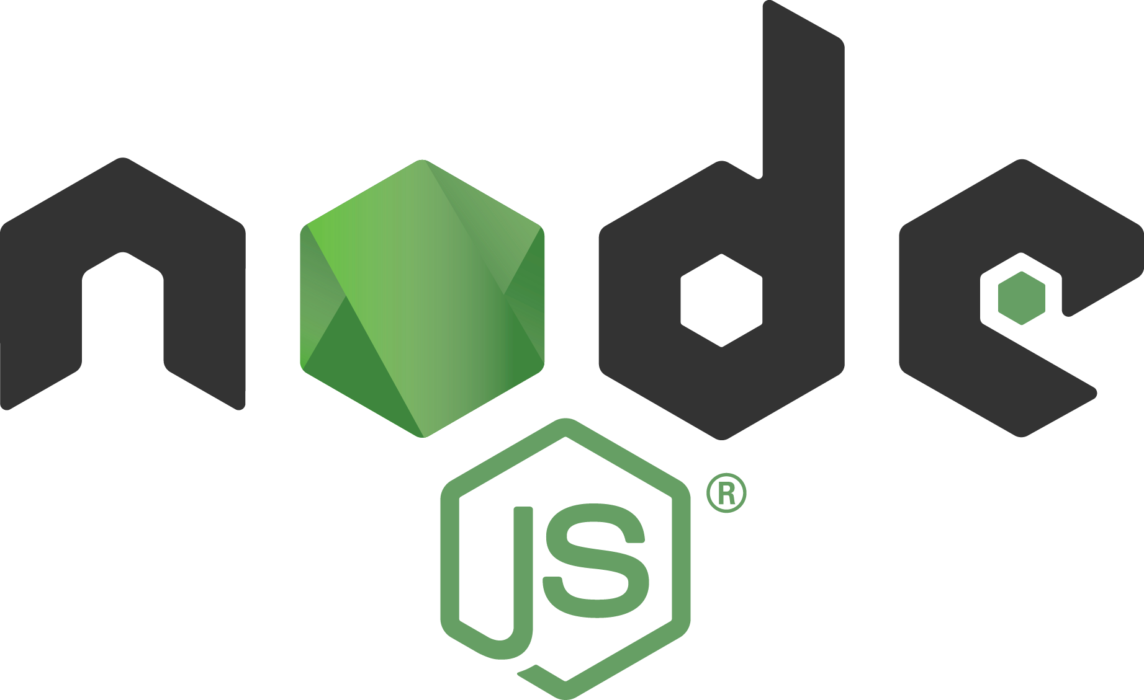
Protractor
Protractor is an end-to-end test framework for Angular and AngularJS applications. Protractor runs tests against your application running in a real browser, interacting with it as a user would.
program

Slide 6
Node.js
JavaScript runtime built on JavaScript engine.
Download and set to system path variables: https://nodejs.org/en/

Slide 7


Angular
Angular is a platform that makes it easy to build applications with the web. Angular combines declarative templates, dependency injection, end to end tooling, and integrated best practices to solve development challenges.

Slide 8
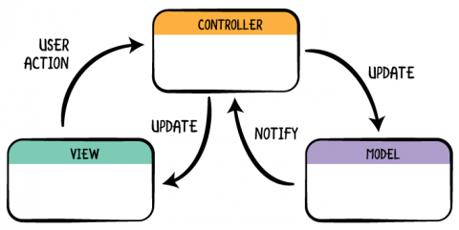
Angular

Slide 9

Jasmine
Testing framework for JavaScript
Easy-to read syntax
Reports (xml)

Slide 10
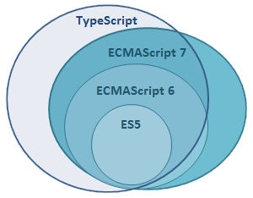
JavaScript and TypeScript

Slide 11
Installation

Slide 12
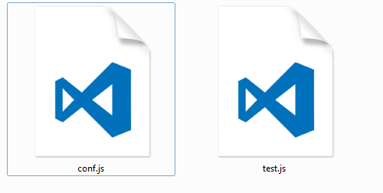
Installation
http://www.protractortest.org/#/
Prerequisites:
  node.js
  JDK

Slide 13
Lessons Learned

Slide 14
When to Use Protractor

Slide 15
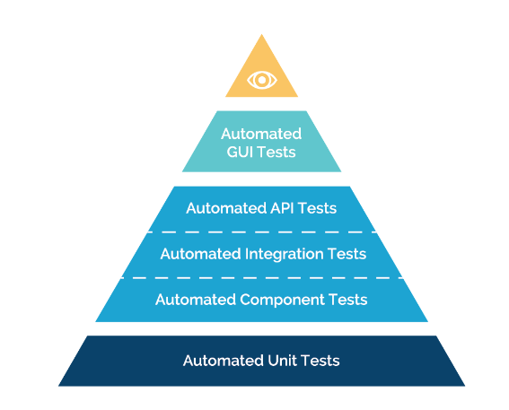
Protractor

Slide 16
Protractor vs. Selenium
accessors to angular models, bindings, ng-options, finding elements inside ng-repeater
locators – by button text, CSS and text or add your own locator
use protractor with existing infrastructure

Slide 17
Usefull links

Slide 18
Protractor
Prerequisites
https://nodejs.org/en/
http://www.oracle.com/technetwork/java/javase/downloads/index.html
Protractor
http://www.protractortest.org/#/api
https://github.com/angular/protractor
https://www.udemy.com/protractor/

Slide 19
Language and locators
XPath, CSS, DOM, Selenium Cookbook
https://www.red-gate.com/simple-talk/dotnet/net-framework/xpath-css-dom-and-selenium-the-rosetta-stone/
ECMAScript6
http://es6-features.org/#Constants
Angular/Protractor-cookbook
https://github.com/angular/protractor-cookbook (.ts)

Slide 20
Questions and Answers

Slide 21

GOOD LUCK!
In case of trouble

