Slide 1
Machine Learning Algorithms Overview
Logistic Regression
Random Forest
Support Vector Machine (SVM)
K-Nearest Neighbors (KNN)

Slide 2
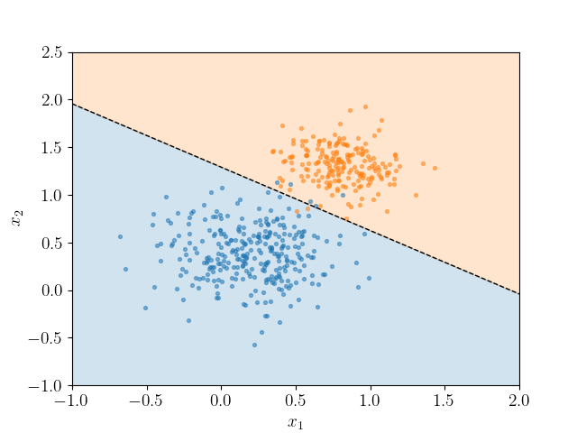
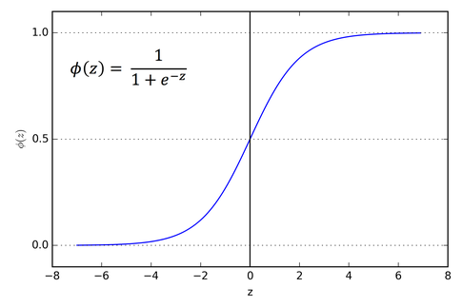
Logistic Regression
Supervised classification algorithm
Predicts probability using sigmoid function
Creates linear decision boundary
Easy to interpret and fast
Probability > 0.5 --> class 1
Else: class 0

Slide 3
Logistic Regression – Key Points
Best for simple, linearly separable data
Outputs Yes/No predictions
Used in binary classification

Slide 4
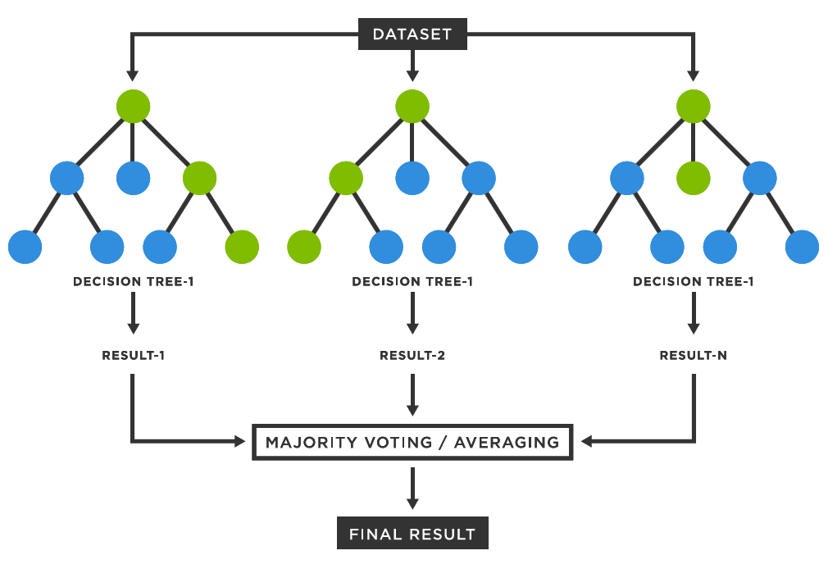
Random Forest
Ensemble of many decision trees
Each tree votes for final prediction
Reduces overfitting
Handles nonlinear patterns

Slide 5
Random Forest – Key Points
Works well on complex real-world data
Robust and accurate
Harder to interpret than single models
Usually better than other baseline models

Slide 6
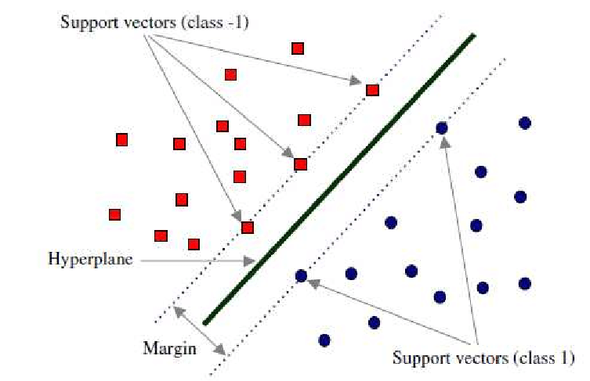
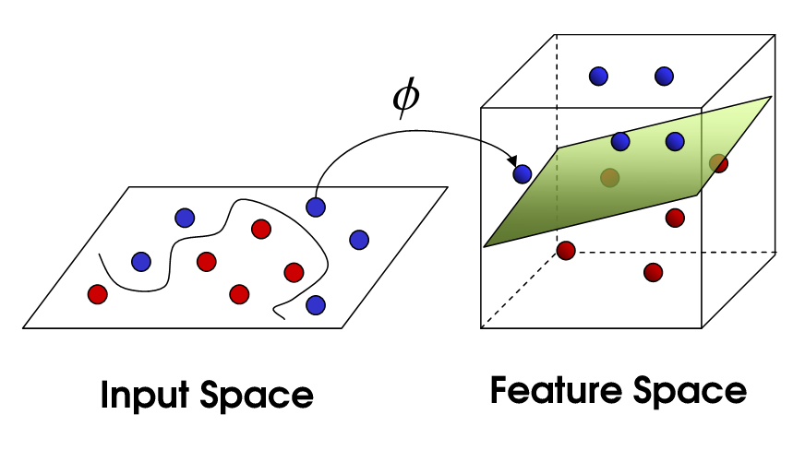
Support Vector Machine (SVM)
Finds optimal boundary between classes
Maximizes margin between groups
Can model nonlinear data using kernels

Slide 7
SVM – Key Points
Effective in high-dimensional data
Works well for smaller datasets
Needs careful parameter tuning

Slide 8
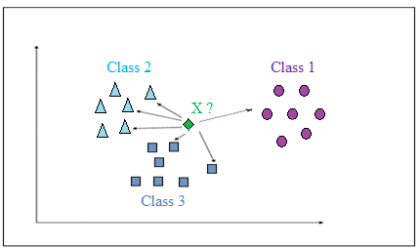
K-Nearest Neighbors (KNN)
Classifies based on closest neighbors
Uses distance measurement to measure the distanc of each test sample (unknown label) with K closest neighbors in train set (known label)
Majority vote determines class

Slide 9
KNN – Key Points
Simple and intuitive
No training phase
Slow for large datasets

Slide 10
Algorithm Comparison Summary
Logistic Regression – Simple & interpretable
Random Forest – Powerful & handles complexity
SVM – Optimal boundary, good for complex spaces
KNN – Instance-based, similarity-driven

