Slide 1
Feature Selection Methods in Machine Learning
Lasso, Ridge Regression, Elastic Net, and MRMR
Purpose:
• Select informative variables
• Prevent overfitting
• Improve interpretability and generalization
Common in high‑dimensional datasets such as genomics and biomedical studies.

Slide 2
Why Feature Selection?
Problems in high‑dimensional datasets:
Large number of predictors (p)
Multicollinearity: Multiple features explain the same thing
Overfitting
Difficult model interpretation
Goals:
Reduce dimensionality and generalizability of a model
Improve prediction accuracy
Identify relevant features

Slide 3
Linear Regression Objective Function
Standard regression minimizes residual error:
MSE = min Σ(y_{i} – ŷ_{i})² = min Σ(y_{i} – X_{i}β)²
Regularization adds penalty terms to control coefficient magnitude.
High coefficient values = overfitted model

Slide 4
L1 and L2 Regularization Penalties
L1 Penalty (Lasso):
λ Σ |β_{j}|
Encourages sparse solutions where many coefficients become zero. → Robust feature selection method
L2 Penalty (Ridge):
λ Σ β_{j}²
Shrinks coefficients toward zero but typically keeps all variables.

Slide 5

Ridge Regression
Loss Function:
Key Properties:
Uses L2 regularization
Handles multicollinearity well
Shrinks coefficients but keeps all variables

Slide 6

Lasso Regression
Loss Function:
Key Properties:
Uses L1 regularization
Performs automatic feature selection
Some coefficients become exactly zero

Slide 7
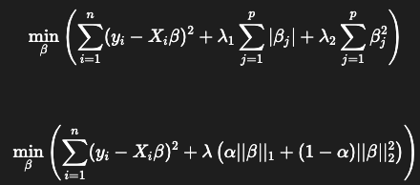
Elastic Net
Loss Function:
Combines strengths of Lasso and Ridge in feature selection
Removes multicollinearity, reduce the impact of features

Slide 8
MRMR Feature Selection
Minimum Redundancy Maximum Relevance (MRMR)
Goal:
Select features that are highly relevant to the target
while minimizing redundancy between selected features.

Slide 9
Method Comparison
Ridge:
• Penalty: L2
• Feature selection: No
• Handles correlation well
Lasso:
• Penalty: L1
• Performs feature selection
Elastic Net:
• L1 + L2
• Good for correlated features
MRMR:
• Mutual information filter method
• Explicitly reduces redundancy

