Slide 1
Week 8: Deep Learning

Slide 2
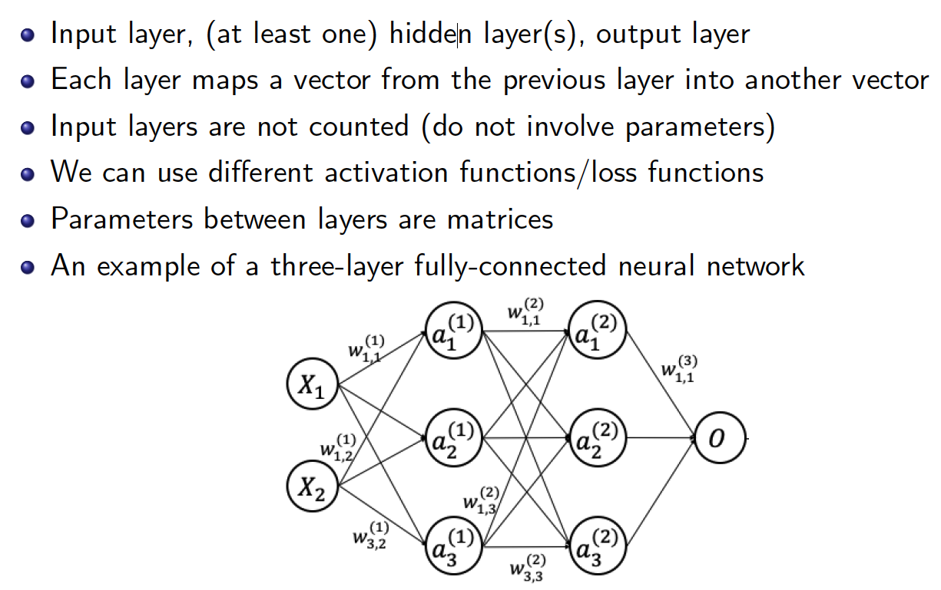
Multi-Layer Perceptron (MLP)

Slide 3
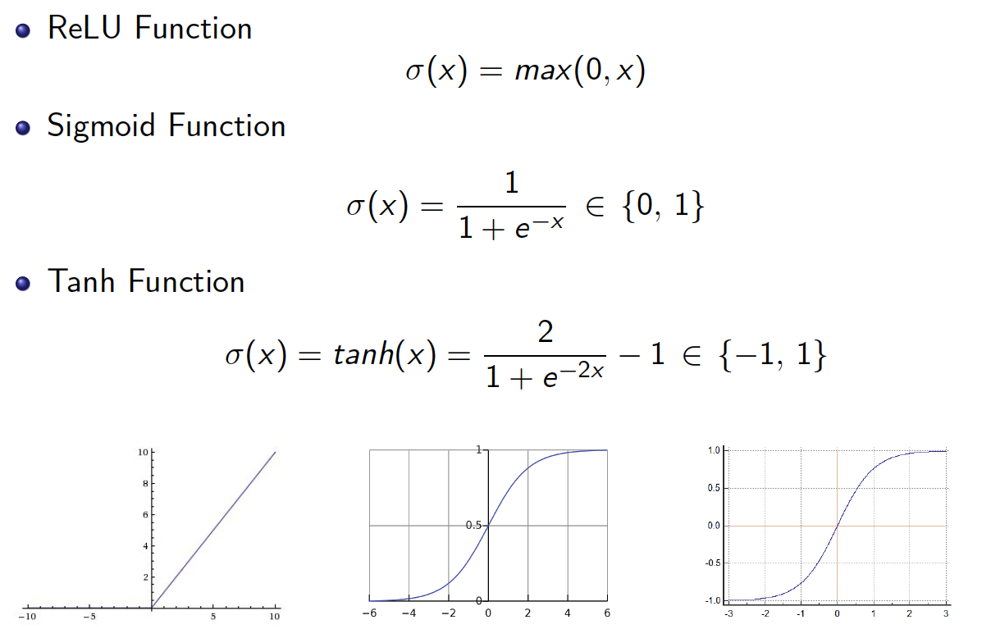
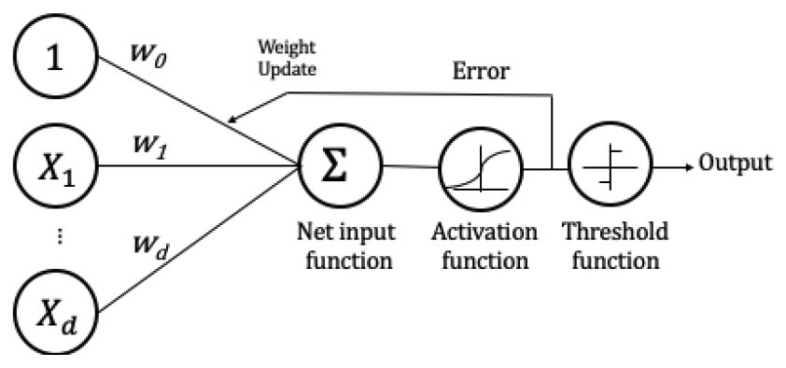
Non-linear activation function

Slide 4
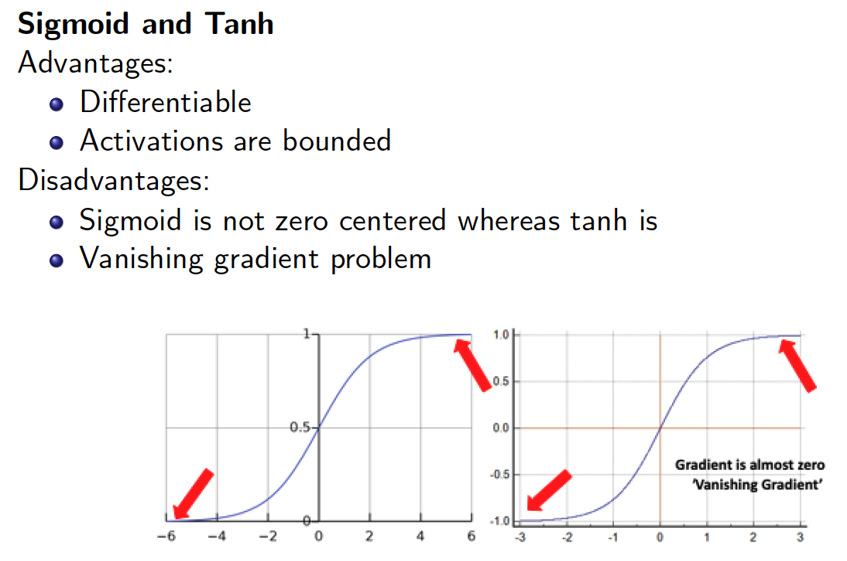
Activation always positive in sigmoid == gradient always positive or negative == all weights updates in same direction
Vanishing gradient: gradient becomes zero at very large inputs → not updating the weights

Slide 5
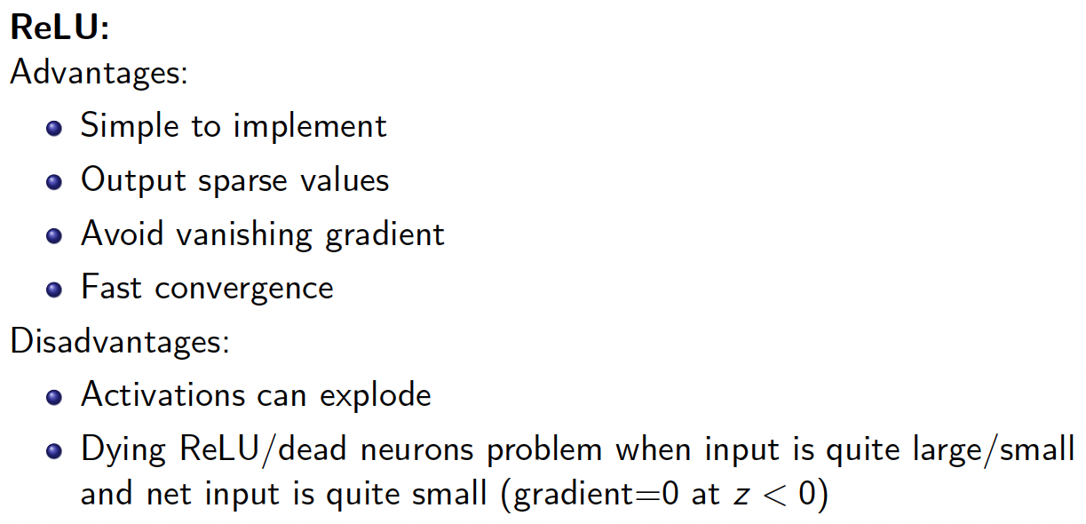

Slide 6
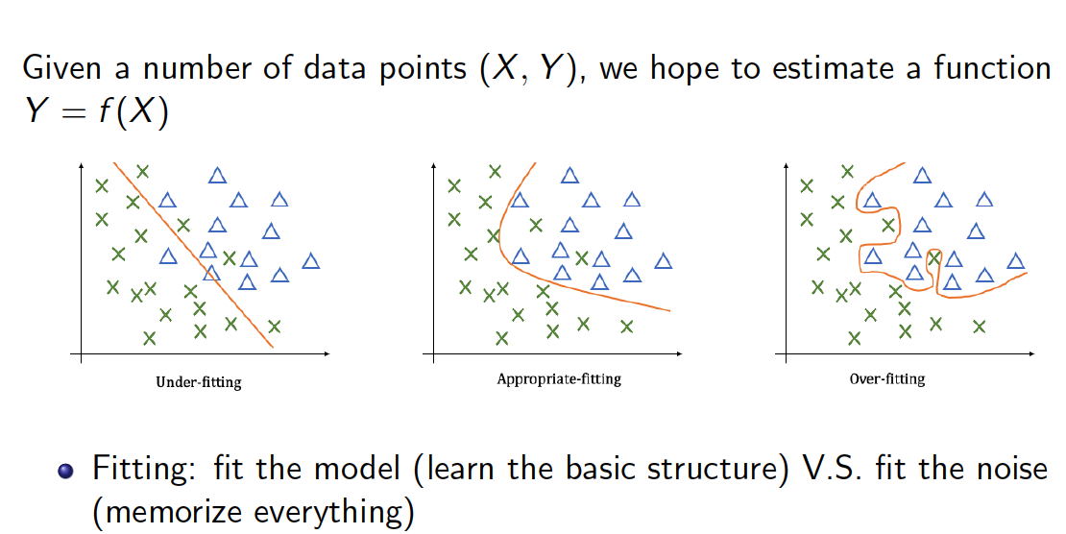
Overfitting vs. underfitting

Slide 7
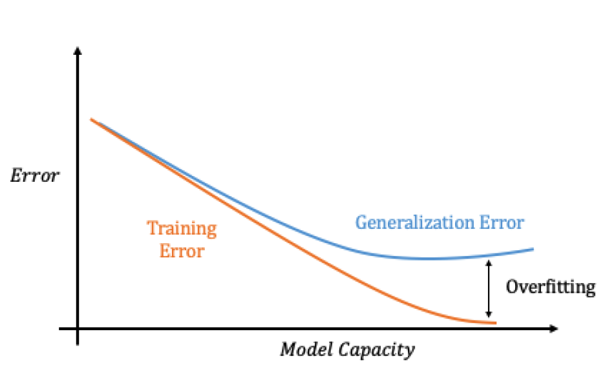

Slide 8
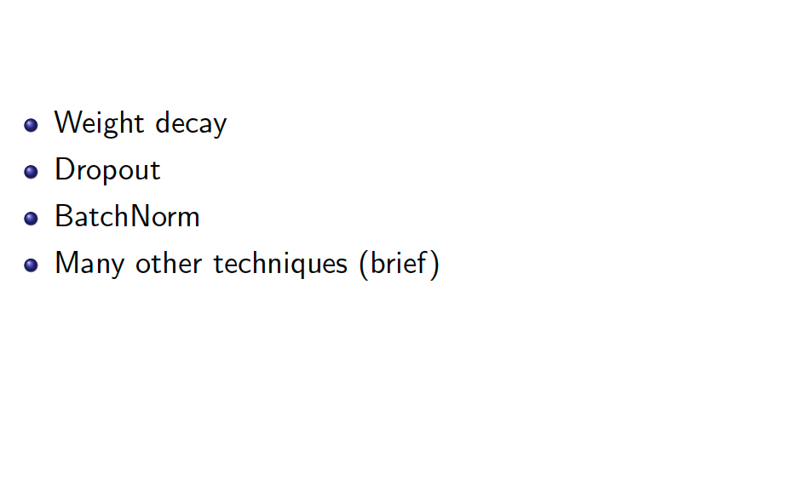
Regularization

Slide 9
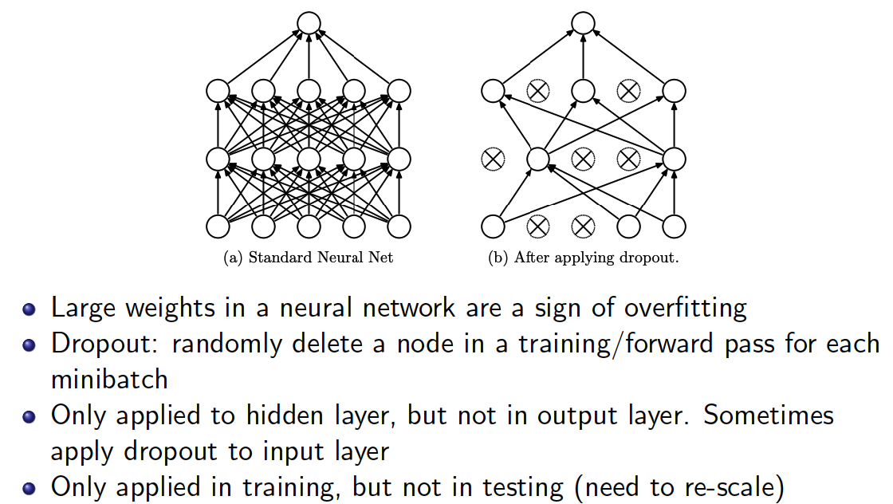
Weight Decay
Prevents of weights to become too big (add penalty term for large weights)
w = w – η . Gradient – λ . W
η = learning rate, λ = weight decay factor
Dropout

Slide 10
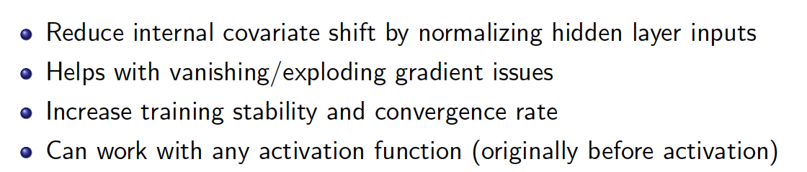
Batch Normalization
For each batch for each layer, normalize inputs before implementing the activation function → activation function receives the normalized data.
Other regularization techniques
Data augmentation: rotation, adding noise, etc.

