Slide 1
AI Interpretation Tools
Help understand model decisions
Improve trust and transparency
Identify important features
Debug and validate models
Why interpretation matters?
Black-box models are hard to trust
Needed in healthcare, finance
Supports decision-making

Slide 2
Types of Interpretation Methods
Global vs Local
Feature importance methods
Example-based explanations (local)

Slide 3
PLS-DA Overview
Partial Least Squares Discriminant Analysis (PLS-DA)
Supervised classification method
Combines PLS regression with classification
Works well with high-dimensional data

Slide 4
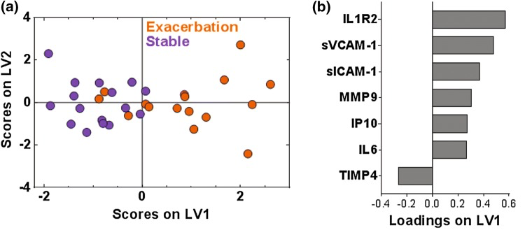
How PLS-DA Works
Projects data into latent space where maximizes covariance between features and labels
Reduces dimensionality
Then performs classification using latent variables
Norman K. et al. Cell Mol Bioeng, (2019)

Slide 5
Advantages of PLS-DA
Handles multicollinearity (reduce dimension)
Works with small sample sizes
Interpretable latent variables
Common in bioinformatics

Slide 6
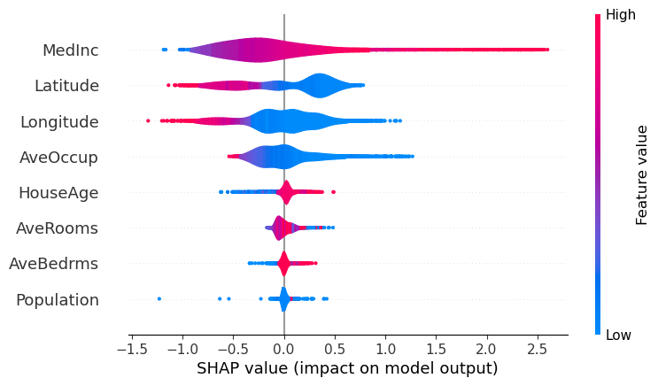
SHAP Overview
SHAP = SHapley Additive exPlanations
Based on game theory
Can explain predictions on every type of ML or DL algorithm
Assigns importance to each feature
Documentation: https://shap.readthedocs.io/en/latest/
Feature contribution to housing price in California:

Slide 7
How SHAP Works
Considers all feature combinations
Calculates marginal contribution
Produces Shapley values
SHAP Advantages
Works on any model
Consistent explanations
Local and global interpretability
Strong theoretical foundation

Slide 8
PLS-DA vs SHAP
PLS-DA:
Model-based
Dimensionality reduction
SHAP:
Works with any model
Focus on feature contributions

Slide 9
Conclusion
Interpretability is essential in AI
PLS-DA useful for structured data
SHAP explains complex models (e.g. DL algorithm)
Choose based on problem context (compare the performance of both)

