Slide 1

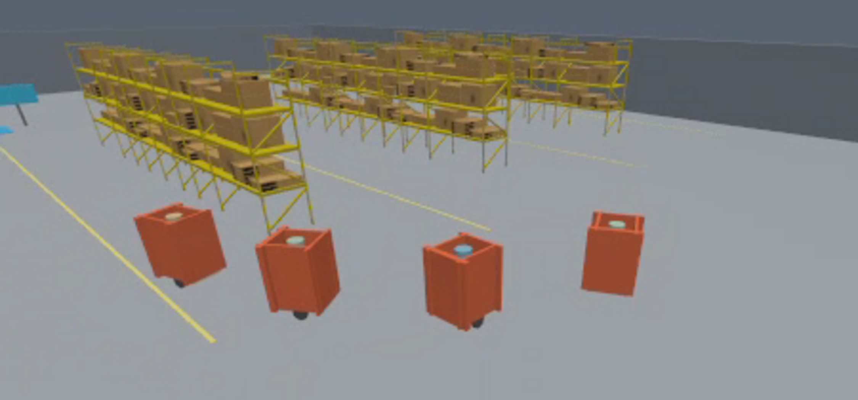
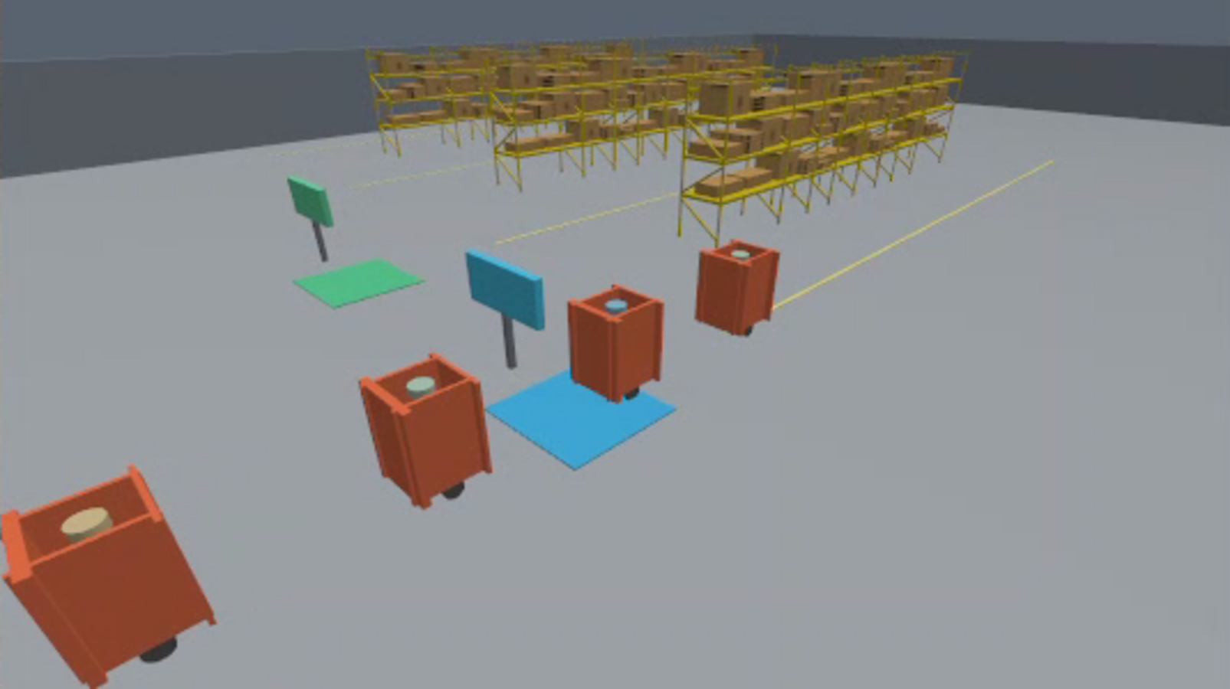
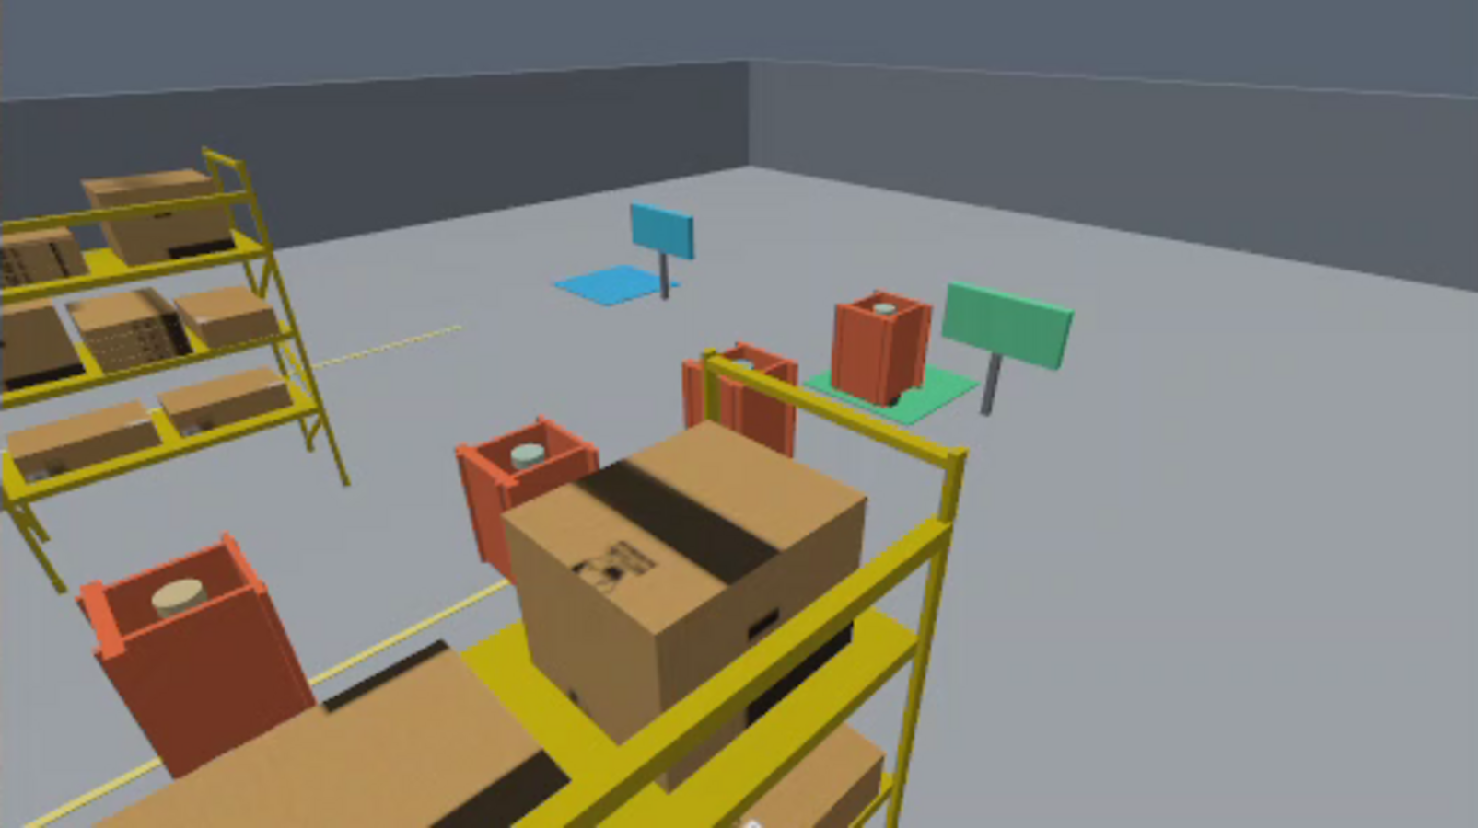
Vision-Based Predecessor-Following Robot Convoys
for Flexible Material Transport
Neeraj Kumar Kanchani
EE 616-57 | Clarkson University
Advisor: Professor Masudul Imtiaz
Code and evidence
Objective
Results
Can one route-aware robot guide independent cargo carts through warehouse aisles while each follower sees only the robot ahead?
10/10 routes completed
One controlled blackout plus nine mapped missions. Zero sampled collisions; four mapped runs passed every strict check.
Nominal convoy spacing error
Three repeated full missions, mean RMSE (cm)
Test task: receiving dock to dispatch dock through mapped shelf aisles.
Approach
LEADER PLANS THE ROUTE
LiDAR, AMCL, Nav2 Smac Hybrid-A*, and Regulated Pure Pursuit.
FOLLOWERS TRACK THE ROBOT AHEAD
Each cart uses forward RGB and local wheel odometry. Followers receive no map, LiDAR, planned path, or Gazebo truth.
Mapped aisle turn in Gazebo. This frame illustrates a presentation run.
Strict evaluator checks
Mapped group | Strict pass | Min TRACK
Pair, n=3 | 3/3 | 95.24%
Chain, n=3 | 1/3 | 89.01%
Dropout, n=3 | 0/3 | 83.15%
WHEN THE TARGET DISAPPEARS
TRACK, PREDICT, SAFE STOP, bounded SEARCH, then confirmed REACQUIRE. Search has zero forward command and a 0.20 rad/s yaw limit.
SEALED STATIC CAMERA GATE
Five chain runs missed only the unchanged 90% TRACK-time check.
YOLOv8n v3: 100% valid full-visible samples; 3.23 cm range RMSE; 0.157° bearing MAE; 9.02 ms inference p95.
Receiving: scripted cargo cue
Dispatch: simulated unload cue
Conclusions
Demonstrated
Future work and application
One route-owning leader guided three independent carts through controlled Gazebo warehouse routes. Spacing limits held, while recovery reduced TRACK time in five chain runs.
Improve target visibility, then test physical carts with changing light and moving obstacles. Small or midsize airport baggage and inspection-cart transport is a future application hypothesis.
Simulation only: no physical robot, person-safety, airport, robotic loading, throughput, or savings evidence.
References
[1] Kanchani, EE 616 project repository and November 9 evidence, 2026. [2] Nav2, Smac Planner and Regulated Pure Pursuit documentation.
github.com/justneeraj12/ee616-vision-leader-follower
Notes:
Template: https://docs.google.com/presentation/d/1VpQm4AbLqUXrJCFY5HfZxkDCVfCdPbYLWFd51c-njS0/edit
Project repository: https://github.com/justneeraj12/ee616-vision-leader-follower
Recovery matrix: work/ros2_ws/results/search_recovery_evidence/aggregate_summary.json and README.md.
YOLOv8n v3 measurement: work/ros2_ws/results/yolo_measurement_gate_v3/summary.json.
Gazebo images: deliverables/warehouse_nav_mission_screenshots/README.md. These are frames from the refreshed GUI video, not independent experiment repetitions.
The result concerns controlled simulation. Cargo events are scripted visual cues. Gazebo truth is evaluation-only.
Nav2 methods: https://docs.nav2.org/configuration/packages/smac/configuring-smac-hybrid.html and https://docs.nav2.org/configuration/packages/configuring-regulated-pp.html

