Slide 1
Diffie-Hellman key exchange
(Yet you would not necessarily understand this)

Slide 2
The problem is…
Eve
That will not help!
We have ciphers!!!
Reading
Alice
Bob
Message exchange

Slide 3

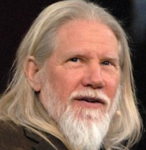
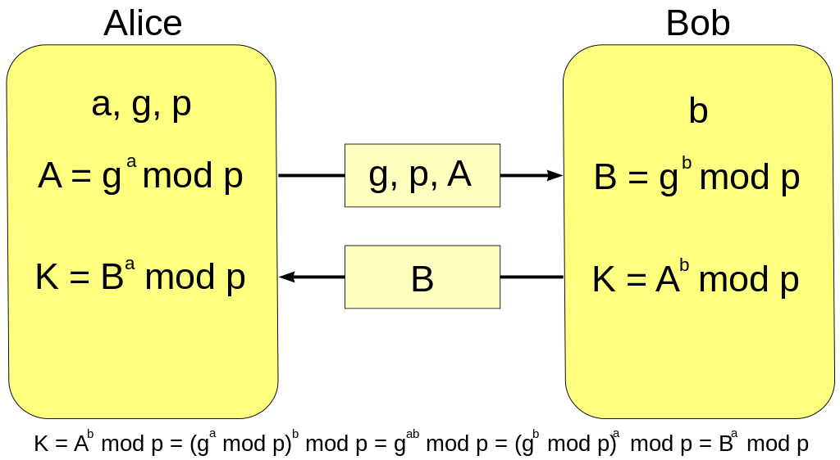
There is a solution – math

Slide 4
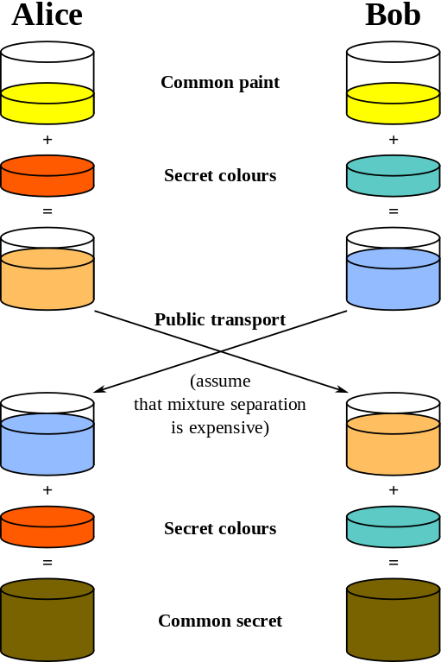
Not simple enough?
p,g
p,g
a
b
A
B
B
A
a
b
K
K

Slide 5
Thanks!
Hope you did understand a little… ah, wait let`s check it!
What is a problem?
And who are the solution authors?
And last what it is based on?

