Slide 1
U.S. Childcare Costs: A Data-Driven Analysis: Exploring Childcare Costs by Age Group and Care Type Across U.S. States By Juston William Suell DSC 640 – Data Presentation & Visualization

Slide 2
Intro
This presentation provides a comprehensive analysis of childcare costs across the United States using data from the national database of childcare prices. The analysis focuses on three major age groups—infants, toddlers, and preschool-aged children—filtered by care type (home-based vs. center-based care). The goal is to provide insights that help both parents and decision-makers understand the significant cost disparities across states and assist them in making informed decisions.

Slide 3
Audience and Presentation Plan
This presentation is designed for two key audiences: working parents and policymakers, both of whom need clear insights into the childcare cost landscape across the United States. For working parents, the primary goal is to provide actionable information that helps them make informed decisions about where to find affordable childcare. By analyzing costs across different age groups—infants, toddlers, and preschoolers—and types of care (home-based vs. center-based), parents can assess which regions or states offer the most cost-effective options based on their specific needs. This data will empower parents to budget accordingly and explore potential savings by selecting more affordable care options in different locations.

Slide 4
Audience and Presentation Plan Cont.
At the same time, this analysis is crucial for policymakers who need to understand regional disparities in childcare costs and how these costs have evolved over time. The data highlights the significant childcare burden placed on families in high-cost states and regions. By identifying these patterns, policymakers can take actionable steps to address childcare affordability through subsidies, tax credits, or other supportive programs. The comparison between the most and least expensive states also offers valuable insights into what’s working in more affordable regions, which can be used as a model for policy initiatives in higher-cost areas.
By presenting this data through interactive maps, bar charts, trend lines, and a final infographic, the presentation is structured to provide both in-depth analysis and easy-to-digest key insights tailored to each audience.

Slide 5
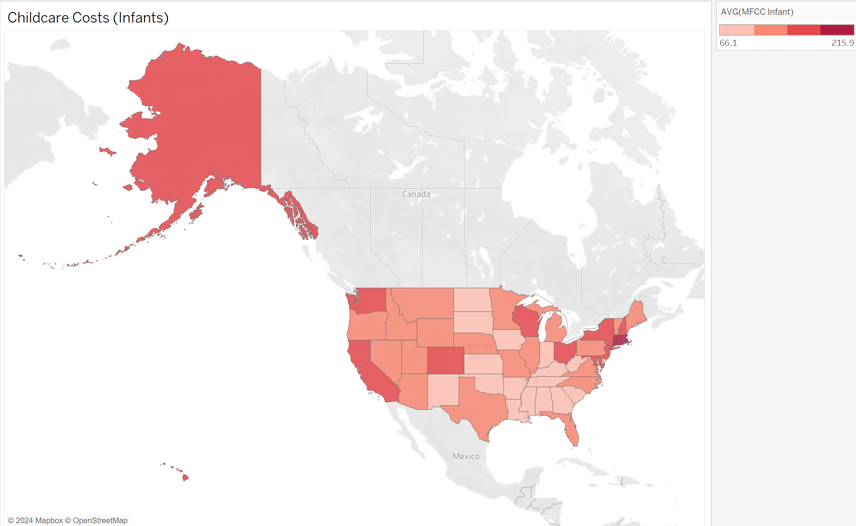
Average Childcare Costs for Infants by State
This map visualizes the average cost of infant care across U.S. states using data from the MFCCInfant column. States are color-coded, with darker shades representing higher average costs and lighter shades representing lower costs. This provides a quick visual understanding of which states have the highest and lowest childcare costs for infants, helping parents and policymakers identify areas where childcare is particularly expensive.

Slide 6
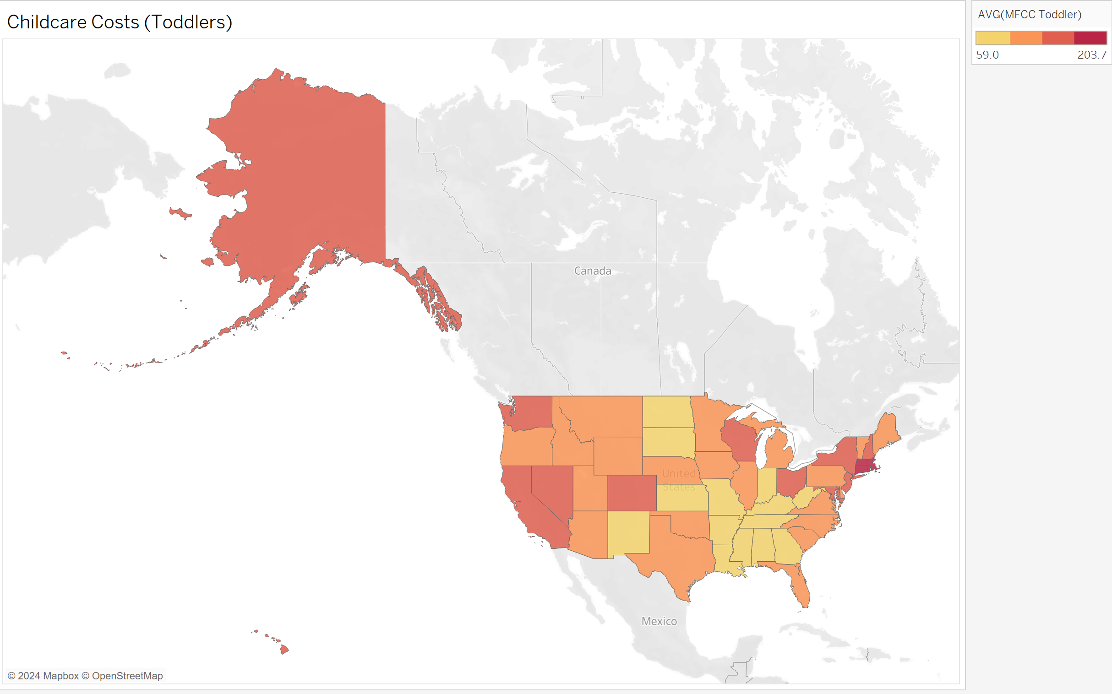
Average Childcare Costs for Toddlers by State
This map shows the average cost of toddler care across U.S. states, drawn from the MFCCToddler column. By comparing states, we can see how costs vary for toddler care, and which regions have higher or lower costs. This is especially useful for parents seeking affordable childcare options or policymakers addressing regional childcare affordability issues.

Slide 7
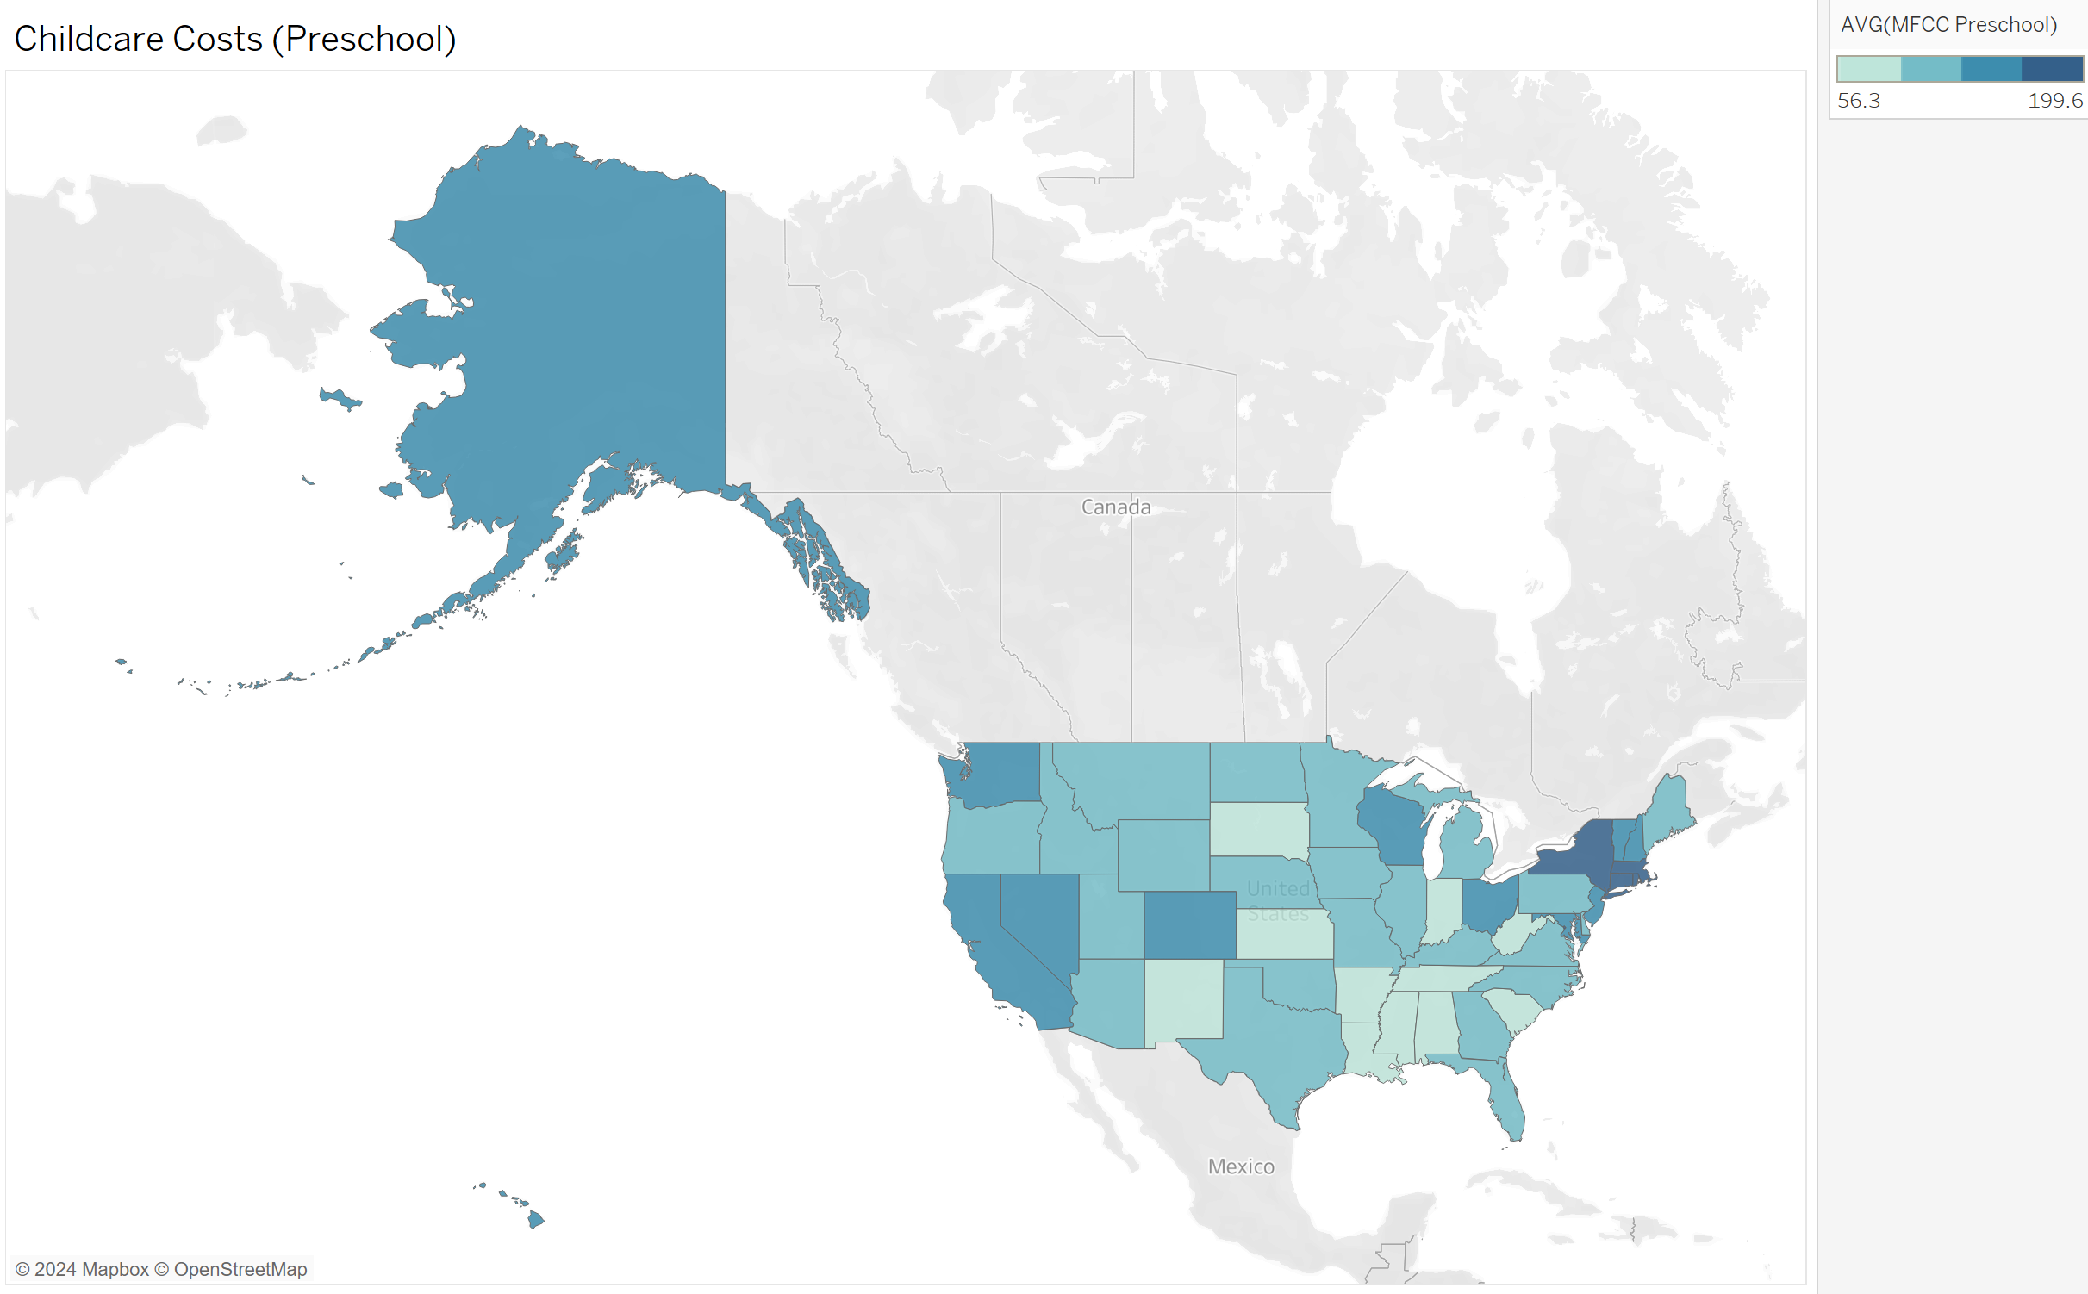
Average Childcare Costs for Preschool-Aged Children by State
This map illustrates the average cost of preschool care across states using data from the MFCCPreschool column. Preschool costs vary widely depending on state and region, and this map helps identify areas where preschool care is particularly expensive or affordable.

Slide 8
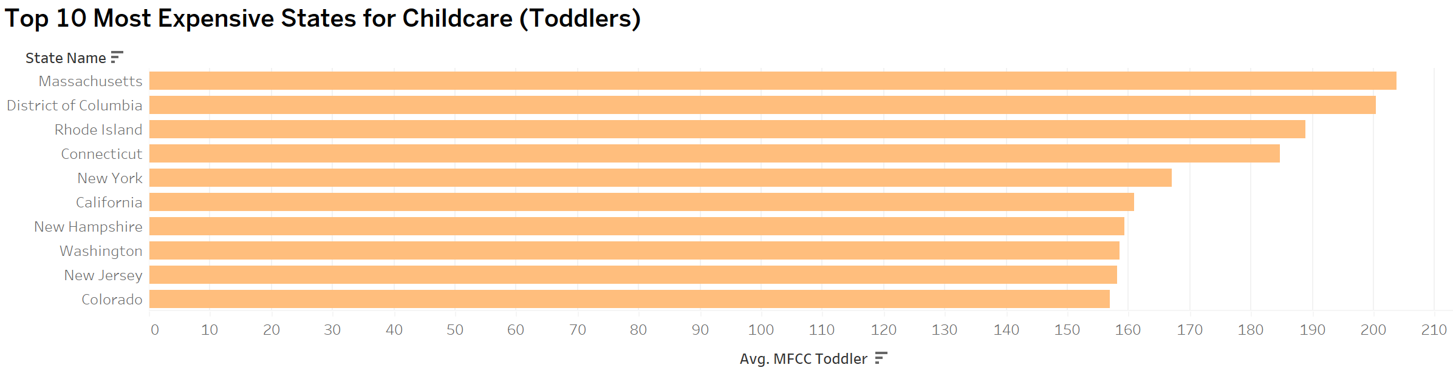
Top 10 Most Expensive States for Toddler Care
This bar chart highlights the 10 states with the highest average toddler care costs, using data from the MFCCToddler column. By examining these high-cost states, we can pinpoint regions where families face the steepest childcare bills, which may indicate a need for additional childcare subsidies or cost-cutting measures.

Slide 9
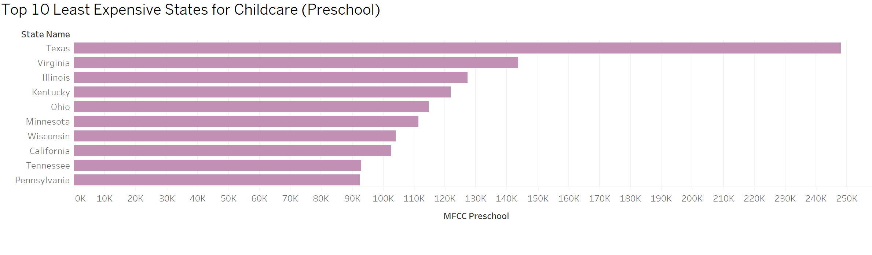
Top 10 Most Expensive States for Preschool Care
This bar chart shows the 10 states with the lowest average preschool care costs, using data from the MFCCPreschool column. Identifying these more affordable states can help families and childcare advocates understand which areas offer more accessible preschool care options.

Slide 10
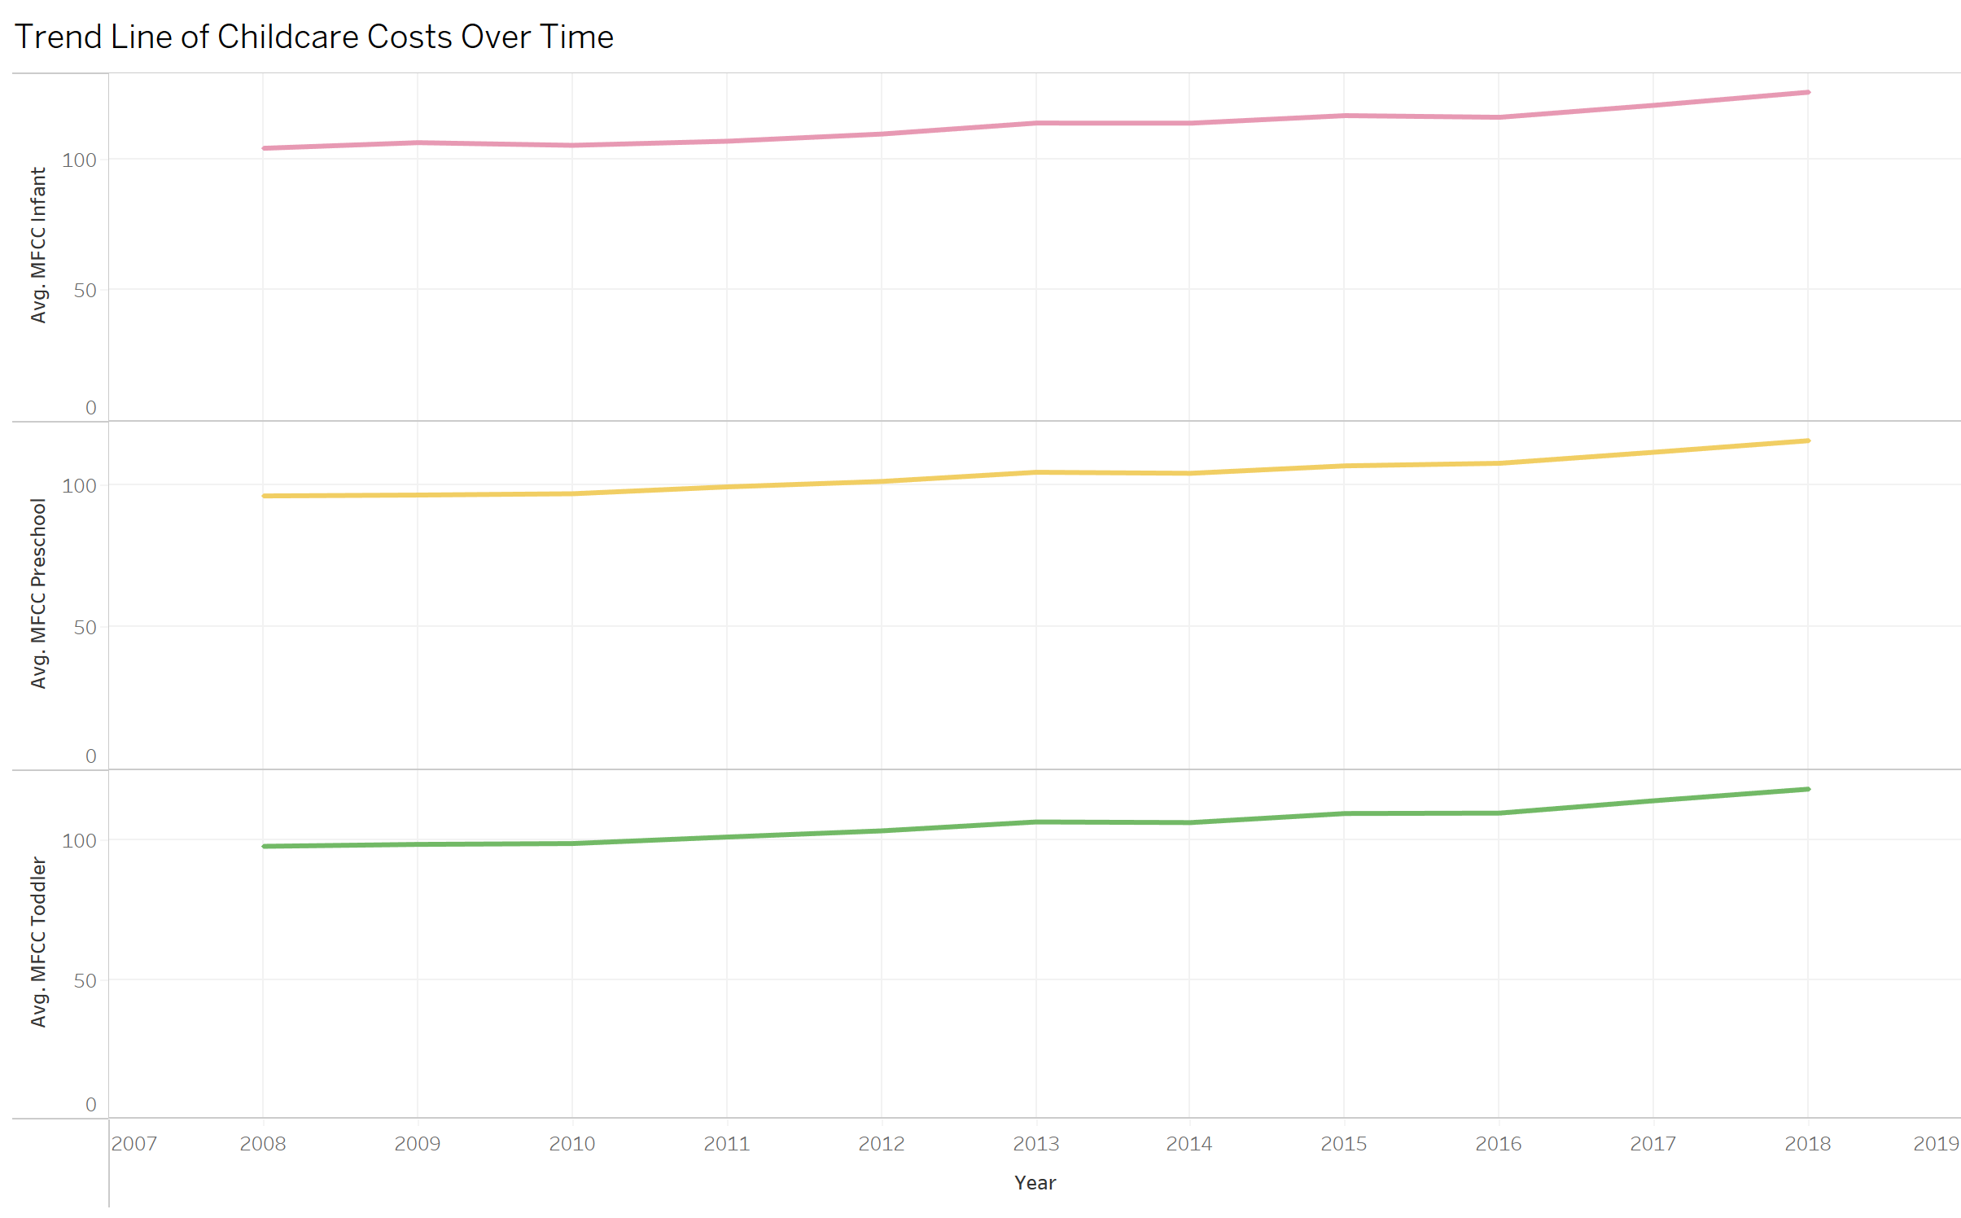
Trend of Childcare Costs Over Time
This trend line visualizes the change in childcare costs over time, showing data for infants, toddlers, and preschoolers. It is based on the StudyYear field, and tracks how average childcare costs have risen over the years for different age groups. This trend is important for understanding long-term affordability challenges.

Slide 11
Key Insights from Childcare Costs Analysis (weekly Daycare costs)
Infant Care: $321
Toddler Care: $293
Preschool Care: $292
Notes:
(Care.com,2024)

Slide 12
Conclusion
In conclusion, the data reveals significant variability in childcare costs across the U.S. Certain states, particularly those on the coasts and in urban areas, experience much higher costs for infants, toddlers, and preschoolers. Conversely, some states in the South and Midwest offer more affordable options. This information can be valuable for working parents, childcare providers, and policymakers to address affordability and access to childcare.

Slide 13
Calls to Action
Call to Action for Parents:
Explore more affordable childcare options within your state by comparing home-based care providers, part-time care, or cooperative childcare solutions. Utilize state and local resources, such as subsidy programs or childcare assistance services, to help reduce costs and find quality care that fits your budget.
Call to Action for Policymakers:
Address affordability issues in high-cost states through targeted subsidies or tax credits to support families in need. Additionally, consider implementing comprehensive childcare support policies that include sliding-scale fee structures, increased funding for community-based childcare services, and collaboration with local organizations to enhance the availability of affordable childcare options. Policy interventions should also include research on successful models in lower-cost states to replicate effective strategies and close the childcare affordability gap nationwide.

Slide 14
Reference
Staff, Care. com E. (2024, April 29). This is how much child care costs in 2024. Care.com Resources. https://www.care.com/c/how-much-does-child-care-cost/

Slide 15
Design Narrative
The design choices in this draft prioritize clarity and impact. Visual elements like heat maps, bar charts, and trend lines were chosen for their ability to illustrate cost disparities across regions. Color schemes were selected to differentiate between high and low-cost states effectively, guiding the audience’s attention to areas of interest. Sizing and spacing were carefully adjusted to ensure readability and accessibility. Each chart concludes with a direct call to action tailored to either parents or policymakers, ensuring the insights provided lead to informed decision-making and action.

