Slide 1
Image Encryption
ANKIT LAKRA – 201301137
ADITYA P.S.V.S - 201301427

Slide 2
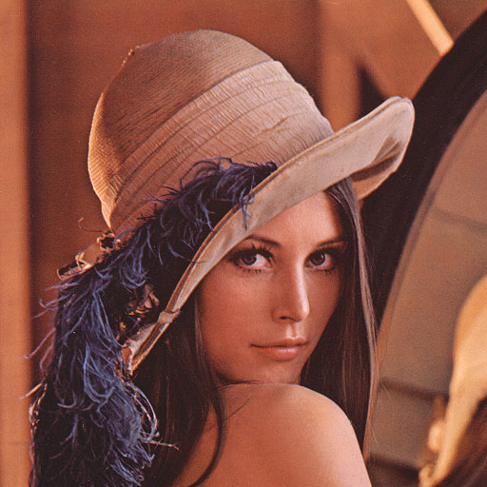

OBJECTIVE
Image Encryption
Decryption of encrypted image
Key
ENCRYPTION
KEY
DECRYPTION
KEY

Slide 3
ALGORITHM
User inputs an image and a KEY
Load image data into an array
Divide array into blocks with KEY elements each
Invert each block by swapping elements
Recreate image as encrypted
Same procedure for decryption

Slide 4
SERIAL ALGORITHM
Both encryption and decryption use two nested loops
1st loop runs (SIZE OF ARRAY)/KEY times
2nd loop runs KEY/2 times
COMPLEXITY: O(SIZE OF ARRAY)

Slide 5
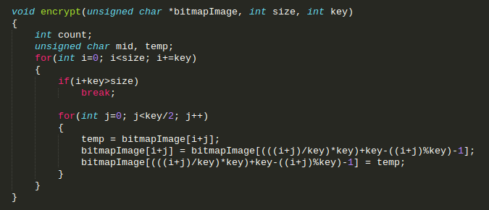
SERIAL CODE

Slide 6
SERIAL ANALYSIS
Size of Image (pixels) | Size of Problem | Time in ms (serial) for Encryption/Decryption
500x480 | 720000 | 5.801984
512x512 | 786432 | 6.050786
787x576 | 1361664 | 11.865050
1024x768 | 2359298 | 19.893215
1024x1024 | 3145728 | 26.952671
1293x1480 | 5742400 | 46.073826
1747x1469 | 7674056 | 60.005314
2560x1920 | 14745600 | 114.705406

Slide 7
PARALLEL ALGORITHM
One thread assigned to each swap of element

Slide 8
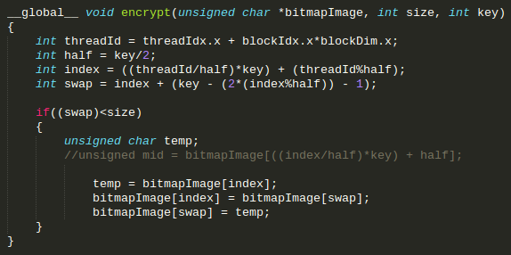
PARALLEL CODE

Slide 9
PARALLEL ANALYSIS
Size of Image (pixels) | Size of Problem | Time in ms (serial) | Time in ms (parallel) | Speed Up
500x480 | 720000 | 5.801984 | 0.357392 | 16.4934048
512x512 | 786432 | 6.050786 | 0.364512 | 16.5996894
787x576 | 1361664 | 11.865050 | 0.62256 | 19.0584939
1024x768 | 2359298 | 27.711420 | 1.064928 | 18.6803380
1024x1024 | 3145728 | 26.952671 | 1.399776 | 19.2549886
1293x1480 | 5742400 | 46.073826 | 2.550752 | 18.0628402
1747x1469 | 7674056 | 60.005314 | 3.395552 | 17.6717405
2560x1920 | 14745600 | 114.705406 | 6.943712 | 16.51932079

Slide 10
SPEEDUP CURVE

Slide 11
CONCLUSION
Can be used for moderate size images
Cannot use shared memory
Encryption algorithms include jumbling of pixels and then restoring back
Data in the array not independent

Slide 12
FURTHER APPLICATIONS
Can be implemented for other image encrypting algorithms
RSA Algorithm
Chaotic Algorithm
Can also be implemented for encryption of files other than images

Slide 13
THANK YOU

