Slide 1

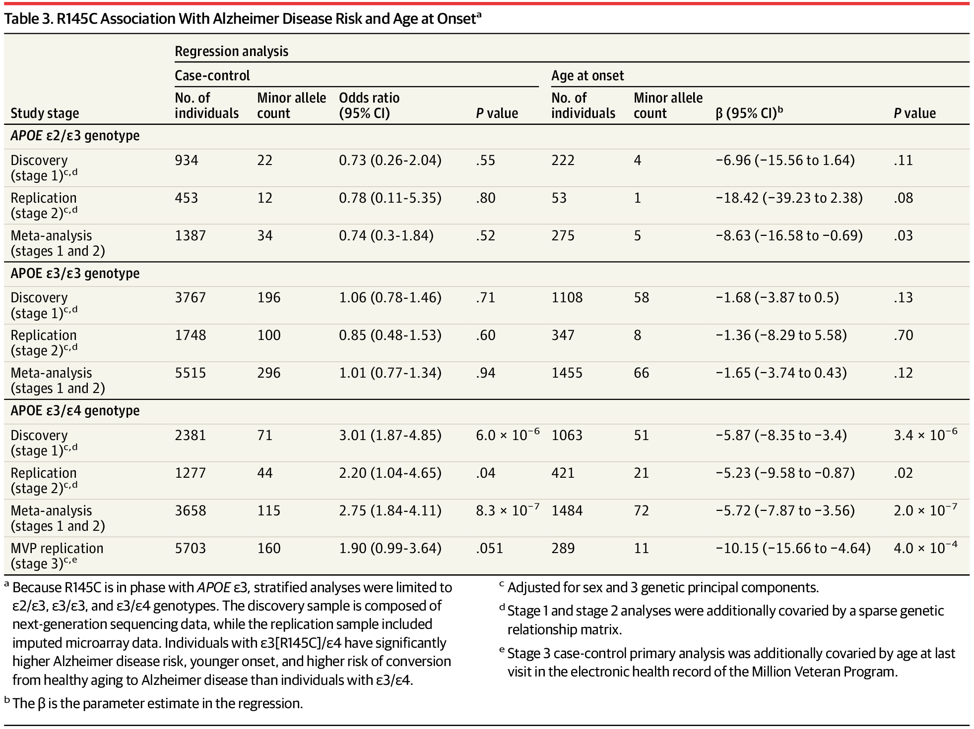
From: Association of African Ancestry–Specific APOE Missense Variant R145C With Risk of Alzheimer Disease
JAMA. 2023;329(7):551-560. doi:10.1001/jama.2023.0268
^{Table Title:}
R145C Association With Alzheimer Disease Risk and Age at Onset^{aa} Because R145C is in phase with APOE ε3, stratified analyses were limited to ε2/ε3, ε3/ε3, and ε3/ε4 genotypes. The discovery sample is composed of next-generation sequencing data, while the replication sample included imputed microarray data. Individuals with ε3[R145C]/ε4 have significantly higher Alzheimer disease risk, younger onset, and higher risk of conversion from healthy aging to Alzheimer disease than individuals with ε3/ε4.
b The β is the parameter estimate in the regression.
c Adjusted for sex and 3 genetic principal components.
d Stage 1 and stage 2 analyses were additionally covaried by a sparse genetic relationship matrix.
e Stage 3 case-control primary analysis was additionally covaried by age at last visit in the electronic health record of the Million Veteran Program.
^{Date of download: 2/9/2026}
Copyright 2023 American Medical Association. All Rights Reserved.

