Slide 1
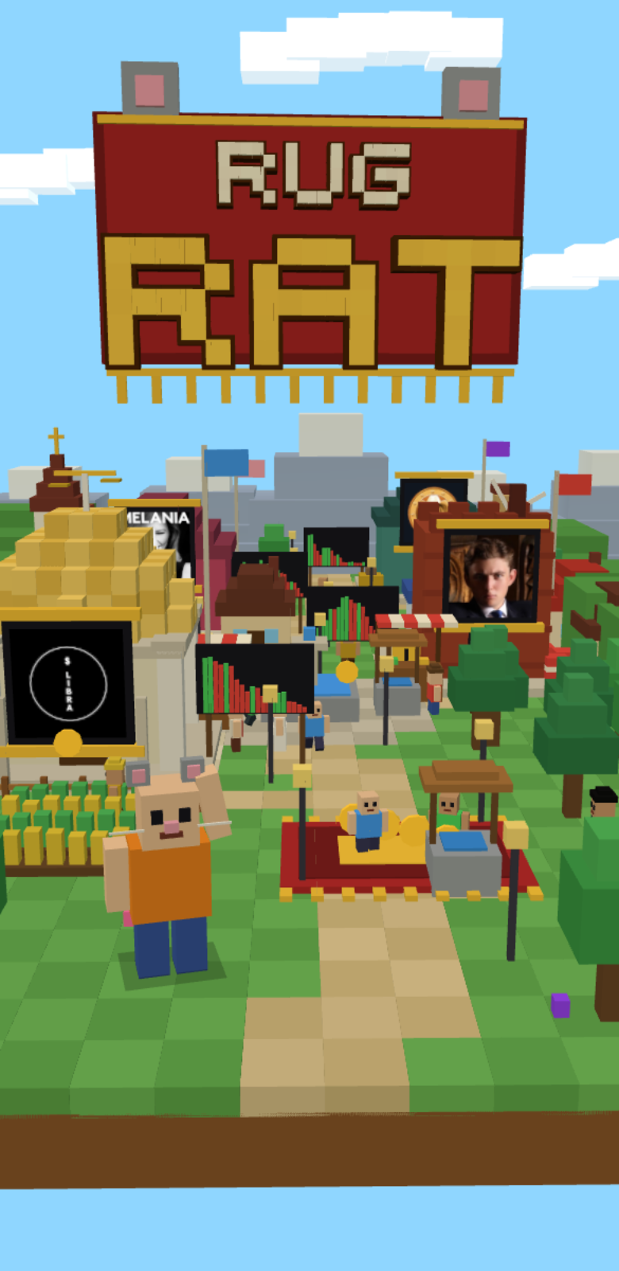
CLOCK IN · SOLANA MOBILE HACKATHON
RUGRAT
Replay real Solana rug pulls
with 10 paper SOL.
Can you get out in time?
A voxel arcade game for Android, built for the Solana Seeker.
Four real rugs. One decision. No money at risk.
Notes:
Rugrat is a voxel arcade game where you replay real, historical Solana rug pulls with 10 paper SOL and try to get out in time. Built for Android and the Solana Seeker for the CLOCK IN hackathon.

Slide 2
We teach traders to spot opportunities.
What about spotting the exit?
Memecoin trading is pattern recognition. We study charts to find tokens before they run, but rarely practise recognising the signs of a rug before it’s too late.
Every rug pull looks obvious on a finished chart. That’s hindsight. You already know the ending.
The real skill is deciding while it’s still unfolding. I built Rugrat to give traders a place to practise that decision before real money is on the line.
You are here.
What happens next?
That’s why I built Rugrat.
BARRON, 20 Jan 2025 · real prices, log scale, about 3 hours. Lighter blocks: what you couldn’t see yet.
RUGRAT · CLOCK IN: Solana Mobile Hackathon
2
Notes:
Why I built Rugrat. Memecoin trading is pattern recognition, but we rarely practise recognising the signs of a rug early enough to get out. Every rug looks obvious on a finished chart; that is hindsight. The skill that matters is deciding in the moment. The chart is the real BARRON price history from 20 Jan 2025, rebuilt as blocks on a log scale; the lighter blocks are what a trader could not see yet at the marked moment.

Slide 3
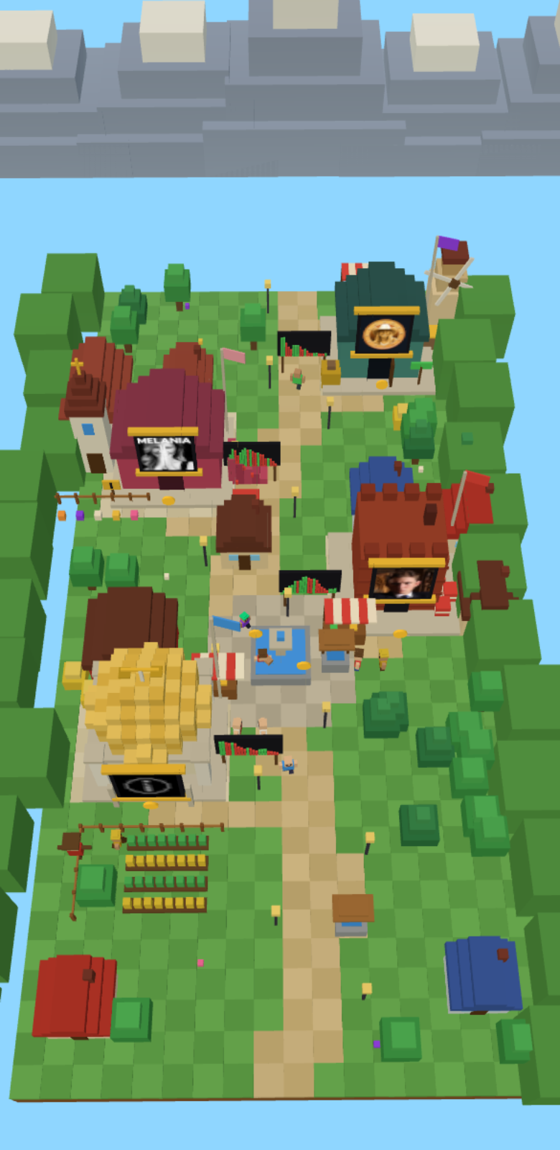
Live the rug instead of reading about it
Real history.
Recorded prices, timestamps and wallet events, replayed in order. Nothing is simulated.
A real decision.
Buy with 10 paper SOL, sell when you think the end is near.
A real verdict.
CLEAN EXIT, LATE EXIT or RUGGED, then watch the Reveal with every tracked wallet visible.
One run takes about a minute to a minute and a half.
RUGRAT · CLOCK IN: Solana Mobile Hackathon
3
Notes:
Rugrat turns a recorded rug pull into a short level. You get the same information a trader had at that moment, the real price and the real wallet activity, and you make one decision: when to sell. Only the money is pretend.

Slide 4
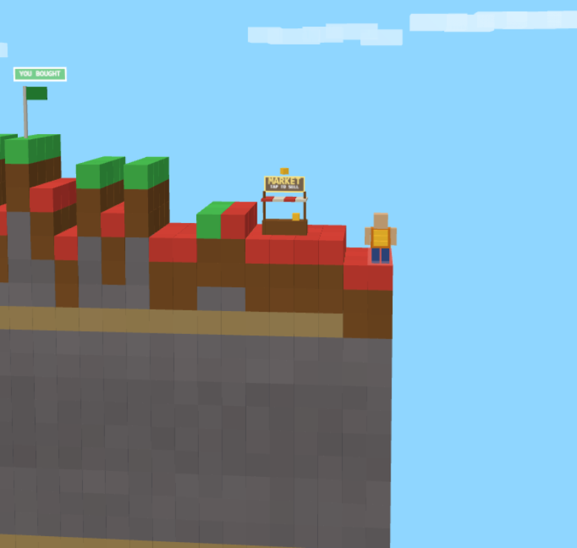
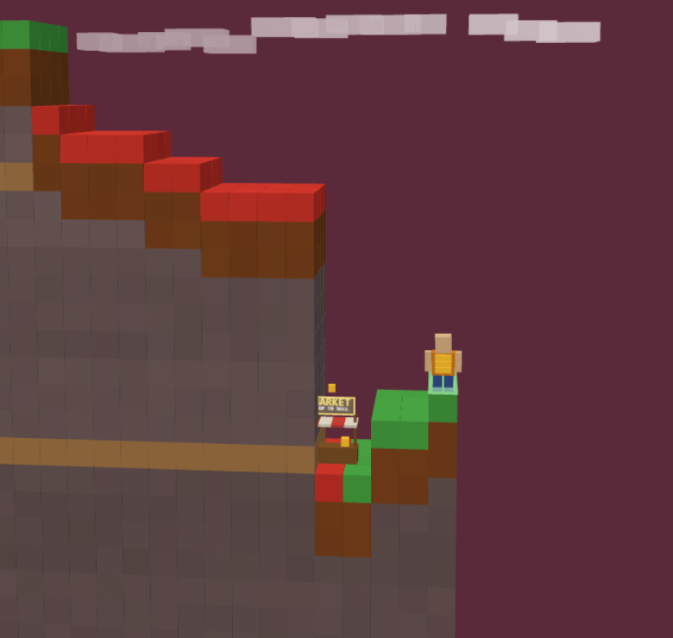
Real history in, one clock, one verdict out
1 Recorded data
2 One replay clock
3 Terrain = chart
4 Verdict + score
5 Optional onchain
Price candles and wallet events from public APIs
Price, terrain, events and sound all follow it
Each block column is a real price step, log scale
CLEAN / LATE / RUGGED, skill score 0 to 1000
Signed score memo and soulbound badge
Deterministic
Same decisions, same result.
Fair
Speed, frame rate and paper profit never change a score.
Climb: the price is rising
Collapse: the ground gives way
RUGRAT · CLOCK IN: Solana Mobile Hackathon
4
Notes:
The data are public price candles and wallet trades, processed ahead of time and shipped inside the app, so the running game makes no API calls. A single replay clock drives the terrain, the wallet events and the sound. The engine is deterministic: the same decisions give the same verdict and score.

Slide 5
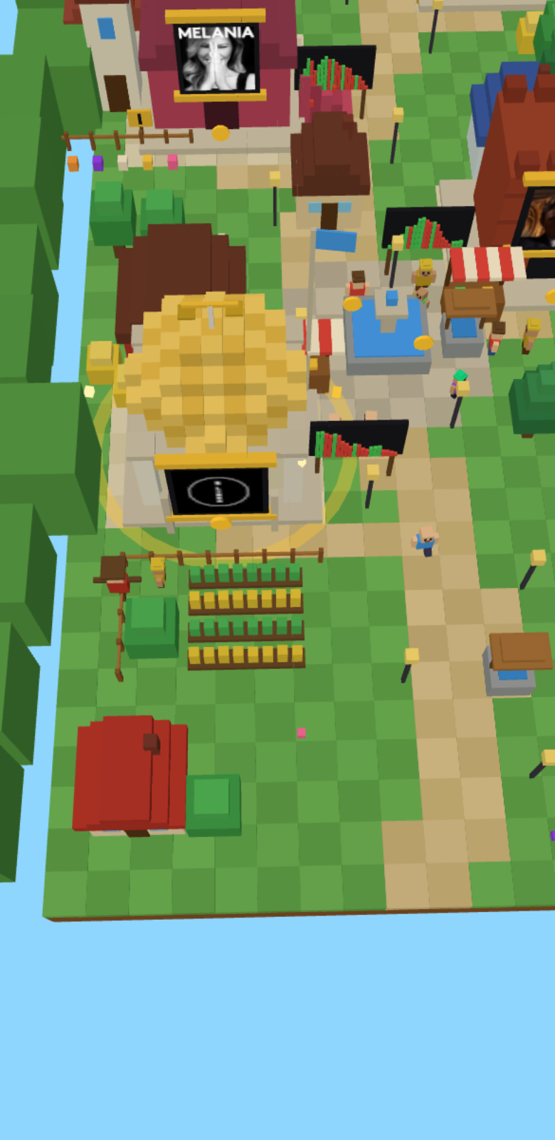
A village where every building is a real rug
LIBRA, BARRON, MELANIA, HAWK
Each building shows its token's logo.
EASY or HARD
Wallet tags shown while you play, or hidden until the end.
No menus of lists
You walk up to the rug you want.
Home: the village gate
Play: four real rugs
Select: tap a building
RUGRAT · CLOCK IN: Solana Mobile Hackathon
5
Notes:
The menu is the world. The home screen is a village gate with the Rugrat character. Pressing play lifts the camera over a village where each replay has its own building carrying that token's real logo. Tapping one selects it and lets you pick Easy or Hard.

Slide 6
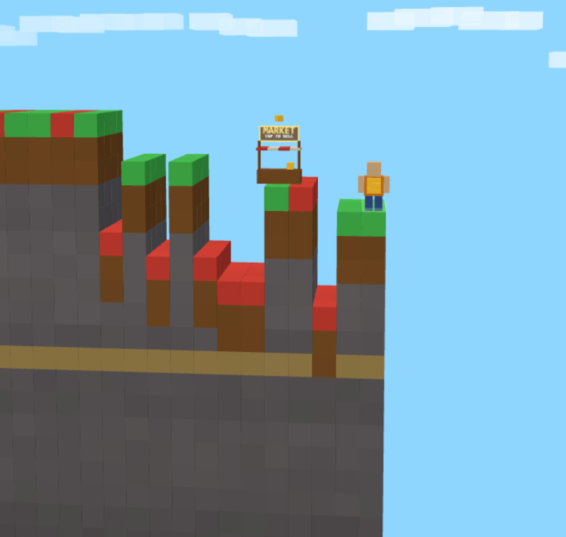
One decision: when do you get out?
CLEAN EXIT
Sold before the signal
score 800 to 1000
LATE EXIT
Sold after the signal, before the collapse
score 500 to 700
RUGGED
Still in when it collapsed
LIBRA: you bought, price climbing
HAWK: dev wallet events on the way
score 0
Scores use the verdict and timing only, so paper SOL, speed and frame rate cannot change them. The difficulty is locked for the whole run.
RUGRAT · CLOCK IN: Solana Mobile Hackathon
6
Notes:
Buy spends all 10 paper SOL at the replay price at that timestamp. Selling freezes your position and you keep watching. The verdict compares your sell time to a per-replay signal and to the collapse. The score uses the verdict and timing only, never paper profit.

Slide 7
More than watching a chart
Chart viewer
Rugrat
Rug
Date
Kind
Ticks
Events
Run
You see
The finished chart
Only the present moment
LIBRA
14 Feb 25
Historical
182
35
~1 min
BARRON
20 Jan 25
Fast dump
181
25
~1 min
You do
Read and scroll
Decide when to sell
MELANIA
19 Jan 25
Slow bleed
321
21
~1 min
You learn
In hindsight
Scored against the real signal
HAWK
4 Dec 24
Dev exit
208
28
~1.5 min
You can
Look again
Replay, improve, rank
Ticks: price points in the replay. Events: tracked wallet events. Run: typical session length at the fixed playback speed.
Wallet labels are derived by mechanical rules over sampled wallets. They are not identities.
The catalogue comes from a repeatable data pipeline, so adding a rug is a data job.
RUGRAT · CLOCK IN: Solana Mobile Hackathon
7
Notes:
A chart viewer is passive and shows you the ending. Rugrat hides the future the way real time does, asks for one decision, and grades it against the real signal. The table lists the four rugs shipped in the build with figures taken from the recorded data.

Slide 8
Built for Solana Mobile, wallet optional
Mobile first
Wallet optional
Onchain score
Portrait, one thumb, runs of about a minute. Android APK built for the Seeker.
Mobile Wallet Adapter. Everything plays offline; connect only to record.
A Memo signed by your wallet, read back and verified. Duplicate runs are blocked.
Rug Hunter badge
SKR holder perks
Survive 3 unique recorded rugs to mint a soulbound Metaplex Core badge.
Read-only balance check unlocks a purple skin and a twilight arena. Cosmetic only.
Onchain flow tested on devnet. The SKR balance check reads mainnet and is read-only.
RUGRAT · CLOCK IN: Solana Mobile Hackathon
8
Notes:
The game is fully playable offline with no wallet. Connecting through Mobile Wallet Adapter unlocks recording a score onchain and claiming the badge. The onchain flow was tested on devnet. SKR perks are read-only and cosmetic and never touch scores.

Slide 9
What works today, and what does not yet
WORKING TODAY
NOT YET
Four real replays: LIBRA, BARRON, MELANIA, HAWK
Mainnet deployment (checklist is in the repo)
Full loop: buy, sell, verdict, Reveal, skill score
Hosted leaderboard: it is local, no indexer yet
Local stats, friends and leaderboard
Anti-cheat: a memo is a signed, rule-consistent record, not proof of play
Wallet connect, signed score memo and soulbound badge (devnet)
SKR badge upgrades and prize pool: code only, inactive
SKR holder cosmetics
Wallet labels are derived heuristics, not identities
Automated suites: engine, scoring, chain records, menu, stress
Chain behaviour tested with mocks and by hand
Production Android APK built · public repository, Apache-2.0 · github.com/justriri/rugrat
RUGRAT · CLOCK IN: Solana Mobile Hackathon
9
Notes:
The honest picture. The core game and the devnet onchain flow are built and tested. Mainnet deployment, a hosted leaderboard indexer and the SKR upgrade issuer are not done. The prize pool is dormant code with a gate that is off.

Slide 10
Why you'd come back, and what's next
WHY IT STICKS
NEXT
Every rug plays differently
Fast dump, slow bleed, dev exit.
More rugs, which also unlock higher badge tiers
Wallet indexer for weekly leaderboards
A score to beat
0 to 1000, HARD mode, clean exits.
Issuer attestation of runs for stronger anti-cheat
A badge to earn
Three unique rugs, higher tiers as rugs are added.
Mainnet deployment of the score and badge flow
RUGRAT
Can you get out in time?
github.com/justriri/rugrat · Educational game, not financial advice. Not affiliated with any token, person or project it replays.
RUGRAT · CLOCK IN: Solana Mobile Hackathon
10
Notes:
Stickiness comes from the catalogue, the score to beat and the badge. Each rug is a different kind of exit, so skill transfers imperfectly and the score is worth chasing. The roadmap is honest about what needs infrastructure and review.

