Slide 1

Harnessing Data to Elevate Pharmacy Sales and Customer Experience
This comprehensive report explores how Axum Pharmacy can leverage data mining techniques to forecast sales, uncover customer purchasing patterns, and optimize inventory management. By transforming raw transactional data into actionable insights, the pharmacy can drive operational efficiency, enhance customer satisfaction, and position itself for long-term growth in the highly competitive pharmaceutical industry.

Slide 2
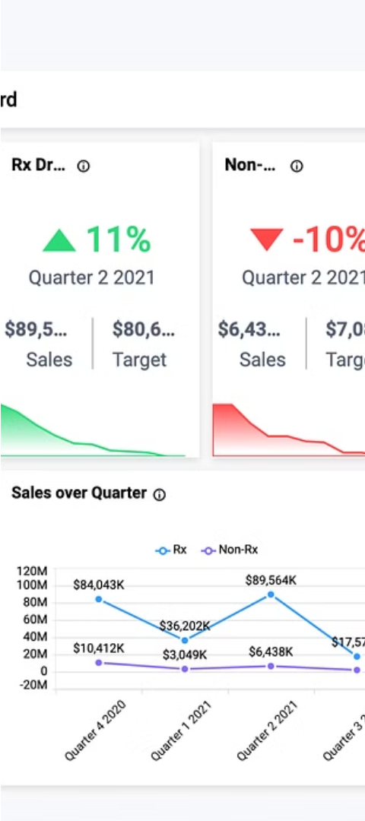
Pharmacy Sales Trends and Insights
1
Daily Sales Fluctuations
Analyzing daily sales patterns reveals significant variability, with a 55.79% increase from the lowest to the highest month.
2
Branch-level Performance
The top-performing branch contributed 27.43% of total sales, while the lowest-performing branch accounted for only 1.20%.
3
Top-selling Products
The top 10 products generated 18.75% of overall sales, with Zithromax 500 Mg Of 3 Tabs. being the best-seller.

Slide 3
Forecasting Future Pharmacy Sales
Using linear regression and time series analysis, the project developed accurate models to predict future sales trends. The models demonstrated a strong fit, with low mean squared error and high R-squared values, enabling the pharmacy to make informed decisions about inventory management and strategic planning.

Slide 4
Uncovering Customer Purchasing Patterns
Association Rule Mining
Top Product Pairings
Data-driven Strategies
The association rule graph highlights the strongest relationships between frequently purchased items, providing valuable insights to enhance the customer experience.
The Apriori algorithm was applied to identify frequent itemsets and generate association rules, revealing key product affinities that can be leveraged for targeted marketing and optimized product placement.
By understanding customer purchasing behavior, the pharmacy can develop personalized recommendations, cross-selling opportunities, and tailored promotions to drive sales and customer loyalty.

Slide 5
Data Preprocessing and Cleaning
1
Date Transformation
2
Handling Missing Values
Correcting the inconsistent date format in the dataset was a crucial step to ensure accurate analysis and forecasting.
Missing values were imputed with the mean for numerical columns, maintaining dataset integrity.
3
Addressing Inconsistencies
4
Feature Engineering
Rows with negative values in Quantity or Amount were removed to maintain data quality.
New features, such as Month, Year, and DayOfWeek, were created to enhance the predictive modeling process.

Slide 6
Evaluation and Performance Metrics
Linear Regression
Time Series Analysis
The linear regression model achieved a low mean squared error and high R-squared value, demonstrating its effectiveness in forecasting sales.
The time series model accurately predicted future sales trends, closely aligning with the actual sales data.
Association Rule Mining
Overall Evaluation
The Apriori algorithm successfully identified strong product affinities, with the top 10 rules having high lift values.
The comprehensive analysis provided actionable insights to support strategic decision-making and enhance the customer experience.

Slide 7




Recommendations for Future Enhancements
Integrate Additional Data
Experiment with Advanced Algorithms
Automate Reporting
Enable Real-time Analysis
Incorporate demographic information, customer feedback, and external market data to enrich the analysis.
Implement systems for generating regular analytical reports to support continuous monitoring and decision-making.
Develop capabilities for real-time data processing and analysis to provide timely insights and support dynamic decision-making.
Explore more sophisticated machine learning models to further improve predictive accuracy and uncover deeper insights.

Slide 8
Conclusion
This data mining project has demonstrated the immense value that can be extracted from pharmacy sales data. By leveraging predictive models, association rule mining, and robust data preprocessing techniques, the pharmacy can enhance its operational efficiency, personalize the customer experience, and drive long-term growth in the highly competitive pharmaceutical industry.

Slide 9

Acknowledgments
The authors would like to express their gratitude to the Axum Pharmacy team for providing the comprehensive dataset and invaluable insights that made this project possible. We also acknowledge the support and guidance of the data science faculty at the university, whose expertise and feedback were instrumental in shaping the direction and success of this endeavor.

