Slide 1
DAN LEVY
Adaptive, agentic apps
30-minute route · Reading edition
13 source sections
September 6, 2026
Adaptive, agentic apps
1
Notes:
Give each job exactly enough agent. Prove every repair. Let the app ask for its own scale.
Rewritten 2026-09-06 from Dan's notes. 40 minutes, 15 slides, four audience moments, no Q&A. Add five minutes for a 45-minute booking. The design is Dan's; the incidents are composites of real integrations with the names filed off. Say that once, on slide 1, and never apologize for it again.
[Presenter scripts](../packets/adaptive-systems/script-40min.md) · [Contracts](../packets/adaptive-systems/contracts.md) · [Memory pattern and prompt](../packets/adaptive-systems/memory-pattern.md) · [Walkthrough](../packets/adaptive-systems/demo.md) · [Evidence](../packets/adaptive-systems/evidence-bank.md)
Regenerate scripts, adaptations and the browser deck with `bun artifacts/speaking-portfolio-expanded/build-talk.ts adaptive-systems`.

Slide 2
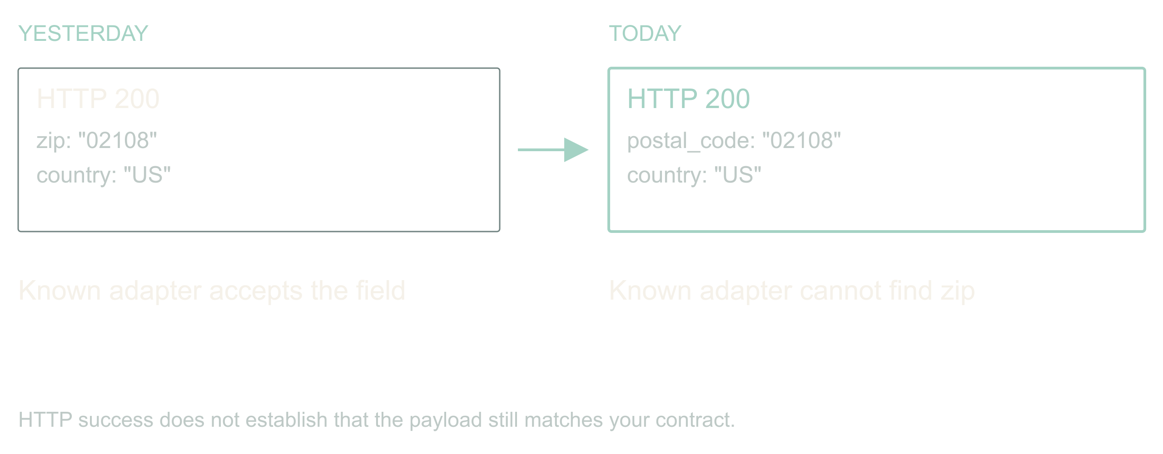
01 / 13 SOURCE SLIDE 1
The vendor renamed a field
Yesterday: zip
Today: postal_code
Your ingest stops. The status page is green.
The API still returns 200. Authentication works. The
vendor's status page is green. Your ingest is broken
because somebody renamed a field. If you work around
B2B integrations, this is a very boring way to have a
very expensive morning.
Here is the promise of this talk. An application can
notice that, investigate it, propose a fix, prove the
fix, and keep the other ninety-eight percent of
records flowing, all before you wake up. And it can
do that without ever holding a permission you would
be scared to give it.
The design is mine. The incidents are composites; I
have had this exact morning more than once. We will
follow one address ingest job through a rename, a
change in meaning, and a provider that stops
answering.
Adaptive, agentic apps
2
Notes:
Adaptive, agentic apps
Source slide 1. 00:00 to 01:30
Yesterday: zip
Today: postal_code
Your ingest stops. The status page is green.
The API still returns 200. Authentication works. The vendor's status page is green. Your ingest is broken because somebody renamed a field. If you work around B2B integrations, this is a very boring way to have a very expensive morning.
Here is the promise of this talk. An application can notice that, investigate it, propose a fix, prove the fix, and keep the other ninety-eight percent of records flowing, all before you wake up. And it can do that without ever holding a permission you would be scared to give it.
The design is mine. The incidents are composites; I have had this exact morning more than once. We will follow one address ingest job through a rename, a change in meaning, and a provider that stops answering.
The vendor rename you actually lived through. Name the field, the hour you noticed, and what it cost.
Hands up for a 200 response that carried a breaking change. Take one story, thirty seconds, and return to the ingest job.

Slide 3
02 / 13 SOURCE SLIDE 2
The bar is: diff the schema and page a human
Baseline: alert, wait for a person, replay
Agent: investigate, propose, prove,
continue
Win condition: faster recovery, zero new
false repairs
Before anyone gets excited about agents,
name the boring alternative. A schema diff,
an alert, and a human who replays the batch
after coffee. It works. It costs a morning
per surprise, and it does nothing for the
unaffected records that are stuck behind
the broken ones.
The agent has to beat that. Not on vibes.
On time to recover, on records kept moving,
and on a number the baseline gets for free:
false repairs. Alert-and-wait never turns a
rename into plausible wrong data. If the
adaptive version does, even once, it has
made operations worse.
So every slide from here is about buying
recovery speed without buying corruption.
Keep that trade in your head; it is the
whole talk.
Adaptive, agentic apps
3
Notes:
Adaptive, agentic apps
Source slide 2. 01:30 to 03:00
Baseline: alert, wait for a person, replay
Agent: investigate, propose, prove, continue
Win condition: faster recovery, zero new false repairs
Before anyone gets excited about agents, name the boring alternative. A schema diff, an alert, and a human who replays the batch after coffee. It works. It costs a morning per surprise, and it does nothing for the unaffected records that are stuck behind the broken ones.
The agent has to beat that. Not on vibes. On time to recover, on records kept moving, and on a number the baseline gets for free: false repairs. Alert-and-wait never turns a rename into plausible wrong data. If the adaptive version does, even once, it has made operations worse.
So every slide from here is about buying recovery speed without buying corruption. Keep that trade in your head; it is the whole talk.
Write the three metrics on the board and leave them there.

Slide 4
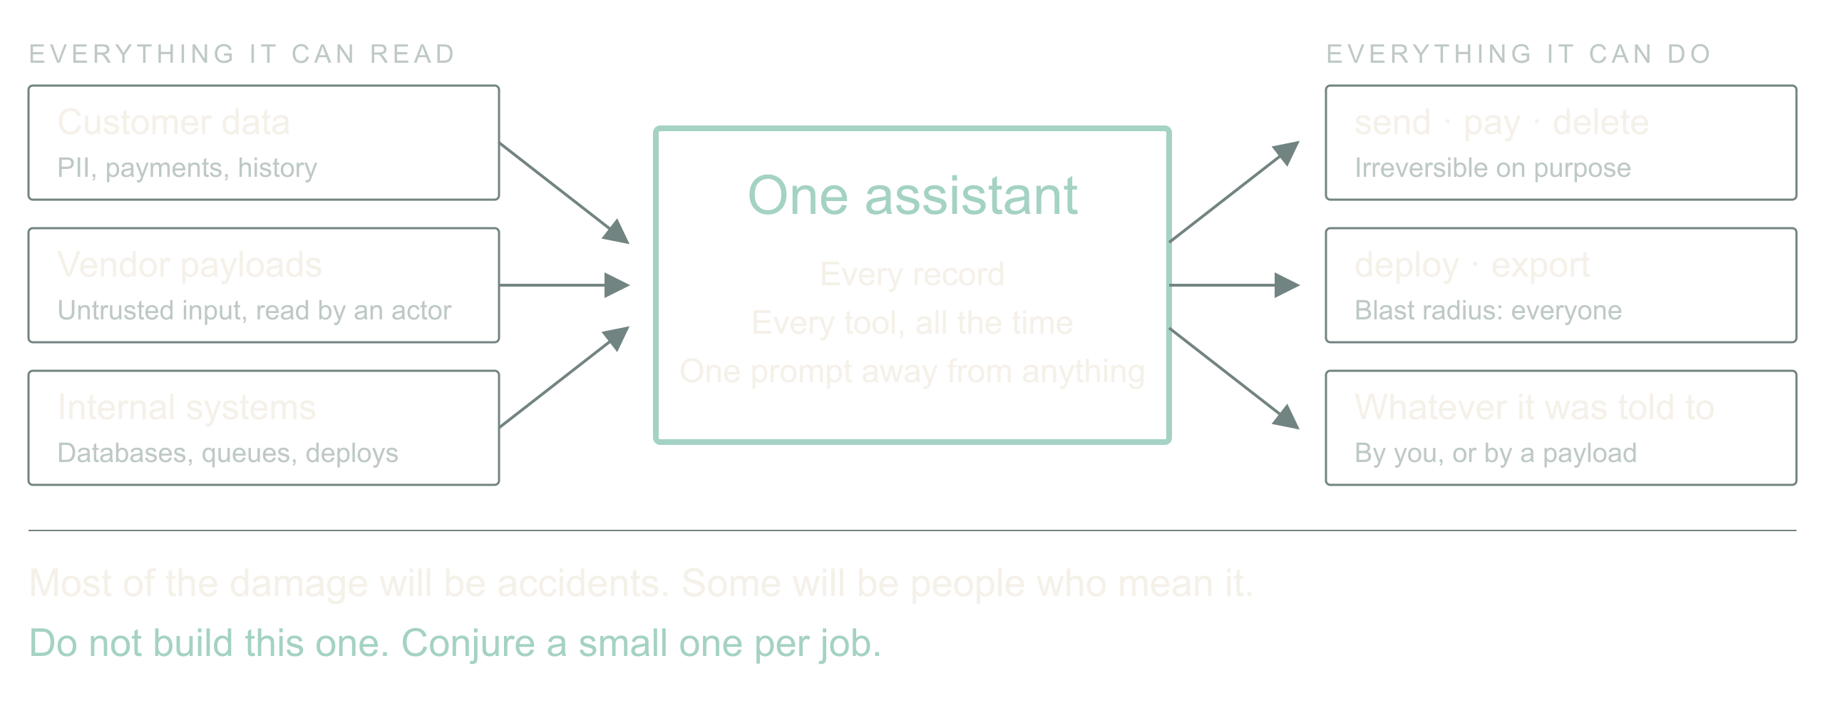
03 / 13 SOURCE SLIDE 3
Now imagine the assistant that has everything
All customer data
Tools that email, refund, delete, deploy
Accidents first. Then people who mean it.
Zoom out from the ingest job. The thing we are all
building toward is an assistant with access to every
customer's data and a toolbox that can send email,
issue refunds, delete records and ship code. Most of
the damage it will ever do will be an accident: a
confident mapping, a helpful cleanup, a tool called
with the wrong ID.
Then there are the people who mean it. That renamed
field could carry a sentence aimed at the model. A
vendor payload is untrusted input that now gets read
by something that can act.
So the question for the next few years is not whether
to give the assistant access. It is which strategies
let us give it access and manage the risk. My answer,
and what I have been building, is: never build the
one assistant that has everything. Conjure a small
one for each job, with exactly enough.
Adaptive, agentic apps
4
Notes:
Adaptive, agentic apps
Source slide 3. 03:00 to 05:30
All customer data
Tools that email, refund, delete, deploy
Accidents first. Then people who mean it.
Zoom out from the ingest job. The thing we are all building toward is an assistant with access to every customer's data and a toolbox that can send email, issue refunds, delete records and ship code. Most of the damage it will ever do will be an accident: a confident mapping, a helpful cleanup, a tool called with the wrong ID.
Then there are the people who mean it. That renamed field could carry a sentence aimed at the model. A vendor payload is untrusted input that now gets read by something that can act.
So the question for the next few years is not whether to give the assistant access. It is which strategies let us give it access and manage the risk. My answer, and what I have been building, is: never build the one assistant that has everything. Conjure a small one for each job, with exactly enough.
Your own near miss with an over-permissioned agent, or a tool call you were glad had a dry-run flag.
Pause on the third line. Let the room feel that the accident case is the common one.

Slide 5
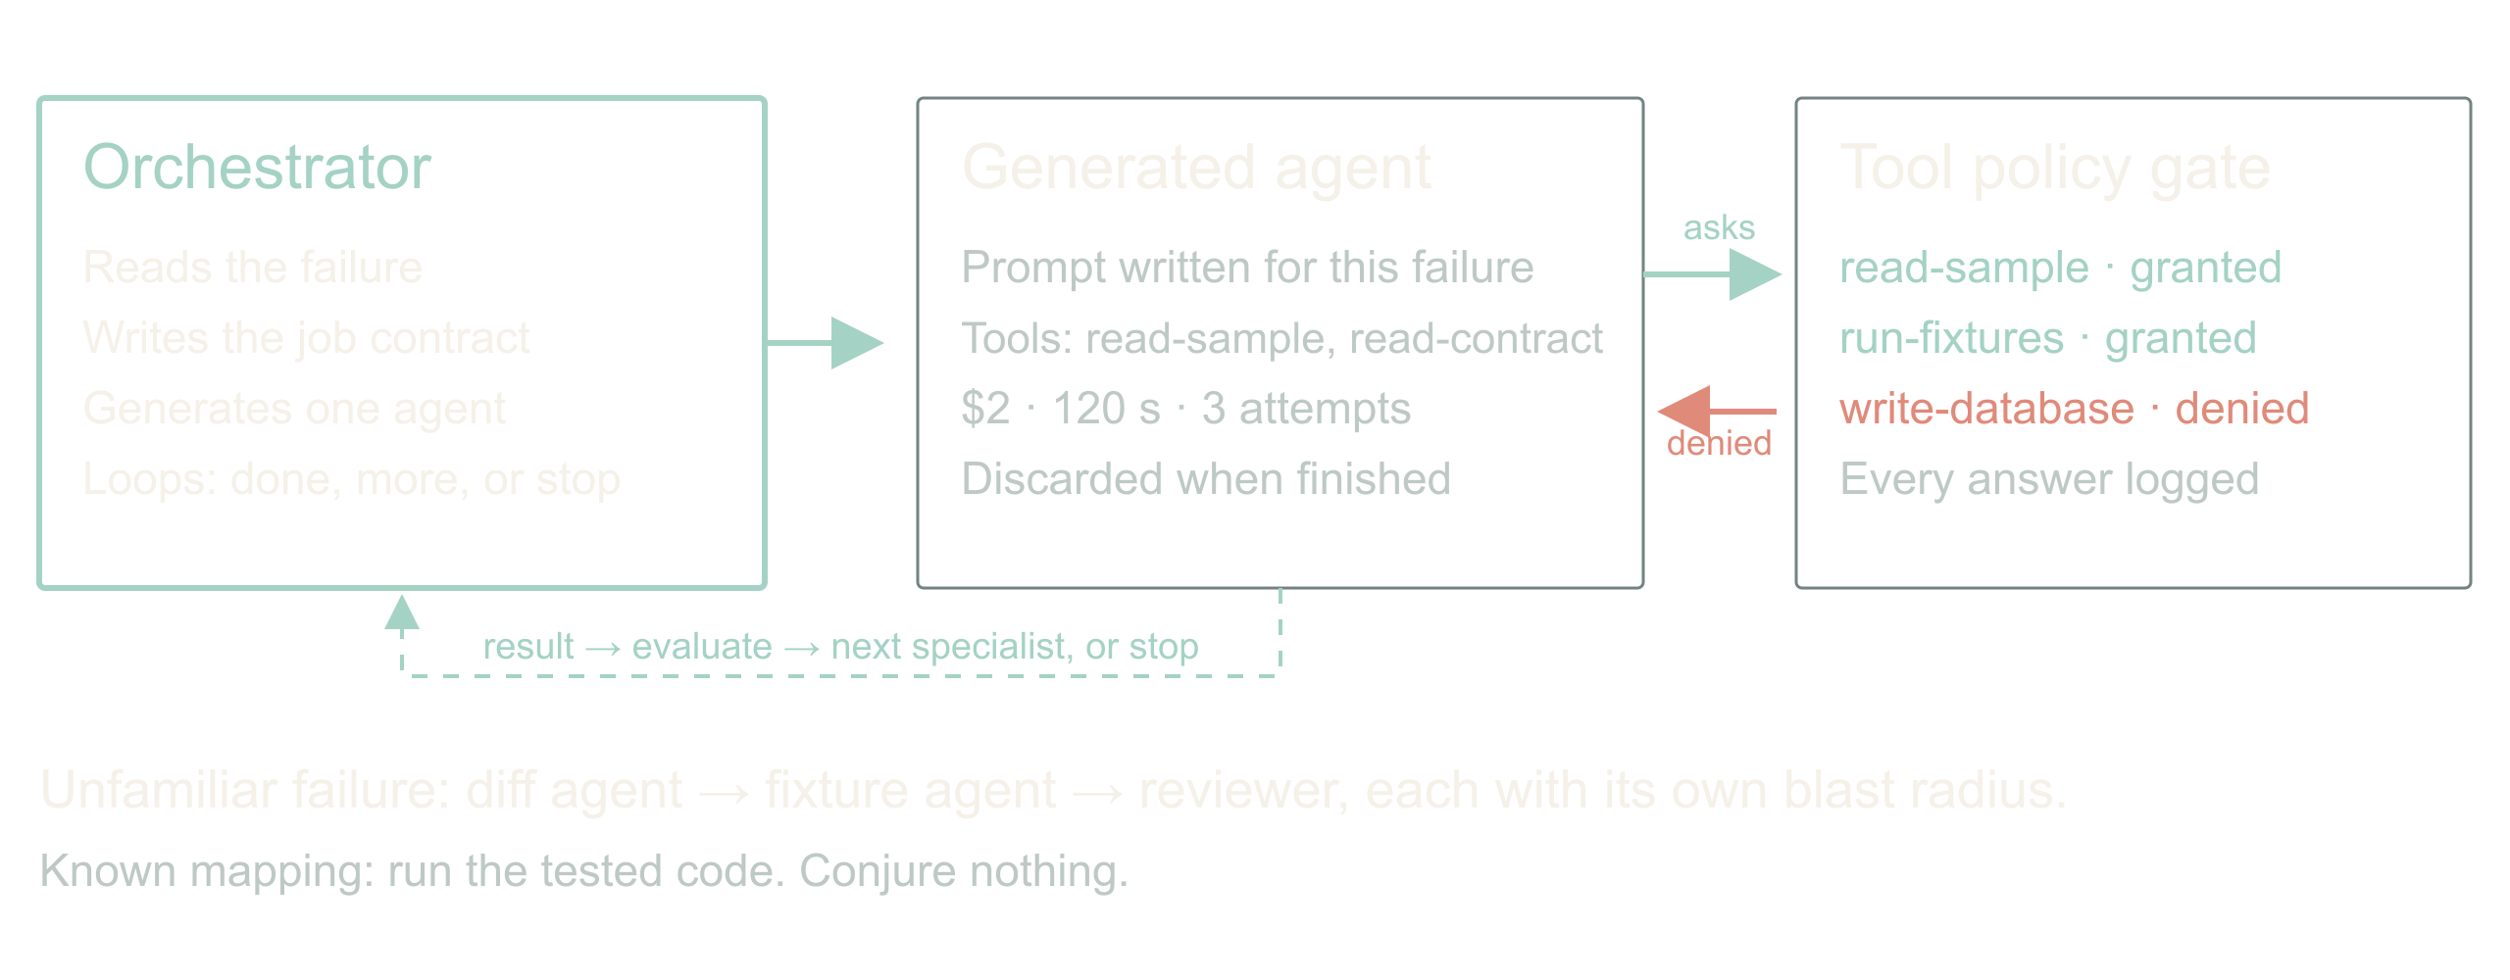
04 / 13 SOURCE SLIDE 4
Conjure the agent the job needs
Tailored prompt, minimum tools, hard budget
Tool search on request, policy decides, request
logged
Orchestrator loops: done, more help, or stop
Here is the shape. An orchestrator reads the failure
and writes a job: goal, evidence it may read, actions
it may take, deadline, spend, and the conditions that
end it. Then it generates an agent for that job with
a tailored prompt and only the tools it expects to
need. A schema-diff agent gets read access to two
samples and a contract. It does not get the database.
If the agent needs something else, it asks. Dynamic
tool search lets it discover a tool; policy decides
whether this job may have it; the request and the
answer are logged whether or not it was granted. That
log is the most interesting file in the system.
Adaptive, agentic apps
5
Notes:
Adaptive, agentic apps
Source slide 4. 05:30 to 09:00
Tailored prompt, minimum tools, hard budget
Tool search on request, policy decides, request logged
Orchestrator loops: done, more help, or stop
Here is the shape. An orchestrator reads the failure and writes a job: goal, evidence it may read, actions it may take, deadline, spend, and the conditions that end it. Then it generates an agent for that job with a tailored prompt and only the tools it expects to need. A schema-diff agent gets read access to two samples and a contract. It does not get the database.
If the agent needs something else, it asks. Dynamic tool search lets it discover a tool; policy decides whether this job may have it; the request and the answer are logged whether or not it was granted. That log is the most interesting file in the system.
The orchestrator runs the result through a loop: is the job done, does it need another specialist, or must it stop? A diff agent hands to a fixture-writer agent hands to a reviewer, each with its own blast radius, each disposable when finished. Nobody rents a committee every time a CSV arrives; the known mapping runs as code, and only the unfamiliar case conjures anything.
I have this working as a prototype on my own integrations. I am not going to give you a success rate today, because I do not have one I trust yet. I can tell you the log of denied tool requests taught me more about my own permissions than any audit.
What the prototype's first denied tool request was, and what it revealed.
Draw the three boxes: orchestrator, generated agent, tool catalog with policy gate. Show one request crossing the gate and being refused.

Slide 6
04 / 13 SOURCE SLIDE 4
Conjure the agent the job needs (continued)
The orchestrator runs the result through a
loop: is the job done, does it need another
specialist, or must it stop? A diff agent
hands to a fixture-writer agent hands to a
reviewer, each with its own blast radius,
each disposable when finished. Nobody rents
a committee every time a CSV arrives; the
known mapping runs as code, and only the
unfamiliar case conjures anything.
I have this working as a prototype on my
own integrations. I am not going to give
you a success rate today, because I do not
have one I trust yet. I can tell you the
log of denied tool requests taught me more
about my own permissions than any audit.
Adaptive, agentic apps
6
Notes:
Adaptive, agentic apps
Source slide 4. 05:30 to 09:00
Tailored prompt, minimum tools, hard budget
Tool search on request, policy decides, request logged
Orchestrator loops: done, more help, or stop
Here is the shape. An orchestrator reads the failure and writes a job: goal, evidence it may read, actions it may take, deadline, spend, and the conditions that end it. Then it generates an agent for that job with a tailored prompt and only the tools it expects to need. A schema-diff agent gets read access to two samples and a contract. It does not get the database.
If the agent needs something else, it asks. Dynamic tool search lets it discover a tool; policy decides whether this job may have it; the request and the answer are logged whether or not it was granted. That log is the most interesting file in the system.
The orchestrator runs the result through a loop: is the job done, does it need another specialist, or must it stop? A diff agent hands to a fixture-writer agent hands to a reviewer, each with its own blast radius, each disposable when finished. Nobody rents a committee every time a CSV arrives; the known mapping runs as code, and only the unfamiliar case conjures anything.
I have this working as a prototype on my own integrations. I am not going to give you a success rate today, because I do not have one I trust yet. I can tell you the log of denied tool requests taught me more about my own permissions than any audit.
What the prototype's first denied tool request was, and what it revealed.
Draw the three boxes: orchestrator, generated agent, tool catalog with policy gate. Show one request crossing the gate and being refused.

Slide 7
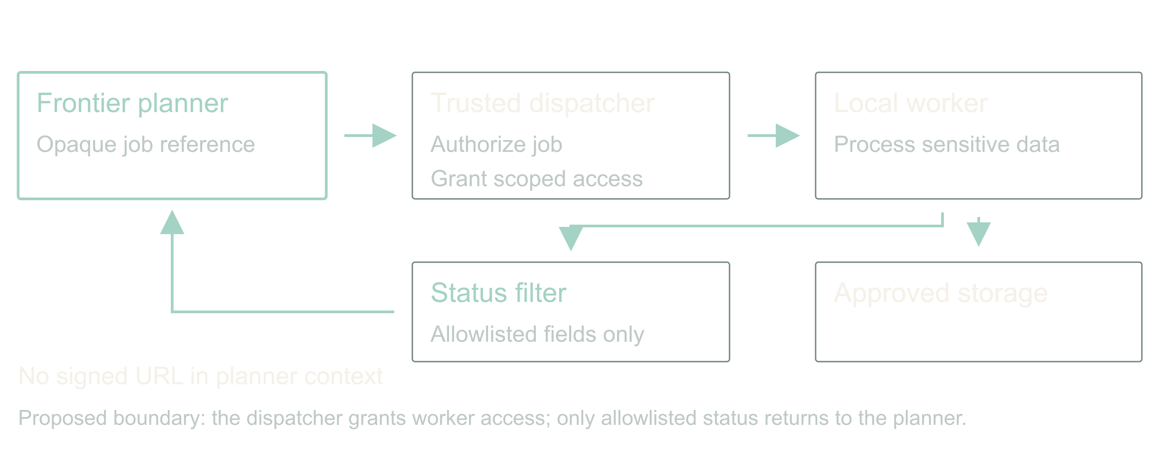
05 / 13 SOURCE SLIDE 5
Guard the tools that can hurt
High-risk classes: write, send, pay, delete, deploy,
export
Read customer data and post to a vendor never share
one agent
A signed URL is a credential
Two guards do most of the work. First, tools come in
risk classes. Read is cheap to grant. Write, send,
pay, delete, deploy and export each need their own
approval path, and a generated agent gets at most one
of them per job. Do not smuggle a destructive
migration through a tool called repair mapping.
This is least privilege, and Saltzer and Schroeder
wrote it down in 1975: every program runs with the
least set of privileges the job needs. We have all
been nodding at that for fifty years and shipping
service accounts that can do anything. A per-job
agent is the first thing I have built where complying
is genuinely easier than not.
Adaptive, agentic apps
7
Notes:
Adaptive, agentic apps
Source slide 5. 09:00 to 11:30
High-risk classes: write, send, pay, delete, deploy, export
Read customer data and post to a vendor never share one agent
A signed URL is a credential
Two guards do most of the work. First, tools come in risk classes. Read is cheap to grant. Write, send, pay, delete, deploy and export each need their own approval path, and a generated agent gets at most one of them per job. Do not smuggle a destructive migration through a tool called repair mapping.
This is least privilege, and Saltzer and Schroeder wrote it down in 1975: every program runs with the least set of privileges the job needs. We have all been nodding at that for fifty years and shipping service accounts that can do anything. A per-job agent is the first thing I have built where complying is genuinely easier than not.
Second, watch the boundary between systems. An agent that can read customer data and an agent that can post to a vendor are two agents, with a filter between them. That is where data leaks: not through the model being evil, but through a tool result flowing into the next tool call.
For sensitive processing, the planner gets an opaque job reference. A trusted dispatcher grants a local worker scoped access; the worker touches the data; only an allowlisted status comes back. A signed download URL is a bearer credential. Handing it to a model while asking the model not to use it is not isolation, it is hope.
Saltzer and Schroeder (1975), [The Protection of Information in Computer Systems](https://doi.org/10.1109/PROC.1975.9939), Proceedings of the IEEE 63(9), 1278 to 1308. Least privilege is their principle (f).
The client setup with local models for sensitive data and a frontier orchestrator. Say which parts were real and which are the stronger design you would build now.
Point at the filter between worker and planner. Ask what else crosses it: prompts, traces, error bodies, notification previews.

Slide 8
05 / 13 SOURCE SLIDE 5
Guard the tools that can hurt (continued)
Second, watch the boundary between systems.
An agent that can read customer data and an
agent that can post to a vendor are two
agents, with a filter between them. That is
where data leaks: not through the model
being evil, but through a tool result
flowing into the next tool call.
For sensitive processing, the planner gets
an opaque job reference. A trusted
dispatcher grants a local worker scoped
access; the worker touches the data; only
an allowlisted status comes back. A signed
download URL is a bearer credential.
Handing it to a model while asking the
model not to use it is not isolation, it is
hope.
Adaptive, agentic apps
8
Notes:
Adaptive, agentic apps
Source slide 5. 09:00 to 11:30
High-risk classes: write, send, pay, delete, deploy, export
Read customer data and post to a vendor never share one agent
A signed URL is a credential
Two guards do most of the work. First, tools come in risk classes. Read is cheap to grant. Write, send, pay, delete, deploy and export each need their own approval path, and a generated agent gets at most one of them per job. Do not smuggle a destructive migration through a tool called repair mapping.
This is least privilege, and Saltzer and Schroeder wrote it down in 1975: every program runs with the least set of privileges the job needs. We have all been nodding at that for fifty years and shipping service accounts that can do anything. A per-job agent is the first thing I have built where complying is genuinely easier than not.
Second, watch the boundary between systems. An agent that can read customer data and an agent that can post to a vendor are two agents, with a filter between them. That is where data leaks: not through the model being evil, but through a tool result flowing into the next tool call.
For sensitive processing, the planner gets an opaque job reference. A trusted dispatcher grants a local worker scoped access; the worker touches the data; only an allowlisted status comes back. A signed download URL is a bearer credential. Handing it to a model while asking the model not to use it is not isolation, it is hope.
Saltzer and Schroeder (1975), [The Protection of Information in Computer Systems](https://doi.org/10.1109/PROC.1975.9939), Proceedings of the IEEE 63(9), 1278 to 1308. Least privilege is their principle (f).
The client setup with local models for sensitive data and a frontier orchestrator. Say which parts were real and which are the stronger design you would build now.
Point at the filter between worker and planner. Ask what else crosses it: prompts, traces, error bodies, notification previews.

Slide 9
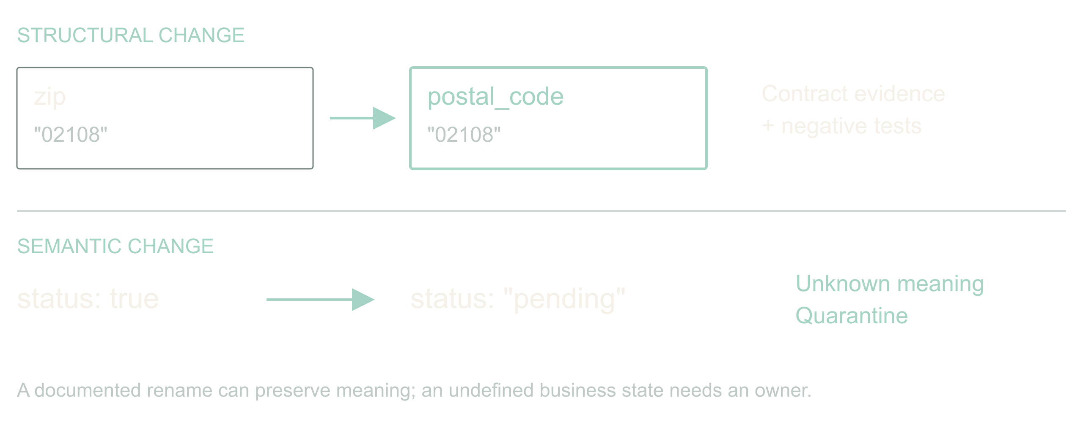
06 / 13 SOURCE SLIDE 6
Repair syntax; prove meaning
zip → postal_code: investigate
status: true → pending: stop
Back to the ingest. A name resemblance is a
hypothesis, not evidence. A postal code is not always
a US ZIP. Keep the leading zero, keep the country,
and remember ZIP+4 has a four-digit extension that
somebody, somewhere, is joining on.
A Boolean status becoming an enum is harder. Does
true mean active, eligible, verified, or anything
except cancelled? Pending cannot become true just
because both are truthy in JavaScript.
So the generated agent may propose a reversible
mapping when evidence supports equivalence, and it
must quarantine the rest. An unexplained
business-state change goes to an owner with samples
and a question. Automatic recovery is useful
precisely because it has somewhere honest to stop.
Adaptive, agentic apps
9
Notes:
Adaptive, agentic apps
Source slide 6. 11:30 to 14:00
zip → postal_code: investigate
status: true → pending: stop
Back to the ingest. A name resemblance is a hypothesis, not evidence. A postal code is not always a US ZIP. Keep the leading zero, keep the country, and remember ZIP+4 has a four-digit extension that somebody, somewhere, is joining on.
A Boolean status becoming an enum is harder. Does true mean active, eligible, verified, or anything except cancelled? Pending cannot become true just because both are truthy in JavaScript.
So the generated agent may propose a reversible mapping when evidence supports equivalence, and it must quarantine the rest. An unexplained business-state change goes to an owner with samples and a question. Automatic recovery is useful precisely because it has somewhere honest to stop.
Show {zip:"02108"} and {postal_code:"02108"}, then {status:"pending"}. Ask what evidence is missing in each. Two answers, then move.

Slide 10
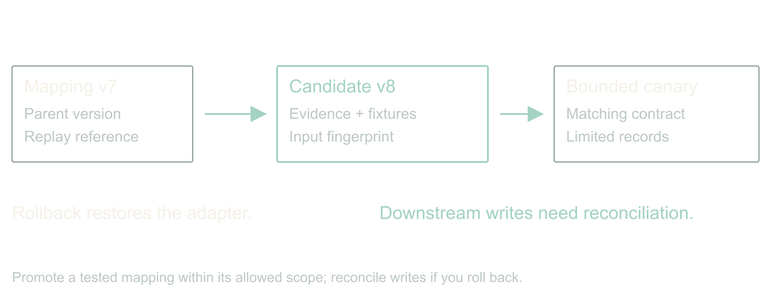
07 / 13 SOURCE SLIDE 7
The repair is a versioned artifact
Input fingerprint + mapping version
Evidence + fixtures + rollback
No silent mutation of the database
The agent produces a mapping artifact, not a
paragraph saying it fixed things. Parent version,
input fingerprint, the transforms, the rejected
cases, the evidence it read, and the fixture results.
A narrow mapping change can pass a pre-authorized
canary policy. A schema migration has a different
blast radius and its own approval path. Keep the
source records so you can replay; keep the old
mapping so you can restore. Rollback changes future
processing. It does not un-write yesterday's
downstream rows; those need reconciliation.
Adaptive, agentic apps
10
Notes:
Adaptive, agentic apps
Source slide 7. 14:00 to 15:30
Input fingerprint + mapping version
Evidence + fixtures + rollback
No silent mutation of the database
The agent produces a mapping artifact, not a paragraph saying it fixed things. Parent version, input fingerprint, the transforms, the rejected cases, the evidence it read, and the fixture results.
A narrow mapping change can pass a pre-authorized canary policy. A schema migration has a different blast radius and its own approval path. Keep the source records so you can replay; keep the old mapping so you can restore. Rollback changes future processing. It does not un-write yesterday's downstream rows; those need reconciliation.
Walk the mapping artifact in contracts.md. Point at parent version, activation scope, replay reference.
Bridge: the repair also has to survive an exam it did not write; the walkthrough shows those fixtures.

Slide 11
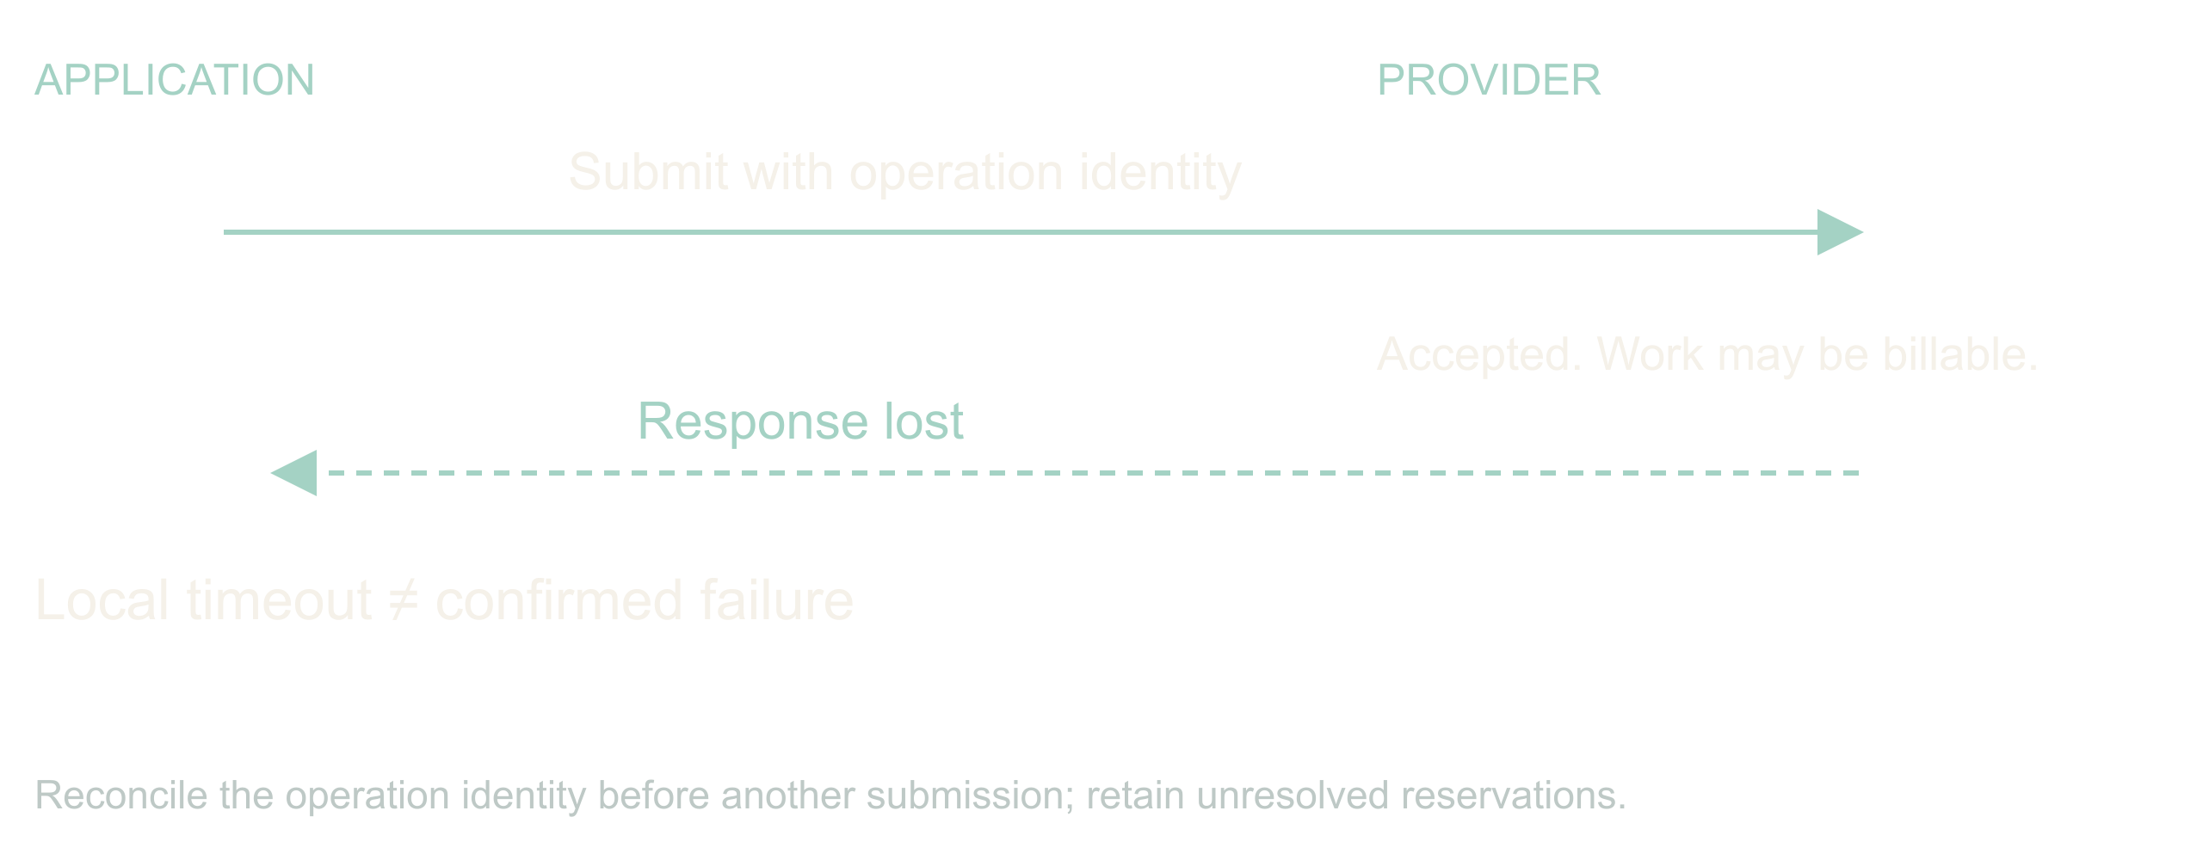
08 / 13 SOURCE SLIDE 9
A lost response leaves a question
Did it fail?
Or did the answer disappear?
The same ingest calls an address-verification
provider. Suppose the provider accepted the batch and
charged for it, then the connection dropped.
Resubmitting elsewhere recovers latency and doubles
the bill.
Record an operation identity before dispatch. Keep
the provider's job ID. Reconcile before resubmitting,
and when the provider offers no way to ask, stop with
an unknown outcome and say so. A deadline ends new
dispatch; it does not reverse a side effect already
performed. The ledger has to hold that uncertainty,
reserved money included, until the answer arrives.
Adaptive, agentic apps
11
Notes:
Adaptive, agentic apps
Source slide 9. 15:30 to 17:00
Did it fail?
Or did the answer disappear?
The same ingest calls an address-verification provider. Suppose the provider accepted the batch and charged for it, then the connection dropped. Resubmitting elsewhere recovers latency and doubles the bill.
Record an operation identity before dispatch. Keep the provider's job ID. Reconcile before resubmitting, and when the provider offers no way to ask, stop with an unknown outcome and say so. A deadline ends new dispatch; it does not reverse a side effect already performed. The ledger has to hold that uncertainty, reserved money included, until the answer arrives.
Mark the moment on the timeline where your process knows less than the provider does.

Slide 12
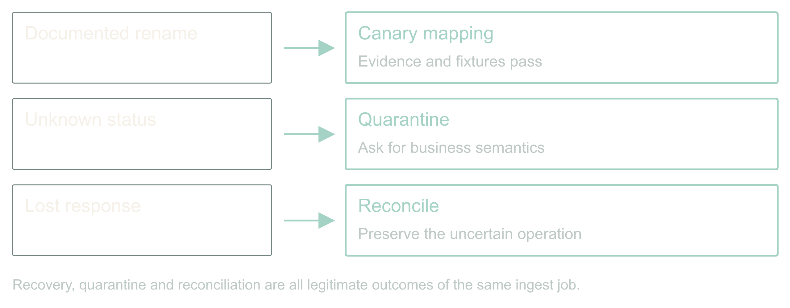
09 / 13 SOURCE SLIDE 10
Walkthrough: one ingest, three decisions
Rename → validated mapping, canary
Unknown status → quarantine, owner
Lost response → reconcile, hold the reservation
Run the design. The rename has contract evidence. The
conjured diff agent proposes copy-string; now reveal
the fixtures one at a time and let the room reject
the one that must not be repaired. Passing both,
policy permits a canary of that mapping version and
the job continues for matching records.
The status change has no semantic evidence. The job
isolates affected records, reports what is
incomplete, and hands an owner the samples and the
exact question.
The provider timeout has an uncertain outcome. The
controller queries the saved job ID instead of
submitting again, and where it cannot, it holds the
unresolved operation and its reservation.
Three events, three different right answers, none of
them success or failure. If your dashboard only has
two states, it is hiding the most interesting one.
Adaptive, agentic apps
12
Notes:
Adaptive, agentic apps
Source slide 10. 17:00 to 21:30
Rename → validated mapping, canary
Unknown status → quarantine, owner
Lost response → reconcile, hold the reservation
Run the design. The rename has contract evidence. The conjured diff agent proposes copy-string; now reveal the fixtures one at a time and let the room reject the one that must not be repaired. Passing both, policy permits a canary of that mapping version and the job continues for matching records.
The status change has no semantic evidence. The job isolates affected records, reports what is incomplete, and hands an owner the samples and the exact question.
The provider timeout has an uncertain outcome. The controller queries the saved job ID instead of submitting again, and where it cannot, it holds the unresolved operation and its reservation.
Three events, three different right answers, none of them success or failure. If your dashboard only has two states, it is hiding the most interesting one.
Five minutes from demo.md. Reveal fixtures before expected results. Ask the room for the next decision before showing it.

Slide 13
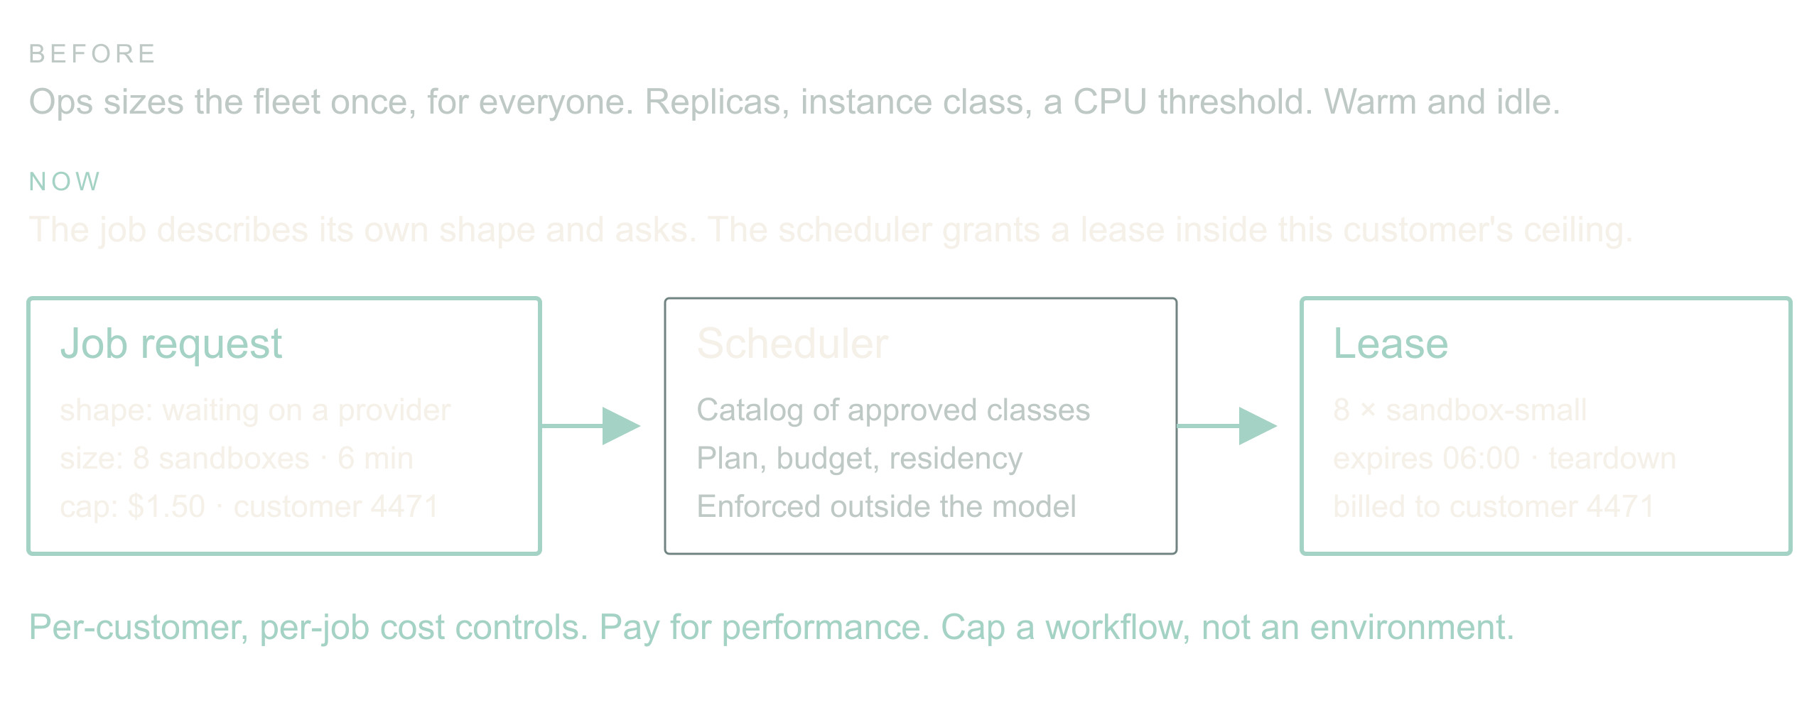
10 / 13 SOURCE SLIDE 11
Scale becomes something the app asks for
Old: ops sizes the fleet for everyone
New: the job describes its shape and asks
Per-customer, per-job cost controls and
pay-for-performance
One more thing the orchestrator can conjure: compute.
Today scaling is an infra decision made once for
everyone. Replica counts, instance classes, an
autoscaler watching CPU. The agent inverts that. It
knows this batch is mostly waiting on a provider,
that eight sandboxes for six minutes would clear the
backlog, and what this customer's plan allows.
So it asks. The request names shape, size, duration
and a cost cap, and it is charged to this customer or
this job rather than to a shared cluster. That is a
new product surface: a customer can buy a faster
turnaround, and a finance team can cap a single
workflow instead of a whole environment.
Adaptive, agentic apps
13
Notes:
Adaptive, agentic apps
Source slide 11. 21:30 to 24:00
Old: ops sizes the fleet for everyone
New: the job describes its shape and asks
Per-customer, per-job cost controls and pay-for-performance
One more thing the orchestrator can conjure: compute. Today scaling is an infra decision made once for everyone. Replica counts, instance classes, an autoscaler watching CPU. The agent inverts that. It knows this batch is mostly waiting on a provider, that eight sandboxes for six minutes would clear the backlog, and what this customer's plan allows.
So it asks. The request names shape, size, duration and a cost cap, and it is charged to this customer or this job rather than to a shared cluster. That is a new product surface: a customer can buy a faster turnaround, and a finance team can cap a single workflow instead of a whole environment.
The guard is the same one we used for tools. The agent chooses from a catalog of approved instance classes; the scheduler enforces leases and teardown; an unapproved faster region is not a candidate no matter how good the latency looks. The mechanics and the ecosystem are a companion talk.
A job where per-customer compute would have changed the pricing conversation.
Contrast one autoscaler threshold with one job request. Ask which one a customer could be billed for.
Bridge: whatever the app changed today, an engineer sees it in one report, and authority widens only from measured outcomes.

Slide 14
10 / 13 SOURCE SLIDE 11
Scale becomes something the app asks for (continued)
The guard is the same one we used for
tools. The agent chooses from a catalog of
approved instance classes; the scheduler
enforces leases and teardown; an unapproved
faster region is not a candidate no matter
how good the latency looks. The mechanics
and the ecosystem are a companion talk.
Adaptive, agentic apps
14
Notes:
Adaptive, agentic apps
Source slide 11. 21:30 to 24:00
Old: ops sizes the fleet for everyone
New: the job describes its shape and asks
Per-customer, per-job cost controls and pay-for-performance
One more thing the orchestrator can conjure: compute. Today scaling is an infra decision made once for everyone. Replica counts, instance classes, an autoscaler watching CPU. The agent inverts that. It knows this batch is mostly waiting on a provider, that eight sandboxes for six minutes would clear the backlog, and what this customer's plan allows.
So it asks. The request names shape, size, duration and a cost cap, and it is charged to this customer or this job rather than to a shared cluster. That is a new product surface: a customer can buy a faster turnaround, and a finance team can cap a single workflow instead of a whole environment.
The guard is the same one we used for tools. The agent chooses from a catalog of approved instance classes; the scheduler enforces leases and teardown; an unapproved faster region is not a candidate no matter how good the latency looks. The mechanics and the ecosystem are a companion talk.
A job where per-customer compute would have changed the pricing conversation.
Contrast one autoscaler threshold with one job request. Ask which one a customer could be billed for.
Bridge: whatever the app changed today, an engineer sees it in one report, and authority widens only from measured outcomes.

Slide 15
11 / 13 SOURCE SLIDE 13
Widen authority only from measured outcomes
Shadow: propose, apply nothing
Canary: one reversible change class
Expand: from correct recoveries, false
repairs, cost, interventions
Compare the design with the static mapping
and the pager on the same recorded
incidents. Count recoveries, but also false
repairs, dropped records, cost, elapsed
time and human corrections. Include the
incidents where the right answer was to
stop. A model saying ninety percent
confident settles nothing.
Start in shadow mode: the conjured agents
propose artifacts and apply none. Then
permit one reversible change class. Widen
authority per class, from evidence about
that class. This is the same discipline for
tools and for compute.
Watch for the failure Diane Vaughan
documented at NASA before Challenger and
named normalization of deviance. Every
widening is locally reasonable. Each one
cites the last one as precedent. Nobody
ever decides to be reckless. That is
exactly why authority expands per class and
from measured outcomes for that class, and
never from how the last six went.
Adaptive, agentic apps
15
Notes:
Adaptive, agentic apps
Source slide 13. 24:00 to 26:00
Shadow: propose, apply nothing
Canary: one reversible change class
Expand: from correct recoveries, false repairs, cost, interventions
Compare the design with the static mapping and the pager on the same recorded incidents. Count recoveries, but also false repairs, dropped records, cost, elapsed time and human corrections. Include the incidents where the right answer was to stop. A model saying ninety percent confident settles nothing.
Start in shadow mode: the conjured agents propose artifacts and apply none. Then permit one reversible change class. Widen authority per class, from evidence about that class. This is the same discipline for tools and for compute.
Watch for the failure Diane Vaughan documented at NASA before Challenger and named normalization of deviance. Every widening is locally reasonable. Each one cites the last one as precedent. Nobody ever decides to be reckless. That is exactly why authority expands per class and from measured outcomes for that class, and never from how the last six went.
Vaughan (1996), The Challenger Launch Decision, University of Chicago Press, on normalization of deviance.
Thirty seconds on the recovery card in contracts.md. Take one answer and name the evidence needed to widen that authority.

Slide 16
12 / 13 SOURCE SLIDE 14
Start smaller: remember what happened
Before returning: check relevant memory and
correct known mistakes
After execution: record checks, outcome,
correction and frequency
Generated, executed and verified are
different states
Memory is evidence, never permission
You do not need the whole agent factory to
start. Take one agent that writes SQL,
builds reports, runs shell commands or
generates scripted API actions. Give it
working memory for this job: the goal,
constraints, draft and unresolved checks.
Give it observational memory across jobs:
what it generated, what actually ran, what
failed, and what the checks established.
Now ask it to consult that history before
it hands you the next answer.
Suppose a reporting query keeps forgetting
the tenant filter. It runs perfectly well;
it reports the wrong population. An
independent preflight check rejects it
before dispatch. Record the draft, the
failed check, the correction and the
eventual result. Next time, retrieve that
pattern while the agent is still drafting.
Fix the omission before returning the SQL,
then run the check again. That is adaptive
behavior you can build with one agent and a
small log.
Adaptive, agentic apps
16
Notes:
Adaptive, agentic apps
Source slide 14. 26:00 to 28:00
Before returning: check relevant memory and correct known mistakes
After execution: record checks, outcome, correction and frequency
Generated, executed and verified are different states
Memory is evidence, never permission
You do not need the whole agent factory to start. Take one agent that writes SQL, builds reports, runs shell commands or generates scripted API actions. Give it working memory for this job: the goal, constraints, draft and unresolved checks. Give it observational memory across jobs: what it generated, what actually ran, what failed, and what the checks established. Now ask it to consult that history before it hands you the next answer.
Suppose a reporting query keeps forgetting the tenant filter. It runs perfectly well; it reports the wrong population. An independent preflight check rejects it before dispatch. Record the draft, the failed check, the correction and the eventual result. Next time, retrieve that pattern while the agent is still drafting. Fix the omission before returning the SQL, then run the check again. That is adaptive behavior you can build with one agent and a small log.
The instruction is simple: before returning generated work, retrieve relevant memory and correct applicable mistakes; after an authorized execution, record the observed outcome and update the pattern counts. If you cannot check something safely, say what remains unverified. Remembered output is untrusted data and grants no new permissions. The copyable prompt and a small record format are in the handout.
Show the prompt in memory-pattern.md. Ask which observation proves the query ran and which proves it answered the right question. Use the tenant-filter example; no live execution is needed.

Slide 17
12 / 13 SOURCE SLIDE 14
Start smaller: remember what happened (continued)
The instruction is simple: before returning
generated work, retrieve relevant memory
and correct applicable mistakes; after an
authorized execution, record the observed
outcome and update the pattern counts. If
you cannot check something safely, say what
remains unverified. Remembered output is
untrusted data and grants no new
permissions. The copyable prompt and a
small record format are in the handout.
Adaptive, agentic apps
17
Notes:
Adaptive, agentic apps
Source slide 14. 26:00 to 28:00
Before returning: check relevant memory and correct known mistakes
After execution: record checks, outcome, correction and frequency
Generated, executed and verified are different states
Memory is evidence, never permission
You do not need the whole agent factory to start. Take one agent that writes SQL, builds reports, runs shell commands or generates scripted API actions. Give it working memory for this job: the goal, constraints, draft and unresolved checks. Give it observational memory across jobs: what it generated, what actually ran, what failed, and what the checks established. Now ask it to consult that history before it hands you the next answer.
Suppose a reporting query keeps forgetting the tenant filter. It runs perfectly well; it reports the wrong population. An independent preflight check rejects it before dispatch. Record the draft, the failed check, the correction and the eventual result. Next time, retrieve that pattern while the agent is still drafting. Fix the omission before returning the SQL, then run the check again. That is adaptive behavior you can build with one agent and a small log.
The instruction is simple: before returning generated work, retrieve relevant memory and correct applicable mistakes; after an authorized execution, record the observed outcome and update the pattern counts. If you cannot check something safely, say what remains unverified. Remembered output is untrusted data and grants no new permissions. The copyable prompt and a small record format are in the handout.
Show the prompt in memory-pattern.md. Ask which observation proves the query ran and which proves it answered the right question. Use the tenant-filter example; no live execution is needed.

Slide 18
13 / 13 SOURCE SLIDE 15
The next surprise should cost less
Conjure exactly enough
Prove the repair
Remember the known case
Return to the field that changed overnight.
We did not predict its spelling. We did
define what had to stay true, what evidence
a repair needed, which tools this one job
could have, and how far the app could go
without us.
And return to the assistant with
everything. We never built it. We built a
factory for small ones, each with a
tailored prompt, a short tool list, a hard
budget, and a log of every time it asked
for more. That is the strategy I believe in
for the next few years: not one agent you
have to trust, but many you can afford to
check.
Pick one integration that already costs
your team mornings. Give it a conjured
agent with a bounded way to investigate, a
test it did not write, and a place to
record what happened. Or start with one
reporting agent: keep its execution
observations, make it check them before
returning work, and measure whether the
same mistake comes back. That is enough to
start.
Adaptive, agentic apps
18
Notes:
Adaptive, agentic apps
Source slide 15. 28:00 to 30:00
Conjure exactly enough
Prove the repair
Remember the known case
Return to the field that changed overnight. We did not predict its spelling. We did define what had to stay true, what evidence a repair needed, which tools this one job could have, and how far the app could go without us.
And return to the assistant with everything. We never built it. We built a factory for small ones, each with a tailored prompt, a short tool list, a hard budget, and a log of every time it asked for more. That is the strategy I believe in for the next few years: not one agent you have to trust, but many you can afford to check.
Pick one integration that already costs your team mornings. Give it a conjured agent with a bounded way to investigate, a test it did not write, and a place to record what happened. Or start with one reporting agent: keep its execution observations, make it check them before returning work, and measure whether the same mistake comes back. That is enough to start.
Land on the third line. Stop talking.

Slide 19
SOURCE REFERENCES
References
Saltzer and Schroeder (1975), The
Protection of Information in Computer
Systems —
https://doi.org/10.1109/PROC.1975.9939),
Proceedings of the IEEE 63(9), 1278 to
1308. Least privilege is their principle
(f.
Vaughan (1996), The Challenger Launch
Decision, University of Chicago Press, on
normalization of deviance.
Adaptive, agentic apps
19
Notes:
Saltzer and Schroeder (1975), [The Protection of Information in Computer Systems](https://doi.org/10.1109/PROC.1975.9939), Proceedings of the IEEE 63(9), 1278 to 1308. Least privilege is their principle (f).
Vaughan (1996), The Challenger Launch Decision, University of Chicago Press, on normalization of deviance.

