Slide 1
DAN LEVY
Dynamic Scaling of Agentic Workloads
15-minute route · Reading edition
7 source sections
September 6, 2026
Dynamic Scaling of Agentic Workloads
1
Notes:
Agents now direct their own compute. Put the limits where the work begins.
Rewritten 2026-09-06 from Dan's notes. 40 minutes, 14 slides, four audience moments, no Q&A. Add five minutes for a 45-minute booking. Job counts and prices are fixtures; the vendors on slide 8 are real and were checked on the date above. Say the scope once, on slide 1.
[Presenter scripts](../packets/dynamic-scaling/script-40min.md) · [Contracts](../packets/dynamic-scaling/contracts.md) · [Walkthrough](../packets/dynamic-scaling/demo.md) · [Evidence](../packets/dynamic-scaling/evidence-bank.md)
Regenerate scripts, adaptations and the browser deck with `bun artifacts/speaking-portfolio-expanded/build-talk.ts dynamic-scaling`.

Slide 2
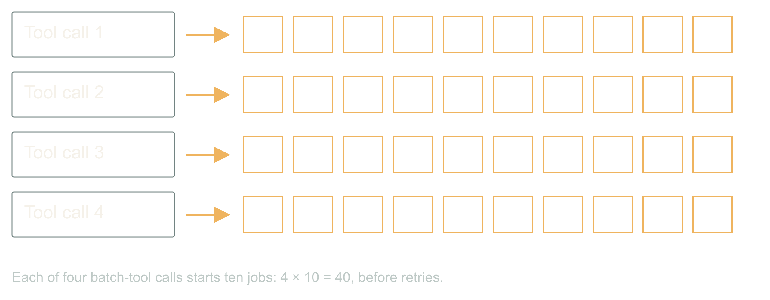
01 / 07 SOURCE SLIDE 1
Four callers, forty images, one customer
A chat turn, a retry, a cron job, a second tab
Each legal. Each ten images.
The customer bought ten.
A customer asks for ten images. Four things happen
within a minute, and every one of them is legitimate.
The chat turn calls the batch tool. A worker crashed
halfway and its replacement retries. A nightly job
re-runs anything not marked done. The customer opened
a second tab because the first one looked stuck.
Four callers, ten images each. Every local limit
passed. The provider is rendering forty. Your
dashboard proudly reports four tool calls. We put the
limit on the wrong unit of work.
That is the whole talk in one multiplication. The
agentic part is what comes next: the same system that
hid the fan-out can also ask for its own compute, and
we have to decide what that is allowed to mean.
Numbers here are fixtures; the vendors later are
real.
Dynamic Scaling of Agentic Workloads
2
Notes:
Dynamic Scaling of Agentic Workloads
Source slide 1. 00:00 to 01:30
A chat turn, a retry, a cron job, a second tab
Each legal. Each ten images.
The customer bought ten.
A customer asks for ten images. Four things happen within a minute, and every one of them is legitimate. The chat turn calls the batch tool. A worker crashed halfway and its replacement retries. A nightly job re-runs anything not marked done. The customer opened a second tab because the first one looked stuck.
Four callers, ten images each. Every local limit passed. The provider is rendering forty. Your dashboard proudly reports four tool calls. We put the limit on the wrong unit of work.
That is the whole talk in one multiplication. The agentic part is what comes next: the same system that hid the fan-out can also ask for its own compute, and we have to decide what that is allowed to mean. Numbers here are fixtures; the vendors later are real.
The fan-out you found on a bill before you found it in a dashboard.
Let the room multiply before you show forty. Then ask which component knew the customer's entitlement. Silence is the answer.

Slide 3
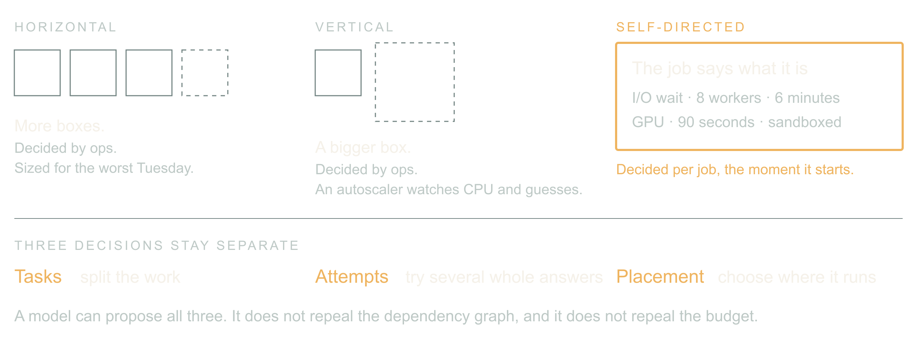
02 / 07 SOURCE SLIDE 2
Horizontal, vertical, and now self-directed
Horizontal: more boxes, decided by ops
Vertical: bigger box, decided by ops
Self-directed: the job describes its shape and asks
For twenty years scaling was an infra question
answered once for everyone. Add replicas or buy a
bigger box, then let an autoscaler watch CPU and
guess. The workload never got a vote.
Agentic workloads can vote. The orchestrator knows
this batch is mostly waiting on a provider, that this
one needs a GPU for ninety seconds, that this one is
untrusted code and wants a sandbox. It can say so,
per job, at the moment the job starts.
Dynamic Scaling of Agentic Workloads
3
Notes:
Dynamic Scaling of Agentic Workloads
Source slide 2. 01:30 to 03:30
Horizontal: more boxes, decided by ops
Vertical: bigger box, decided by ops
Self-directed: the job describes its shape and asks
For twenty years scaling was an infra question answered once for everyone. Add replicas or buy a bigger box, then let an autoscaler watch CPU and guess. The workload never got a vote.
Agentic workloads can vote. The orchestrator knows this batch is mostly waiting on a provider, that this one needs a GPU for ninety seconds, that this one is untrusted code and wants a sandbox. It can say so, per job, at the moment the job starts.
Classify an image batch, a route-optimization run, three competing designs and a region move. Note that an LLM can schedule a solver without doing the arithmetic.
Bridge: count logical items and provider attempts separately; a retry is not a new entitlement.

Slide 4
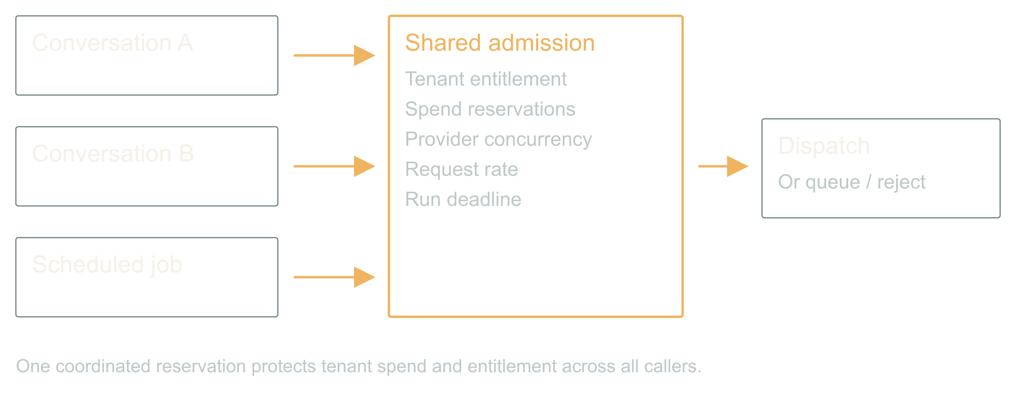
03 / 07 SOURCE SLIDE 4
Put admission below every caller
Reserve before dispatch
Share tenant and provider limits
Queue or reject what does not fit
A prompt that says only run one expensive tool is
guidance. It is not a lock. The chat turn, the retry,
the cron job and the second tab arrive at once, and
none of them can see the others.
So every external dispatch crosses one shared
admission controller. It atomically checks tenant
entitlement, budget, provider concurrency, rate and
deadline, then reserves. If the request does not fit,
it queues or returns an explicit rejection. A
process-local semaphore only works when that process
owns all the work, and in an agentic system it never
does.
Dynamic Scaling of Agentic Workloads
4
Notes:
Dynamic Scaling of Agentic Workloads
Source slide 4. 03:30 to 05:30
Reserve before dispatch
Share tenant and provider limits
Queue or reject what does not fit
A prompt that says only run one expensive tool is guidance. It is not a lock. The chat turn, the retry, the cron job and the second tab arrive at once, and none of them can see the others.
So every external dispatch crosses one shared admission controller. It atomically checks tenant entitlement, budget, provider concurrency, rate and deadline, then reserves. If the request does not fit, it queues or returns an explicit rejection. A process-local semaphore only works when that process owns all the work, and in an agentic system it never does.
Walk two simultaneous callers in contracts.md. Read-balance-then-write loses; atomic reservation admits one.
Bridge: money, concurrency and rate are three different limits; a run can satisfy one and blow the other two.

Slide 5
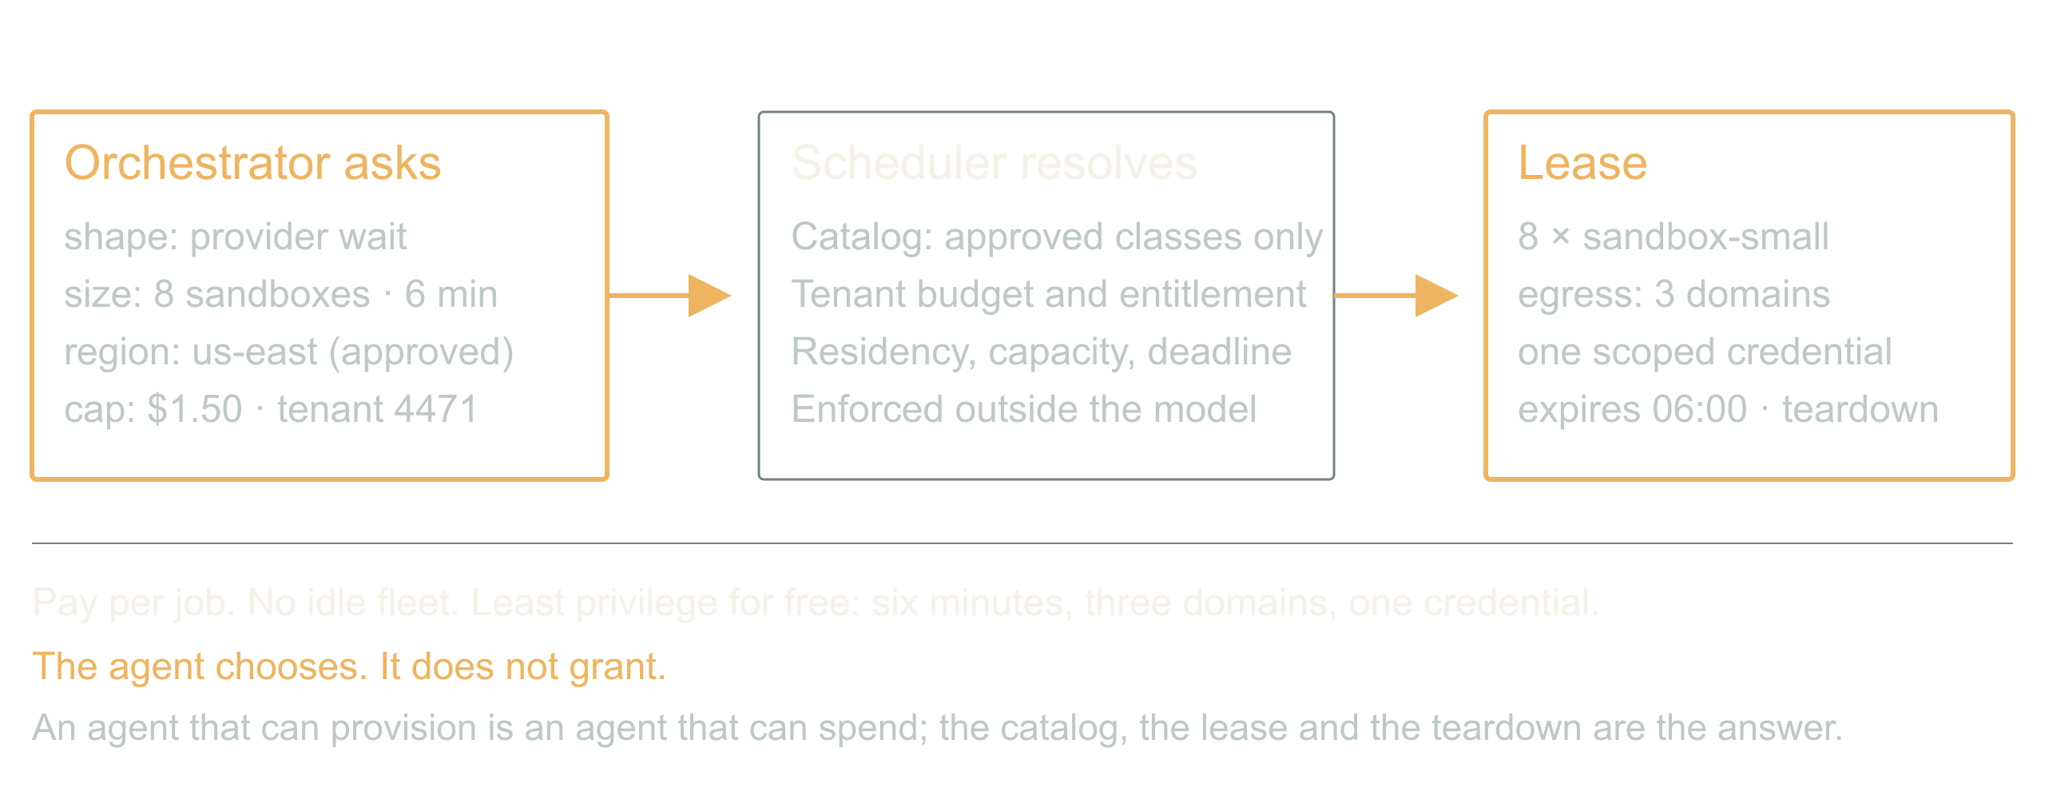
04 / 07 SOURCE SLIDE 7
The inversion: infra as an agent capability
Request: shape, size, duration, region, cost cap
Resolve: catalog, tenant budget, lease
Pay per job. No idle fleet. Least privilege for free.
Here is the part that is actually new. The
orchestrator asks for compute the way it asks for a
tool. Eight sandboxes for six minutes, this region,
this cost cap. The scheduler resolves that against a
catalog of approved classes and the tenant's budget,
and returns a lease with a teardown.
What you get is per-job economics. A customer can buy
a faster turnaround. Finance can cap one workflow
instead of one environment. Nobody pays for a warm
fleet sized for the worst Tuesday of the year. And
least privilege stops being a project: an instance
that lives six minutes, reaches three domains, and
holds one scoped credential is hard to abuse even
when the agent inside it is confused.
Dynamic Scaling of Agentic Workloads
5
Notes:
Dynamic Scaling of Agentic Workloads
Source slide 7. 05:30 to 08:00
Request: shape, size, duration, region, cost cap
Resolve: catalog, tenant budget, lease
Pay per job. No idle fleet. Least privilege for free.
Here is the part that is actually new. The orchestrator asks for compute the way it asks for a tool. Eight sandboxes for six minutes, this region, this cost cap. The scheduler resolves that against a catalog of approved classes and the tenant's budget, and returns a lease with a teardown.
What you get is per-job economics. A customer can buy a faster turnaround. Finance can cap one workflow instead of one environment. Nobody pays for a warm fleet sized for the worst Tuesday of the year. And least privilege stops being a project: an instance that lives six minutes, reaches three domains, and holds one scoped credential is hard to abuse even when the agent inside it is confused.
What you risk is obvious. An agent that can provision is an agent that can spend. The catalog, the lease and the teardown are the answer, and they are enforced outside the model. The agent chooses; it does not grant.
The moment an agent-sized request would have replaced a capacity-planning meeting.
Contrast one autoscaler threshold with one job request. Ask which one you could put on an invoice.

Slide 6
04 / 07 SOURCE SLIDE 7
The inversion: infra as an agent capability
(continued)
What you risk is obvious. An agent that can
provision is an agent that can spend. The
catalog, the lease and the teardown are the
answer, and they are enforced outside the
model. The agent chooses; it does not
grant.
Dynamic Scaling of Agentic Workloads
6
Notes:
Dynamic Scaling of Agentic Workloads
Source slide 7. 05:30 to 08:00
Request: shape, size, duration, region, cost cap
Resolve: catalog, tenant budget, lease
Pay per job. No idle fleet. Least privilege for free.
Here is the part that is actually new. The orchestrator asks for compute the way it asks for a tool. Eight sandboxes for six minutes, this region, this cost cap. The scheduler resolves that against a catalog of approved classes and the tenant's budget, and returns a lease with a teardown.
What you get is per-job economics. A customer can buy a faster turnaround. Finance can cap one workflow instead of one environment. Nobody pays for a warm fleet sized for the worst Tuesday of the year. And least privilege stops being a project: an instance that lives six minutes, reaches three domains, and holds one scoped credential is hard to abuse even when the agent inside it is confused.
What you risk is obvious. An agent that can provision is an agent that can spend. The catalog, the lease and the teardown are the answer, and they are enforced outside the model. The agent chooses; it does not grant.
The moment an agent-sized request would have replaced a capacity-planning meeting.
Contrast one autoscaler threshold with one job request. Ask which one you could put on an invoice.

Slide 7
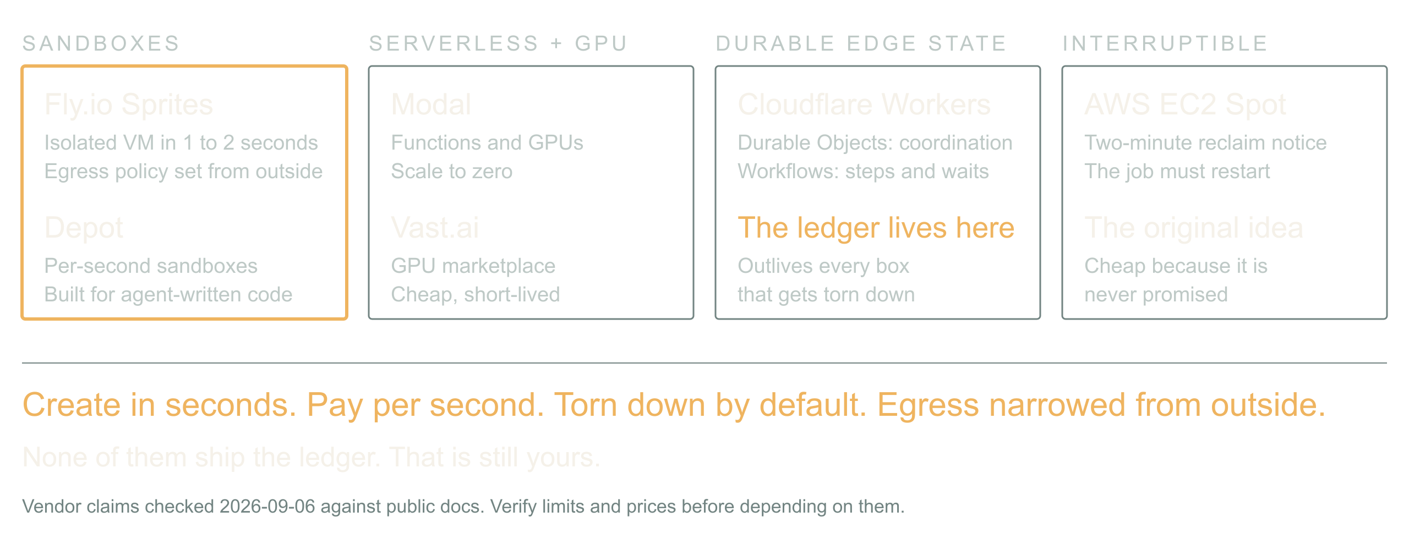
05 / 07 SOURCE SLIDE 8
The ecosystem is already ephemeral by default
Sandboxes: Fly.io Sprites, Depot
Serverless compute and GPUs: Modal, Vast.ai
Durable edge state: Cloudflare Workers, Durable
Objects, Workflows
Interruptible capacity: AWS EC2 Spot
The pieces exist, and they are shaped for this.
Fly.io Sprites are hardware-isolated VMs that create
in a second or two, checkpoint and restore, and take
an egress policy from outside so the agent inside
cannot loosen it. Depot sandboxes bill per second for
exactly this: run agent-generated code, stream
output, throw it away.
Modal gives you functions and GPUs that scale to
zero; Vast.ai is a marketplace where a spare GPU is
cheap and short-lived. Cloudflare Workers with
Durable Objects and Workflows hold the coordination
state that survives everything else being torn down.
EC2 Spot is the old version of the same idea:
capacity that can vanish, so the job had better be
restartable.
Dynamic Scaling of Agentic Workloads
7
Notes:
Dynamic Scaling of Agentic Workloads
Source slide 8. 08:00 to 10:30
Sandboxes: Fly.io Sprites, Depot
Serverless compute and GPUs: Modal, Vast.ai
Durable edge state: Cloudflare Workers, Durable Objects, Workflows
Interruptible capacity: AWS EC2 Spot
The pieces exist, and they are shaped for this. Fly.io Sprites are hardware-isolated VMs that create in a second or two, checkpoint and restore, and take an egress policy from outside so the agent inside cannot loosen it. Depot sandboxes bill per second for exactly this: run agent-generated code, stream output, throw it away.
Modal gives you functions and GPUs that scale to zero; Vast.ai is a marketplace where a spare GPU is cheap and short-lived. Cloudflare Workers with Durable Objects and Workflows hold the coordination state that survives everything else being torn down. EC2 Spot is the old version of the same idea: capacity that can vanish, so the job had better be restartable.
The common thread: create in seconds, pay per second, torn down unless someone says otherwise, and the network narrowed from the outside. That is the substrate an agent-directed scheduler needs. What none of them give you is the ledger; that is still yours.
Ask who runs agent code on something with a lifetime under an hour. Then ask who has an egress policy on it.
Bridge: a job survives the caller when its intent, provider IDs and reservations are persisted before dispatch.

Slide 8
05 / 07 SOURCE SLIDE 8
The ecosystem is already ephemeral by default
(continued)
The common thread: create in seconds, pay
per second, torn down unless someone says
otherwise, and the network narrowed from
the outside. That is the substrate an
agent-directed scheduler needs. What none
of them give you is the ledger; that is
still yours.
Dynamic Scaling of Agentic Workloads
8
Notes:
Dynamic Scaling of Agentic Workloads
Source slide 8. 08:00 to 10:30
Sandboxes: Fly.io Sprites, Depot
Serverless compute and GPUs: Modal, Vast.ai
Durable edge state: Cloudflare Workers, Durable Objects, Workflows
Interruptible capacity: AWS EC2 Spot
The pieces exist, and they are shaped for this. Fly.io Sprites are hardware-isolated VMs that create in a second or two, checkpoint and restore, and take an egress policy from outside so the agent inside cannot loosen it. Depot sandboxes bill per second for exactly this: run agent-generated code, stream output, throw it away.
Modal gives you functions and GPUs that scale to zero; Vast.ai is a marketplace where a spare GPU is cheap and short-lived. Cloudflare Workers with Durable Objects and Workflows hold the coordination state that survives everything else being torn down. EC2 Spot is the old version of the same idea: capacity that can vanish, so the job had better be restartable.
The common thread: create in seconds, pay per second, torn down unless someone says otherwise, and the network narrowed from the outside. That is the substrate an agent-directed scheduler needs. What none of them give you is the ledger; that is still yours.
Ask who runs agent code on something with a lifetime under an hour. Then ask who has an egress policy on it.
Bridge: a job survives the caller when its intent, provider IDs and reservations are persisted before dispatch.

Slide 9
06 / 07 SOURCE SLIDE 11
Walkthrough: restart the batch
Two callers, one entitlement
Spot instance reclaimed mid-batch
One response lost, one email fails
Two callers each want a full batch. The
first reserves the entitlement; the second
queues with an explicit reason. Dispatch
begins on a spot worker. Halfway through,
the instance is reclaimed with two minutes'
notice: the lease expires, the provider
keeps rendering, the reservations stay
charged.
A new worker reloads the job, checks
provider status for every submitted item,
and collects what finished. One item's
response never arrived; it stays unresolved
with its reservation held, and the worker
asks the provider rather than resubmitting.
All outputs land. The email fails. The
delivery worker retries the email against
the completed job, and the expensive
generation is untouched.
One job, a recoverable lifecycle, honest
accounting, and a compute substrate that
was allowed to disappear under it. That is
the abstraction the batch tool owed us.
Dynamic Scaling of Agentic Workloads
9
Notes:
Dynamic Scaling of Agentic Workloads
Source slide 11. 10:30 to 13:30
Two callers, one entitlement
Spot instance reclaimed mid-batch
One response lost, one email fails
Two callers each want a full batch. The first reserves the entitlement; the second queues with an explicit reason. Dispatch begins on a spot worker. Halfway through, the instance is reclaimed with two minutes' notice: the lease expires, the provider keeps rendering, the reservations stay charged.
A new worker reloads the job, checks provider status for every submitted item, and collects what finished. One item's response never arrived; it stays unresolved with its reservation held, and the worker asks the provider rather than resubmitting. All outputs land. The email fails. The delivery worker retries the email against the completed job, and the expensive generation is untouched.
One job, a recoverable lifecycle, honest accounting, and a compute substrate that was allowed to disappear under it. That is the abstraction the batch tool owed us.
Five minutes from demo.md. Ask the room for each next transition before revealing it.
Bridge: attempts are a scaling axis too; bound them, gate them, and treat any synthesis as a new candidate.

Slide 10
07 / 07 SOURCE SLIDE 14
Put the limit where the work begins
One ledger across every caller
Durable state across every restart
A lease on every box, a gate on every
candidate
Back to the four callers. Forty jobs were
legal by four local counters. The missing
piece was one shared account of what the
application had promised and what it had
already started.
The inversion is real: the workload can now
describe its own shape and ask for its own
compute, and the substrate to grant it in
seconds already exists. That is a better
world than a warm fleet and a guess. It is
only safe because the agent chooses from a
catalog, spends from a ledger, and runs on
boxes that expire.
Inspect one expensive tool in your system.
Count the work it can launch underneath
itself. Put the limit where that work
actually begins.
Dynamic Scaling of Agentic Workloads
10
Notes:
Dynamic Scaling of Agentic Workloads
Source slide 14. 13:30 to 15:00
One ledger across every caller
Durable state across every restart
A lease on every box, a gate on every candidate
Back to the four callers. Forty jobs were legal by four local counters. The missing piece was one shared account of what the application had promised and what it had already started.
The inversion is real: the workload can now describe its own shape and ask for its own compute, and the substrate to grant it in seconds already exists. That is a better world than a warm fleet and a guess. It is only safe because the agent chooses from a catalog, spends from a ledger, and runs on boxes that expire.
Inspect one expensive tool in your system. Count the work it can launch underneath itself. Put the limit where that work actually begins.
Close on the multiplication and the shared admission line. Do not add a vendor.

