Slide 1
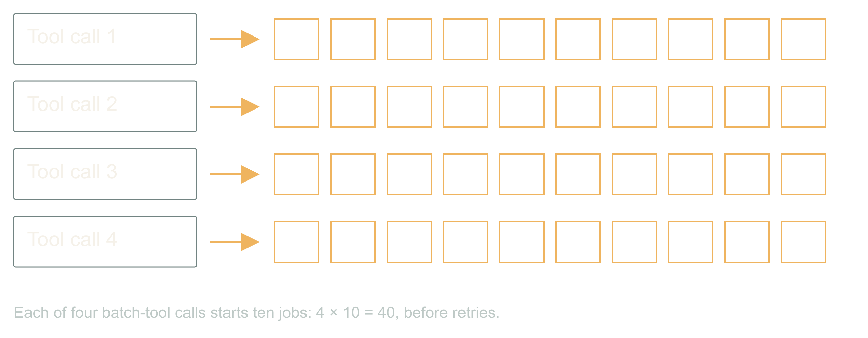
Dynamic Scaling of Agentic Workloads · Dan Levy
Four callers, forty images, one customer
Dynamic Scaling of Agentic Workloads
1
Notes:
Dynamic Scaling of Agentic Workloads
Source slide 1. 00:00 to 01:30
A chat turn, a retry, a cron job, a second tab
Each legal. Each ten images.
The customer bought ten.
A customer asks for ten images. Four things happen within a minute, and every one of them is legitimate. The chat turn calls the batch tool. A worker crashed halfway and its replacement retries. A nightly job re-runs anything not marked done. The customer opened a second tab because the first one looked stuck.
Four callers, ten images each. Every local limit passed. The provider is rendering forty. Your dashboard proudly reports four tool calls. We put the limit on the wrong unit of work.
That is the whole talk in one multiplication. The agentic part is what comes next: the same system that hid the fan-out can also ask for its own compute, and we have to decide what that is allowed to mean. Numbers here are fixtures; the vendors later are real.
The fan-out you found on a bill before you found it in a dashboard.
Let the room multiply before you show forty. Then ask which component knew the customer's entitlement. Silence is the answer.

Slide 2
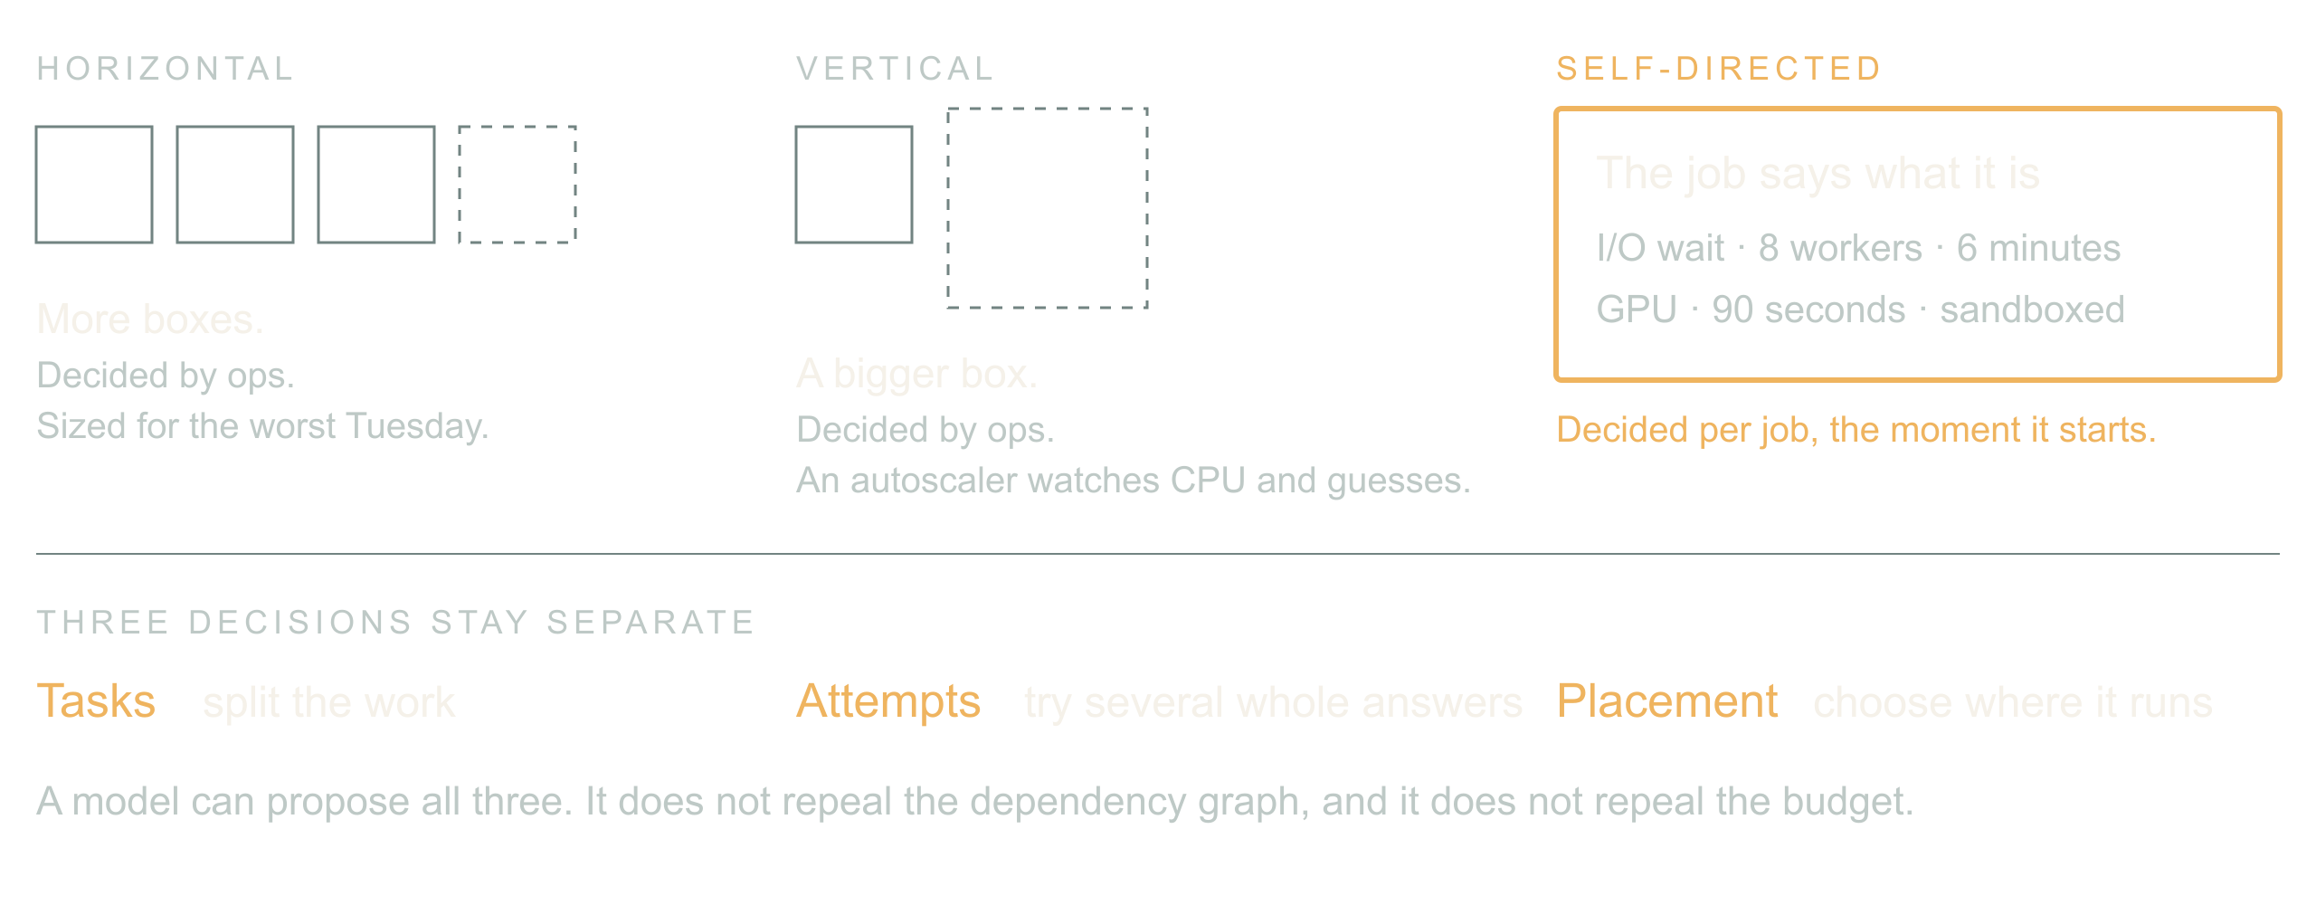
02 / 07 SOURCE SLIDE 2
Horizontal, vertical, and now self-directed
Dynamic Scaling of Agentic Workloads
2
Notes:
Dynamic Scaling of Agentic Workloads
Source slide 2. 01:30 to 03:30
Horizontal: more boxes, decided by ops
Vertical: bigger box, decided by ops
Self-directed: the job describes its shape and asks
For twenty years scaling was an infra question answered once for everyone. Add replicas or buy a bigger box, then let an autoscaler watch CPU and guess. The workload never got a vote.
Agentic workloads can vote. The orchestrator knows this batch is mostly waiting on a provider, that this one needs a GPU for ninety seconds, that this one is untrusted code and wants a sandbox. It can say so, per job, at the moment the job starts.
Classify an image batch, a route-optimization run, three competing designs and a region move. Note that an LLM can schedule a solver without doing the arithmetic.
Bridge: count logical items and provider attempts separately; a retry is not a new entitlement.

Slide 3
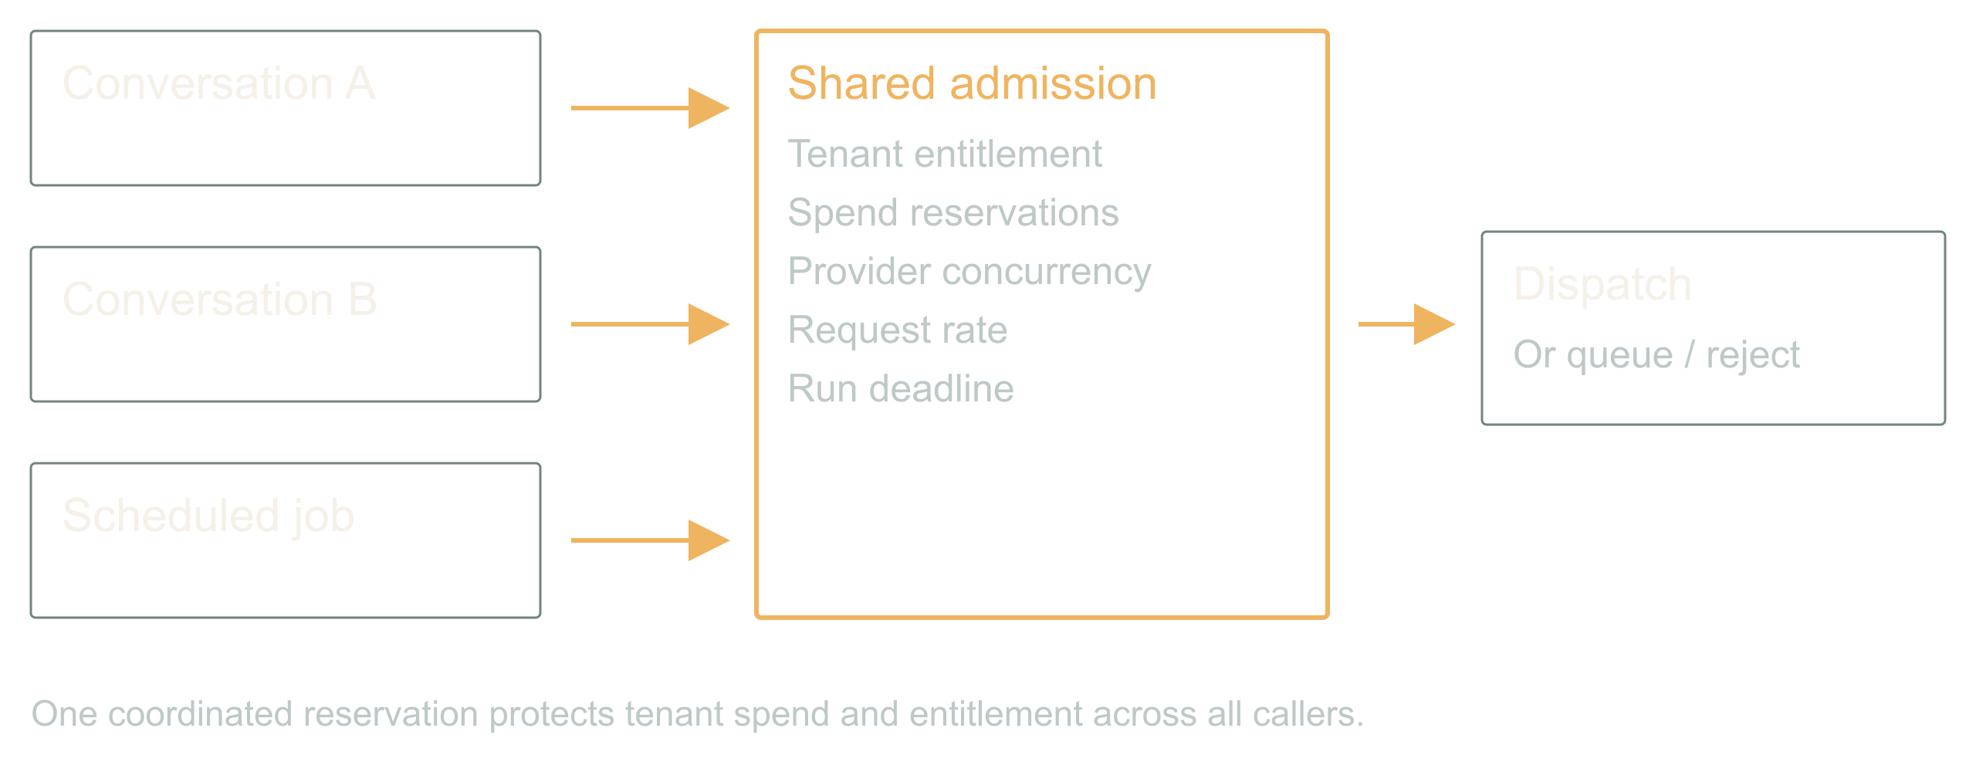
03 / 07 SOURCE SLIDE 4
Put admission below every caller
Dynamic Scaling of Agentic Workloads
3
Notes:
Dynamic Scaling of Agentic Workloads
Source slide 4. 03:30 to 05:30
Reserve before dispatch
Share tenant and provider limits
Queue or reject what does not fit
A prompt that says only run one expensive tool is guidance. It is not a lock. The chat turn, the retry, the cron job and the second tab arrive at once, and none of them can see the others.
So every external dispatch crosses one shared admission controller. It atomically checks tenant entitlement, budget, provider concurrency, rate and deadline, then reserves. If the request does not fit, it queues or returns an explicit rejection. A process-local semaphore only works when that process owns all the work, and in an agentic system it never does.
Walk two simultaneous callers in contracts.md. Read-balance-then-write loses; atomic reservation admits one.
Bridge: money, concurrency and rate are three different limits; a run can satisfy one and blow the other two.

Slide 4
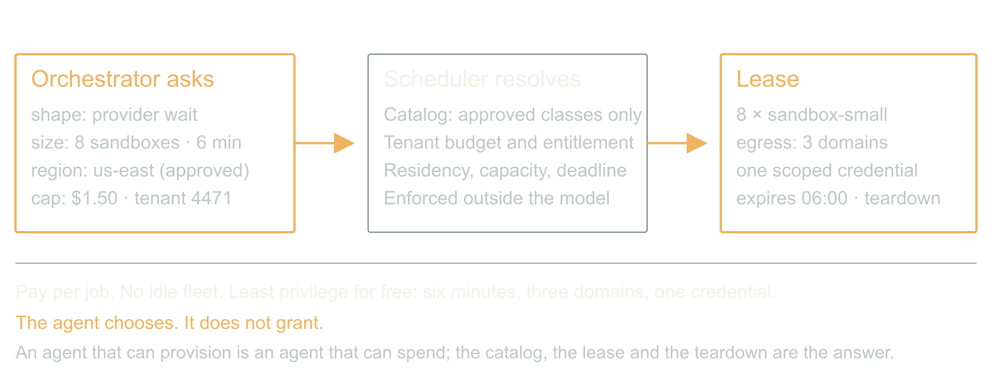
04 / 07 SOURCE SLIDE 7
The inversion: infra as an agent capability
Dynamic Scaling of Agentic Workloads
4
Notes:
Dynamic Scaling of Agentic Workloads
Source slide 7. 05:30 to 08:00
Request: shape, size, duration, region, cost cap
Resolve: catalog, tenant budget, lease
Pay per job. No idle fleet. Least privilege for free.
Here is the part that is actually new. The orchestrator asks for compute the way it asks for a tool. Eight sandboxes for six minutes, this region, this cost cap. The scheduler resolves that against a catalog of approved classes and the tenant's budget, and returns a lease with a teardown.
What you get is per-job economics. A customer can buy a faster turnaround. Finance can cap one workflow instead of one environment. Nobody pays for a warm fleet sized for the worst Tuesday of the year. And least privilege stops being a project: an instance that lives six minutes, reaches three domains, and holds one scoped credential is hard to abuse even when the agent inside it is confused.
What you risk is obvious. An agent that can provision is an agent that can spend. The catalog, the lease and the teardown are the answer, and they are enforced outside the model. The agent chooses; it does not grant.
The moment an agent-sized request would have replaced a capacity-planning meeting.
Contrast one autoscaler threshold with one job request. Ask which one you could put on an invoice.

Slide 5
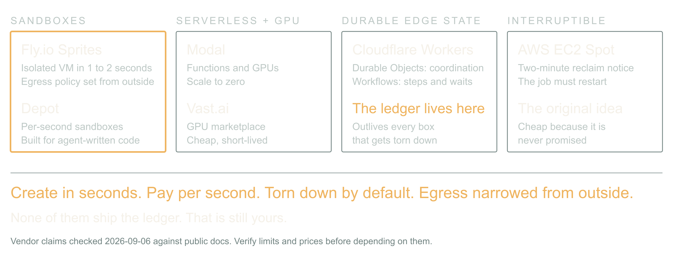
05 / 07 SOURCE SLIDE 8
The ecosystem is already ephemeral by default
Dynamic Scaling of Agentic Workloads
5
Notes:
Dynamic Scaling of Agentic Workloads
Source slide 8. 08:00 to 10:30
Sandboxes: Fly.io Sprites, Depot
Serverless compute and GPUs: Modal, Vast.ai
Durable edge state: Cloudflare Workers, Durable Objects, Workflows
Interruptible capacity: AWS EC2 Spot
The pieces exist, and they are shaped for this. Fly.io Sprites are hardware-isolated VMs that create in a second or two, checkpoint and restore, and take an egress policy from outside so the agent inside cannot loosen it. Depot sandboxes bill per second for exactly this: run agent-generated code, stream output, throw it away.
Modal gives you functions and GPUs that scale to zero; Vast.ai is a marketplace where a spare GPU is cheap and short-lived. Cloudflare Workers with Durable Objects and Workflows hold the coordination state that survives everything else being torn down. EC2 Spot is the old version of the same idea: capacity that can vanish, so the job had better be restartable.
The common thread: create in seconds, pay per second, torn down unless someone says otherwise, and the network narrowed from the outside. That is the substrate an agent-directed scheduler needs. What none of them give you is the ledger; that is still yours.
Ask who runs agent code on something with a lifetime under an hour. Then ask who has an egress policy on it.
Bridge: a job survives the caller when its intent, provider IDs and reservations are persisted before dispatch.

Slide 6
06 / 07 SOURCE SLIDE 11
Walkthrough: restart the batch
01
Two callers, one entitlement
02
Spot instance reclaimed mid-batch
03
One response lost, one email fails
Dynamic Scaling of Agentic Workloads
6
Notes:
Dynamic Scaling of Agentic Workloads
Source slide 11. 10:30 to 13:30
Two callers, one entitlement
Spot instance reclaimed mid-batch
One response lost, one email fails
Two callers each want a full batch. The first reserves the entitlement; the second queues with an explicit reason. Dispatch begins on a spot worker. Halfway through, the instance is reclaimed with two minutes' notice: the lease expires, the provider keeps rendering, the reservations stay charged.
A new worker reloads the job, checks provider status for every submitted item, and collects what finished. One item's response never arrived; it stays unresolved with its reservation held, and the worker asks the provider rather than resubmitting. All outputs land. The email fails. The delivery worker retries the email against the completed job, and the expensive generation is untouched.
One job, a recoverable lifecycle, honest accounting, and a compute substrate that was allowed to disappear under it. That is the abstraction the batch tool owed us.
Five minutes from demo.md. Ask the room for each next transition before revealing it.
Bridge: attempts are a scaling axis too; bound them, gate them, and treat any synthesis as a new candidate.

Slide 7
07 / 07 SOURCE SLIDE 14
Put the limit where the work begins
01
One ledger across every caller
02
Durable state across every restart
03
A lease on every box, a gate on every candidate
Dynamic Scaling of Agentic Workloads
7
Notes:
Dynamic Scaling of Agentic Workloads
Source slide 14. 13:30 to 15:00
One ledger across every caller
Durable state across every restart
A lease on every box, a gate on every candidate
Back to the four callers. Forty jobs were legal by four local counters. The missing piece was one shared account of what the application had promised and what it had already started.
The inversion is real: the workload can now describe its own shape and ask for its own compute, and the substrate to grant it in seconds already exists. That is a better world than a warm fleet and a guess. It is only safe because the agent chooses from a catalog, spends from a ledger, and runs on boxes that expire.
Inspect one expensive tool in your system. Count the work it can launch underneath itself. Put the limit where that work actually begins.
Close on the multiplication and the shared admission line. Do not add a vendor.

