Slide 1
DAN LEVY
Dynamic Scaling of Agentic Workloads
40-minute route · Reading edition
14 source sections
September 6, 2026
Dynamic Scaling of Agentic Workloads
1
Notes:
Agents now direct their own compute. Put the limits where the work begins.
Rewritten 2026-09-06 from Dan's notes. 40 minutes, 14 slides, four audience moments, no Q&A. Add five minutes for a 45-minute booking. Job counts and prices are fixtures; the vendors on slide 8 are real and were checked on the date above. Say the scope once, on slide 1.
[Presenter scripts](../packets/dynamic-scaling/script-40min.md) · [Contracts](../packets/dynamic-scaling/contracts.md) · [Walkthrough](../packets/dynamic-scaling/demo.md) · [Evidence](../packets/dynamic-scaling/evidence-bank.md)
Regenerate scripts, adaptations and the browser deck with `bun artifacts/speaking-portfolio-expanded/build-talk.ts dynamic-scaling`.

Slide 2
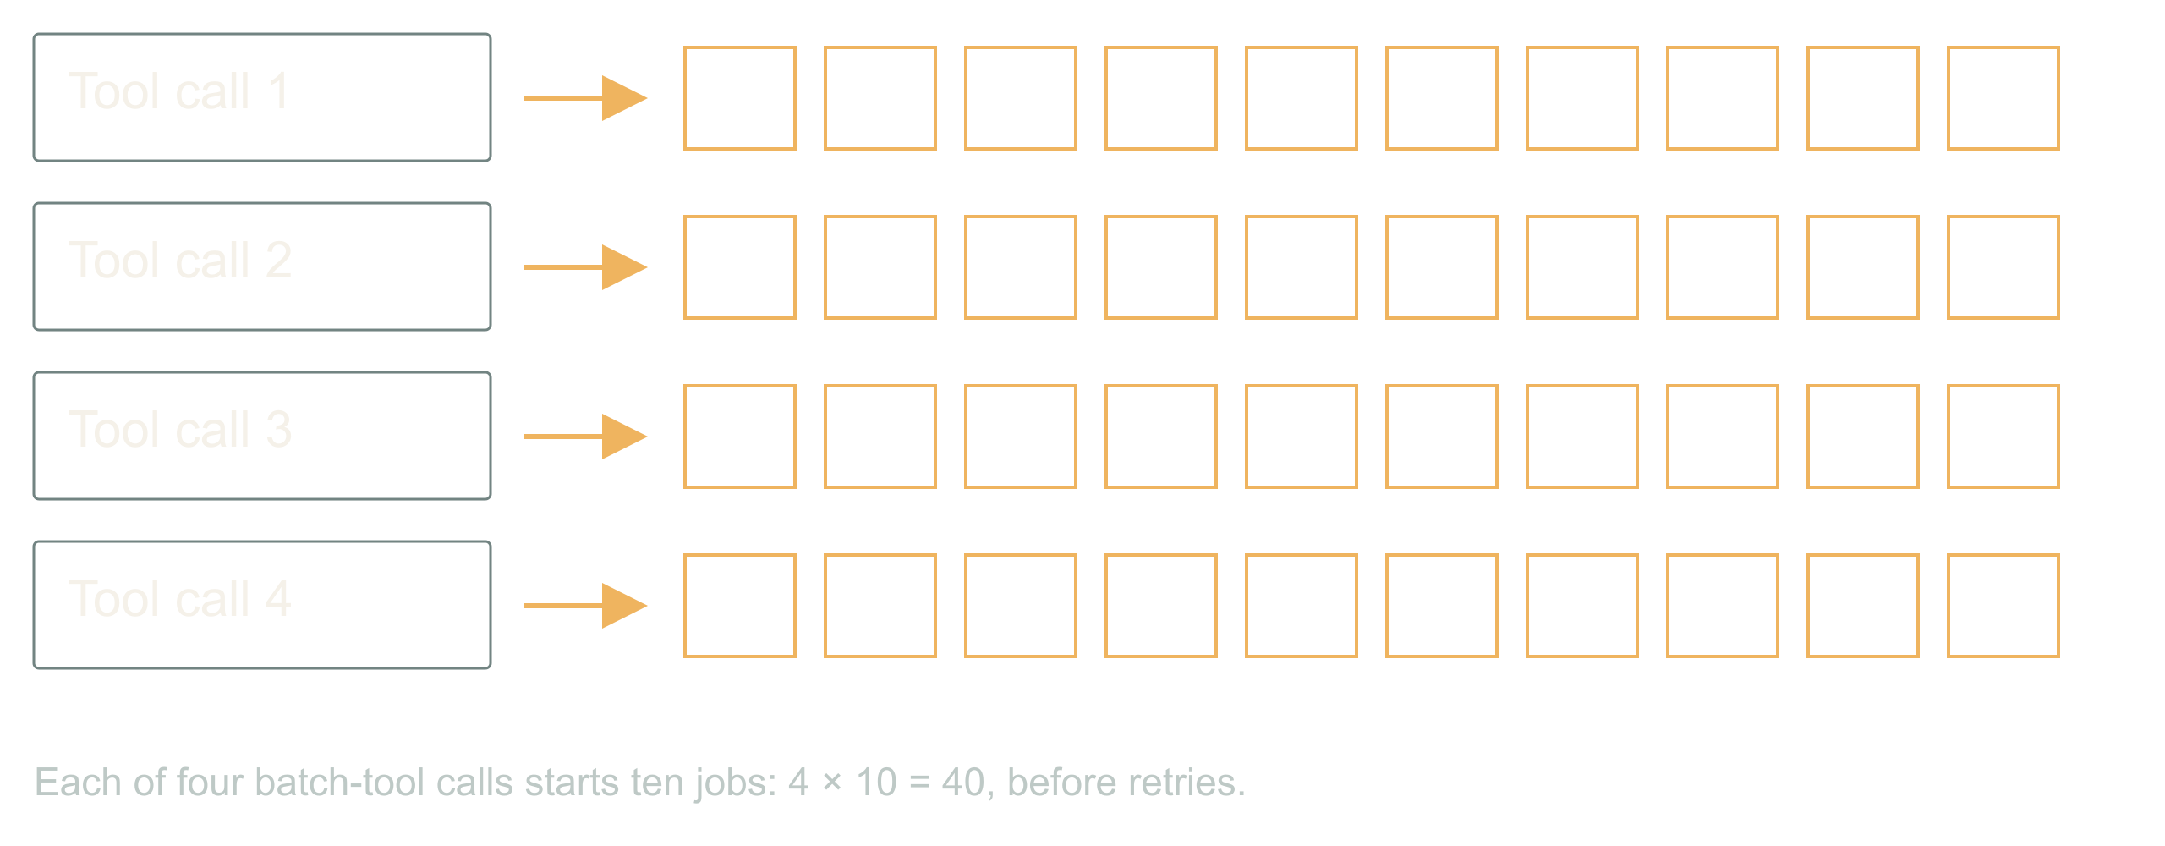
01 / 14 SOURCE SLIDE 1
Four callers, forty images, one customer
A chat turn, a retry, a cron job, a second tab
Each legal. Each ten images.
The customer bought ten.
A customer asks for ten images. Four things happen
within a minute, and every one of them is legitimate.
The chat turn calls the batch tool. A worker crashed
halfway and its replacement retries. A nightly job
re-runs anything not marked done. The customer opened
a second tab because the first one looked stuck.
Four callers, ten images each. Every local limit
passed. The provider is rendering forty. Your
dashboard proudly reports four tool calls. We put the
limit on the wrong unit of work.
That is the whole talk in one multiplication. The
agentic part is what comes next: the same system that
hid the fan-out can also ask for its own compute, and
we have to decide what that is allowed to mean.
Numbers here are fixtures; the vendors later are
real.
Dynamic Scaling of Agentic Workloads
2
Notes:
Four callers, forty images, one customer
00:00 to 02:00 · warm
![Each of four batch-tool calls starts ten jobs: 4 × 10 = 40, before retries.](../../reveal-talks/assets/dynamic-scaling/01-four-calls-hide-forty-provider-jobs.svg)
> A chat turn, a retry, a cron job, a second tab
> Each legal. Each ten images.
> The customer bought ten.
A customer asks for ten images. Four things happen within a minute, and every one of them is legitimate. The chat turn calls the batch tool. A worker crashed halfway and its replacement retries. A nightly job re-runs anything not marked done. The customer opened a second tab because the first one looked stuck.
Four callers, ten images each. Every local limit passed. The provider is rendering forty. Your dashboard proudly reports four tool calls. We put the limit on the wrong unit of work.
That is the whole talk in one multiplication. The agentic part is what comes next: the same system that hid the fan-out can also ask for its own compute, and we have to decide what that is allowed to mean. Numbers here are fixtures; the vendors later are real.
Story: The fan-out you found on a bill before you found it in a dashboard.
Stage direction: Let the room multiply before you show forty. Then ask which component knew the customer's entitlement. Silence is the answer.

Slide 3
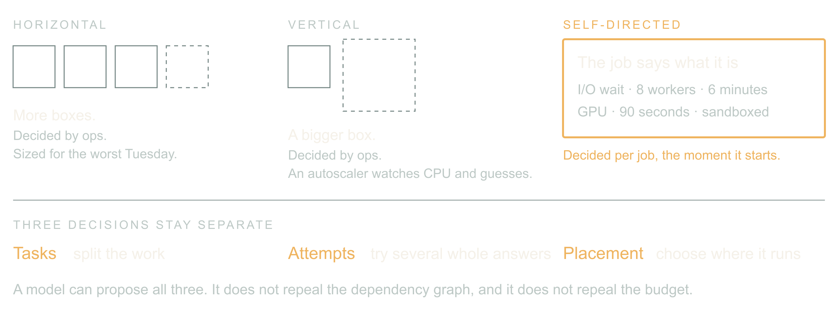
02 / 14 SOURCE SLIDE 2
Horizontal, vertical, and now self-directed
Horizontal: more boxes, decided by ops
Vertical: bigger box, decided by ops
Self-directed: the job describes its shape and asks
For twenty years scaling was an infra question
answered once for everyone. Add replicas or buy a
bigger box, then let an autoscaler watch CPU and
guess. The workload never got a vote.
Agentic workloads can vote. The orchestrator knows
this batch is mostly waiting on a provider, that this
one needs a GPU for ninety seconds, that this one is
untrusted code and wants a sandbox. It can say so,
per job, at the moment the job starts.
Three decisions stay separate. Tasks: split the work.
Attempts: try several complete answers. Placement:
choose where it runs. A model can propose all three
cheaply now; it does not repeal the dependency graph,
and it does not get to repeal the budget.
Dynamic Scaling of Agentic Workloads
3
Notes:
Horizontal, vertical, and now self-directed
02:00 to 05:00 · warm
![Ops sized the fleet for everyone; an autoscaler reacts to CPU; an agentic job describes its own shape and asks.](../../reveal-talks/assets/dynamic-scaling/02-horizontal-vertical-self-directed.svg)
> Horizontal: more boxes, decided by ops
> Vertical: bigger box, decided by ops
> Self-directed: the job describes its shape and asks
For twenty years scaling was an infra question answered once for everyone. Add replicas or buy a bigger box, then let an autoscaler watch CPU and guess. The workload never got a vote.
Agentic workloads can vote. The orchestrator knows this batch is mostly waiting on a provider, that this one needs a GPU for ninety seconds, that this one is untrusted code and wants a sandbox. It can say so, per job, at the moment the job starts.
Three decisions stay separate. Tasks: split the work. Attempts: try several complete answers. Placement: choose where it runs. A model can propose all three cheaply now; it does not repeal the dependency graph, and it does not get to repeal the budget.
Stage direction: Classify an image batch, a route-optimization run, three competing designs and a region move. Note that an LLM can schedule a solver without doing the arithmetic.

Slide 4
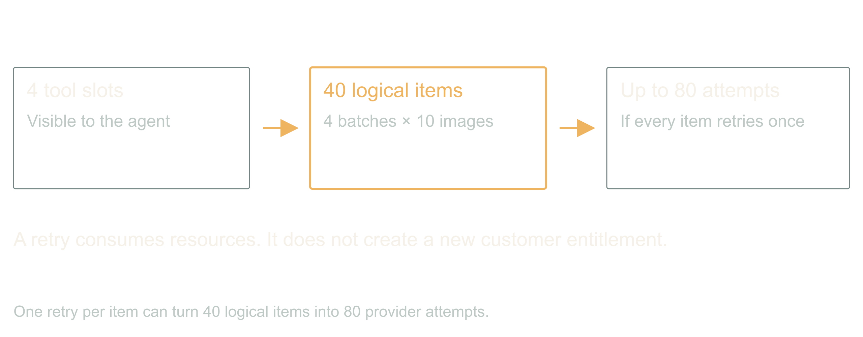
03 / 14 SOURCE SLIDE 3
Count items and attempts, not tool slots
Agent slots ≠ tool batch size ≠ provider attempts ≠
entitlement
A runtime's concurrency limit counts tool calls. A
batch tool multiplies each one. A retry layer
multiplies again. Forty logical items become eighty
provider attempts when every item gets one retry, and
the visible count still says four.
Record logical items and external attempts
separately. A retry is another attempt at an item,
not a new entitlement. And read the batch tool's
actual contract: maximum batch size, resource
estimate, cancellation behavior, what a partial
result looks like.
Dynamic Scaling of Agentic Workloads
4
Notes:
Count items and attempts, not tool slots
05:00 to 07:00 · steady
![One retry per item can turn 40 logical items into 80 provider attempts.](../../reveal-talks/assets/dynamic-scaling/03-count-items-and-attempts-separately.svg)
> Agent slots ≠ tool batch size ≠ provider attempts ≠ entitlement
A runtime's concurrency limit counts tool calls. A batch tool multiplies each one. A retry layer multiplies again. Forty logical items become eighty provider attempts when every item gets one retry, and the visible count still says four.
Record logical items and external attempts separately. A retry is another attempt at an item, not a new entitlement. And read the batch tool's actual contract: maximum batch size, resource estimate, cancellation behavior, what a partial result looks like.
Stage direction: Draw four callers, ten children, one retry layer. Count to eighty out loud.

Slide 5
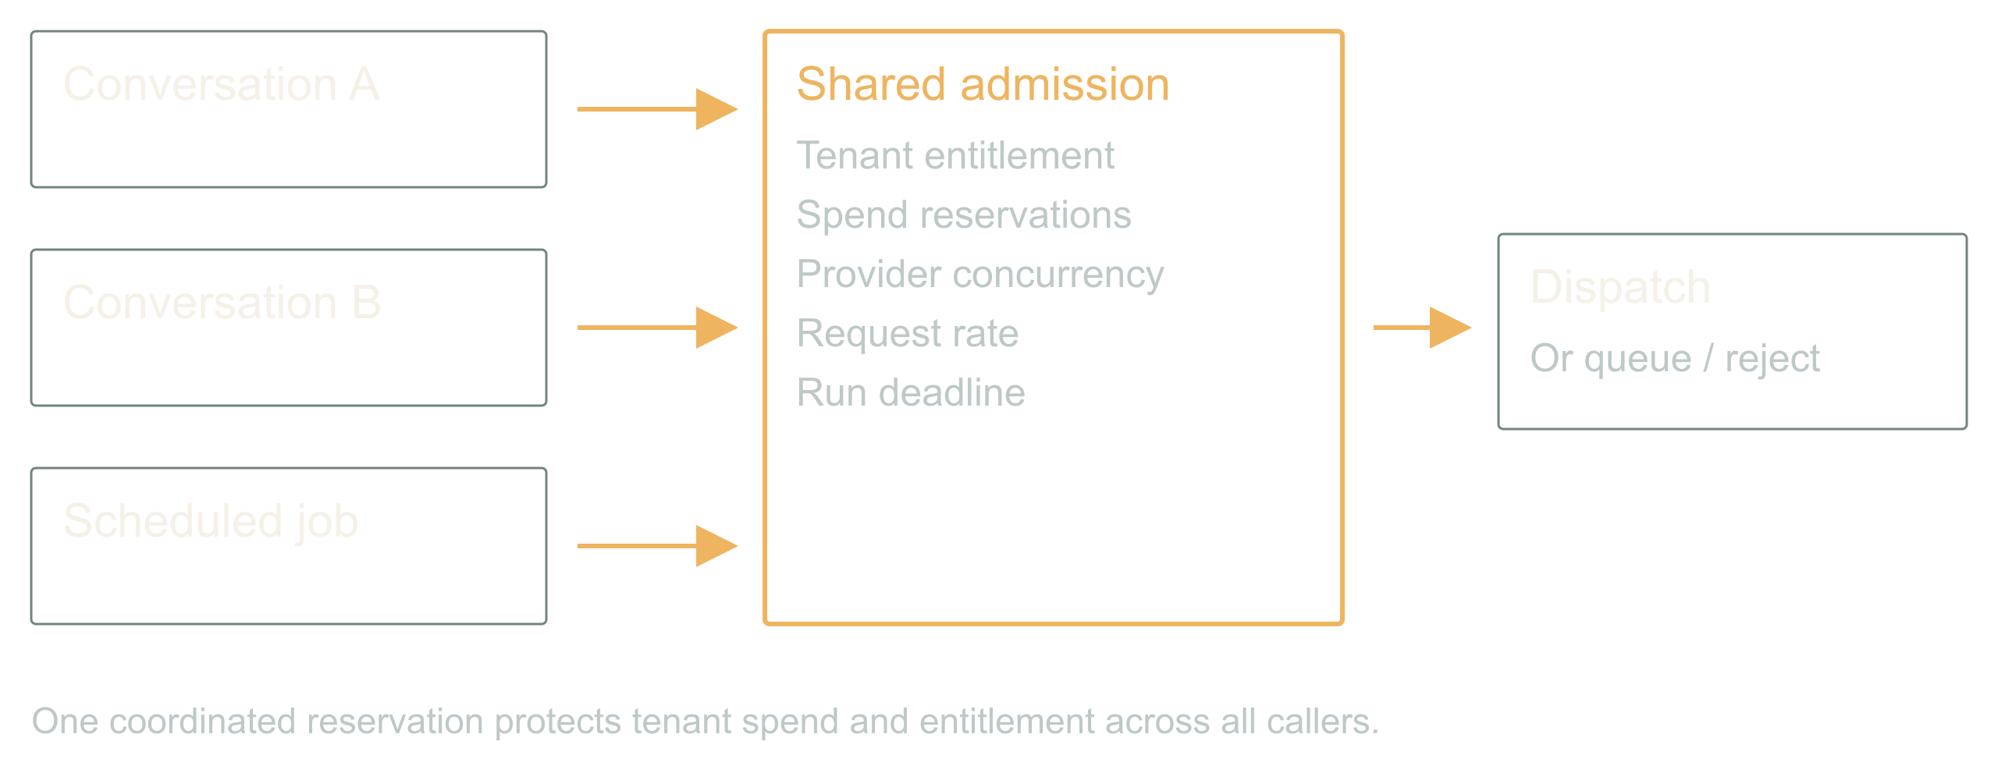
04 / 14 SOURCE SLIDE 4
Put admission below every caller
Reserve before dispatch
Share tenant and provider limits
Queue or reject what does not fit
A prompt that says only run one expensive tool is
guidance. It is not a lock. The chat turn, the retry,
the cron job and the second tab arrive at once, and
none of them can see the others.
So every external dispatch crosses one shared
admission controller. It atomically checks tenant
entitlement, budget, provider concurrency, rate and
deadline, then reserves. If the request does not fit,
it queues or returns an explicit rejection. A
process-local semaphore only works when that process
owns all the work, and in an agentic system it never
does.
Dynamic Scaling of Agentic Workloads
5
Notes:
Put admission below every caller
07:00 to 10:00 · build
![One coordinated reservation protects tenant spend and entitlement across all callers.](../../reveal-talks/assets/dynamic-scaling/04-every-caller-crosses-shared-admission.svg)
> Reserve before dispatch
> Share tenant and provider limits
> Queue or reject what does not fit
A prompt that says only run one expensive tool is guidance. It is not a lock. The chat turn, the retry, the cron job and the second tab arrive at once, and none of them can see the others.
So every external dispatch crosses one shared admission controller. It atomically checks tenant entitlement, budget, provider concurrency, rate and deadline, then reserves. If the request does not fit, it queues or returns an explicit rejection. A process-local semaphore only works when that process owns all the work, and in an agentic system it never does.
Stage direction: Walk two simultaneous callers in contracts.md. Read-balance-then-write loses; atomic reservation admits one.

Slide 6
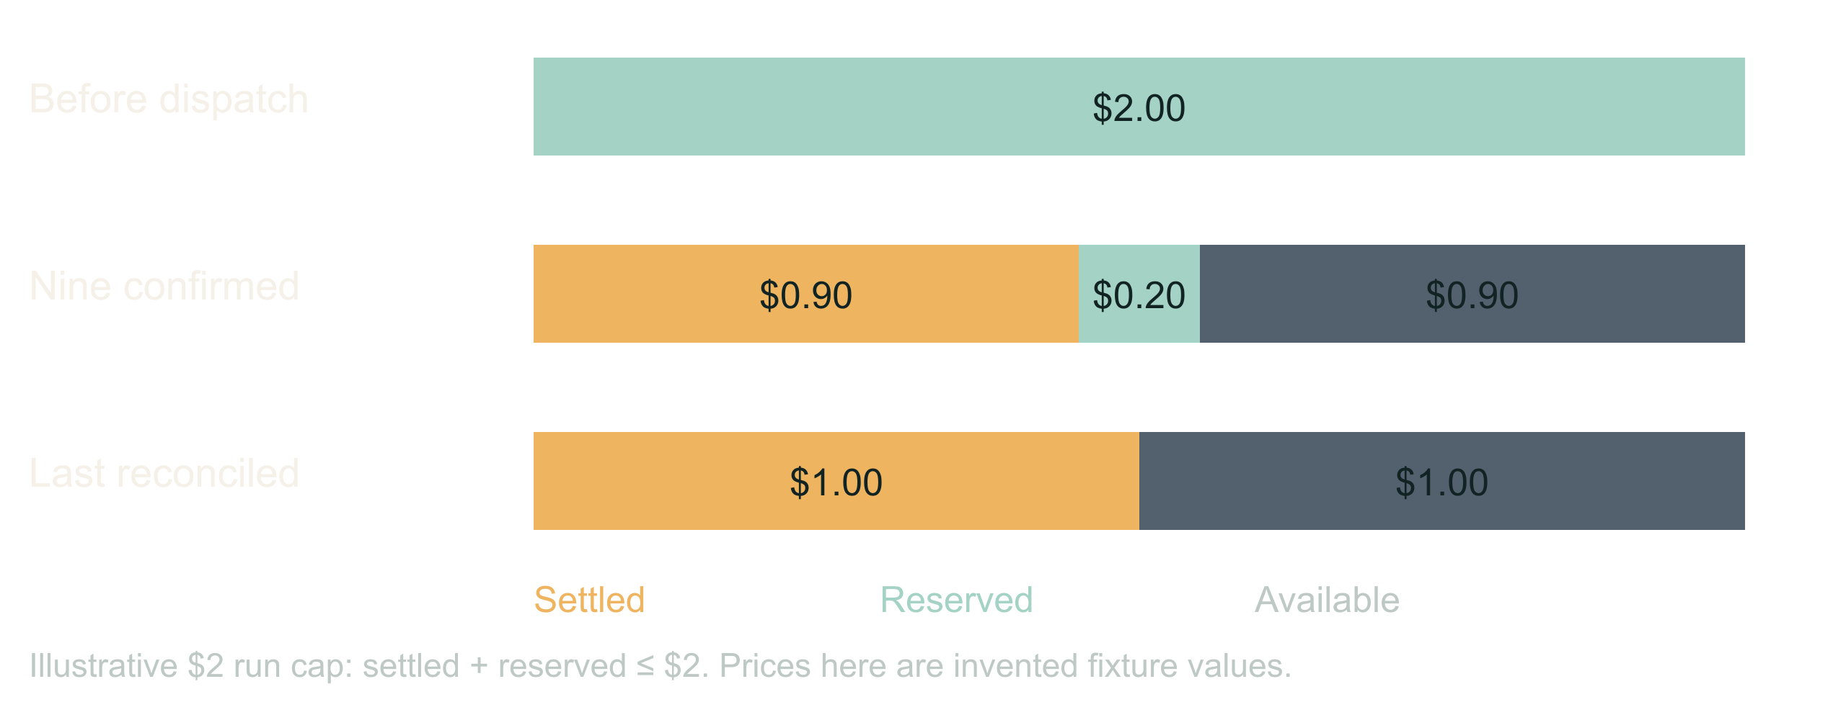
05 / 14 SOURCE SLIDE 5
Money, concurrency and rate are three limits
Concurrency ≠ requests per minute ≠ dollars
Reserved ≠ charged. Cancelled ≠ refunded.
Pessimistic reservations refuse real work; choose
your tightness
You can satisfy any one of these and blow the other
two. Reserve a defensible maximum per operation,
reconcile against the bill when the answer arrives,
and keep unresolved provider jobs charged until you
know. A worker lease expiring proves the worker died,
not that the remote render stopped.
There is a real trade here. Reserve the full retry
allowance up front and a second legitimate caller
gets queued behind money that may never be spent.
Reserve lazily and you can overshoot. Pick a
tightness on purpose and write it down.
Dynamic Scaling of Agentic Workloads
6
Notes:
Money, concurrency and rate are three limits
10:00 to 12:00 · steady
![Illustrative $2 run cap: settled + reserved ≤ $2. Prices here are invented fixture values.](../../reveal-talks/assets/dynamic-scaling/05-reservations-and-charges-share-one-ceiling.svg)
> Concurrency ≠ requests per minute ≠ dollars
> Reserved ≠ charged. Cancelled ≠ refunded.
> Pessimistic reservations refuse real work; choose your tightness
You can satisfy any one of these and blow the other two. Reserve a defensible maximum per operation, reconcile against the bill when the answer arrives, and keep unresolved provider jobs charged until you know. A worker lease expiring proves the worker died, not that the remote render stopped.
There is a real trade here. Reserve the full retry allowance up front and a second legitimate caller gets queued behind money that may never be spent. Reserve lazily and you can overshoot. Pick a tightness on purpose and write it down.
Stage direction: Use the $2 ledger in contracts.md. Show settled plus reserved never passing $2, then ask what the second caller should have seen.

Slide 7
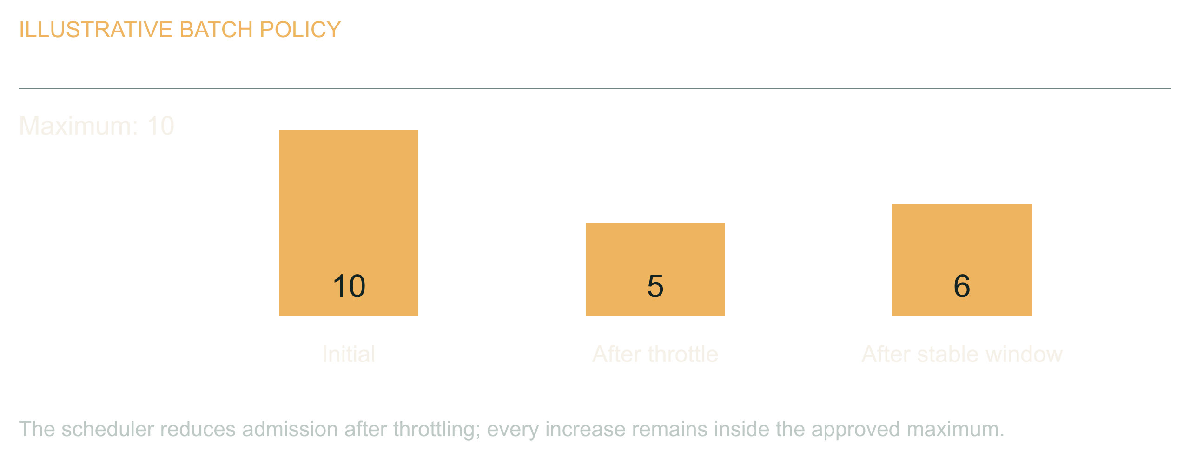
06 / 14 SOURCE SLIDE 6
Adapt pressure inside a fixed ceiling
Throttled → wait and reduce
Healthy window → cautious increase
Deadline → stop dispatch, report honestly
An agent can propose that a batch of ten becomes five
after the provider starts failing. Good. The
scheduler still owns the range. For known throttling,
deterministic policy is enough: respect retry
guidance, add jitter, reduce admission, increase
cautiously after a healthy window. Never let each
worker double its own throughput because its last
call worked.
When the deadline arrives, stop new work and report
completed, pending and unresolved separately. The
user needs an accurate result, not a cheerful
completion message over a pile of missing images.
Dynamic Scaling of Agentic Workloads
7
Notes:
Adapt pressure inside a fixed ceiling
12:00 to 14:00 · steady
![The scheduler reduces admission after throttling; every increase remains inside the approved maximum.](../../reveal-talks/assets/dynamic-scaling/06-adapt-pressure-within-a-fixed-limit.svg)
> Throttled → wait and reduce
> Healthy window → cautious increase
> Deadline → stop dispatch, report honestly
An agent can propose that a batch of ten becomes five after the provider starts failing. Good. The scheduler still owns the range. For known throttling, deterministic policy is enough: respect retry guidance, add jitter, reduce admission, increase cautiously after a healthy window. Never let each worker double its own throughput because its last call worked.
When the deadline arrives, stop new work and report completed, pending and unresolved separately. The user needs an accurate result, not a cheerful completion message over a pile of missing images.
Stage direction: Walk ten to five, then a cautious recovery that never exceeds the original ceiling.

Slide 8
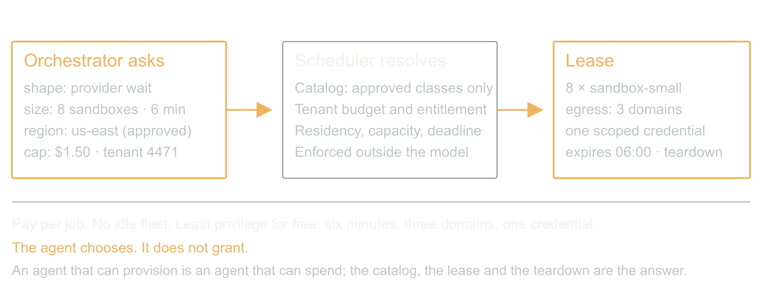
07 / 14 SOURCE SLIDE 7
The inversion: infra as an agent capability
Request: shape, size, duration, region, cost cap
Resolve: catalog, tenant budget, lease
Pay per job. No idle fleet. Least privilege for free.
Here is the part that is actually new. The
orchestrator asks for compute the way it asks for a
tool. Eight sandboxes for six minutes, this region,
this cost cap. The scheduler resolves that against a
catalog of approved classes and the tenant's budget,
and returns a lease with a teardown.
What you get is per-job economics. A customer can buy
a faster turnaround. Finance can cap one workflow
instead of one environment. Nobody pays for a warm
fleet sized for the worst Tuesday of the year. And
least privilege stops being a project: an instance
that lives six minutes, reaches three domains, and
holds one scoped credential is hard to abuse even
when the agent inside it is confused.
Dynamic Scaling of Agentic Workloads
8
Notes:
The inversion: infra as an agent capability
14:00 to 17:00 · peak
![The job requests shape, size, duration and a cost cap; the scheduler resolves it against a catalog and tenant budget and returns a lease.](../../reveal-talks/assets/dynamic-scaling/07-infra-as-an-agent-capability.svg)
> Request: shape, size, duration, region, cost cap
> Resolve: catalog, tenant budget, lease
> Pay per job. No idle fleet. Least privilege for free.
Here is the part that is actually new. The orchestrator asks for compute the way it asks for a tool. Eight sandboxes for six minutes, this region, this cost cap. The scheduler resolves that against a catalog of approved classes and the tenant's budget, and returns a lease with a teardown.
What you get is per-job economics. A customer can buy a faster turnaround. Finance can cap one workflow instead of one environment. Nobody pays for a warm fleet sized for the worst Tuesday of the year. And least privilege stops being a project: an instance that lives six minutes, reaches three domains, and holds one scoped credential is hard to abuse even when the agent inside it is confused.
What you risk is obvious. An agent that can provision is an agent that can spend. The catalog, the lease and the teardown are the answer, and they are enforced outside the model. The agent chooses; it does not grant.
Story: The moment an agent-sized request would have replaced a capacity-planning meeting.
Stage direction: Contrast one autoscaler threshold with one job request. Ask which one you could put on an invoice.

Slide 9
07 / 14 SOURCE SLIDE 7
The inversion: infra as an agent capability
(continued)
What you risk is obvious. An agent that can
provision is an agent that can spend. The
catalog, the lease and the teardown are the
answer, and they are enforced outside the
model. The agent chooses; it does not
grant.
Dynamic Scaling of Agentic Workloads
9
Notes:
The inversion: infra as an agent capability
14:00 to 17:00 · peak
![The job requests shape, size, duration and a cost cap; the scheduler resolves it against a catalog and tenant budget and returns a lease.](../../reveal-talks/assets/dynamic-scaling/07-infra-as-an-agent-capability.svg)
> Request: shape, size, duration, region, cost cap
> Resolve: catalog, tenant budget, lease
> Pay per job. No idle fleet. Least privilege for free.
Here is the part that is actually new. The orchestrator asks for compute the way it asks for a tool. Eight sandboxes for six minutes, this region, this cost cap. The scheduler resolves that against a catalog of approved classes and the tenant's budget, and returns a lease with a teardown.
What you get is per-job economics. A customer can buy a faster turnaround. Finance can cap one workflow instead of one environment. Nobody pays for a warm fleet sized for the worst Tuesday of the year. And least privilege stops being a project: an instance that lives six minutes, reaches three domains, and holds one scoped credential is hard to abuse even when the agent inside it is confused.
What you risk is obvious. An agent that can provision is an agent that can spend. The catalog, the lease and the teardown are the answer, and they are enforced outside the model. The agent chooses; it does not grant.
Story: The moment an agent-sized request would have replaced a capacity-planning meeting.
Stage direction: Contrast one autoscaler threshold with one job request. Ask which one you could put on an invoice.

Slide 10
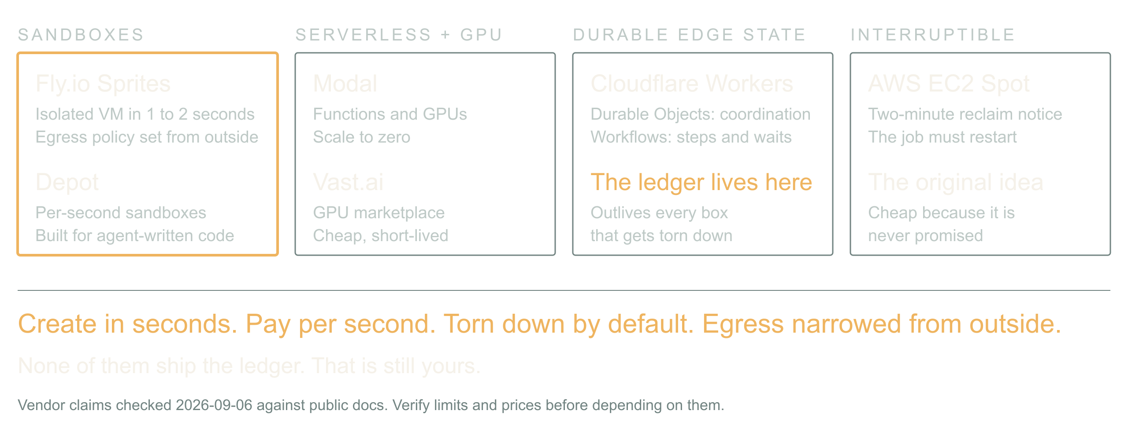
08 / 14 SOURCE SLIDE 8
The ecosystem is already ephemeral by default
Sandboxes: Fly.io Sprites, Depot
Serverless compute and GPUs: Modal, Vast.ai
Durable edge state: Cloudflare Workers, Durable
Objects, Workflows
Interruptible capacity: AWS EC2 Spot
The pieces exist, and they are shaped for this.
Fly.io Sprites are hardware-isolated VMs that create
in a second or two, checkpoint and restore, and take
an egress policy from outside so the agent inside
cannot loosen it. Depot sandboxes bill per second for
exactly this: run agent-generated code, stream
output, throw it away.
Modal gives you functions and GPUs that scale to
zero; Vast.ai is a marketplace where a spare GPU is
cheap and short-lived. Cloudflare Workers with
Durable Objects and Workflows hold the coordination
state that survives everything else being torn down.
EC2 Spot is the old version of the same idea:
capacity that can vanish, so the job had better be
restartable.
Dynamic Scaling of Agentic Workloads
10
Notes:
The ecosystem is already ephemeral by default
17:00 to 20:00 · steady
![Sandboxes, serverless GPUs, durable edge state and spot capacity, all created in seconds and torn down by default.](../../reveal-talks/assets/dynamic-scaling/08-the-ephemeral-ecosystem.svg)
> Sandboxes: Fly.io Sprites, Depot
> Serverless compute and GPUs: Modal, Vast.ai
> Durable edge state: Cloudflare Workers, Durable Objects, Workflows
> Interruptible capacity: AWS EC2 Spot
The pieces exist, and they are shaped for this. Fly.io Sprites are hardware-isolated VMs that create in a second or two, checkpoint and restore, and take an egress policy from outside so the agent inside cannot loosen it. Depot sandboxes bill per second for exactly this: run agent-generated code, stream output, throw it away.
Modal gives you functions and GPUs that scale to zero; Vast.ai is a marketplace where a spare GPU is cheap and short-lived. Cloudflare Workers with Durable Objects and Workflows hold the coordination state that survives everything else being torn down. EC2 Spot is the old version of the same idea: capacity that can vanish, so the job had better be restartable.
The common thread: create in seconds, pay per second, torn down unless someone says otherwise, and the network narrowed from the outside. That is the substrate an agent-directed scheduler needs. What none of them give you is the ledger; that is still yours.
Stage direction: Ask who runs agent code on something with a lifetime under an hour. Then ask who has an egress policy on it.

Slide 11
08 / 14 SOURCE SLIDE 8
The ecosystem is already ephemeral by default
(continued)
The common thread: create in seconds, pay
per second, torn down unless someone says
otherwise, and the network narrowed from
the outside. That is the substrate an
agent-directed scheduler needs. What none
of them give you is the ledger; that is
still yours.
Dynamic Scaling of Agentic Workloads
11
Notes:
The ecosystem is already ephemeral by default
17:00 to 20:00 · steady
![Sandboxes, serverless GPUs, durable edge state and spot capacity, all created in seconds and torn down by default.](../../reveal-talks/assets/dynamic-scaling/08-the-ephemeral-ecosystem.svg)
> Sandboxes: Fly.io Sprites, Depot
> Serverless compute and GPUs: Modal, Vast.ai
> Durable edge state: Cloudflare Workers, Durable Objects, Workflows
> Interruptible capacity: AWS EC2 Spot
The pieces exist, and they are shaped for this. Fly.io Sprites are hardware-isolated VMs that create in a second or two, checkpoint and restore, and take an egress policy from outside so the agent inside cannot loosen it. Depot sandboxes bill per second for exactly this: run agent-generated code, stream output, throw it away.
Modal gives you functions and GPUs that scale to zero; Vast.ai is a marketplace where a spare GPU is cheap and short-lived. Cloudflare Workers with Durable Objects and Workflows hold the coordination state that survives everything else being torn down. EC2 Spot is the old version of the same idea: capacity that can vanish, so the job had better be restartable.
The common thread: create in seconds, pay per second, torn down unless someone says otherwise, and the network narrowed from the outside. That is the substrate an agent-directed scheduler needs. What none of them give you is the ledger; that is still yours.
Stage direction: Ask who runs agent code on something with a lifetime under an hour. Then ask who has an egress policy on it.

Slide 12
09 / 14 SOURCE SLIDE 9
Match the execution class to the work
Waiting on a provider → durable step, not a
GPU
CPU or GPU work → compute worker, spot if
restartable
Untrusted code → sandbox with egress policy
If the provider is rendering the image, you
are waiting on the network. Fifty
containers do not make it render faster.
For long waits, persist state and resume
from callbacks or bounded polling. For real
computation, use a worker sized for it. For
code you did not write, use a sandbox and
take the egress policy seriously.
These combine. The decision that matters is
where execution happens and where recovery
state lives; get those two right and the
vendor list is a detail.
Dynamic Scaling of Agentic Workloads
12
Notes:
Match the execution class to the work
20:00 to 22:00 · steady
> Waiting on a provider → durable step, not a GPU
> CPU or GPU work → compute worker, spot if restartable
> Untrusted code → sandbox with egress policy
If the provider is rendering the image, you are waiting on the network. Fifty containers do not make it render faster. For long waits, persist state and resume from callbacks or bounded polling. For real computation, use a worker sized for it. For code you did not write, use a sandbox and take the egress policy seriously.
These combine. The decision that matters is where execution happens and where recovery state lives; get those two right and the vendor list is a detail.
Stage direction: Place a local graph solver, a remote image request and an agent-written script into their classes.

Slide 13
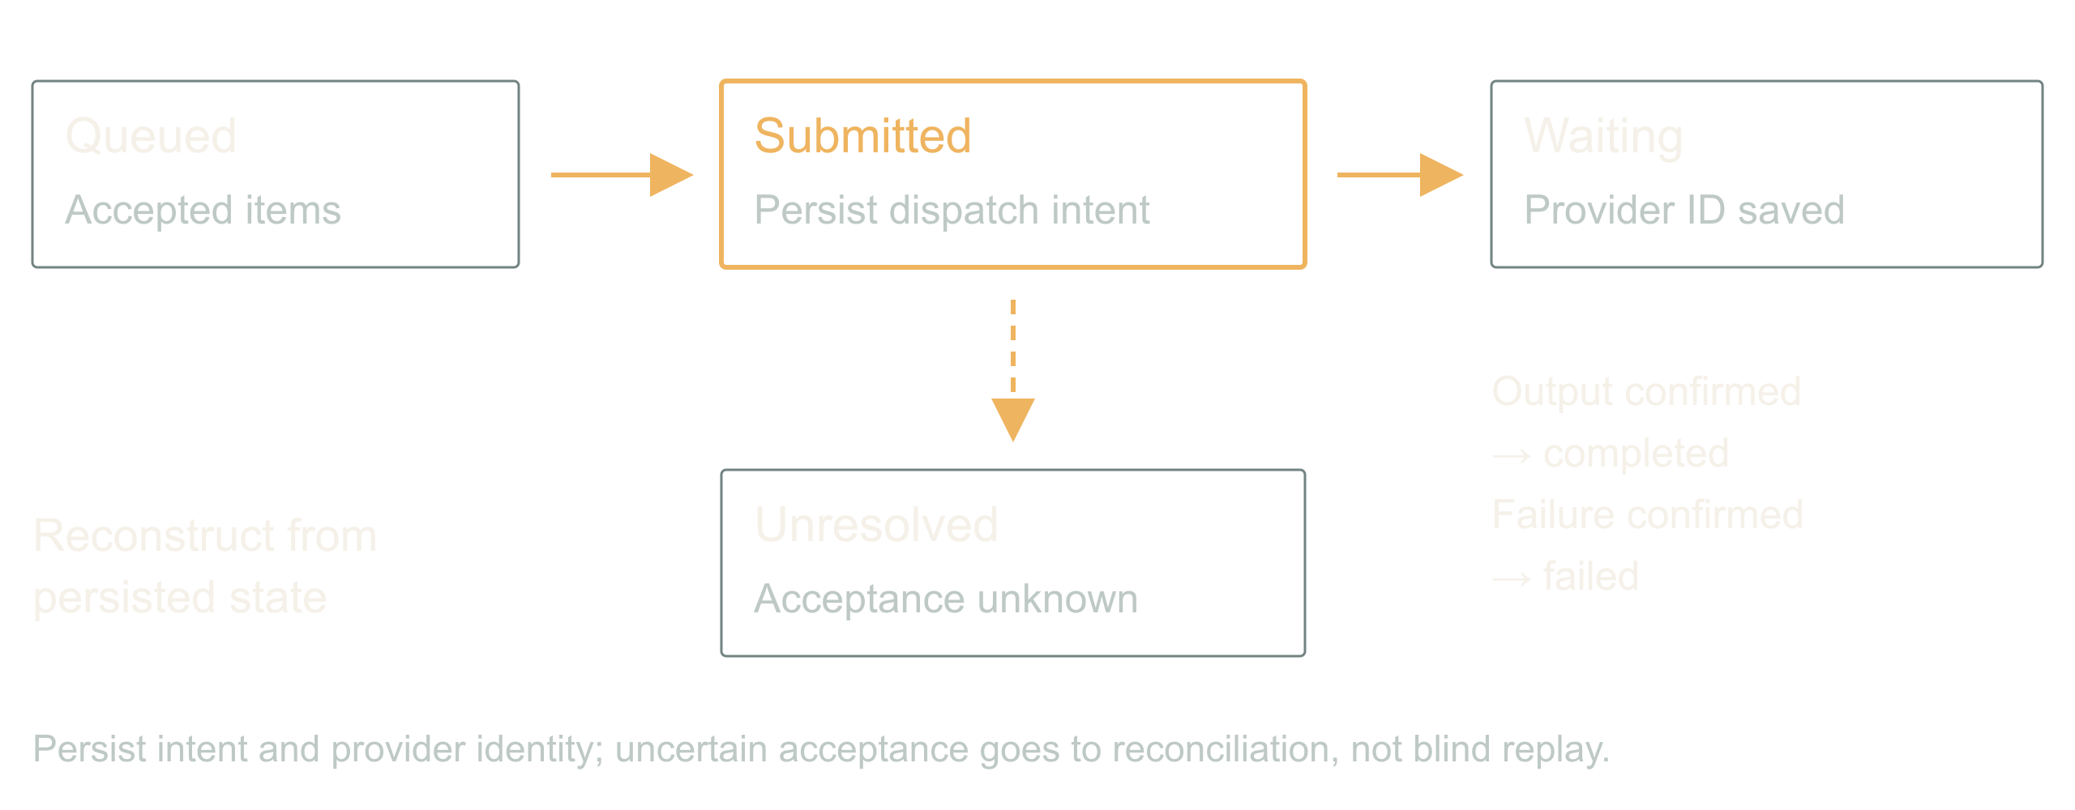
10 / 14 SOURCE SLIDE 10
A durable job survives the caller
accepted → submitted → waiting → completed / failed /
unresolved
Callbacks: authenticate, deduplicate, valid
transitions only
Notification is its own job
Accept ten prompts, return a stable job ID, persist
item IDs, provider IDs, reservations, attempts,
output locations and terminal states. The
conversation can end. The sandbox can be reclaimed.
The job continues.
Callbacks arrive twice and out of order;
authenticate, deduplicate, apply only valid
transitions. A restart rebuilds pending work from
storage, not from replaying the conversation. And
when the output is stored, enqueue the notification
through an outbox so an email failure never
regenerates an image. Naming something durable does
not make an in-flight promise survive a lifecycle
transition; the recovery protocol is yours to write.
Dynamic Scaling of Agentic Workloads
13
Notes:
A durable job survives the caller
22:00 to 25:00 · build
![Persist intent and provider identity; uncertain acceptance goes to reconciliation, not blind replay.](../../reveal-talks/assets/dynamic-scaling/08-a-job-survives-the-caller.svg)
> accepted → submitted → waiting → completed / failed / unresolved
> Callbacks: authenticate, deduplicate, valid transitions only
> Notification is its own job
Accept ten prompts, return a stable job ID, persist item IDs, provider IDs, reservations, attempts, output locations and terminal states. The conversation can end. The sandbox can be reclaimed. The job continues.
Callbacks arrive twice and out of order; authenticate, deduplicate, apply only valid transitions. A restart rebuilds pending work from storage, not from replaying the conversation. And when the output is stored, enqueue the notification through an outbox so an email failure never regenerates an image. Naming something durable does not make an in-flight promise survive a lifecycle transition; the recovery protocol is yours to write.
Stage direction: Draw the state machine in contracts.md. Crash after submission and before the provider ID is saved. Discuss unresolved.

Slide 14
11 / 14 SOURCE SLIDE 11
Walkthrough: restart the batch
Two callers, one entitlement
Spot instance reclaimed mid-batch
One response lost, one email fails
Two callers each want a full batch. The
first reserves the entitlement; the second
queues with an explicit reason. Dispatch
begins on a spot worker. Halfway through,
the instance is reclaimed with two minutes'
notice: the lease expires, the provider
keeps rendering, the reservations stay
charged.
A new worker reloads the job, checks
provider status for every submitted item,
and collects what finished. One item's
response never arrived; it stays unresolved
with its reservation held, and the worker
asks the provider rather than resubmitting.
All outputs land. The email fails. The
delivery worker retries the email against
the completed job, and the expensive
generation is untouched.
One job, a recoverable lifecycle, honest
accounting, and a compute substrate that
was allowed to disappear under it. That is
the abstraction the batch tool owed us.
Dynamic Scaling of Agentic Workloads
14
Notes:
Walkthrough: restart the batch
25:00 to 30:00 · peak
> Two callers, one entitlement
> Spot instance reclaimed mid-batch
> One response lost, one email fails
Two callers each want a full batch. The first reserves the entitlement; the second queues with an explicit reason. Dispatch begins on a spot worker. Halfway through, the instance is reclaimed with two minutes' notice: the lease expires, the provider keeps rendering, the reservations stay charged.
A new worker reloads the job, checks provider status for every submitted item, and collects what finished. One item's response never arrived; it stays unresolved with its reservation held, and the worker asks the provider rather than resubmitting. All outputs land. The email fails. The delivery worker retries the email against the completed job, and the expensive generation is untouched.
One job, a recoverable lifecycle, honest accounting, and a compute substrate that was allowed to disappear under it. That is the abstraction the batch tool owed us.
Stage direction: Five minutes from demo.md. Ask the room for each next transition before revealing it.

Slide 15
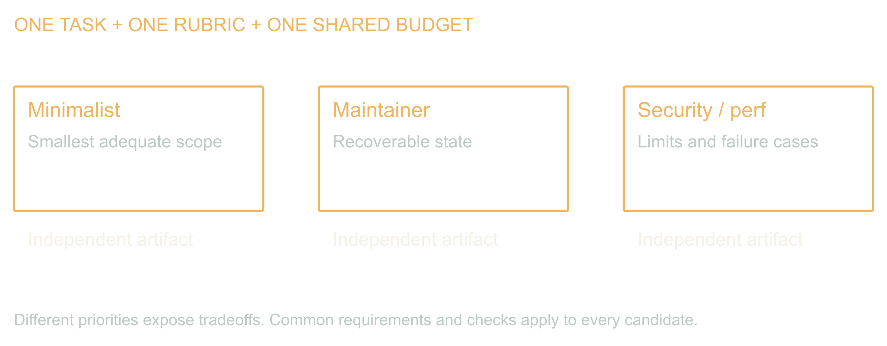
12 / 14 SOURCE SLIDE 12
Attempts are a scaling axis too
Same brief, contrasting priorities, separate first
drafts
Gates before preferences; the judge may reject
everyone
A synthesis is a new candidate
Change the unit of work from images to whole designs.
Give the batch-job problem to three generated agents
with the same requirements and different priorities:
a minimalist, a maintainer, a security and
performance reviewer. Keep first drafts separate so
they do not converge on the first plausible answer.
They can still share a blind spot; the contrast is
the product.
Dynamic Scaling of Agentic Workloads
15
Notes:
Attempts are a scaling axis too
30:00 to 34:00 · build
![Different priorities expose tradeoffs. Common requirements and checks apply to every candidate.](../../reveal-talks/assets/dynamic-scaling/11-independent-attempts-share-requirements.svg)
> Same brief, contrasting priorities, separate first drafts
> Gates before preferences; the judge may reject everyone
> A synthesis is a new candidate
Change the unit of work from images to whole designs. Give the batch-job problem to three generated agents with the same requirements and different priorities: a minimalist, a maintainer, a security and performance reviewer. Keep first drafts separate so they do not converge on the first plausible answer. They can still share a blind spot; the contrast is the product.
That last part is not a hunch, and software engineering settled it forty years ago. Knight and Leveson ran the experiment in 1986: twenty-seven teams wrote the same program from the same specification, independently, and after a million tests the versions failed together far more often than independence predicts. Independently written does not mean independently wrong. Parallel attempts buy you contrast. They do not buy you coverage, and anyone selling you three-model consensus as a correctness argument is selling the assumption that experiment rejected.
Write the gates before reading the candidates: no duplicate dispatch after restart, no cross-tenant spend, no regeneration on notification retry, no dispatch after deadline. Run executable checks first. In the exercise every candidate fails a gate, including the careful one, which is the point: the judge is allowed to reject the room.
Then combine compatible ideas into a new candidate with one coherent set of assumptions and run the gates again. Passing parts do not make a passing whole. Stop at the review budget; an endless debate is an expensive way to not ship.
Source: Knight and Leveson (1986), [An Experimental Evaluation of the Assumption of Independence in Multiversion Programming](https://doi.org/10.1109/TSE.1986.6312924), IEEE Transactions on Software Engineering SE-12(1), 96 to 109.
Stage direction: Score the three candidates in demo.md. Have the room find each candidate's failed gate before revealing it.

Slide 16
12 / 14 SOURCE SLIDE 12
Attempts are a scaling axis too (continued)
That last part is not a hunch, and software
engineering settled it forty years ago.
Knight and Leveson ran the experiment in
1986: twenty-seven teams wrote the same
program from the same specification,
independently, and after a million tests
the versions failed together far more often
than independence predicts. Independently
written does not mean independently wrong.
Parallel attempts buy you contrast. They do
not buy you coverage, and anyone selling
you three-model consensus as a correctness
argument is selling the assumption that
experiment rejected.
Write the gates before reading the
candidates: no duplicate dispatch after
restart, no cross-tenant spend, no
regeneration on notification retry, no
dispatch after deadline. Run executable
checks first. In the exercise every
candidate fails a gate, including the
careful one, which is the point: the judge
is allowed to reject the room.
Then combine compatible ideas into a new
candidate with one coherent set of
assumptions and run the gates again.
Passing parts do not make a passing whole.
Stop at the review budget; an endless
debate is an expensive way to not ship.
Dynamic Scaling of Agentic Workloads
16
Notes:
Attempts are a scaling axis too
30:00 to 34:00 · build
![Different priorities expose tradeoffs. Common requirements and checks apply to every candidate.](../../reveal-talks/assets/dynamic-scaling/11-independent-attempts-share-requirements.svg)
> Same brief, contrasting priorities, separate first drafts
> Gates before preferences; the judge may reject everyone
> A synthesis is a new candidate
Change the unit of work from images to whole designs. Give the batch-job problem to three generated agents with the same requirements and different priorities: a minimalist, a maintainer, a security and performance reviewer. Keep first drafts separate so they do not converge on the first plausible answer. They can still share a blind spot; the contrast is the product.
That last part is not a hunch, and software engineering settled it forty years ago. Knight and Leveson ran the experiment in 1986: twenty-seven teams wrote the same program from the same specification, independently, and after a million tests the versions failed together far more often than independence predicts. Independently written does not mean independently wrong. Parallel attempts buy you contrast. They do not buy you coverage, and anyone selling you three-model consensus as a correctness argument is selling the assumption that experiment rejected.
Write the gates before reading the candidates: no duplicate dispatch after restart, no cross-tenant spend, no regeneration on notification retry, no dispatch after deadline. Run executable checks first. In the exercise every candidate fails a gate, including the careful one, which is the point: the judge is allowed to reject the room.
Then combine compatible ideas into a new candidate with one coherent set of assumptions and run the gates again. Passing parts do not make a passing whole. Stop at the review budget; an endless debate is an expensive way to not ship.
Source: Knight and Leveson (1986), [An Experimental Evaluation of the Assumption of Independence in Multiversion Programming](https://doi.org/10.1109/TSE.1986.6312924), IEEE Transactions on Software Engineering SE-12(1), 96 to 109.
Stage direction: Score the three candidates in demo.md. Have the room find each candidate's failed gate before revealing it.

Slide 17
13 / 14 SOURCE SLIDE 13
Measure the accepted outcome
Latency: dispatch + queue + slowest branch
+ merge + verify
Cost: every candidate, every retry, every
held reservation, review time
Compare against one competent attempt
Starting three workers does not delete the
serial parts. That is Amdahl, 1967, and it
is unkind: if a tenth of the job is serial,
ten workers get you five and a quarter
times, and a hundred workers get you nine.
Waiting on every branch can make a finished
task slower. Count the whole thing: all
candidates, failed work, reserved
uncertainty, judging and human review, and
compare against one competent attempt on
the same task set.
Measure accepted outcomes, not launched
workers. Start with one extra attempt or
one batch boundary; if it does not buy
quality, time or cost, keep the simpler
path. We are trying to buy useful work, not
maximize the number of things blinking.
Dynamic Scaling of Agentic Workloads
17
Notes:
Measure the accepted outcome
34:00 to 37:00 · land
> Latency: dispatch + queue + slowest branch + merge + verify
> Cost: every candidate, every retry, every held reservation, review time
> Compare against one competent attempt
Starting three workers does not delete the serial parts. That is Amdahl, 1967, and it is unkind: if a tenth of the job is serial, ten workers get you five and a quarter times, and a hundred workers get you nine. Waiting on every branch can make a finished task slower. Count the whole thing: all candidates, failed work, reserved uncertainty, judging and human review, and compare against one competent attempt on the same task set.
Measure accepted outcomes, not launched workers. Start with one extra attempt or one batch boundary; if it does not buy quality, time or cost, keep the simpler path. We are trying to buy useful work, not maximize the number of things blinking.
Source: Amdahl (1967), Validity of the single processor approach to achieving large scale computing capabilities, AFIPS Conference Proceedings 30, 483 to 485.
Stage direction: Ninety seconds: choose a baseline, a cap and an acceptance gate. Keep latency and total cost as separate numbers.

Slide 18
14 / 14 SOURCE SLIDE 14
Put the limit where the work begins
One ledger across every caller
Durable state across every restart
A lease on every box, a gate on every
candidate
Back to the four callers. Forty jobs were
legal by four local counters. The missing
piece was one shared account of what the
application had promised and what it had
already started.
The inversion is real: the workload can now
describe its own shape and ask for its own
compute, and the substrate to grant it in
seconds already exists. That is a better
world than a warm fleet and a guess. It is
only safe because the agent chooses from a
catalog, spends from a ledger, and runs on
boxes that expire.
Inspect one expensive tool in your system.
Count the work it can launch underneath
itself. Put the limit where that work
actually begins.
Dynamic Scaling of Agentic Workloads
18
Notes:
Put the limit where the work begins
37:00 to 40:00 · land
> One ledger across every caller
> Durable state across every restart
> A lease on every box, a gate on every candidate
Back to the four callers. Forty jobs were legal by four local counters. The missing piece was one shared account of what the application had promised and what it had already started.
The inversion is real: the workload can now describe its own shape and ask for its own compute, and the substrate to grant it in seconds already exists. That is a better world than a warm fleet and a guess. It is only safe because the agent chooses from a catalog, spends from a ledger, and runs on boxes that expire.
Inspect one expensive tool in your system. Count the work it can launch underneath itself. Put the limit where that work actually begins.
Stage direction: Close on the multiplication and the shared admission line. Do not add a vendor.

Slide 19
SOURCE REFERENCES
References
Knight and Leveson (1986), An Experimental
Evaluation of the Assumption of
Independence in Multiversion Programming —
https://doi.org/10.1109/TSE.1986.6312924),
IEEE Transactions on Software Engineering
SE-12(1, 96 to 109.
Amdahl (1967), Validity of the single
processor approach to achieving large scale
computing capabilities, AFIPS Conference
Proceedings 30, 483 to 485.
Dynamic Scaling of Agentic Workloads
19
Notes:
Knight and Leveson (1986), [An Experimental Evaluation of the Assumption of Independence in Multiversion Programming](https://doi.org/10.1109/TSE.1986.6312924), IEEE Transactions on Software Engineering SE-12(1), 96 to 109.
Amdahl (1967), Validity of the single processor approach to achieving large scale computing capabilities, AFIPS Conference Proceedings 30, 483 to 485.

