Slide 1

Dynamic Scaling of Agentic Workloads · Dan Levy
Four callers, forty images, one customer
Dynamic Scaling of Agentic Workloads
1
Notes:
Dynamic Scaling of Agentic Workloads
Source slide 1. 00:00 to 01:30
A chat turn, a retry, a cron job, a second tab
Each legal. Each ten images.
The customer bought ten.
A customer asks for ten images. Four things happen within a minute, and every one of them is legitimate. The chat turn calls the batch tool. A worker crashed halfway and its replacement retries. A nightly job re-runs anything not marked done. The customer opened a second tab because the first one looked stuck.
Four callers, ten images each. Every local limit passed. The provider is rendering forty. Your dashboard proudly reports four tool calls. We put the limit on the wrong unit of work.
That is the whole talk in one multiplication. The agentic part is what comes next: the same system that hid the fan-out can also ask for its own compute, and we have to decide what that is allowed to mean. Numbers here are fixtures; the vendors later are real.
The fan-out you found on a bill before you found it in a dashboard.
Let the room multiply before you show forty. Then ask which component knew the customer's entitlement. Silence is the answer.

Slide 2

02 / 12 SOURCE SLIDE 2
Horizontal, vertical, and now self-directed
Dynamic Scaling of Agentic Workloads
2
Notes:
Dynamic Scaling of Agentic Workloads
Source slide 2. 01:30 to 04:00
Horizontal: more boxes, decided by ops
Vertical: bigger box, decided by ops
Self-directed: the job describes its shape and asks
For twenty years scaling was an infra question answered once for everyone. Add replicas or buy a bigger box, then let an autoscaler watch CPU and guess. The workload never got a vote.
Agentic workloads can vote. The orchestrator knows this batch is mostly waiting on a provider, that this one needs a GPU for ninety seconds, that this one is untrusted code and wants a sandbox. It can say so, per job, at the moment the job starts.
Three decisions stay separate. Tasks: split the work. Attempts: try several complete answers. Placement: choose where it runs. A model can propose all three cheaply now; it does not repeal the dependency graph, and it does not get to repeal the budget.
Classify an image batch, a route-optimization run, three competing designs and a region move. Note that an LLM can schedule a solver without doing the arithmetic.

Slide 3

03 / 12 SOURCE SLIDE 3
Count items and attempts, not tool slots
Dynamic Scaling of Agentic Workloads
3
Notes:
Dynamic Scaling of Agentic Workloads
Source slide 3. 04:00 to 05:30
Agent slots ≠ tool batch size ≠ provider attempts ≠ entitlement
A runtime's concurrency limit counts tool calls. A batch tool multiplies each one. A retry layer multiplies again. Forty logical items become eighty provider attempts when every item gets one retry, and the visible count still says four.
Record logical items and external attempts separately. A retry is another attempt at an item, not a new entitlement. And read the batch tool's actual contract: maximum batch size, resource estimate, cancellation behavior, what a partial result looks like.
Draw four callers, ten children, one retry layer. Count to eighty out loud.

Slide 4

04 / 12 SOURCE SLIDE 4
Put admission below every caller
Dynamic Scaling of Agentic Workloads
4
Notes:
Dynamic Scaling of Agentic Workloads
Source slide 4. 05:30 to 08:00
Reserve before dispatch
Share tenant and provider limits
Queue or reject what does not fit
A prompt that says only run one expensive tool is guidance. It is not a lock. The chat turn, the retry, the cron job and the second tab arrive at once, and none of them can see the others.
So every external dispatch crosses one shared admission controller. It atomically checks tenant entitlement, budget, provider concurrency, rate and deadline, then reserves. If the request does not fit, it queues or returns an explicit rejection. A process-local semaphore only works when that process owns all the work, and in an agentic system it never does.
Walk two simultaneous callers in contracts.md. Read-balance-then-write loses; atomic reservation admits one.

Slide 5
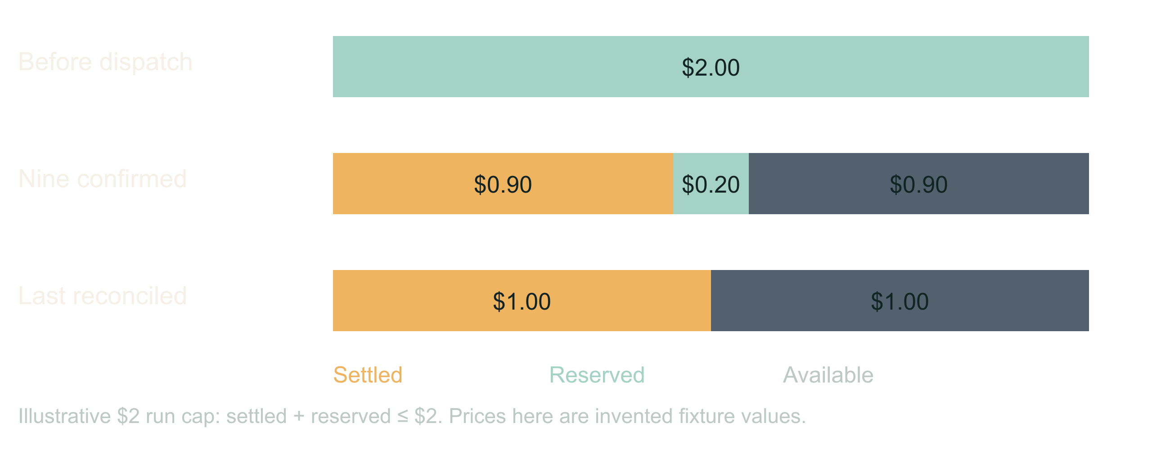
05 / 12 SOURCE SLIDE 5
Money, concurrency and rate are three limits
Dynamic Scaling of Agentic Workloads
5
Notes:
Dynamic Scaling of Agentic Workloads
Source slide 5. 08:00 to 09:30
Concurrency ≠ requests per minute ≠ dollars
Reserved ≠ charged. Cancelled ≠ refunded.
Pessimistic reservations refuse real work; choose your tightness
You can satisfy any one of these and blow the other two. Reserve a defensible maximum per operation, reconcile against the bill when the answer arrives, and keep unresolved provider jobs charged until you know. A worker lease expiring proves the worker died, not that the remote render stopped.
There is a real trade here. Reserve the full retry allowance up front and a second legitimate caller gets queued behind money that may never be spent. Reserve lazily and you can overshoot. Pick a tightness on purpose and write it down.
Use the $2 ledger in contracts.md. Show settled plus reserved never passing $2, then ask what the second caller should have seen.
Bridge: a scheduler can lower pressure after throttling without ever raising the ceiling; that policy is deterministic code, not a prompt.

Slide 6

06 / 12 SOURCE SLIDE 7
The inversion: infra as an agent capability
Dynamic Scaling of Agentic Workloads
6
Notes:
Dynamic Scaling of Agentic Workloads
Source slide 7. 09:30 to 12:30
Request: shape, size, duration, region, cost cap
Resolve: catalog, tenant budget, lease
Pay per job. No idle fleet. Least privilege for free.
Here is the part that is actually new. The orchestrator asks for compute the way it asks for a tool. Eight sandboxes for six minutes, this region, this cost cap. The scheduler resolves that against a catalog of approved classes and the tenant's budget, and returns a lease with a teardown.
What you get is per-job economics. A customer can buy a faster turnaround. Finance can cap one workflow instead of one environment. Nobody pays for a warm fleet sized for the worst Tuesday of the year. And least privilege stops being a project: an instance that lives six minutes, reaches three domains, and holds one scoped credential is hard to abuse even when the agent inside it is confused.
What you risk is obvious. An agent that can provision is an agent that can spend. The catalog, the lease and the teardown are the answer, and they are enforced outside the model. The agent chooses; it does not grant.
The moment an agent-sized request would have replaced a capacity-planning meeting.
Contrast one autoscaler threshold with one job request. Ask which one you could put on an invoice.

Slide 7
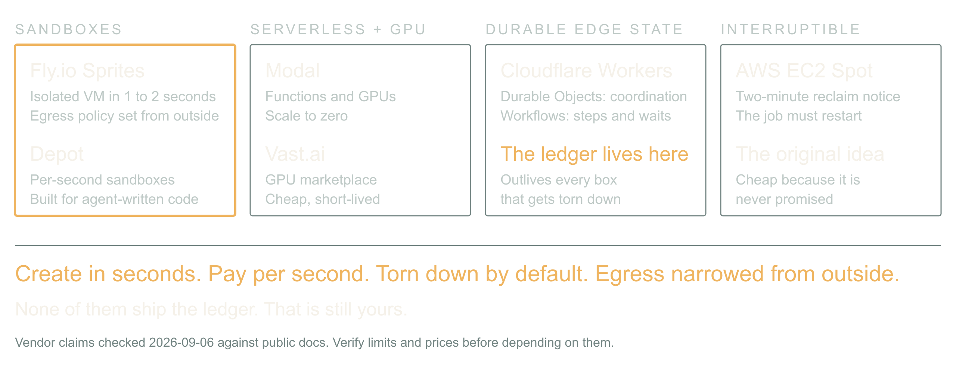
07 / 12 SOURCE SLIDE 8
The ecosystem is already ephemeral by default
Dynamic Scaling of Agentic Workloads
7
Notes:
Dynamic Scaling of Agentic Workloads
Source slide 8. 12:30 to 15:00
Sandboxes: Fly.io Sprites, Depot
Serverless compute and GPUs: Modal, Vast.ai
Durable edge state: Cloudflare Workers, Durable Objects, Workflows
Interruptible capacity: AWS EC2 Spot
The pieces exist, and they are shaped for this. Fly.io Sprites are hardware-isolated VMs that create in a second or two, checkpoint and restore, and take an egress policy from outside so the agent inside cannot loosen it. Depot sandboxes bill per second for exactly this: run agent-generated code, stream output, throw it away.
Modal gives you functions and GPUs that scale to zero; Vast.ai is a marketplace where a spare GPU is cheap and short-lived. Cloudflare Workers with Durable Objects and Workflows hold the coordination state that survives everything else being torn down. EC2 Spot is the old version of the same idea: capacity that can vanish, so the job had better be restartable.
The common thread: create in seconds, pay per second, torn down unless someone says otherwise, and the network narrowed from the outside. That is the substrate an agent-directed scheduler needs. What none of them give you is the ledger; that is still yours.
Ask who runs agent code on something with a lifetime under an hour. Then ask who has an egress policy on it.
Bridge: match the execution class to the work; waiting on a provider needs a durable step, not a GPU.

Slide 8

08 / 12 SOURCE SLIDE 10
A durable job survives the caller
Dynamic Scaling of Agentic Workloads
8
Notes:
Dynamic Scaling of Agentic Workloads
Source slide 10. 15:00 to 17:30
accepted → submitted → waiting → completed / failed / unresolved
Callbacks: authenticate, deduplicate, valid transitions only
Notification is its own job
Accept ten prompts, return a stable job ID, persist item IDs, provider IDs, reservations, attempts, output locations and terminal states. The conversation can end. The sandbox can be reclaimed. The job continues.
Callbacks arrive twice and out of order; authenticate, deduplicate, apply only valid transitions. A restart rebuilds pending work from storage, not from replaying the conversation. And when the output is stored, enqueue the notification through an outbox so an email failure never regenerates an image. Naming something durable does not make an in-flight promise survive a lifecycle transition; the recovery protocol is yours to write.
Draw the state machine in contracts.md. Crash after submission and before the provider ID is saved. Discuss unresolved.

Slide 9
09 / 12 SOURCE SLIDE 11
Walkthrough: restart the batch
01
Two callers, one entitlement
02
Spot instance reclaimed mid-batch
03
One response lost, one email fails
Dynamic Scaling of Agentic Workloads
9
Notes:
Dynamic Scaling of Agentic Workloads
Source slide 11. 17:30 to 21:30
Two callers, one entitlement
Spot instance reclaimed mid-batch
One response lost, one email fails
Two callers each want a full batch. The first reserves the entitlement; the second queues with an explicit reason. Dispatch begins on a spot worker. Halfway through, the instance is reclaimed with two minutes' notice: the lease expires, the provider keeps rendering, the reservations stay charged.
A new worker reloads the job, checks provider status for every submitted item, and collects what finished. One item's response never arrived; it stays unresolved with its reservation held, and the worker asks the provider rather than resubmitting. All outputs land. The email fails. The delivery worker retries the email against the completed job, and the expensive generation is untouched.
One job, a recoverable lifecycle, honest accounting, and a compute substrate that was allowed to disappear under it. That is the abstraction the batch tool owed us.
Five minutes from demo.md. Ask the room for each next transition before revealing it.

Slide 10
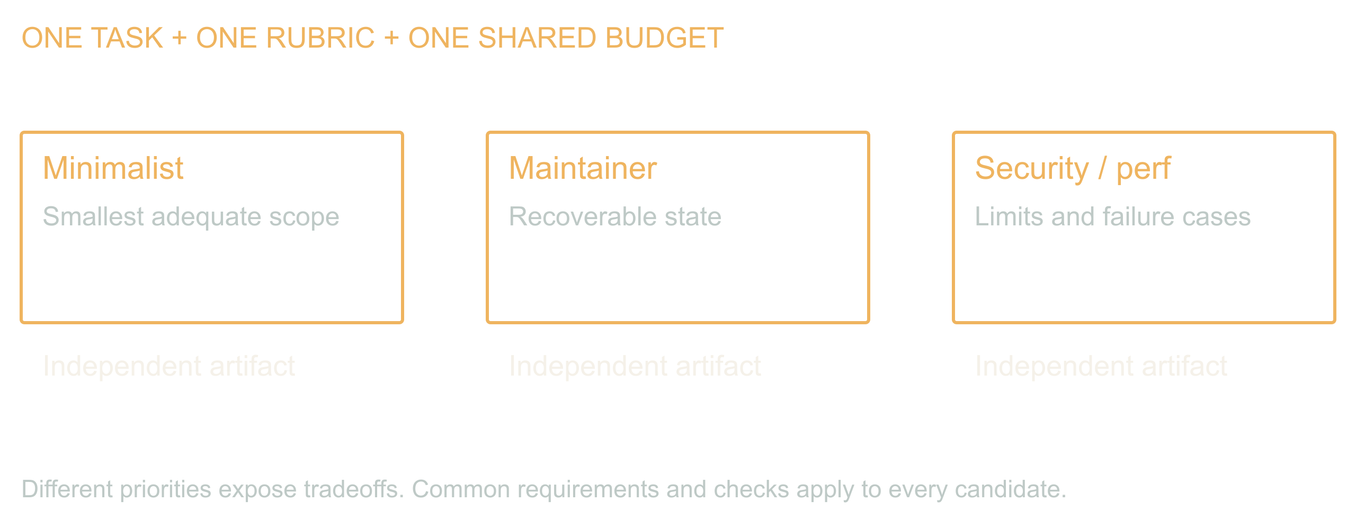
10 / 12 SOURCE SLIDE 12
Attempts are a scaling axis. So is judging.
Dynamic Scaling of Agentic Workloads
10
Notes:
Dynamic Scaling of Agentic Workloads
Source slide 12. 21:30 to 26:00
Barrel of monkeys: lead with cheap parallel generation, on purpose
Council of guards: judges read a thousand tokens and write fifty; measure the disagreement
Gates before preferences; the judge may reject everyone
Change the unit of work from images to whole designs. Give the batch-job problem to three generated agents with the same requirements and different priorities: a minimalist, a maintainer, a security and performance reviewer. Keep first drafts separate so they do not converge on the first plausible answer. The contrast is the product.
Somebody is going to cite Knight and Leveson at me, so let me do it first. 1986, twenty-seven teams, one specification, a million tests, and the independently written versions failed together far more than independence predicts. True, important, and about N-version programming as a correctness strategy. That is not what this is. I am not voting three models toward the truth, and I am not going to tell you the ensemble is right because it agreed with itself. If that is the pitch you heard, it is not mine.
Here is what parallel attempts actually buy. Understanding of the models you depend on: run one brief through two of them and you learn what each reaches for and what each forgets. A migration harness: same brief, new model, diff the behavior before you switch, instead of after the incident. Better output: a synthesis of compatible ideas is often better than any single draft. And the cheap one, which is the one I care about: judging. A judge reads a thousand tokens and writes fifty. Output is what costs, so you can afford three or five judges from different models on every candidate, and the number you want back is not the average score. It is the disagreement. When the judges split or their reasons barely overlap, that candidate is sitting in territory nobody understands, and that is the one you do not ship on autopilot. I call this the Council of Guards. It picks between one and three alternatives to generate, and it costs a fraction of the generation it is guarding.
The generation side has a name too, and I am not sorry about it: the barrel-of-monkeys maneuver. Lead with parallel generation on purpose. You are adding a controlled section of chaos that the next stage has to handle: a revision loop, a router, the council, or your users in an A/B test. Why you would want the chaos varies. Sometimes you want the fastest answer, so you race. Sometimes you want the best parts of several, so a frontier model, whose input tokens are the cheap ones, reads all of them and writes one coherent output. Sometimes you just want more candidates for the judges to rank so the best whole answer goes downstream. In law or medicine, where the rules are extensive and specific, that is how you catch the one errant mistake that shows up in one output out of ten. And the monkeys can be cheap: models at a hundredth or a thousandth the price of the frontier, generating alternatives in a loop. Some of them need a tool-calling agent with files, search and git, which means a sandbox and somebody's cloud; others single-shot it fine. That is an architecture question about how much effort you want in a system that keeps improving versus one you can retune at runtime. Fan-out is a tool you encapsulate at points in the graph: default model most of the time, n alternatives for a sample of requests. Your needs and your opportunities decide why, where and how often.
Does this border on speculative optimization dressed up as learning? Yes, possibly. Probably sometimes. We will find out. So do not build any of it without env vars to turn it down, and ideally build the system that adjusts its own fan-out and token burn from what it measures. Right? Right. That system is the companion talk.
Write the gates before reading the candidates: no duplicate dispatch after restart, no cross-tenant spend, no regeneration on notification retry, no dispatch after deadline. Run executable checks first. In the exercise every candidate fails a gate, including the careful one, which is the point: the council is allowed to reject the room. Then combine compatible ideas into a new candidate with one coherent set of assumptions and run the gates again. Passing parts do not make a passing whole. Stop at the review budget; an endless debate is an expensive way to not ship.
None of this looks like the engineering we were raised on. Do not do the work twice. Do not spend compute speculatively. One right answer per ticket. Those were axioms when the expensive thing was the engineer. When the expensive thing is being wrong, and a second draft costs cents, doing it three times and reading what disagrees is the frugal move. I am not a shill for Big Token. I am telling you that cheaper, safer and faster now sometimes come from spending exactly where yesterday's wisdom told you not to.
Knight and Leveson (1986), [An Experimental Evaluation of the Assumption of Independence in Multiversion Programming](https://doi.org/10.1109/TSE.1986.6312924), IEEE Transactions on Software Engineering SE-12(1), 96 to 109. Cited to set aside: it is a result about redundancy as a correctness strategy, which this slide does not claim.
Score the three candidates in demo.md. Have the room find each candidate's failed gate before revealing it. Then show the council split per candidate: high agreement on the minimalist's failure, low overlap on the maintainer's, and ask which one deserves the human's afternoon.

Slide 11
11 / 12 SOURCE SLIDE 13
Measure the accepted outcome
01
Latency: dispatch + queue + slowest branch + merge +
verify
02
Cost: every candidate, every retry, every held
reservation, review time
03
Compare against one competent attempt
Dynamic Scaling of Agentic Workloads
11
Notes:
Dynamic Scaling of Agentic Workloads
Source slide 13. 26:00 to 27:30
Latency: dispatch + queue + slowest branch + merge + verify
Cost: every candidate, every retry, every held reservation, review time
Compare against one competent attempt
Starting three workers does not delete the serial parts. That is Amdahl, 1967, and it is unkind: if a tenth of the job is serial, ten workers get you five and a quarter times, and a hundred workers get you nine. Waiting on every branch can make a finished task slower. Count the whole thing: all candidates, failed work, reserved uncertainty, judging and human review, and compare against one competent attempt on the same task set.
Measure accepted outcomes, not launched workers. Start with one extra attempt or one batch boundary; if it does not buy quality, time or cost, keep the simpler path. We are trying to buy useful work, not maximize the number of things blinking.
Amdahl (1967), Validity of the single processor approach to achieving large scale computing capabilities, AFIPS Conference Proceedings 30, 483 to 485.
Ninety seconds: choose a baseline, a cap and an acceptance gate. Keep latency and total cost as separate numbers.

Slide 12
12 / 12 SOURCE SLIDE 14
Put the limit where the work begins
01
One ledger across every caller
02
Durable state across every restart
03
A lease on every box, a gate on every candidate
Dynamic Scaling of Agentic Workloads
12
Notes:
Dynamic Scaling of Agentic Workloads
Source slide 14. 27:30 to 30:00
One ledger across every caller
Durable state across every restart
A lease on every box, a gate on every candidate
Back to the four callers. Forty jobs were legal by four local counters. The missing piece was one shared account of what the application had promised and what it had already started.
The inversion is real: the workload can now describe its own shape and ask for its own compute, and the substrate to grant it in seconds already exists. That is a better world than a warm fleet and a guess. It is only safe because the agent chooses from a catalog, spends from a ledger, and runs on boxes that expire.
Inspect one expensive tool in your system. Count the work it can launch underneath itself. Put the limit where that work actually begins.
Close on the multiplication and the shared admission line. Do not add a vendor.

