Slide 1

Dynamic Scaling of Agentic Workloads · Dan Levy
Four callers, forty images, one customer
Dynamic Scaling of Agentic Workloads
1
Notes:
Four callers, forty images, one customer
00:00 to 02:00 · warm
![Each of four batch-tool calls starts ten jobs: 4 × 10 = 40, before retries.](../../reveal-talks/assets/dynamic-scaling/01-four-calls-hide-forty-provider-jobs.svg)
> A chat turn, a retry, a cron job, a second tab
> Each legal. Each ten images.
> The customer bought ten.
A customer asks for ten images. Four things happen within a minute, and every one of them is legitimate. The chat turn calls the batch tool. A worker crashed halfway and its replacement retries. A nightly job re-runs anything not marked done. The customer opened a second tab because the first one looked stuck.
Four callers, ten images each. Every local limit passed. The provider is rendering forty. Your dashboard proudly reports four tool calls. We put the limit on the wrong unit of work.
That is the whole talk in one multiplication. The agentic part is what comes next: the same system that hid the fan-out can also ask for its own compute, and we have to decide what that is allowed to mean. Numbers here are fixtures; the vendors later are real.
Story: The fan-out you found on a bill before you found it in a dashboard.
Stage direction: Let the room multiply before you show forty. Then ask which component knew the customer's entitlement. Silence is the answer.

Slide 2

02 / 14 SOURCE SLIDE 2
Horizontal, vertical, and now self-directed
Dynamic Scaling of Agentic Workloads
2
Notes:
Horizontal, vertical, and now self-directed
02:00 to 05:00 · warm
![Ops sized the fleet for everyone; an autoscaler reacts to CPU; an agentic job describes its own shape and asks.](../../reveal-talks/assets/dynamic-scaling/02-horizontal-vertical-self-directed.svg)
> Horizontal: more boxes, decided by ops
> Vertical: bigger box, decided by ops
> Self-directed: the job describes its shape and asks
For twenty years scaling was an infra question answered once for everyone. Add replicas or buy a bigger box, then let an autoscaler watch CPU and guess. The workload never got a say.
Agentic workloads do. The orchestrator knows this batch is mostly waiting on a provider, that this one needs a GPU for ninety seconds, that this one is untrusted code and wants a sandbox. It can say so, per job, at the moment the job starts.
Three decisions stay separate. Tasks: split the work. Attempts: try several complete answers. Placement: choose where it runs. A model can propose all three cheaply now; it does not repeal the dependency graph, and it does not get to repeal the budget.
Stage direction: Classify an image batch, a route-optimization run, three competing designs and a region move. Note that an LLM can schedule a solver without doing the arithmetic.

Slide 3

03 / 14 SOURCE SLIDE 3
Count items and attempts, not tool slots
Dynamic Scaling of Agentic Workloads
3
Notes:
Count items and attempts, not tool slots
05:00 to 07:00 · steady
![One retry per item can turn 40 logical items into 80 provider attempts.](../../reveal-talks/assets/dynamic-scaling/03-count-items-and-attempts-separately.svg)
> Agent slots ≠ tool batch size ≠ provider attempts ≠ entitlement
A runtime's concurrency limit counts tool calls. A batch tool multiplies each one. A retry layer multiplies again. Forty logical items become eighty provider attempts when every item gets one retry, and the visible count still says four.
Record logical items and external attempts separately. A retry is another attempt at an item, not a new entitlement. And read the batch tool's actual contract: maximum batch size, resource estimate, cancellation behavior, what a partial result looks like.
Stage direction: Draw four callers, ten children, one retry layer. Count to eighty out loud.

Slide 4

04 / 14 SOURCE SLIDE 4
Put admission below every caller
Dynamic Scaling of Agentic Workloads
4
Notes:
Put admission below every caller
07:00 to 10:00 · build
![One coordinated reservation protects tenant spend and entitlement across all callers.](../../reveal-talks/assets/dynamic-scaling/04-every-caller-crosses-shared-admission.svg)
> Reserve before dispatch
> Share tenant and provider limits
> Queue or reject what does not fit
A prompt that says only run one expensive tool is guidance. It is not a lock. The chat turn, the retry, the cron job and the second tab arrive at once, and none of them can see the others.
So every external dispatch crosses one shared admission controller. It atomically checks tenant entitlement, budget, provider concurrency, rate and deadline, then reserves. If the request does not fit, it queues or returns an explicit rejection. A process-local semaphore only works when that process owns all the work, and in an agentic system it never does.
Stage direction: Walk two simultaneous callers in contracts.md. Read-balance-then-write loses; atomic reservation admits one.

Slide 5
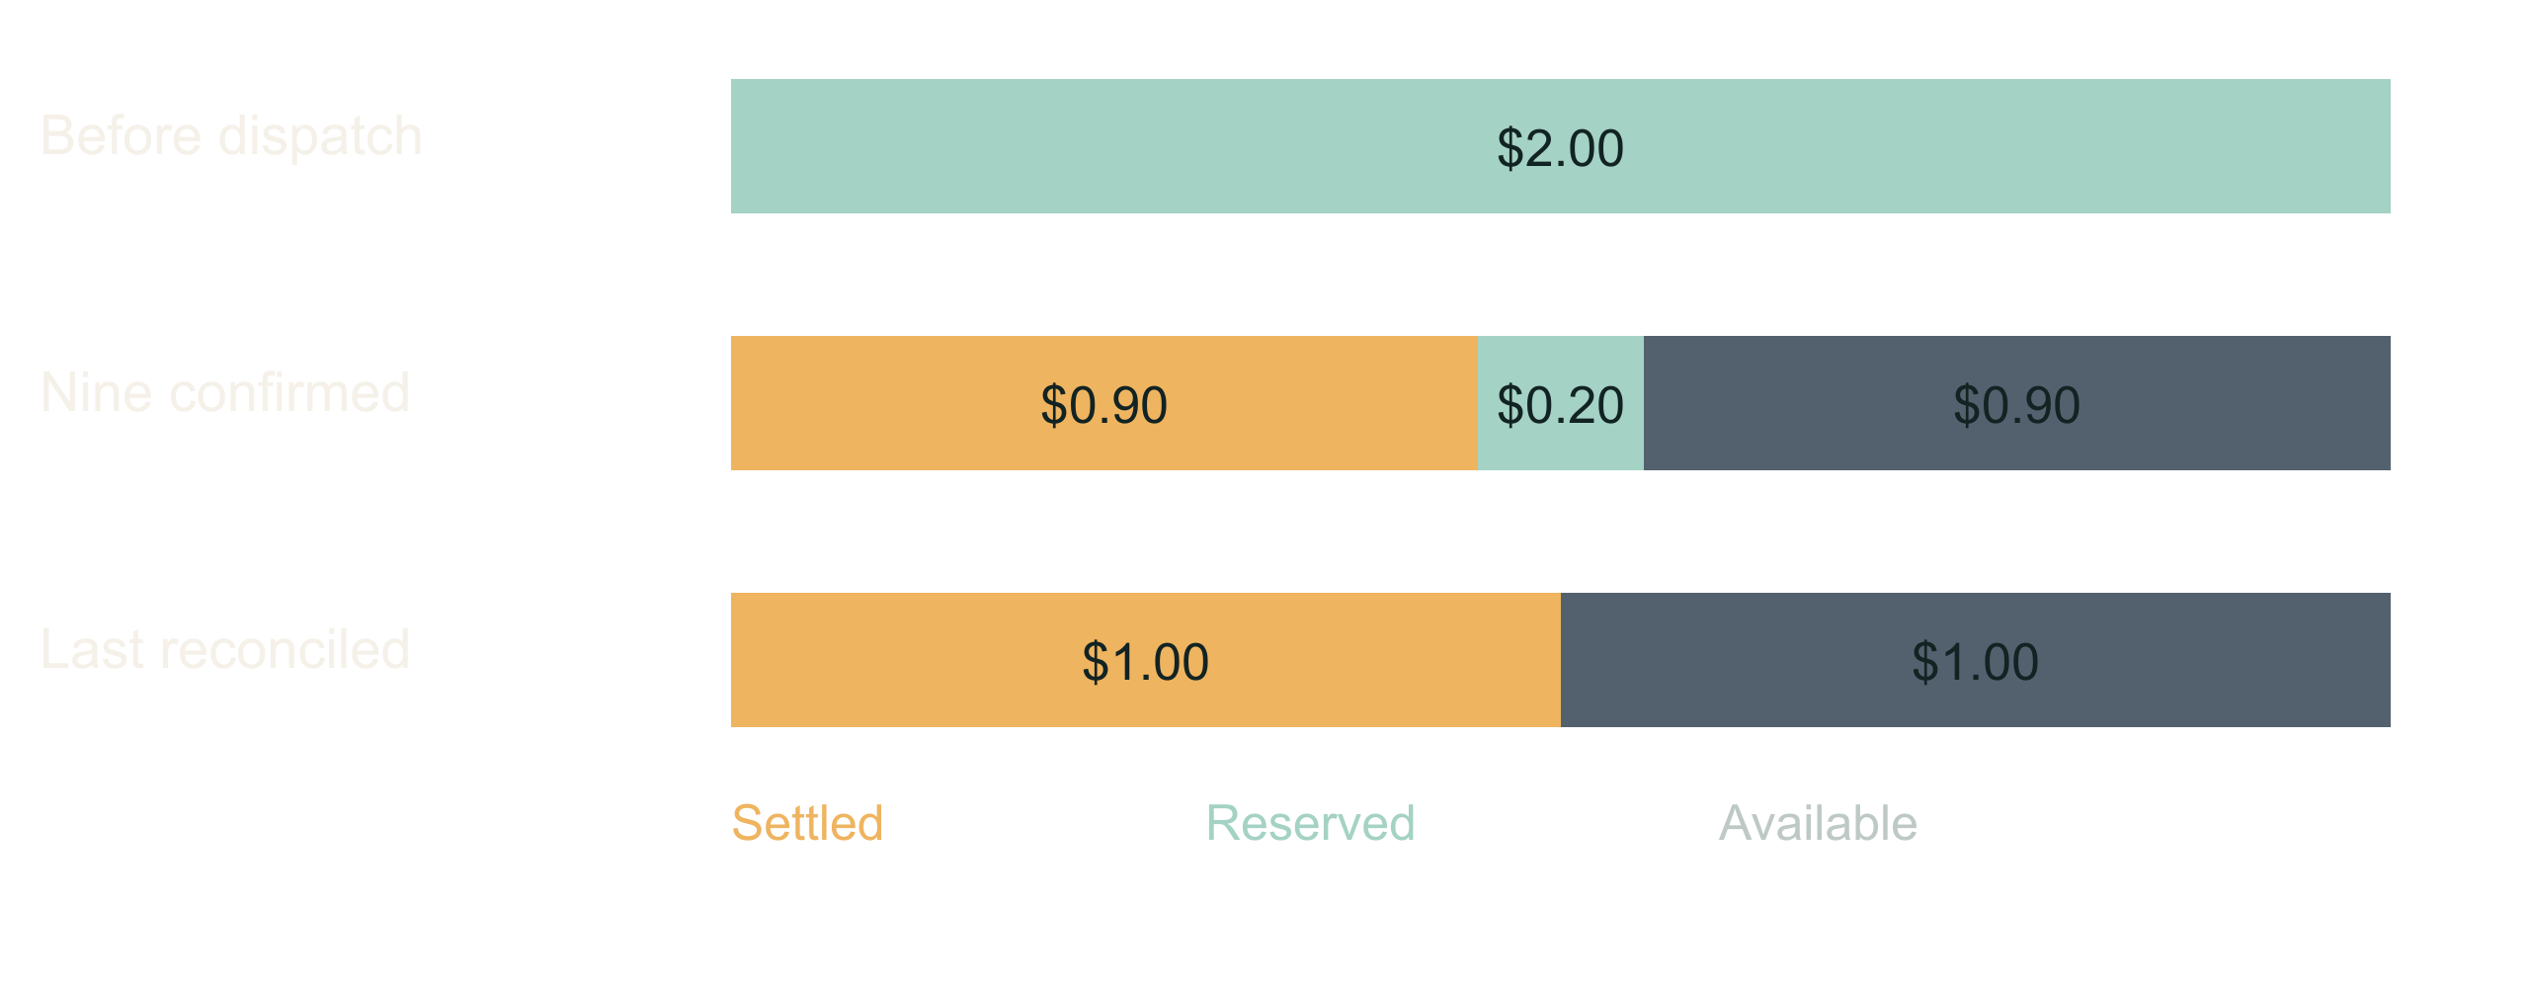
05 / 14 SOURCE SLIDE 5
Money, concurrency and rate are three limits
Dynamic Scaling of Agentic Workloads
5
Notes:
Money, concurrency and rate are three limits
10:00 to 12:00 · steady
![Illustrative $2 run cap: settled + reserved ≤ $2. Prices here are invented fixture values.](../../reveal-talks/assets/dynamic-scaling/05-reservations-and-charges-share-one-ceiling.svg)
> Concurrency ≠ requests per minute ≠ dollars
> Reserved ≠ charged. Cancelled ≠ refunded.
> Pessimistic reservations refuse real work; choose your tightness
You can satisfy any one of these and blow the other two. Reserve a defensible maximum per operation, reconcile against the bill when the answer arrives, and keep unresolved provider jobs charged until you know. A worker lease expiring proves the worker died, not that the remote render stopped.
There is a real trade here. Reserve the full retry allowance up front and a second legitimate caller gets queued behind money that may never be spent. Reserve lazily and you can overshoot. Pick a tightness on purpose and write it down.
Stage direction: Use the $2 ledger in contracts.md. Show settled plus reserved never passing $2, then ask what the second caller should have seen.

Slide 6
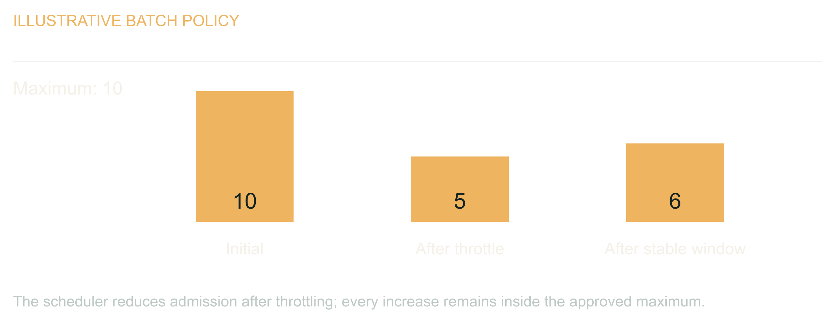
06 / 14 SOURCE SLIDE 6
Adapt pressure inside a fixed ceiling
Dynamic Scaling of Agentic Workloads
6
Notes:
Adapt pressure inside a fixed ceiling
12:00 to 14:00 · steady
![The scheduler reduces admission after throttling; every increase remains inside the approved maximum.](../../reveal-talks/assets/dynamic-scaling/06-adapt-pressure-within-a-fixed-limit.svg)
> Throttled → wait and reduce
> Healthy window → cautious increase
> Deadline → stop dispatch, report honestly
An agent can propose that a batch of ten becomes five after the provider starts failing. Good. The scheduler still owns the range. For known throttling, deterministic policy is enough: respect retry guidance, add jitter, reduce admission, increase cautiously after a healthy window. Never let each worker double its own throughput because its last call worked.
When the deadline arrives, stop new work and report completed, pending and unresolved separately. The user needs an accurate result, not a cheerful completion message over a pile of missing images.
Stage direction: Walk ten to five, then a cautious recovery that never exceeds the original ceiling.

Slide 7

07 / 14 SOURCE SLIDE 7
Infra Is a Tool Call
Dynamic Scaling of Agentic Workloads
7
Notes:
Infra Is a Tool Call
14:00 to 17:00 · peak
![The job requests shape, size, duration and a cost cap; the scheduler resolves it against a catalog and tenant budget and returns a lease.](../../reveal-talks/assets/dynamic-scaling/07-infra-as-an-agent-capability.svg)
> Request: shape, size, duration, region, cost cap
> Resolve: catalog, tenant budget, lease
> Pay per job. No idle fleet. Least privilege for free.
Here is the part that is actually new. The orchestrator asks for compute the way it asks for a tool. Eight sandboxes for six minutes, this region, this cost cap. The scheduler resolves that against a catalog of approved classes and the tenant's budget, and returns a lease with a teardown.
What you get is per-job economics. A customer can buy a faster turnaround. Finance can cap one workflow instead of one environment. Nobody pays for a warm fleet sized for the worst Tuesday of the year. And least privilege stops being a project: an instance that lives six minutes, reaches three domains, and holds one scoped credential is hard to abuse even when the agent inside it is confused.
What you risk is obvious. An agent that can provision is an agent that can spend. The catalog, the lease and the teardown are the answer, and they are enforced outside the model. The agent chooses; it does not grant.
Story: The moment an agent-sized request would have replaced a capacity-planning meeting.
Stage direction: Contrast one autoscaler threshold with one job request. Ask which one you could put on an invoice.

Slide 8

08 / 14 SOURCE SLIDE 8
Torn Down by Default
Dynamic Scaling of Agentic Workloads
8
Notes:
Torn Down by Default
17:00 to 20:00 · steady
![Sandboxes, serverless GPUs, durable edge state and spot capacity, all created in seconds and torn down by default.](../../reveal-talks/assets/dynamic-scaling/08-the-ephemeral-ecosystem.svg)
> Sandboxes: Fly.io Sprites, Depot
> Serverless compute and GPUs: Modal, Vast.ai
> Durable edge state: Cloudflare Workers, Durable Objects, Workflows
> Interruptible capacity: AWS EC2 Spot
The pieces exist, and they are shaped for this. Fly.io Sprites are microVMs whose stated creation target is under a second, checkpoint and restore, and take an egress policy from outside so the agent inside cannot loosen it. Depot sandboxes bill by the second for exactly this: run agent-generated code, throw it away.
Modal gives you functions and GPUs that scale to zero; Vast.ai is a marketplace where a spare GPU is cheap and short-lived. Cloudflare Workers with Durable Objects and Workflows hold the coordination state that survives everything else being torn down. EC2 Spot is the old version of the same idea: capacity that can vanish, so the job had better be restartable.
The common thread: create in seconds, pay per second, torn down unless someone says otherwise, and the network narrowed from the outside. That is the substrate an agent-directed scheduler needs. What none of them give you is the ledger; that is still yours.
Stage direction: Ask who runs agent code on something with a lifetime under an hour. Then ask who has an egress policy on it.

Slide 9
09 / 14 SOURCE SLIDE 9
Fifty Containers Don't Render Faster
01
Waiting on a provider → durable step, not a GPU
02
CPU or GPU work → compute worker, spot if
restartable
03
Untrusted code → sandbox with egress policy
Dynamic Scaling of Agentic Workloads
9
Notes:
Fifty Containers Don't Render Faster
20:00 to 22:00 · steady
> Waiting on a provider → durable step, not a GPU
> CPU or GPU work → compute worker, spot if restartable
> Untrusted code → sandbox with egress policy
If the provider is rendering the image, you are waiting on the network. Fifty containers do not make it render faster. For long waits, persist state and resume from callbacks or bounded polling. For real computation, use a worker sized for it. For code you did not write, use a sandbox and take the egress policy seriously.
These combine. The decision that matters is where execution happens and where recovery state lives; get those two right and the vendor list is a detail.
Stage direction: Place a local graph solver, a remote image request and an agent-written script into their classes.

Slide 10

10 / 14 SOURCE SLIDE 10
A durable job survives the caller
Dynamic Scaling of Agentic Workloads
10
Notes:
A durable job survives the caller
22:00 to 25:00 · build
![Persist intent and provider identity; uncertain acceptance goes to reconciliation, not blind replay.](../../reveal-talks/assets/dynamic-scaling/08-a-job-survives-the-caller.svg)
> queued → submitted → waiting → completed / failed / unresolved
> Callbacks: authenticate, deduplicate, valid transitions only
> Notification is its own job
Accept ten prompts, return a stable job ID, persist item IDs, provider IDs, reservations, attempts, output locations and terminal states. The conversation can end. The sandbox can be reclaimed. The job continues.
Callbacks arrive twice and out of order; authenticate, deduplicate, apply only valid transitions. A restart rebuilds pending work from storage, not from replaying the conversation. And when the output is stored, enqueue the notification through an outbox so an email failure never regenerates an image. Naming something durable does not make an in-flight promise survive a lifecycle transition; the recovery protocol is yours to write.
Stage direction: Draw the state machine in contracts.md. Crash after submission and before the provider ID is saved. Discuss unresolved.

Slide 11
11 / 14 SOURCE SLIDE 11
Walkthrough: restart the batch
01
Two callers, one entitlement
02
Spot instance reclaimed mid-batch
03
One response lost, one email fails
Dynamic Scaling of Agentic Workloads
11
Notes:
Walkthrough: restart the batch
25:00 to 30:00 · peak
> Two callers, one entitlement
> Spot instance reclaimed mid-batch
> One response lost, one email fails
Two callers each want a full batch. The first reserves the entitlement; the second queues with an explicit reason. Dispatch begins on a spot worker. Halfway through, the instance is reclaimed with two minutes' notice: the lease expires, the provider keeps rendering, the reservations stay charged.
A new worker reloads the job, checks provider status for every submitted item, and collects what finished. One item's response never arrived; it stays unresolved with its reservation held, and the worker asks the provider rather than resubmitting. All outputs land. The email fails. The delivery worker retries the email against the completed job, and the expensive generation is untouched.
One job, a recoverable lifecycle, honest accounting, and a compute substrate that was allowed to disappear under it. That is the abstraction the batch tool owed us.
Stage direction: The trace in demo.md; compress rows 1 and 2 on the short routes. Ask the room for each next transition before revealing it.

Slide 12
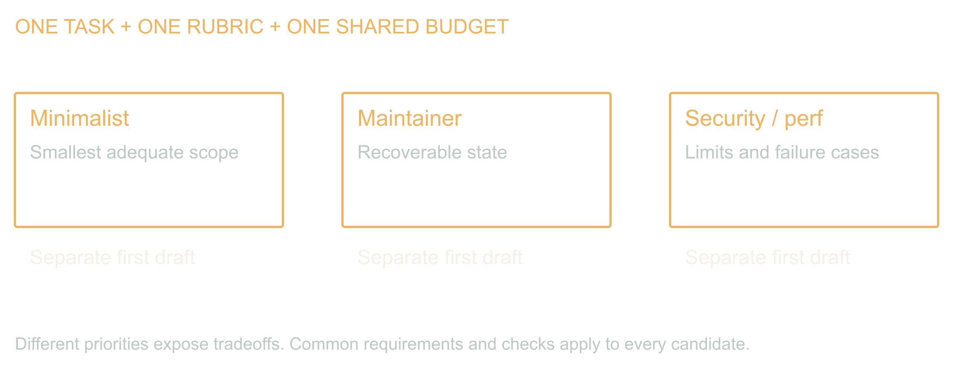
12 / 14 SOURCE SLIDE 12
Monkeys, Then Guards
Dynamic Scaling of Agentic Workloads
12
Notes:
Monkeys, Then Guards
30:00 to 35:00 · build
![Different priorities expose tradeoffs. Common requirements and checks apply to every candidate.](../../reveal-talks/assets/dynamic-scaling/11-independent-attempts-share-requirements.svg)
> Barrel of monkeys: lead with cheap parallel generation, on purpose
> Council of Guards: judges read a thousand tokens and write fifty; measure the disagreement
> Gates before preferences; the judge may reject everyone
Change the unit of work from images to whole designs. One brief, three generated agents: minimalist, maintainer, security and performance reviewer. Separate first drafts. The contrast is the product.
Somebody is going to cite Knight and Leveson at me, so let me do it first. 1986, twenty-seven programmers, one specification, a million tests, and the independently written versions failed together far more than independence predicts. True, important, and about N-version programming as a correctness strategy. Not this. I am not voting three models toward the truth.
The generation side has a name I am not sorry about: the barrel-of-monkeys maneuver. Lead with cheap parallel generation on purpose — monkeys at a hundredth of the frontier's price — and hand the barrel to the next stage. Four reasons. Race: take the first draft that passes the gate. Synthesize: a frontier model reads them all, input tokens being the cheap ones, and writes one coherent output. Rank: more candidates for the judges, so the best whole answer goes downstream. Catch: in law or medicine, where the rules are extensive and specific, the mistake you fear shows up in one output out of ten, and the only way to see it is to have ten.
Speculative optimization in a lab coat? Possibly. Ship it with an env var that sets fan-out to one, and ideally let the system tune that knob itself. Right? Right. That is the companion talk.
The cheap half is judging. A judge reads a thousand tokens and writes fifty, and output is what costs, so five judges from different models on every candidate is affordable. Not the average score. The disagreement. Judges that split, or whose reasons barely overlap, have found territory nobody understands; that candidate does not ship on autopilot. I call this the Council of Guards: it reads everything, writes almost nothing, and costs a fraction of what it guards.
Write the gates before you read the candidates: no duplicate dispatch after restart, no cross-tenant spend, no regeneration on notification retry, no dispatch after deadline. Every candidate fails one, including the careful one; the council is allowed to reject the room. A synthesis is a new candidate. Stop at the review budget.
None of this looks like the engineering we were raised on. Do not do the work twice. Do not spend compute speculatively. One right answer per ticket. Those were axioms when the expensive thing was the engineer. When the expensive thing is being wrong and a second draft costs cents, doing it three times and reading what disagrees is the frugal move. I am not a shill for Big Token. Cheaper, safer and faster now sometimes come from spending exactly where yesterday's wisdom told you not to.
Source: Knight and Leveson (1986), [An Experimental Evaluation of the Assumption of Independence in Multiversion Programming](https://doi.org/10.1109/TSE.1986.6312924), IEEE Transactions on Software Engineering SE-12(1), 96 to 109. Cited to set aside: it is a result about redundancy as a correctness strategy, which this slide does not claim.
Stage direction: Score the three candidates in demo.md. Have the room find each candidate's failed gate before revealing it. Then show the council split per candidate: high agreement on the minimalist's failure, low overlap on the maintainer's, and ask which one deserves the human's afternoon.

Slide 13
13 / 14 SOURCE SLIDE 13
Measure the accepted outcome
01
Latency: dispatch + queue + slowest branch + merge +
verify
02
Cost: every candidate, every retry, every held
reservation, review time
03
Compare against one competent attempt
Dynamic Scaling of Agentic Workloads
13
Notes:
Measure the accepted outcome
35:00 to 37:30 · land
> Latency: dispatch + queue + slowest branch + merge + verify
> Cost: every candidate, every retry, every held reservation, review time
> Compare against one competent attempt
Starting three workers does not delete the serial parts. That is Amdahl, 1967, and it is unkind: if a tenth of the job is serial, ten workers get you five and a quarter times, and a hundred workers get you nine. Waiting on every branch can make a finished task slower. Count the whole thing: all candidates, failed work, reserved uncertainty, judging and human review, and compare against one competent attempt on the same task set.
Measure accepted outcomes, not launched workers. Start with one extra attempt or one batch boundary; if it does not buy quality, time or cost, keep the simpler path. We are trying to buy useful work, not maximize the number of things blinking.
Source: Amdahl (1967), Validity of the single processor approach to achieving large scale computing capabilities, AFIPS Conference Proceedings 30, 483 to 485.
Stage direction: Ninety seconds: choose a baseline, a cap and an acceptance gate. Keep latency and total cost as separate numbers.

Slide 14
14 / 14 SOURCE SLIDE 14
Put the limit where the work begins
01
One ledger across every caller
02
Durable state across every restart
03
A lease on every box, a gate on every candidate
Dynamic Scaling of Agentic Workloads
14
Notes:
Put the limit where the work begins
37:30 to 40:00 · land
> One ledger across every caller
> Durable state across every restart
> A lease on every box, a gate on every candidate
Back to the four callers. Forty jobs were legal by four local counters. The missing piece was one shared account of what the application had promised and what it had already started.
The inversion is real: the workload can now describe its own shape and ask for its own compute, and the substrate to grant it in seconds already exists. That is a better world than a warm fleet and a guess. It is only safe because the agent chooses from a catalog, spends from a ledger, and runs on boxes that expire.
Inspect one expensive tool in your system. Count the work it can launch underneath itself. Put the limit where that work actually begins.
Stage direction: Close on the multiplication and the shared admission line. Do not add a vendor.

