Slide 1
Turn Your Thinkin' Tokens Up to 11 · Dan Levy
These go to eleven
01
Code is free. Features are free.
02
Attention is the budget.
Turn Your Thinkin' Tokens Up to 11
1
Notes:
Turn Your Thinkin' Tokens Up to 11
Source slide 1. 00:00 to 02:00
Code is free. Features are free.
Attention is the budget.
Four features shipped before lunch. All four work. All four have tests. Your best customer opens the app for the first time in six weeks and cannot find the button she used every Friday. Nobody filed a bug.
Here is the line this talk has to earn. Don't count what the feature cost you to build, count what it costs them to relearn.
The title is a Spinal Tap joke and it is load-bearing. Turn the reasoning budget up to eleven. More tokens buy more consideration of situations the model has already seen. They do not buy taste, and they do not tell you which Tuesday.
The feature you were proudest of that a long-absent customer experienced as a broken workflow. Bring the ticket, the gap between their sessions, and what they actually said.
Bridge: scope, once — the arithmetic ahead is counting, not a measurement of your team. Ninety days is forty-six of your deploys and four of her sessions, and between two visits she meets twenty-one changes at once.

Slide 2
02 / 07 SOURCE SLIDE 4
Feature fatigue is a measured effect
01
Before use: capability wins
02
After use: usability wins
03
Delighters decay into expectations
Turn Your Thinkin' Tokens Up to 11
2
Notes:
Turn Your Thinkin' Tokens Up to 11
Source slide 4. 02:00 to 03:45
Before use: capability wins
After use: usability wins
Delighters decay into expectations
Thompson, Hamilton and Rust ran this in 2005 and named it feature fatigue. Before purchase, people prefer the product with more capabilities. After using it, satisfaction tracks usability instead. The same person picks the loaded one and then resents it.
That is not a quirk, it is a structural problem. Your acquisition signal and your retention signal point in opposite directions, and the feature list is exactly where they diverge. Adding capability makes the sale and costs the renewal. Both effects are real and they arrive at different times, which is why no single dashboard shows you the trade.
Debora Viana Thompson, Rebecca W. Hamilton and Roland T. Rust (2005), [Feature Fatigue: When Product Capabilities Become Too Much of a Good Thing](https://doi.org/10.1509/jmkr.2005.42.4.431), Journal of Marketing Research 42(4), 431–442. Noriaki Kano, Nobuhiko Seraku, Fumio Takahashi and Shinichi Tsuji (1984), Attractive Quality and Must-Be Quality, Journal of the Japanese Society for Quality Control 14(2), 39–48.

Slide 3
03 / 07 SOURCE SLIDE 5
A change is a loss before it is a gain
01
Status quo bias · endowment effect
02
Recognition, not recall
03
The gain is yours. The loss is theirs, today.
Turn Your Thinkin' Tokens Up to 11
3
Notes:
Turn Your Thinkin' Tokens Up to 11
Source slide 5. 03:45 to 05:30
Status quo bias · endowment effect
Recognition, not recall
The gain is yours. The loss is theirs, today.
Samuelson and Zeckhauser named status quo bias in 1988: across lab and field decisions, people over-select the option they already hold. Kahneman, Knetsch and Thaler measured the endowment effect the same way — you want more for the mug once it is yours. Your user owns a workflow, and you are proposing to take it.
The gain from a redesign is real, and it arrives later, spread thin. The loss is small, specific and arrives on first login. Individually every change was an improvement. In aggregate, at your cadence, it reads as instability.
William Samuelson and Richard Zeckhauser (1988), [Status Quo Bias in Decision Making](https://doi.org/10.1007/BF00055564), Journal of Risk and Uncertainty 1(1), 7–59. Daniel Kahneman, Jack L. Knetsch and Richard H. Thaler (1990), [Experimental Tests of the Endowment Effect and the Coase Theorem](https://doi.org/10.1086/261737), Journal of Political Economy 98(6), 1325–1348. Jakob Nielsen (1994), [Ten Usability Heuristics for User Interface Design](https://www.nngroup.com/articles/ten-usability-heuristics/).
Bridge: the release decision has five axes, not one — what, who, when, batched or rolling, and reversible. Every one of them commits somebody outside this room.

Slide 4
04 / 07 SOURCE SLIDE 8
Turn the tokens up
01
6 features · 3 cohorts → 524,880 plans
02
12,000 weekly actives · 4 weeks → 16 arms
03
32,805 plans per arm of evidence
Turn Your Thinkin' Tokens Up to 11
4
Notes:
Turn Your Thinkin' Tokens Up to 11
Source slide 8. 05:30 to 08:45
6 features · 3 cohorts → 524,880 plans
12,000 weekly actives · 4 weeks → 16 arms
32,805 plans per arm of evidence
Six features. Order them: seven hundred and twenty sequences. Assign each to one of three cohorts: three to the sixth, seven hundred and twenty-nine. Multiply. Five hundred and twenty-four thousand, eight hundred and eighty distinct plans, and that is before batching and before dates.
Now the evidence you can buy. Twelve thousand weekly actives, a four-week window, forty-eight thousand exposures. At an eight percent baseline, detecting a two-point lift needs roughly three thousand per arm, so sixteen arms. Divide: thirty-two thousand, eight hundred and five plans for every arm of evidence you can afford. Benchmarks owns the power arithmetic; here I only need the count.
So turn the thinkin' tokens up. Chollet's 2019 definition treats intelligence as skill acquisition over novel tasks, and a system that has already seen the situation is not demonstrating that. Your product's next six months is a task nobody has seen, including you.
My claim is weaker and safer. The model has not met your users. More tokens do not fix that, and neither does more of you, because your judgment is biased too. The difference is that you can write your prediction down before the release and check it afterward.
François Chollet (2019), [On the Measure of Intelligence](https://arxiv.org/abs/1911.01547), arXiv:1911.01547. Parshin Shojaee and colleagues (2025), [The Illusion of Thinking](https://machinelearning.apple.com/research/illusion-of-thinking), Apple Machine Learning Research; and the rebuttal, [The Illusion of the Illusion of Thinking](https://arxiv.org/abs/2506.09250), arXiv:2506.09250. Present as a contested exchange, not a settled result.
Run `bun artifacts/speaking-portfolio-expanded/talks/judgment/demo.ts` for the plan count, then add `--evidence` for the arm count. Do the final division on the board rather than reading it. Say once that the numbers are six features and three cohorts, not their company.
Bridge: the machine is good at the search half. Cluster four thousand support threads, find the accounts in the cohort you are about to change, notice that your release week is the week support is at a conference. It proposes; you sequence.

Slide 5
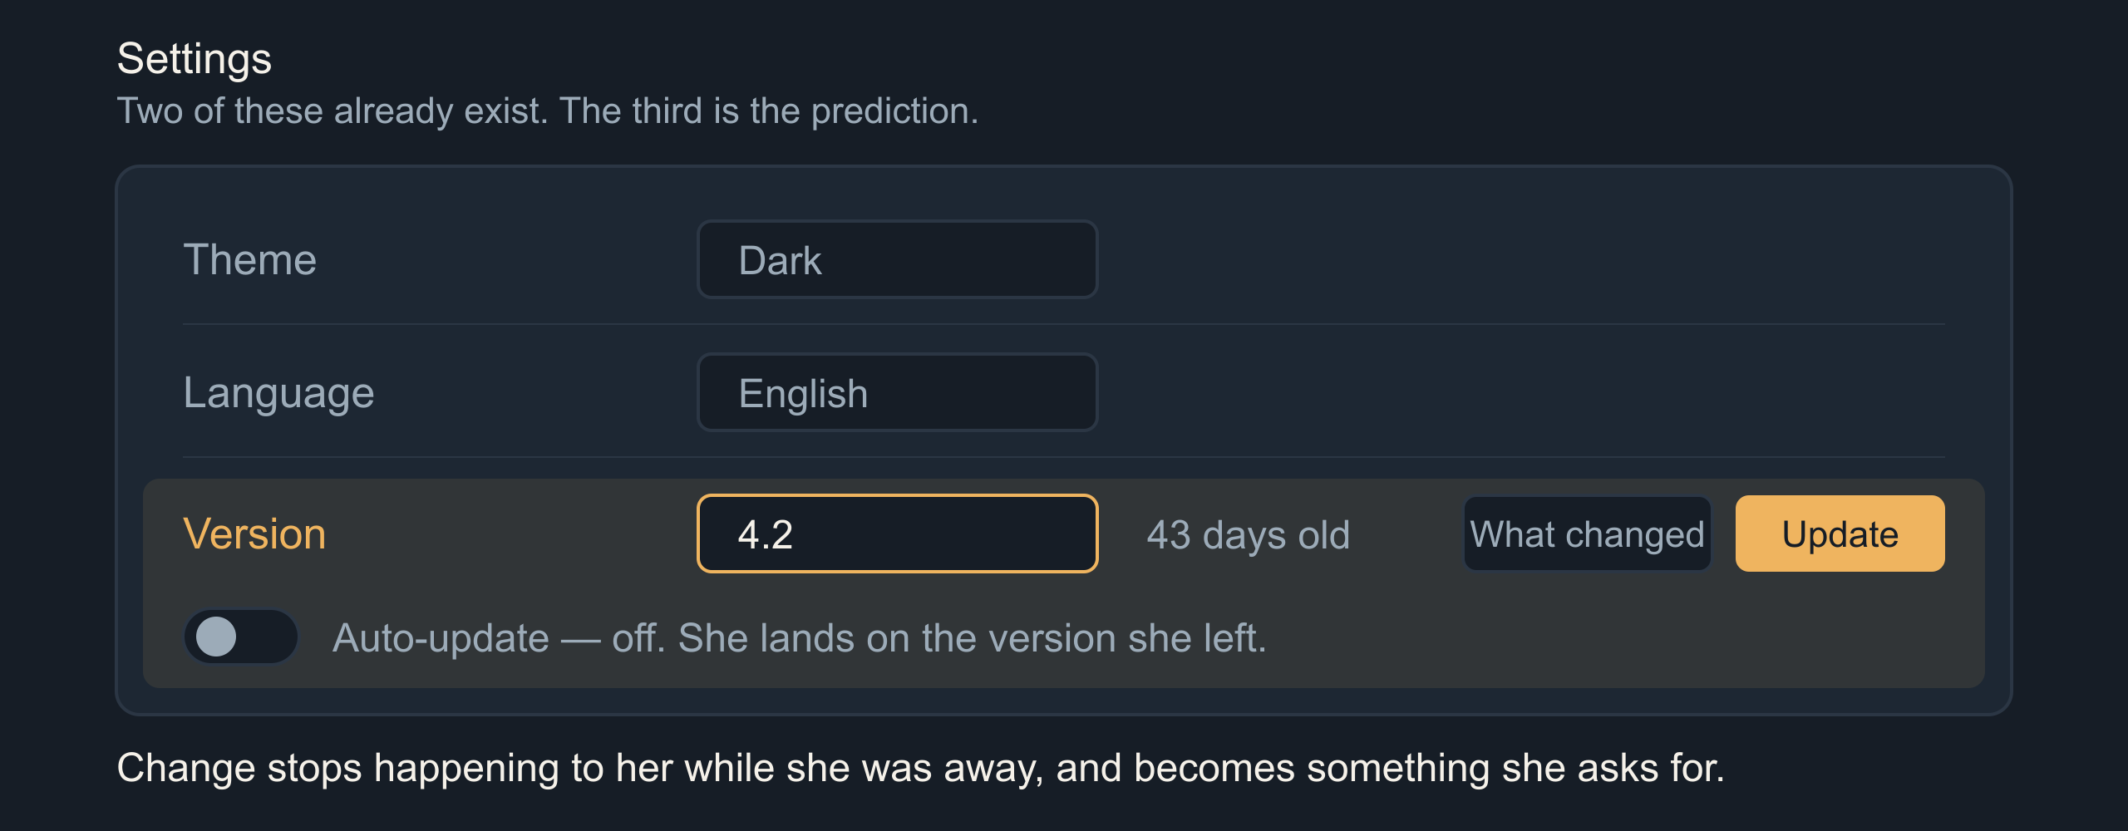
05 / 07 SOURCE SLIDE 10
Prediction: the version picker
Turn Your Thinkin' Tokens Up to 11
5
Notes:
Turn Your Thinkin' Tokens Up to 11
Source slide 10. 08:45 to 11:15
Theme · Language · Version
"You're on 4.2. It's 43 days old. Update, or turn on auto-update."
First prediction, labeled once as a prediction. Version becomes a first-class user-facing control, sitting in settings beside theme and language, because those two are already there for exactly this reason. They are preferences about how the software meets you.
A returning user lands on the version she left. The banner reads: you are on 4.2, it is forty-three days old, here is what changed, update now or turn on auto-update. Change stops being something that happened to her while she was away and becomes something she asks for. That is the whole move.
Bridge: many live versions cost a versioned runtime and a sandbox per user. Privacy improves, patching gets worse, and under Hyrum's law every live version is a live contract, including the behaviors you call bugs.

Slide 6
06 / 07 SOURCE SLIDE 12
Prediction: the app your neighbor configured
01
"Turn on what people like me have on"
02
Shareable configuration profiles
03
Developers have done this for thirty years
Turn Your Thinkin' Tokens Up to 11
6
Notes:
Turn Your Thinkin' Tokens Up to 11
Source slide 12. 11:15 to 13:30
"Turn on what people like me have on"
Shareable configuration profiles
Developers have done this for thirty years
Second prediction. Feature flags stop being your deployment tool and become the user's preference surface. Not a wall of switches: a profile. Turn on what people who use this the way I do have turned on. Follow this person's setup. Adopt my team's.
This is not new, it is unevenly distributed. Dotfiles. VS Code extension packs. Home Assistant blueprints. Excel templates. Figma community files. Mod lists. Developers have been shipping configuration to each other as a social object for thirty years and we never offered it to anybody else.
Eric von Hippel (1986), [Lead Users: A Source of Novel Product Concepts](https://doi.org/10.1287/mnsc.32.7.791), Management Science 32(7), 791–805. Eric von Hippel and Ralph Katz (2002), [Shifting Innovation to Users via Toolkits](https://doi.org/10.1287/mnsc.48.7.821.2817), Management Science 48(7), 821–833. Everett M. Rogers (2003), Diffusion of Innovations, 5th edition, Free Press.
Bridge: a configured fleet breaks support's first question, your screenshots and your A/B baseline, and somebody still owns the default a new user gets. Distribution concentrates, defaults win, and curating shared profiles becomes the job.

Slide 7
07 / 07 SOURCE SLIDE 14
Knowing what not to ship
01
Don't count what it cost you to build.
02
Count what it costs them to relearn.
Turn Your Thinkin' Tokens Up to 11
7
Notes:
Turn Your Thinkin' Tokens Up to 11
Source slide 14. 13:30 to 15:00
Don't count what it cost you to build.
Count what it costs them to relearn.
Back to the two tracks. Forty-six releases, four sessions. You did not get slower and she did not get dumber. You filled the space between her visits with work she has to do.
Turn the reasoning up as far as it goes. It will hand you a better-argued plan for a market it has never seen. The part it cannot do is the part you were hired for: knowing which of these your people will love, and knowing when they can stand to receive it.
Sometimes the right release is a smaller one. Sometimes it is the same app they left.
Step back to slide 3 for the two tracks, then return here. Stop talking.

