Slide 1
Turn Your Thinkin' Tokens Up to 11 · Dan Levy
These go to eleven
01
Code is free. Features are free.
02
Attention is the budget.
Turn Your Thinkin' Tokens Up to 11
1
Notes:
These go to eleven
00:00 to 02:30 · warm
> Code is free. Features are free.
> Attention is the budget.
Four features shipped before lunch. All four work. All four have tests. Your best customer opens the app for the first time in six weeks and cannot find the button she used every Friday. Nobody filed a bug.
Here is the line this talk has to earn. Don't count what the feature cost you to build, count what it costs them to relearn.
The title is a Spinal Tap joke and it is load-bearing. Turn the reasoning budget up to eleven. More tokens buy more consideration of situations the model has already seen. They do not buy taste, and they do not tell you which Tuesday.
Scope, once. The arithmetic later is counting, not a measurement of your team, and the two futures at the end are labeled predictions I have not measured.
Story: The feature you were proudest of that a long-absent customer experienced as a broken workflow. Bring the ticket, the gap between their sessions, and what they actually said.

Slide 2
02 / 14 SOURCE SLIDE 2
What got cheap, and what didn't
01
Someone has to want it · build it · learn it
02
We only automated the middle one
Turn Your Thinkin' Tokens Up to 11
2
Notes:
What got cheap, and what didn't
02:30 to 05:00 · warm
> Someone has to want it · build it · learn it
> We only automated the middle one
Three things used to gate a feature. Someone had to want it, someone had to build it, and someone had to learn it. We spent a decade attacking the middle one and this year we finished the job. The other two did not move.
Build cost is now close enough to zero that it stops being the selection mechanism, and that is the part nobody plans for. Scarcity was doing your prioritization for free. When the constraint dies, the decision it was quietly making lands on your desk, unlabeled.
So the interesting question stopped being what can we build. It is which of these should exist, who should see it, and when. Those are three separate decisions and most roadmaps answer only the first.

Slide 3
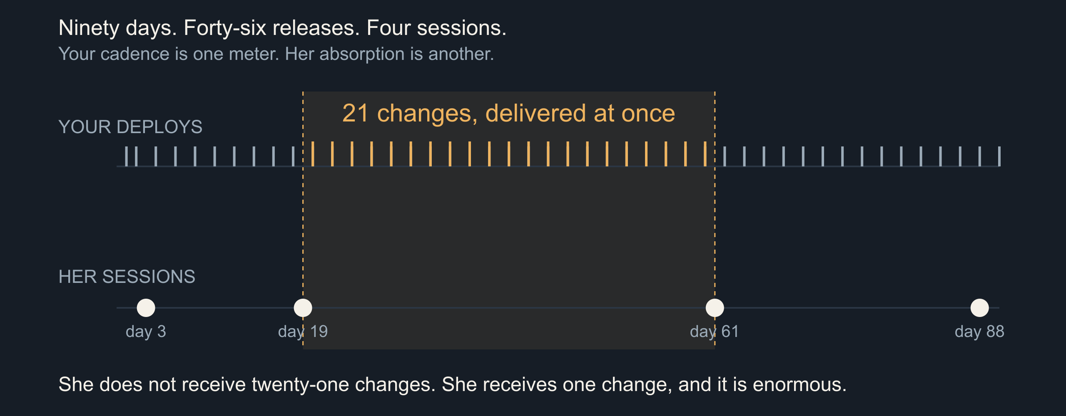
03 / 14 SOURCE SLIDE 3
Nobody lives in your app
Turn Your Thinkin' Tokens Up to 11
3
Notes:
Nobody lives in your app
05:00 to 08:00 · build
![Ninety days of releases against one user's four sessions](../../../../public/talks/assets/judgment/absorption.svg)
> 90 days · 46 releases · 4 sessions
> Between visits two and three: 21 changes, at once
Here is ninety days. The top track is your deploys: forty-six of them, roughly every other day, which any DORA-literate team would call healthy. The bottom track is one customer's sessions: four. Day three, day nineteen, day sixty-one, day eighty-eight.
Between her second visit and her third you shipped twenty-one changes. She does not receive twenty-one changes. She receives one change, all at once, and it is enormous. Your release cadence and her absorption rate are different meters, and only one of them is on a dashboard.
DORA's four keys measure delivery capability: deployment frequency, lead time, change failure rate, time to restore. They are good measures of your pipeline. None of them describes what a returning user walks into. That measurement does not exist at most companies, and it is the one this talk is about.
Stage direction: Ask for a show of hands on median return interval before revealing the bottom track. Most rooms have never measured it; say so and move on.
Source: Nicole Forsgren, Jez Humble and Gene Kim (2018), [Accelerate: The Science of Lean Software and DevOps](https://itrevolution.com/product/accelerate/), IT Revolution. The four key metrics describe delivery performance, not user absorption; the tracks in this diagram are an illustration, not measured telemetry.

Slide 4
04 / 14 SOURCE SLIDE 4
Feature fatigue is a measured effect
01
Before use: capability wins
02
After use: usability wins
03
Delighters decay into expectations
Turn Your Thinkin' Tokens Up to 11
4
Notes:
Feature fatigue is a measured effect
08:00 to 11:00 · build
> Before use: capability wins
> After use: usability wins
> Delighters decay into expectations
Thompson, Hamilton and Rust ran this in 2005 and named it feature fatigue. Before purchase, people prefer the product with more capabilities. After using it, satisfaction tracks usability instead. The same person picks the loaded one and then resents it.
That is not a quirk, it is a structural problem. Your acquisition signal and your retention signal point in opposite directions, and the feature list is exactly where they diverge. Adding capability makes the sale and costs the renewal. Both effects are real and they arrive at different times, which is why no single dashboard shows you the trade.
Kano's model from 1984 splits attributes into must-be, one-dimensional and attractive. The attractive ones are the delighters, and Kano's own point is that they do not stay attractive. Today's delight is next year's baseline expectation, and the year after that its absence is a defect.
Source: Debora Viana Thompson, Rebecca W. Hamilton and Roland T. Rust (2005), [Feature Fatigue: When Product Capabilities Become Too Much of a Good Thing](https://doi.org/10.1509/jmkr.2005.42.4.431), Journal of Marketing Research 42(4), 431–442. Noriaki Kano, Nobuhiko Seraku, Fumio Takahashi and Shinichi Tsuji (1984), Attractive Quality and Must-Be Quality, Journal of the Japanese Society for Quality Control 14(2), 39–48.

Slide 5
05 / 14 SOURCE SLIDE 5
A change is a loss before it is a gain
01
Status quo bias · endowment effect
02
Recognition, not recall
03
The gain is yours. The loss is theirs, today.
Turn Your Thinkin' Tokens Up to 11
5
Notes:
A change is a loss before it is a gain
11:00 to 13:30 · build
> Status quo bias · endowment effect
> Recognition, not recall
> The gain is yours. The loss is theirs, today.
Samuelson and Zeckhauser named status quo bias in 1988: across lab and field decisions, people over-select the option they already hold. Kahneman, Knetsch and Thaler measured the endowment effect the same way — you want more for the mug once it is yours. Your user owns a workflow, and you are proposing to take it.
Nielsen's heuristic says recognition rather than recall. A returning user recognizes; she does not recall. Move the button and you have converted a recognition task into a recall task, against a memory that has been decaying since her last visit.
The gain from a redesign is real, and it arrives later, spread thin. The loss is small, specific and arrives on first login. Individually every change was an improvement. In aggregate, at your cadence, it reads as instability.
Source: William Samuelson and Richard Zeckhauser (1988), [Status Quo Bias in Decision Making](https://doi.org/10.1007/BF00055564), Journal of Risk and Uncertainty 1(1), 7–59. Daniel Kahneman, Jack L. Knetsch and Richard H. Thaler (1990), [Experimental Tests of the Endowment Effect and the Coase Theorem](https://doi.org/10.1086/261737), Journal of Political Economy 98(6), 1325–1348. Jakob Nielsen (1994), [Ten Usability Heuristics for User Interface Design](https://www.nngroup.com/articles/ten-usability-heuristics/).

Slide 6
06 / 14 SOURCE SLIDE 6
"Ship it Tuesday"
01
"Ship it Tuesday."
02
That is the whole request.
Turn Your Thinkin' Tokens Up to 11
6
Notes:
"Ship it Tuesday"
13:30 to 16:30 · build
> "Ship it Tuesday."
> That is the whole request.
Ship it Tuesday. That is the entire request, somebody senior said it, and everyone in the room nodded.
Sixty seconds with the person next to you. Write down what else has to be true for Tuesday to be the right answer. You do not get a second page of context; that is the point.
Which customers get it Tuesday? Do they get it with the other three things in the branch, or on its own? Who is on support Tuesday afternoon? Has anyone told the people who write the docs, the people who trained the account team, or the customer whose renewal is Thursday? Is Tuesday reversible?
None of those are engineering questions and all of them are release questions. We made building free and left the sequencing expensive.
Stage direction: Read the request once, exactly as written. Give pairs sixty seconds here, thirty in the 15-minute cut. Collect two answers, then add the renewal date and the support roster yourself.

Slide 7
07 / 14 SOURCE SLIDE 7
Five axes, one of them a date
Axis | Question | Commits
What | Should it exist at all? | Docs, support surface
Who | Everyone, or a cohort? | Sales, contracts
When | Tuesday, or next quarter? | Marketing, renewals
Shape | One batch or rolling? | Rollback, triage
Reversible | Flag, migration, one-way? | On-call, data model
What · who · when · shape · reversibility
Every axis commits somebody who is not in this room
Turn Your Thinkin' Tokens Up to 11
7
Notes:
Five axes, one of them a date
16:30 to 19:30 · build
> What · who · when · shape · reversibility
> Every axis commits somebody who is not in this room
| Axis | Question | Commits |
| --- | --- | --- |
| What | Should it exist at all? | Docs, support surface |
| Who | Everyone, or a cohort? | Sales, contracts |
| When | Tuesday, or next quarter? | Marketing, renewals |
| Shape | One batch or rolling? | Rollback, triage |
| Reversible | Flag, migration, one-way? | On-call, data model |
Five axes, not one. Most roadmap tools model exactly one of them, the date, which is why the date is the only one that ever gets argued about.
Read the right-hand column. Every one of these commits a person who is not in this room: support staffing, a documentation rewrite, an account executive who already promised it, a renewal conversation on Thursday. Marketing wants a date it can build a campaign against, and a campaign is a promise you cannot flag off.
You also have to keep all of it flexible, because a competitor ships something on a Wednesday and now you want to pull a feature forward. Pulling it forward is not free. It costs you the sequence, and the sequence was the part you had actually reasoned about.
Story: The release you pulled forward to answer a competitor. Bring what slipped, what support absorbed, and whether it worked.

Slide 8
08 / 14 SOURCE SLIDE 8
Turn the tokens up
01
6 features · 3 cohorts → 524,880 plans
02
12,000 weekly actives · 4 weeks → 16 arms
03
32,805 plans per arm of evidence
Turn Your Thinkin' Tokens Up to 11
8
Notes:
Turn the tokens up
19:30 to 23:30 · peak
> 6 features · 3 cohorts → 524,880 plans
> 12,000 weekly actives · 4 weeks → 16 arms
> 32,805 plans per arm of evidence
Six features. Order them: seven hundred and twenty sequences. Assign each to one of three cohorts: three to the sixth, seven hundred and twenty-nine. Multiply. Five hundred and twenty-four thousand, eight hundred and eighty distinct plans, and that is before batching and before dates.
Now the evidence you can buy. Twelve thousand weekly actives, a four-week window, forty-eight thousand exposures. At an eight percent baseline, detecting a two-point lift needs roughly three thousand per arm, so sixteen arms. Divide: thirty-two thousand, eight hundred and five plans for every arm of evidence you can afford. Benchmarks owns the power arithmetic; here I only need the count.
So turn the thinkin' tokens up. Chollet's 2019 definition treats intelligence as skill acquisition over novel tasks, and a system that has already seen the situation is not demonstrating that. Your product's next six months is a task nobody has seen, including you.
There is a paper about exactly this: the Apple group's Illusion of Thinking, 2025, reporting that reasoning models collapse past a complexity threshold and spend fewer tokens as problems get harder. There is also a published rebuttal arguing the collapse was token limits and one unsolvable puzzle. I am citing the exchange, not a verdict.
My claim is weaker and safer. The model has not met your users. More tokens do not fix that, and neither does more of you, because your judgment is biased too. The difference is that you can write your prediction down before the release and check it afterward.
Stage direction: Run `bun artifacts/speaking-portfolio-expanded/talks/judgment/demo.ts` for the plan count, then add `--evidence` for the arm count. Do the final division on the board rather than reading it. Say once that the numbers are six features and three cohorts, not their company.
Source: François Chollet (2019), [On the Measure of Intelligence](https://arxiv.org/abs/1911.01547), arXiv:1911.01547. Parshin Shojaee and colleagues (2025), [The Illusion of Thinking](https://machinelearning.apple.com/research/illusion-of-thinking), Apple Machine Learning Research; and the rebuttal, [The Illusion of the Illusion of Thinking](https://arxiv.org/abs/2506.09250), arXiv:2506.09250. Present as a contested exchange, not a settled result.

Slide 9
09 / 14 SOURCE SLIDE 9
What the machine is actually for
01
Cluster 4,000 support threads → yes
02
Choose the order → no
03
It proposes. You sequence.
Turn Your Thinkin' Tokens Up to 11
9
Notes:
What the machine is actually for
23:30 to 26:00 · build
> Cluster 4,000 support threads → yes
> Choose the order → no
> It proposes. You sequence.
This is not an anti-AI slide, and the useful list is long. Cluster four thousand support threads by complaint. Find the twelve accounts whose usage pattern matches the cohort you are about to change. Draft the rollout plan, the docs diff and the support macro at once.
Better, have it hunt the conflict you would have missed. Your release week is the week two of your three support engineers are at a conference. The workflow you are about to move belongs to your top three renewals this quarter. That is a search problem, and search is what it is good at.
What it cannot do is care which one your users will love, because it has never met them and because the answer does not exist yet. It proposes. You sequence. Then you own the sequence.

Slide 10
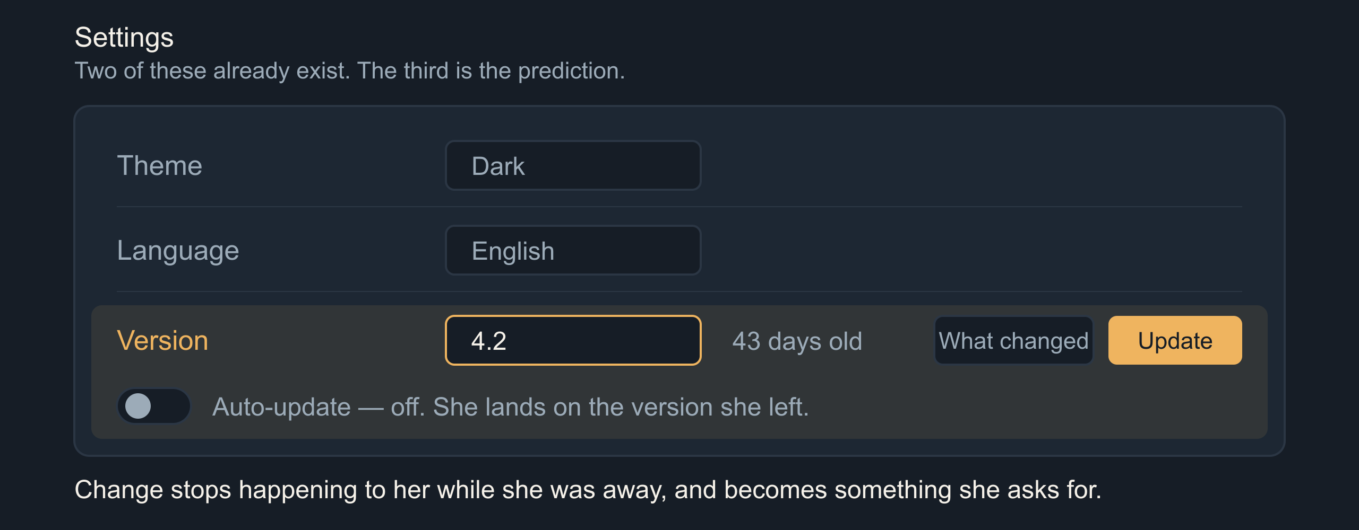
10 / 14 SOURCE SLIDE 10
Prediction: the version picker
Turn Your Thinkin' Tokens Up to 11
10
Notes:
Prediction: the version picker
26:00 to 29:30 · build
![A settings panel where version sits beside theme and language](../../../../public/talks/assets/judgment/version-picker.svg)
> Theme · Language · Version
> "You're on 4.2. It's 43 days old. Update, or turn on auto-update."
First prediction, labeled once as a prediction. Version becomes a first-class user-facing control, sitting in settings beside theme and language, because those two are already there for exactly this reason. They are preferences about how the software meets you.
A returning user lands on the version she left. The banner reads: you are on 4.2, it is forty-three days old, here is what changed, update now or turn on auto-update. Change stops being something that happened to her while she was away and becomes something she asks for. That is the whole move.
The web spent twenty years removing this control and calling it a feature. Everyone runs current, nobody sits on an old build, support reasons about one thing. That was the right trade when shipping was expensive and rare. Ask whether it is still the right trade at forty-six deploys a quarter.
The picker also makes the cost visible to you. If a meaningful share of your users pin, you have measured the thing nobody measures. Their pin rate is your change-fatigue meter and it does not require a survey.

Slide 11
11 / 14 SOURCE SLIDE 11
What that costs to build
01
Versioned runtime + a sandbox per user
02
Privacy: better. Patching: worse.
03
Every live version is a live contract
Turn Your Thinkin' Tokens Up to 11
11
Notes:
What that costs to build
29:30 to 32:00 · build
> Versioned runtime + a sandbox per user
> Privacy: better. Patching: worse.
> Every live version is a live contract
Now the engineering bill, because the prediction is easy and the architecture is not. Serving many live versions means a versioned runtime against a shared data model, or a data model versioned per user: a semi-persistent sandbox holding their build and their state, resumed on arrival and suspended after.
That buys something real on privacy. Data that never leaves a user's sandbox is data you cannot leak in bulk, and a breach costs you one tenant instead of one table. You are trading a class of problem you understand for one you do not: an unpatchable fleet you cannot force forward.
Every live version is also a live contract. Hyrum's law: with enough users, every observable behavior of your system gets depended on, including the ones you consider bugs. Choose how many versions you support on purpose, and give the number an expiry date.
Source: Hyrum Wright, [Hyrum's Law](https://www.hyrumslaw.com/). Stated as an observation about interface consumers, not a measured result.

Slide 12
12 / 14 SOURCE SLIDE 12
Prediction: the app your neighbor configured
01
"Turn on what people like me have on"
02
Shareable configuration profiles
03
Developers have done this for thirty years
Turn Your Thinkin' Tokens Up to 11
12
Notes:
Prediction: the app your neighbor configured
32:00 to 35:00 · build
> "Turn on what people like me have on"
> Shareable configuration profiles
> Developers have done this for thirty years
Second prediction. Feature flags stop being your deployment tool and become the user's preference surface. Not a wall of switches: a profile. Turn on what people who use this the way I do have turned on. Follow this person's setup. Adopt my team's.
This is not new, it is unevenly distributed. Dotfiles. VS Code extension packs. Home Assistant blueprints. Excel templates. Figma community files. Mod lists. Developers have been shipping configuration to each other as a social object for thirty years and we never offered it to anybody else.
Von Hippel's lead-user work found users at the leading edge of a market inventing what the rest will want, and his toolkit work in 2002 is about shipping them the means to do it. Rogers gives you the shape of who adopts first. A shared profile is a toolkit and a diffusion channel in the same object.
Source: Eric von Hippel (1986), [Lead Users: A Source of Novel Product Concepts](https://doi.org/10.1287/mnsc.32.7.791), Management Science 32(7), 791–805. Eric von Hippel and Ralph Katz (2002), [Shifting Innovation to Users via Toolkits](https://doi.org/10.1287/mnsc.48.7.821.2817), Management Science 48(7), 821–833. Everett M. Rogers (2003), Diffusion of Innovations, 5th edition, Free Press.

Slide 13
13 / 14 SOURCE SLIDE 13
Everyone runs a different app now
01
Support: "which app do you have?"
02
Screenshots · A/B baselines · accessibility defaults
03
Same as it ever was: defaults still win
Turn Your Thinkin' Tokens Up to 11
13
Notes:
Everyone runs a different app now
35:00 to 38:00 · build
> Support: "which app do you have?"
> Screenshots · A/B baselines · accessibility defaults
> Same as it ever was: defaults still win
Support opens with a new first question: which app do you have. Your documentation screenshots are wrong for most readers. Your A/B test has no common baseline, because the control group configured itself. Accessibility defaults are the ones people turn off first and need most.
A user can also configure themselves into a corner and never meet the thing that would have helped. Call it a filter bubble for functionality rather than opinion.
Choice overload is the obvious objection and I will raise it myself: Iyengar and Lepper's jam study, 2000. A 2010 meta-analysis across fifty published experiments put the mean effect near zero. So I cite it and set it aside. The risk is not too many switches.
It is that nobody is curating them. Somebody owns the default profile, somebody decides which shared setups get promoted, and somebody decides what a new user gets before they have a neighbor. Distribution still concentrates. Defaults still win.
Source: Sheena S. Iyengar and Mark R. Lepper (2000), [When Choice is Demotivating](https://doi.org/10.1037/0022-3514.79.6.995), Journal of Personality and Social Psychology 79(6), 995–1006. Benjamin Scheibehenne, Rainer Greifeneder and Peter M. Todd (2010), [Can There Ever Be Too Many Options?](https://doi.org/10.1086/651235), Journal of Consumer Research 37(3), 409–425. Cited to set aside.

Slide 14
14 / 14 SOURCE SLIDE 14
Knowing what not to ship
01
Don't count what it cost you to build.
02
Count what it costs them to relearn.
Turn Your Thinkin' Tokens Up to 11
14
Notes:
Knowing what not to ship
38:00 to 40:00 · land
> Don't count what it cost you to build.
> Count what it costs them to relearn.
Back to the two tracks. Forty-six releases, four sessions. You did not get slower and she did not get dumber. You filled the space between her visits with work she has to do.
Turn the reasoning up as far as it goes. It will hand you a better-argued plan for a market it has never seen. The part it cannot do is the part you were hired for: knowing which of these your people will love, and knowing when they can stand to receive it.
Sometimes the right release is a smaller one. Sometimes it is the same app they left.
Stage direction: Step back to slide 3 for the two tracks, then return here. Stop talking.

